Slide 1
A programmable interpolation filter with lowest cost Simulation code guide
김진현

Slide 2
Simulation
Coded with Matlab R2018a
Simulation for my thesis, ‘A programmable Sampling rate Converter with lowest hardware cost.’which is for my graduate in Sogang Univ, to make sure audience how proposed architecture works well.

Slide 3
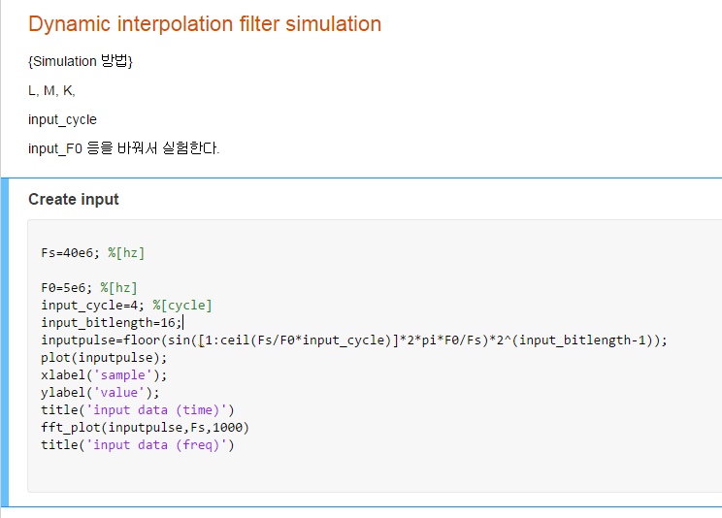
Step 1
First,
Make the input data which
Going through the filters.
You can change
F0 : input pulse frequency
Input_cycle : input pulse cycle
Input bitlength : input range

Slide 4
Step1 results
FFT , 1000 point

Slide 5
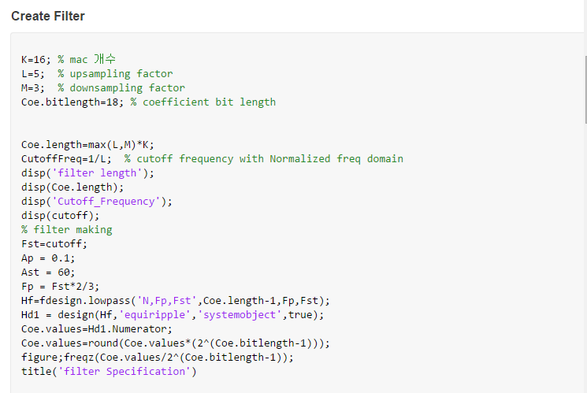
Step 2
Second,
Create filter with specified
L and M and K.
You can change
K : filter expansion factor
L : upsamplnig factor
M : downsampling factor
Coe.bitlength : coefficient bit width

Slide 6
Step2 results
Length : KL = 80

Slide 7
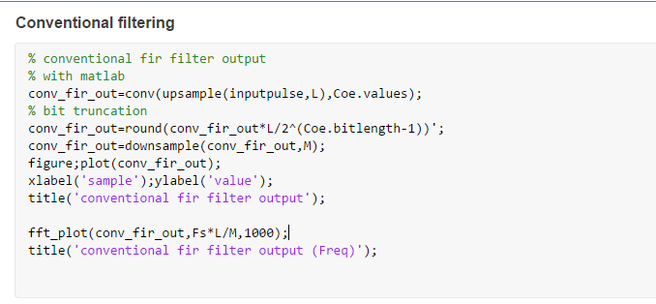
Step 3
Third,
Make conventional filter output.
After this, user should not change
anything

Slide 8
Step3 results ( Conventional filter output )

Slide 9
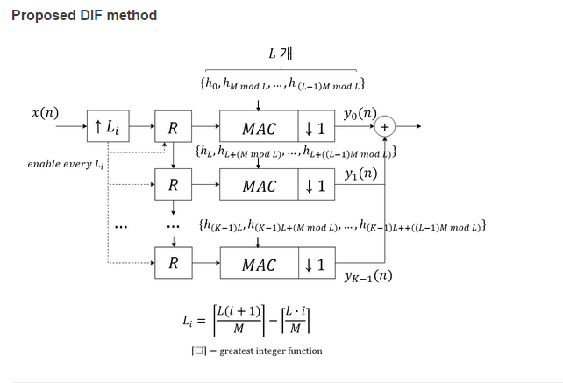
Step 4
Fourth, (1)
I attached picture of proposed
Dynamic interpolation filter

Slide 10
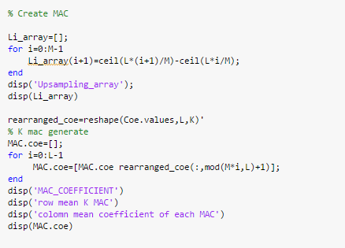
Step 4
Fourth,(2)
And the codes are here.

Slide 11
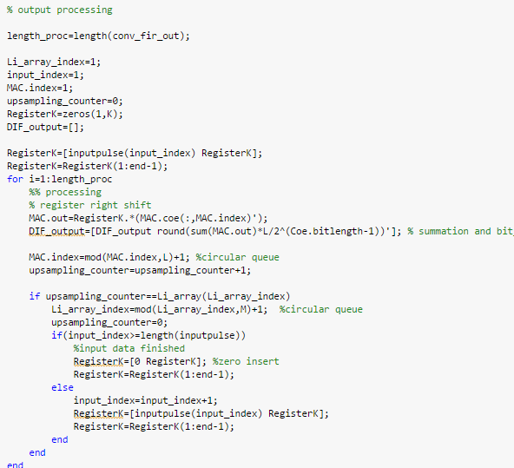
Step 4
Fourth, (3)
And the codes are here.

Slide 12
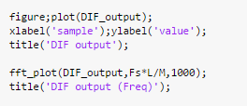
Step 4
Fourth, (4)
And the codes are here.

Slide 13
Step 4 result, (proposed filter output)

Slide 14
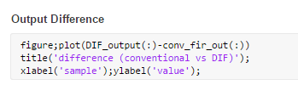
Step 5
Fifth,
Compare
Conventional fir filter output,
Vs
Proposed DIF

Slide 15
Step 5 result,
These
Two filter makes same results.
DIF has the same function
As the existing one and has the
Minimum hardware.

