Slide 1
Outlier detection using a robust estimator
Data plausibility checks under time pressure

Slide 2
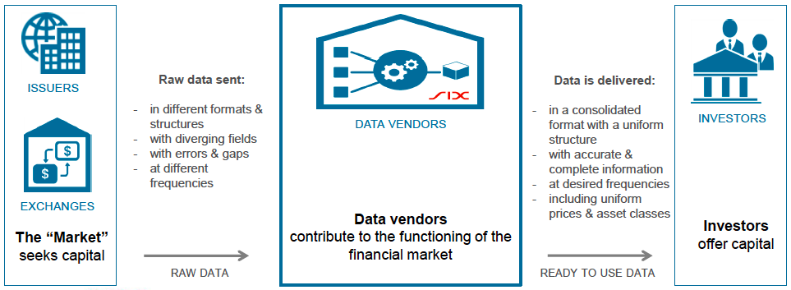
State of the art

Slide 3
The Future: Integrated Monitoring Tool

