Slide 1
Automated Monitoring of Price Feeds
Data plausibility checks under time pressure

Slide 2
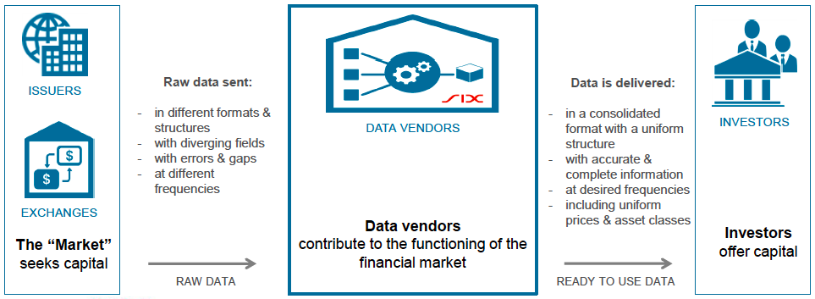
State of the art

Slide 3
What’s the Problem?
Heterogeneous raw data
Multiple monitoring systems
Unreliable error detection (static bounds, manual config)
Slow error processing

Slide 4
What we offer
Built-in raw data aggregation
Integrated data monitoring
Dynamic, robust volatility measurement (fully automated)
Statistical outlier detection for identifying corrupted streams
Fast error handling

Slide 5
What we did
Big-data → not enough data for regression
Switch to workshop 3: Realtime data checks → success
Sliding window robust estimator
No satisfactory plotting libary → own solution
Website using bootstrap and HTML 5 → mobile compatible

Slide 6
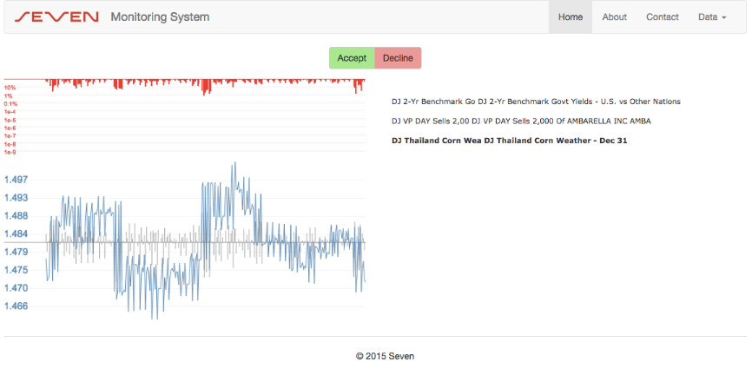
Look and Feel

Slide 7
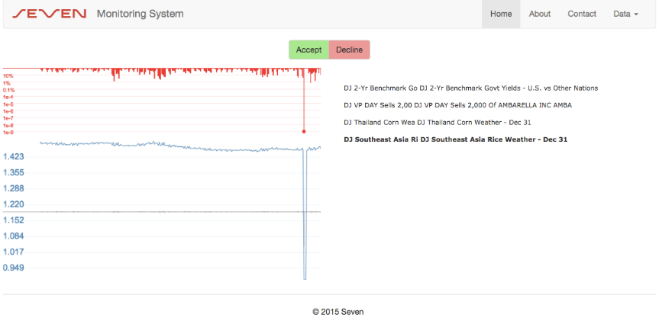
Outlier detected

