Slide 1

Ware-Wolf
Automated Inventory

Slide 2
Introduction
Ware-Wolf is an Automated Inventory Management System that helps retail and food service managers monitor and track their stock in real time.
Businesses are finding that automated inventory management is the future of inventory.

Slide 3
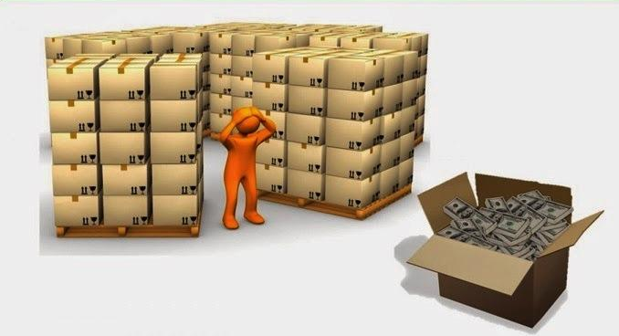
Problems with Traditional Inventory Management
Cost of inventory labor
Manual data entry process
Product Security
Missed sales due to out of stock

Slide 4

Solution: Enter ‘Ware-Wolf’
Ware-Wolf is a commercial software meant to help small businesses run more efficiently.
Monitors inventory in real time using AWS DeepLens
Sends alerts when products in the inventory are less than required.
Automatically orders products at the right time from the cheapest available option
Shows relevant graphs and stats to make inventory management easier

Slide 5
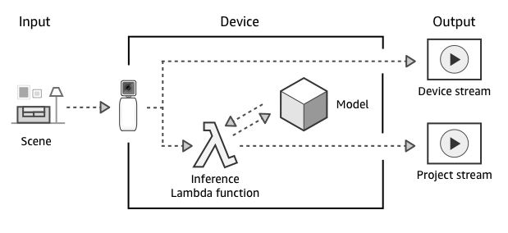
AWS DeepLens
Cloud Integrated
Machine Learning Camera
Model Training

Slide 6
Challenges
Building Image recognition model
Training Deeplens to recognize products and barcodes
Predictive accuracy
Difficult to have high accuracy and performance in Image recognition models
Velocity
Data streams in at an unprecedented speed and must be dealt with in a timely manner.
Volume
Gigantic volume of video data
Notes:
Alerts on expired or damaged goods to be removed from the shelves are generated to protect consumers and reputation of the retailer
Reduce canceled orders: With manual inventory management, you have to keep track of your own inventory. Worse, you may have to keep track of your suppliers inventory. If they go out of stock and you get an order, you may have to backorder or even cancel the order. With an automated inventory management system, no more manually updating inventory quantity.

Slide 7
Data Requirements
Data to be Tracked
Video feed of the stock room.
Video feed of the store floor.
How it will be tracked
AWS DeepLens camera feeds data to the cloud.
Notes:
Inventory- relational
Sales Database- big data
Customer Database- relational

Slide 8
User Interface/Reports
Access to AWS DeepLens camera feeds
Live Inventory Statistics
Predict raw material/inventory requirements
Product order automation, information, and tracking
Alerts and Notifications regarding stock levels

Slide 9
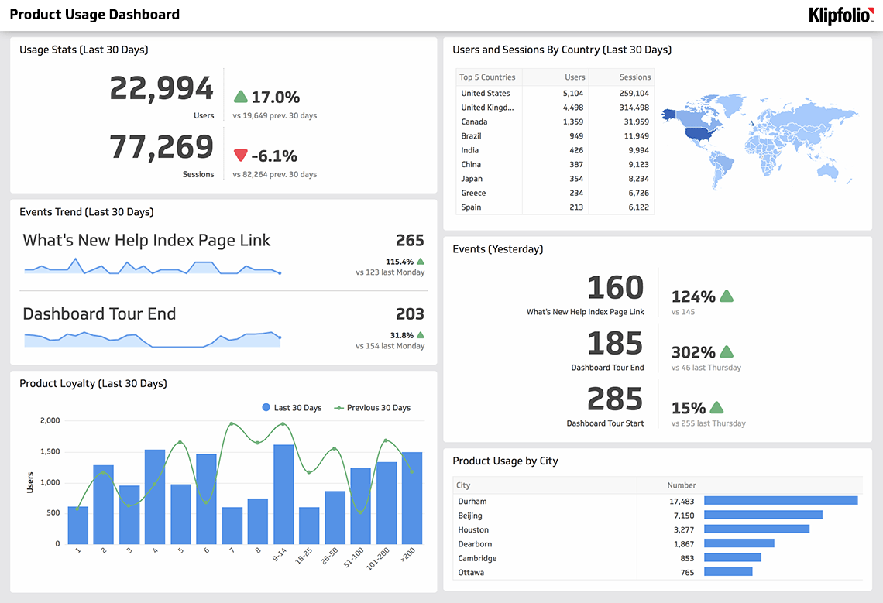
Sample Dashboard
https://www.klipfolio.com/product-management-reporting-tool

Slide 10
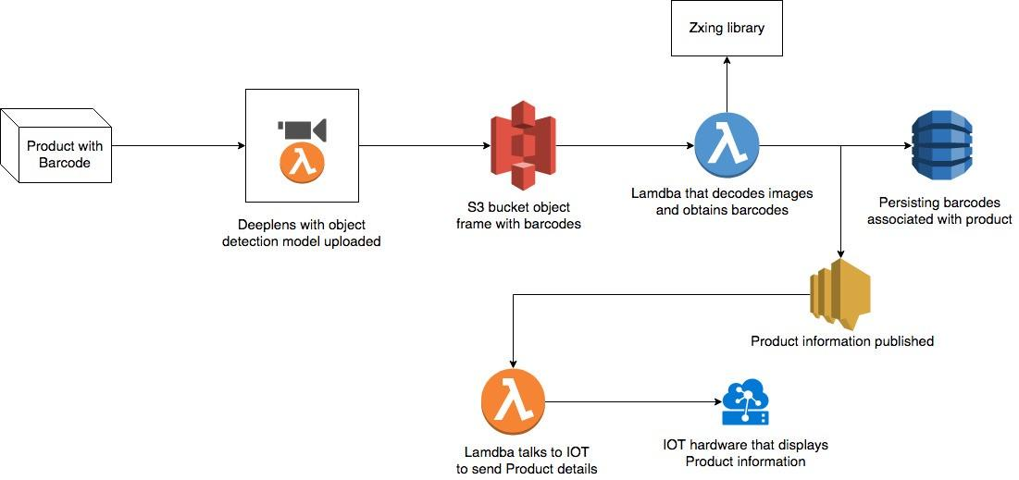
High Level Diagram of System

Slide 11

Database
Big Data:
AWS S3: Live Inventory Video feed streamed in from DeepLens
Metadata for products and barcodes
Relational:
Products, Suppliers, Inventory Transactions

Slide 12
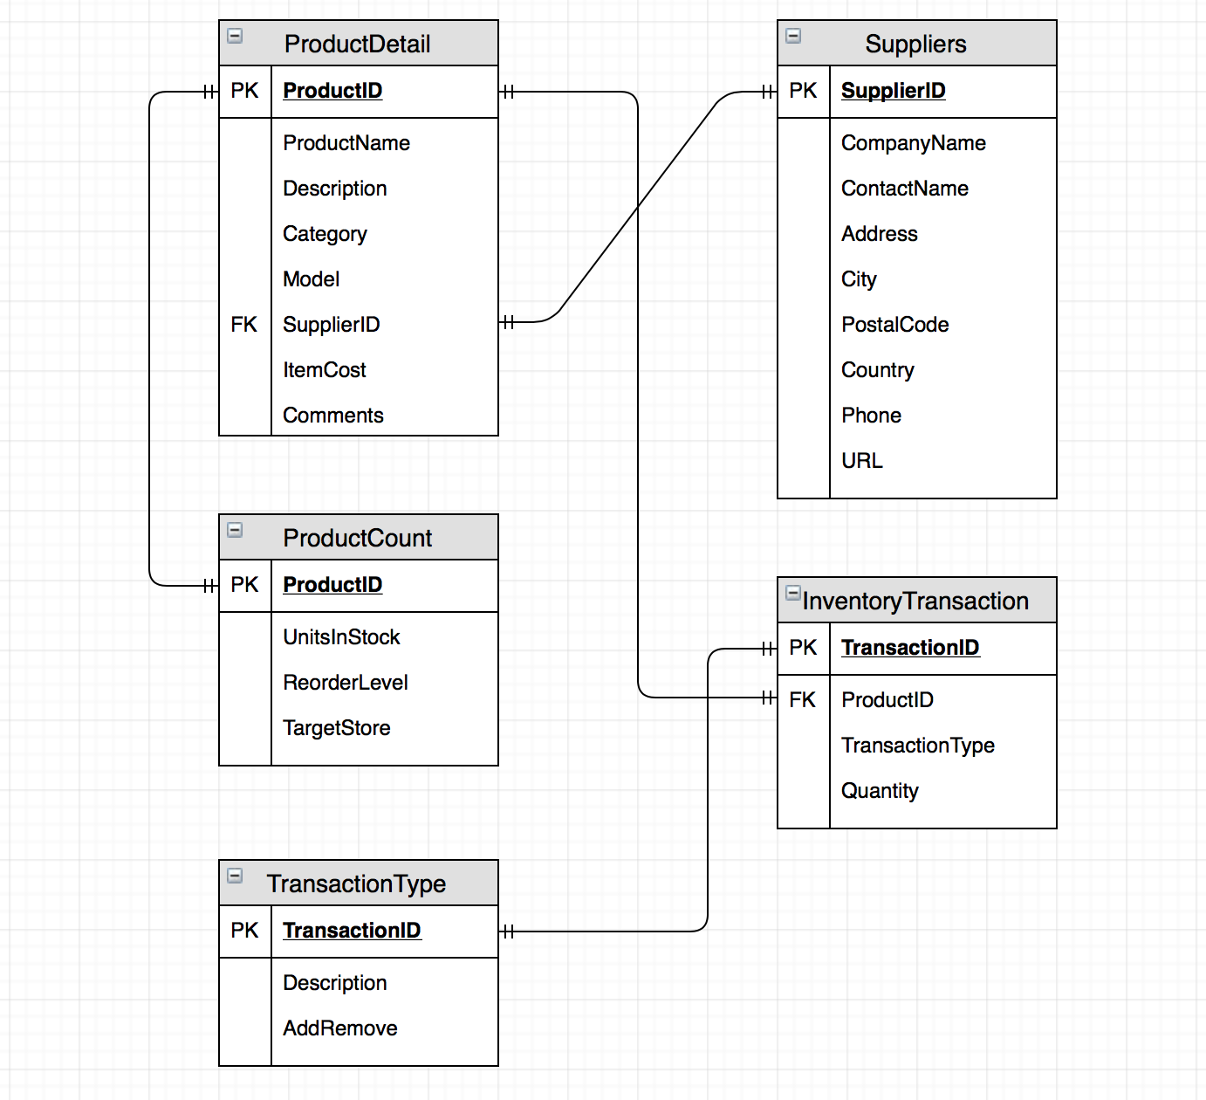
Database Design:

Slide 13





Technology Stack
Visualisation and Analytics
Compute
Storage

Slide 14
Machine Learning
Develop Image recognition models to identify products and barcodes.
Analyze object movements to differentiate between a product coming in or going out.
Recognise Inventory usage pattern to predict stock requirements.

Slide 15
Hardware/Software Estimates
Service Type | Service Price
Amazon EC2 Service | $10,412
Amazon S3 Service | $4,556.80
Amazon CloudFront Service | $8,294.40
Amazon DynamoDB Service | $2,803.75
Amazon ElastiCache Service | $49.80
AWS Support (Business) | $2,128.18
Total Monthly Cost | $28,244.93
AWS
Staff
Hardware
Development Team * | 32 Weeks | $800,000
Maintenance & Support | 24x7 | $300,000/Year
HPE ProLiant DL360 * | As per requirements | $3000/unit
AWS Deeplens | As per requirements | $250/unit

Slide 16
Development Team
Chief Technology Officer
2 Data Analyst
1 Cloud developer
3 Full stack developers

Slide 17
Maintenance and Support Team
AWS Cluster Administrator
Database Administrator
Technical Supporter

Slide 18
Estimated Project Timeline
03/2020
09/2020
12/2020
03/2021
ML Model Development
Software Development
Module Testing
Trial Operation
Image Recognition Models
Auxiliary applications and services
Alpha Testing in controlled environment
Beta Testing in an real-life environment

Slide 19
Benefits
Saving human resource cost and time
Helping managers track Key Performance Indicators (KPIs) to understand strengths and weaknesses of business model
Tracking inventory accurately to improve sales
Avoiding overstocking and reducing leftover products
Providing real-time product usage

Slide 20

Questions?

