Slide 1



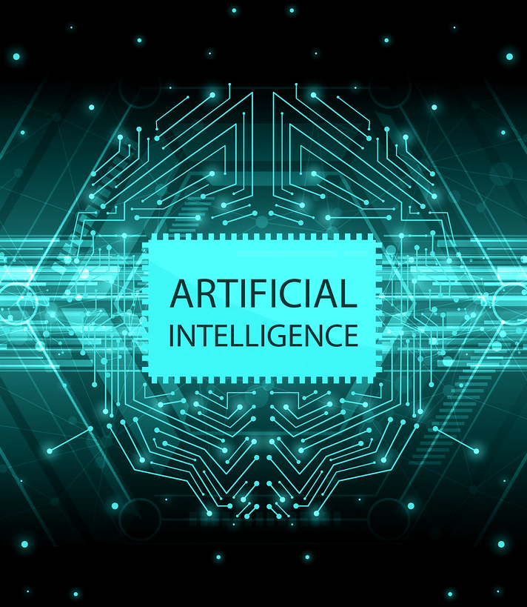

Theme Name – Virtual Assistant Jarvis Python.
Problem Statement – Automation.
Team Name – AI Vantage.
Group Members :
03 Anish Bochare
06 Arya Deshpande
10 Shruti Ghate
62 Ansh Ghodke

Slide 2
Contents
Introduction
Idea Growth Concept
Beginning
Growth
Branching
The Future
Idea Features
Reference

Slide 3
Virtual Assistant Jarvis Python Using NLTK.
A Python virtual assistant is an AI-powered software program that can perform a variety of tasks based on natural language inputs from users.
A Python virtual assistant typically uses natural language processing (NLP) techniques to understand user inputs and generate appropriate responses.
Some common tasks that a Python virtual assistant can perform include finding my phone, understand other regional language , playing music any song you want, unlock my phone, and providing weather updates of any city
A virtual assistant can integrate with other applications and services, providing a seamless experience across different platforms. For example, a virtual assistant could be integrated with a home automation system, allowing users to control their lights or thermostat using voice commands.
NLTK includes a variety of text analysis tools such as tokenization, stemming, and part-of-speech tagging. These tools can help the virtual assistant to better understand the user's input and provide more accurate responses.
PYTHON VIRTUIAL ASSISTANT

Slide 4
There are many reasons why someone might need a virtual assistant. Some reasons include:
If you are a busy person with a lot of responsibilities, a virtual assistant can help take some tasks off your hands so that you can focus on more important things.
If you have a disability or illness that makes it difficult to do certain tasks, a virtual assistant can help by doing those tasks for you.
If you are a student or working professional who needs help with time management and organization, a virtual assistant can be a great asset.
If you are starting a business or working on a project that requires a lot of research, a virtual assistant can do that research for you.
There are many reasons why we need to develop virtual assistant. First, virtual assistant can provide us with great convenience. With virtual assistant, we can get things done more quickly and efficiently. For example, if we need to book a hotel room, we can simply ask our virtual assistant to do it for us. Second, virtual assistant can help us save time. By using virtual assistant, we can avoid wasting time on tasks that can be easily done by computers.
PYTHON VIRTUIAL ASSISTANT

Slide 5
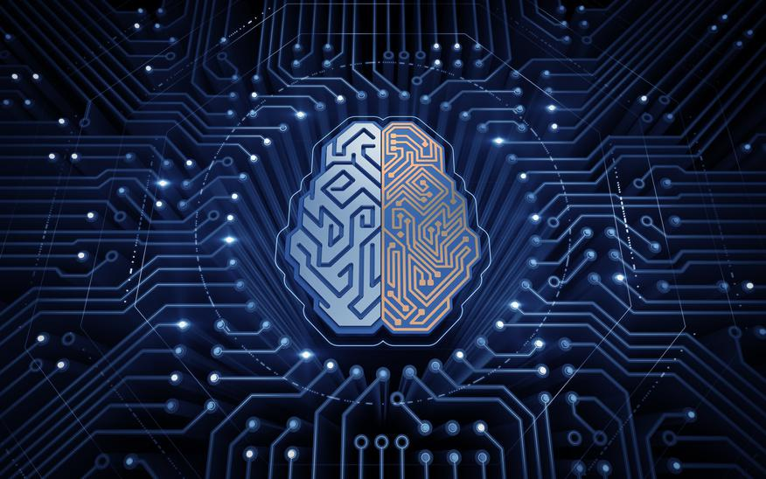
Idea Growth Concept
Idea Feature
Task Automation,
Personalization,
Learning and Improvement
Resources Required
Windows 11,
Python Version 3.5, Visual Studio
Idea Implementation
APIs, NLTK, ML,
DL, NN
Moving on
Regional Language,
Controls Phone,
Answer Any Question
Idea to Product
Chatbot,
Education
Beginning
Growth
Branching
The Future
PYTHON VIRTUIAL ASSISTANT

Slide 6
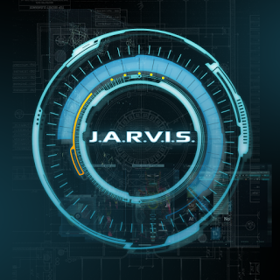
IDEA FEATURES
User-friendly Conversation – Regional Languages
Task Automation – Texting/Calling Friends, Unlocking / Finding Phone, Playing Any Music, Windows Lock & Shutdown, Control Volume
Personalization – Taking Personal Notes, Hot-word Detection, Good Thoughts for the Day, Social Media Updates, Clap Detection, My Location
Learning and Improvement – After Every Conversation Jarvis will be able to Understand more efficiently, gives weather details of any city, International News Update
PYTHON VIRTUIAL ASSISTANT
6

Slide 7
Resources Required
Windows 10
Python Version 3.5
PyCharm
Libraries
Chrome version 105
Internet Connection
API Keys
Visual Studio C++ Libraries
PYTHON VIRTUIAL ASSISTANT
7

Slide 8
Idea Implementation
NLTK – Natural Language Tool Kit used for text classification, tokenization, stemming, tagging, and parsing.
ML – Machine Learning, It helps Jarvis to Learn automatically and improve the Conversation Experience
NN – Neural Network , It’s used for understand and respond to natural language input from users.
DL – Deep Learning, It uses neural networks to model and solve complex problems.
API – For Performing Various Task and Getting Live Updates and Details
PYTHON VIRTUIAL ASSISTANT
8

Slide 9
Moving on
Clap, Hot-word Detection – Jarvis will start when we clap our Hand & It will respond to us only when “JARVIS” word is used
Regional Language – Jarvis can understand Every Language that is spoken in India.
Phone Control – Jarvis Connects to our Phone by both ways (Wired/Wireless) & Perform Various Tasks. E.g. – Unlocking Phone, Making Calls, Answering Call, etc
Question/Answer – Jarvis can answer any of your Question in simple ways.
PYTHON VIRTUIAL ASSISTANT
9

Slide 10
Idea to Product
Chatbot - Automated customer support, answer frequently asked questions, and assist users with tasks
Financial - Tracking expenses, managing budgets, and providing investment advice, to help users with their personal finances.
Education - Help students with their homework, answer their questions
Security – Jarvis can be Integrated with Camera and Security Devices and Maintain the Security and Privacy
PYTHON VIRTUIAL ASSISTANT
10

Slide 11
Idea to product Challenges
Speech Recognition
Elements Tag in Website
Understanding
Microphone gets Stuck due to glitch in Internet Connection
Background Noise cause unwanted understanding
Live data using Web Scraping needs some address to collect information but sometime due to the change in website it gives error
Jarvis has been provide with a intent.json data so that it can train and Understand what we are saying but it need the Value the reply some it might reply wrong

Slide 12
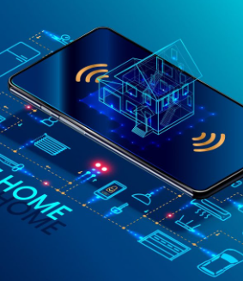
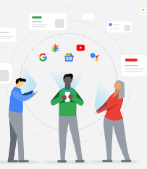
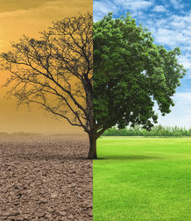



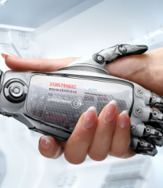

APPLICATION
Home
NEWS
You can Automate Your House with Jarvis
Can you give you News update
Climate
Music
Gives Data About Climate,
Temperature, wind speed
Can Play Any Songs You want
Voice Control
Speed Test
Use the camera to Control Volume
Checks your Internet Speed
Friendly
Call Anyone
Jarvis becomes your friend who can talk with you
Jarvis can Make a Call to The Select Contact Numbers
PYTHON VIRTUIAL ASSISTANT

Slide 13
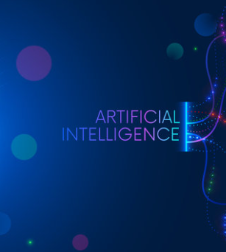
Future Scope
The future of AI
The scope of Artificial Intelligence is limited to domestic and commercial purposes as the medical and invitation sectors are also using AI to improve their services. If AI is outperforming human efforts, then opting for AI automation will reduce costs in the long run for a business.
13

Slide 14




Thank you

