Slide 1
ARXIV:2501.00309v2 · SURVEY · 88 PAGES
GraphRAG
Retrieval-Augmented Generation with Graphs
A five-component reference architecture — what it adds to RAG, and what it costs to run.
For AI Engineers & AI Platform Engineers

Slide 2


THE HOOK
The query RAG can't answer
QUERY
“What drugs treat epithelioid sarcoma and also affect the EZH2 gene product?”
Vector similarity
Graph traversal
Chunk the corpus, embed, return top-k by cosine.
No single chunk contains this answer.
Returns text about the disease and text about the gene — never their intersection.
Relationships were discarded at chunking time.
Disease (Epithelioid Sarcoma)
─[indication]→ Drug
Gene/Protein (EZH2)
─[target]→ Drug
Answer = the intersection of two neighbourhoods, reached by following typed edges.
The answer isn't in the text. It's in the relationships between the texts.

Slide 3
AT A GLANCE
RAG vs GraphRAG
RAG
GraphRAG
Unit of retrieval
Independent text chunks
Nodes, edges, paths, subgraphs
Addressed by
Embedding similarity
Entity IDs + relation types
Relationships
Discarded at chunking
Are the payload
Multi-hop questions
Fails, or needs re-query loops
Native traversal
Explainability
“These chunks scored highest”
The retrieved path IS the trace
I/O contract
Text-in → Text-out
Four contracts: Text/Graph, in/out
Same goal — ground the model in external knowledge. Different substrate, so different machinery.

Slide 4
THE ARCHITECTURE
Five components
01
02
03
04
QUERY
PROCESSOR
RETRIEVER
ORGANIZER
GENERATOR
f(Q) → Q*
f(Q*, G) → C
f(Q*, C) → C*
f(Q*, C*) → A
Text query → graph handles: entity IDs, relation types
Walk the graph. Heuristic, learned, or both
Prune, rerank, augment, verbalise the subgraph
Emit text, a class label, or a whole new graph
05 · GRAPH DATA SOURCE
Explicit (citations, bonds, user–item) or implicit (co-occurrence, feature correlation). Representation is a performance decision, not formatting.
Four composed transforms over one substrate. Two of them have no equivalent in your RAG stack.

Slide 5
THE DELTA
Two you don't have
QUERY PROCESSOR
2/5
Your vector store is addressed by embeddings. A graph is addressed by entity IDs and relation types. Something has to translate — and resolve the entity's type, not just its name, because the type constrains which edges the retriever follows next.
components in this architecture have no counterpart in a standard RAG pipeline
ORGANIZER
Retrieval returns a subgraph. The LLM consumes a linear token sequence. Closing that gap — pruning, reranking, verbalising — is a distinct stage with its own failure modes. It is where most GraphRAG projects quietly fall over.
Skip them and you have
RAG with extra latency.

Slide 6



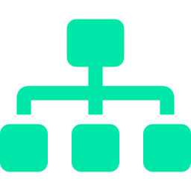

COMPONENT 01
Query Processor
Bridging a text query to a graph you can actually address. Errors here cascade through every later stage.
NER & entity linking
Query mentions → seed node IDs. Resolve the entity TYPE too, not just the string.
Relational extraction
Query verbs → edge types, which set the direction of traversal.
Query structuration
Natural language → Cypher / SPARQL / GraphQL. Text-to-SQL, new dialect.
Query decomposition
Split into sub-queries — but unlike RAG they stay logically linked as a graph.
Query expansion
Expand via graph neighbours of mentioned entities, not via synonyms.

Slide 7
COMPONENT 02
Retriever
RAG is uniformly Text-in → Text-out. GraphRAG has four I/O contracts: Text/Graph in × Text/Graph out.
HEURISTIC
LEARNING-BASED
ADVANCED
Entity linking, relational matching, BFS/DFS, graph kernels
Linear time, zero training, fully explainable
Beats embeddings at disambiguation: Byte vs Bit, President of vs Resident of
Node2Vec, Role2Vec, GNNs, graph transformers
Handles doctor ≈ physician, which rules fluff
Proximity vs role embeddings — related things vs same structural position
Shallow embeddings aren't inductive. GNNs are. Live graphs need inductive.
Integrated — GNN finds seeds, symbolic search extracts paths
Iterative — alternate retrieve/select, one LLM call per hop
Adaptive — predict the hop count per query. A knob RAG doesn't have.
FAILURE MODE Neighbourhood size grows exponentially with hop count. Traversal without pruning blows your context window and your latency budget at the same time.

Slide 8

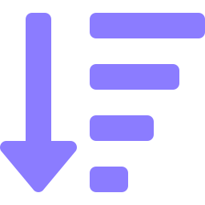

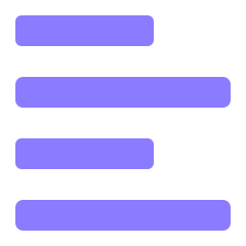
COMPONENT 03
Organizer
The component your stack is missing — and the one that decides whether any of this works.
PRUNE
RERANK
Cut the subgraph without cutting the answer. Semantic scoring, PageRank over reasoning paths, or prize-collecting Steiner tree (G-Retriever).
LLMs over-weight early context and lose the middle. Retrieval scores are coarse rankings over a huge candidate set — rerank fine-grained.
AUGMENT
VERBALISE
Sometimes you add: inject the query itself as a node so it connects directly to evidence; use an LLM to enrich sparse node features.
Graph → text. Tuple → template → model-based summarisation, ascending in cost and fidelity. Ordering measurably changes comprehension.
Four distinct jobs between “we retrieved a subgraph” and “the model can read it”.

Slide 9
COMPONENT 04
Generator
Not every GraphRAG task ends in an LLM — picking the wrong generator type is a common architectural mistake.
GETTING A GRAPH INTO AN LLM
THREE GENERATOR TYPES
Discriminative
1
Verbalise
GNN / Graph Transformer. Node, edge and graph classification or regression.
Serialise to text. Cheap, no training, loses structure.
LLM-based
2
Embedding fusion
The default for QA and text generation.
GNN encodes the subgraph; a learned projector maps it into token-embedding space. LoRA the projector, freeze the LLM.
Graph-based
Diffusion or Graph VAE, when the output is itself a graph. SE(3)-equivariance keeps molecules valid under rotation.
3
Positional fusion
Encode node position and pairwise relations as positional signal.
No study yet shows LLMs reliably distinguish these structural encodings. Ship 1; treat 2 and 3 as experiments.

Slide 10
THE CORE ARGUMENT
Why you can't bolt it on
01
UNIFORM vs DIVERSE
All text is a token sequence, so one retriever fits every corpus. Graphs arrive as KG triples, 3D molecules, taxonomies and document trees — no one-size-fits-all.
02
INDEPENDENT vs INTERDEPENDENT
Chunking throws the edges away. In GraphRAG the edges are the value: they drive traversal, they drive pruning, they carry structure the generator can exploit.
03
DOMAIN-INVARIANT vs DOMAIN-SPECIFIC
In citation networks, connected papers share a topic. In airline networks, hubs specifically do not connect to hubs. Right in one graph, wrong in the next.
There is no domain-general GraphRAG. Whatever you build encodes assumptions about YOUR graph — design the seams so you can re-tune per domain.

Slide 11

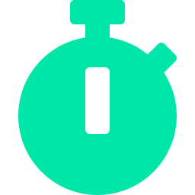




FOR PLATFORM ENGINEERS
What it costs to run
STORAGE
LATENCY
CONSTRUCTION
A graph store and a vector index in the same request path. Plan the join, not two silos.
Link → traverse → prune → rerank → verbalise → generate. Iterative retrievers add an LLM call per hop.
Disambiguation, alignment, coreference, incremental update. A pipeline you now own.
OBSERVABILITY
EVALUATION
SECURITY
Four stages fail differently. End-to-end accuracy won't tell you which one broke.
No benchmark decomposes across components. You will build per-stage eval sets.
Node-level ACLs don't hold: neighbours leak attributes, message-passing propagates them.
The upside that pays for it: the retrieved path is an audit trail a domain expert can actually check.

Slide 12
HONEST SCORECARD
Wins and costs
WHAT YOU GAIN
WHAT IT COSTS
Multi-hop questions answered natively, not with re-query hacks
The retrieved path is an audit trail — decisive in regulated domains
Structural queries: intersections, roles, dependencies, ordering
Adaptive retrieval depth, tuned per query
Heuristics disambiguate what embeddings blur together
Two new components to build, tune and operate
Graph construction becomes your problem — and it's unsolved
Superlinear retrieval latency; an LLM call per hop when iterative
Privacy model changes: connections leak what node ACLs protect
Nothing ports across domains — expect to re-tune every time
Adopt it where relationships carry the answer. Everywhere else, plain RAG is still the right call.

Slide 13
RECOMMENDATION
Where to start
The minimal loop — no training required
Explicit
graph
Entity
linking
Bounded
traversal
Semantic
pruning
Tuple
verbalisation
Off-the-shelf
LLM
Then instrument every stage, find the weakest one, and spend your budget there.
Adopt the five-component vocabulary even if you build a subset.
It buys you clean seams, per-stage metrics, and the ability to swap a heuristic retriever for a GNN without touching anything downstream.
Han et al., “Retrieval-Augmented Generation with Graphs (GraphRAG)” · arXiv:2501.00309v2

