Slide 1
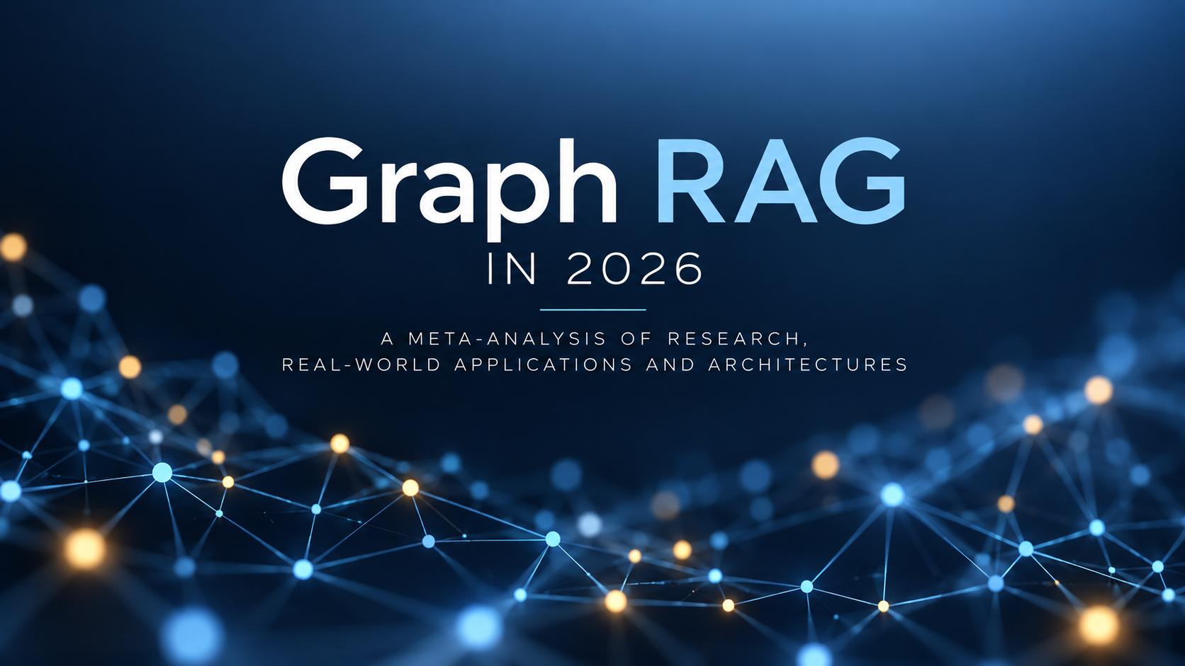

Slide 2
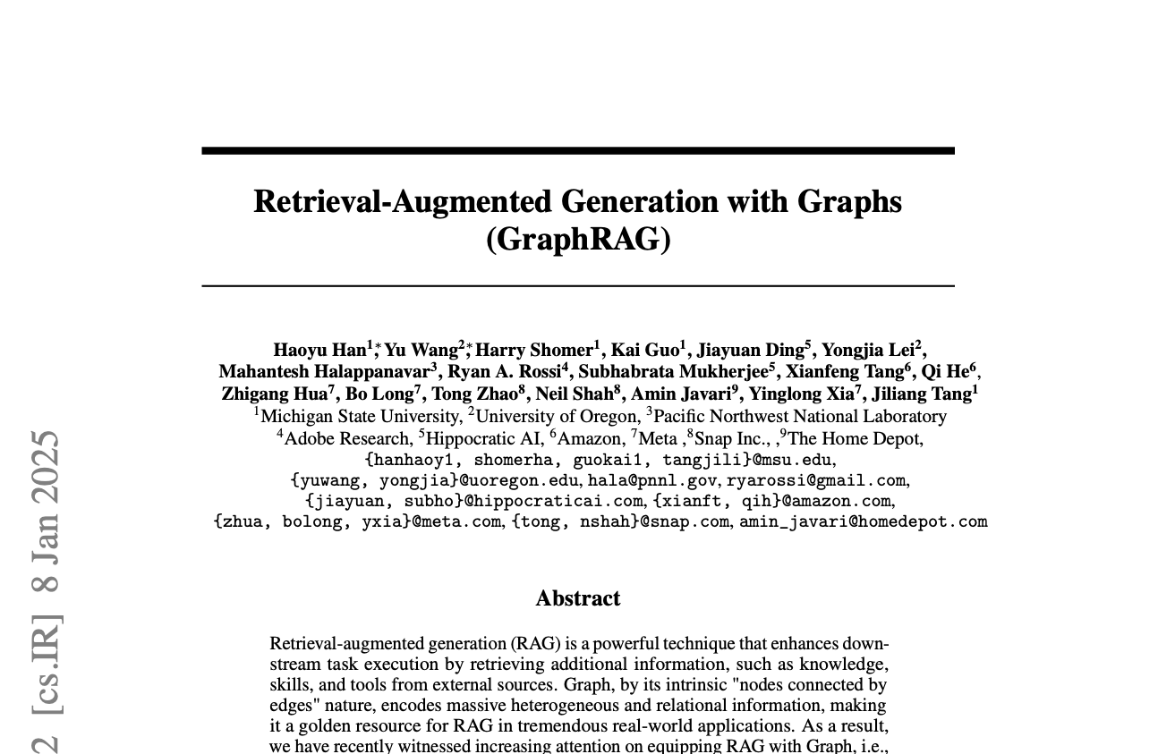
Retrieval-Augmented Generation with Graphs (GraphRAG), Han et al.
Graph RAG follows a multistep process taken from 53 page meta-analysis (Han et al., 2025).
GraphRAG research
1

Slide 3
01
Representations

Slide 4
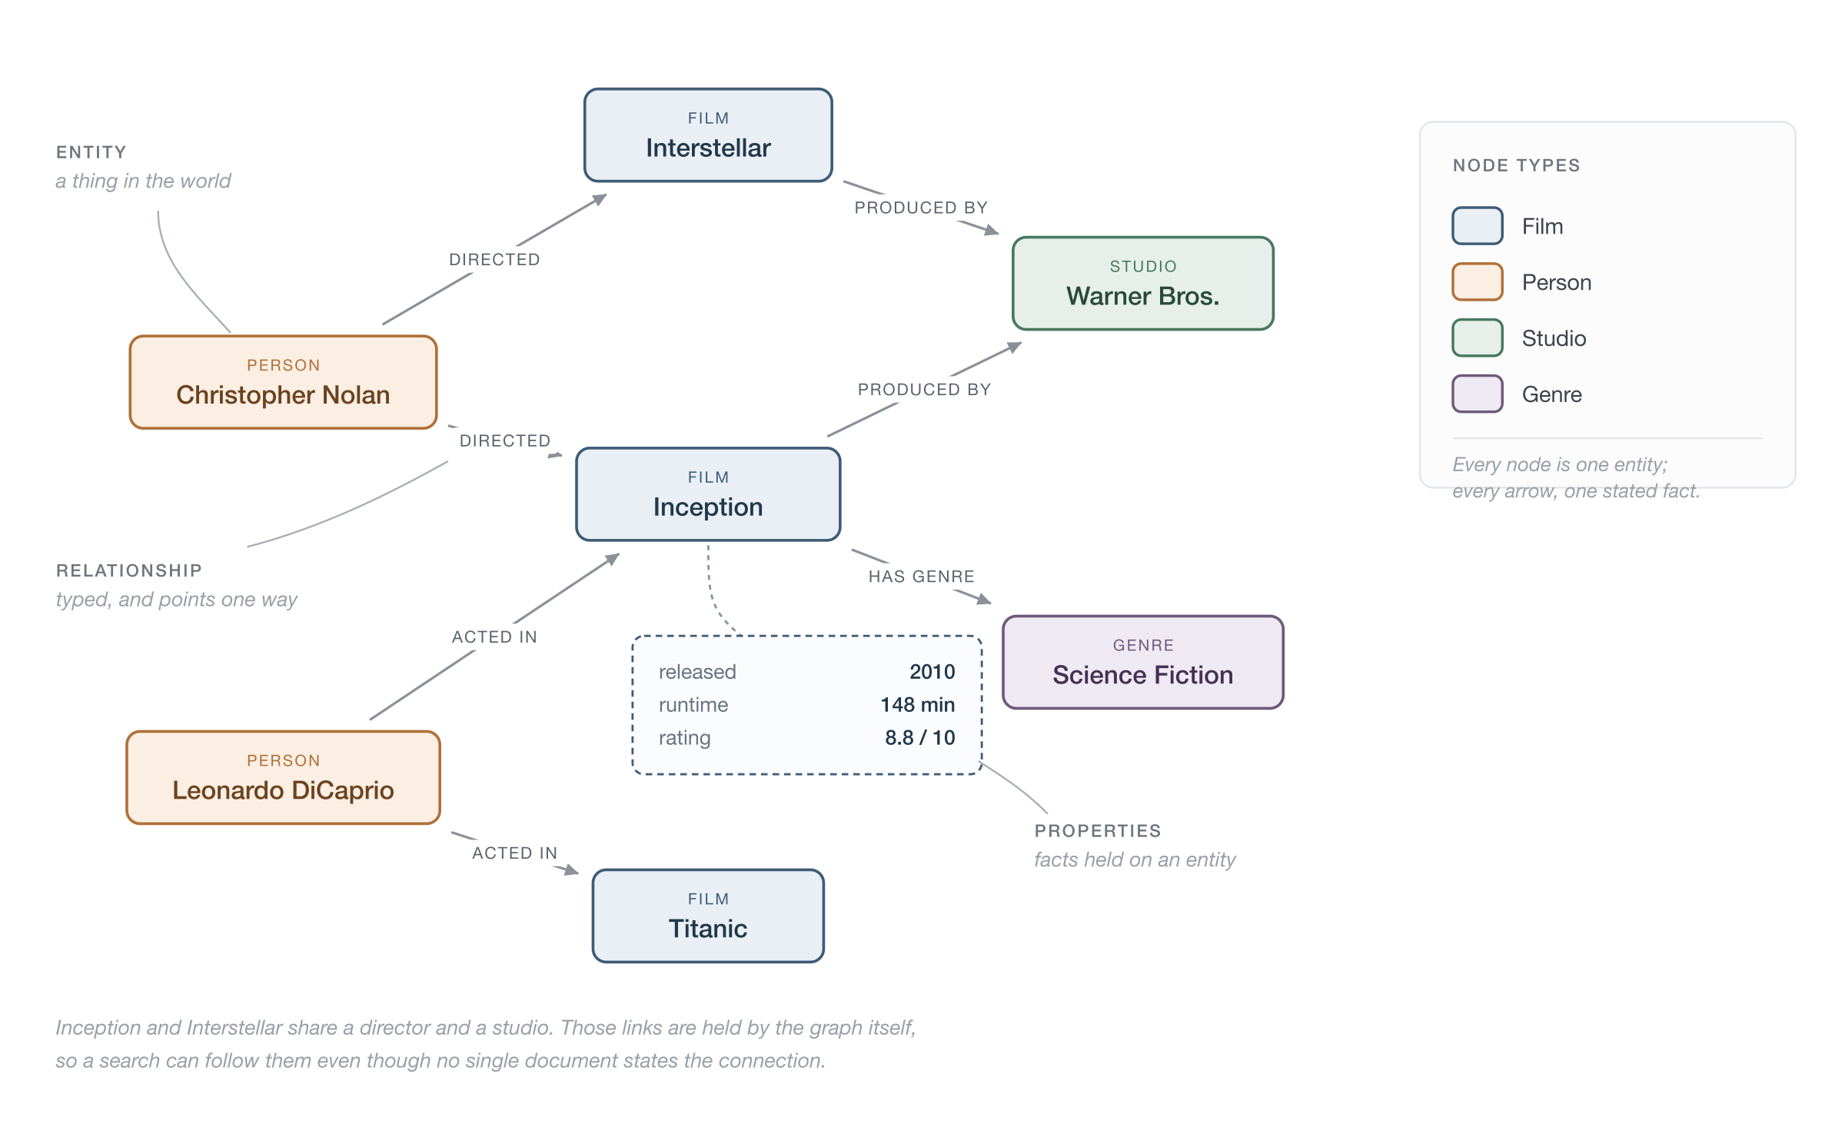
REPRESENTATIONS
A knowledge graph of films, people and studios
GraphRAG research
2

Slide 5
REPRESENTATIONS
Triples, Property Graph vs Tensor
RDF Triples (PaymentsAPI, ownedBy, PaymentsTeam) nodes and edges are represented as subject-relationship-object triples
Labelled Property Graph Neo4j is an example, nodes and relationships can contain multiple properties, which are very useful for searching over
GNN Graph x,edge_index, edge_attr - a numerical representation optimised for ML
GraphRAG research
3

Slide 6
02
Previous spike

Slide 7
PREVIOUS SPIKE
Previous spike
Query processor - The LLM had access to a schema tool, so it had the schema of a graph (in Cypher) and an MCP server for making queries. Based on the schema it converted the query into a Cypher query (Query Structuration) to get the appropriate responses from the graph to answer its question. All the heavy lifting was done by the prompt and the Query -> Cypher translation
Retriever - An MCP server did a raw Cypher request to the graph and returned the
Graph Data Source - Neo4J database
Organiser - The prompt turned the Cypher response back into a human-readable answer, as well as returning the context
Results - It performed very well with single hop queries, queries that required aggregation. Responses were much more deterministic than with the RAG agent. But, it struggled when answers were more than one or two hops. The point of this research is to see what options we have for an engine that is able to return accurate results a more than one hop.
GraphRAG research
4

Slide 8
PREVIOUS SPIKE
Examples of 1–2 Hop Knowledge Graph Paths
Person → Company Alice → works_at → Google 1 hop
Person → City Bob → lives_in → London 1 hop
Person → Company → City Alice → works_at → Google → headquartered_in → Mountain View 2 hops
Drug → Disease → Symptom Metformin → treats → Type 2 Diabetes → has_symptom → Fatigue 2 hops
Developer → API → Service Developer → uses → Payments API → connects_to → Payment Service 2 hops
GraphRAG research
5

Slide 9
03
Background Information

Slide 10
BACKGROUND INFORMATION
Heuristics vs Semantics
Heuristics
Semantics
Uses traditional rules, practical rule of thumb, clues. For example, word clues, if we are looking for a book on gardening, we go to the gardening section, look for books with gardening in the title, check for books next to the gardening book, look for books written by Alan Titchmarsh or Monty Don. Fuzzy searches would fit into this field
Based on meaning, we first understand the meaning behind the sentence and then approach the problem that way. For example if someone says "I'm going to get a sandwich", we can probably ascertain that they are hungry. Within the context of Artificial Intelligence and ML, when we are talking about semantics, we are probably likely to use embeddings and mechanisms such as cosine similarity. Embeddings are able to capture the meaning of a phrase rather than the just the raw shape of the words.
GraphRAG research
6

Slide 11
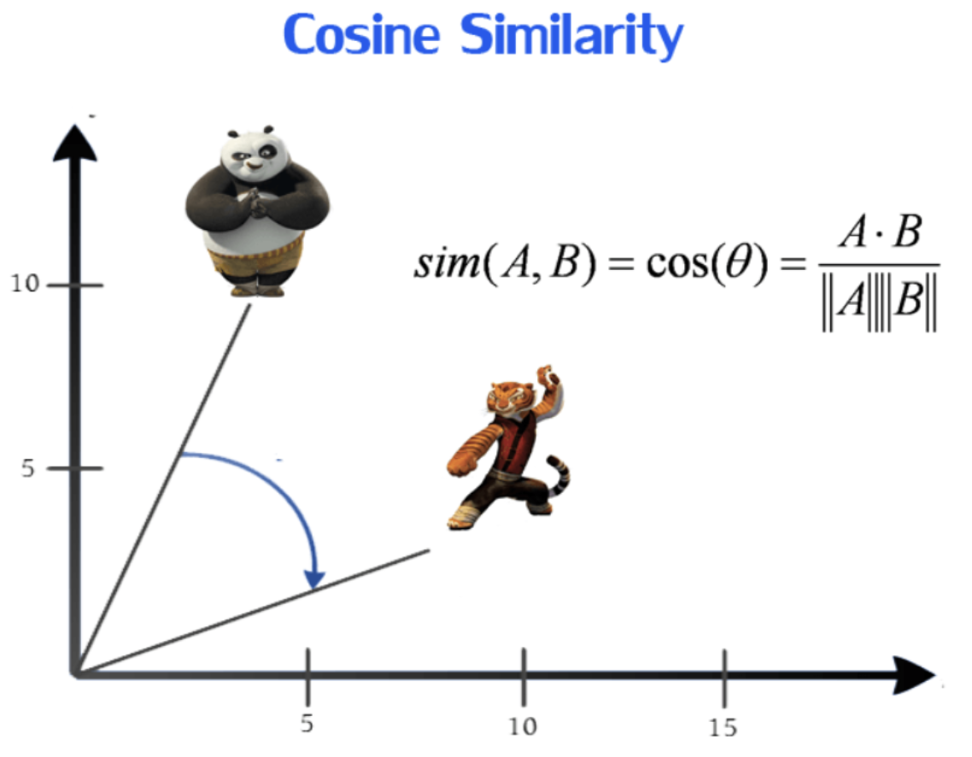
BACKGROUND INFORMATION
Cosine similarity: closeness of meaning as the angle between two vectors
GraphRAG research
7

Slide 12
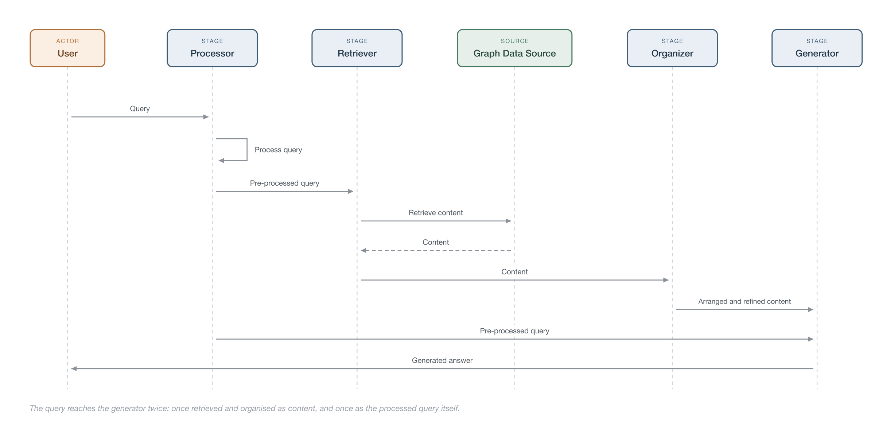
BACKGROUND INFORMATION
The GraphRAG pipeline
How a query moves through the four stages
GraphRAG research
8

Slide 13
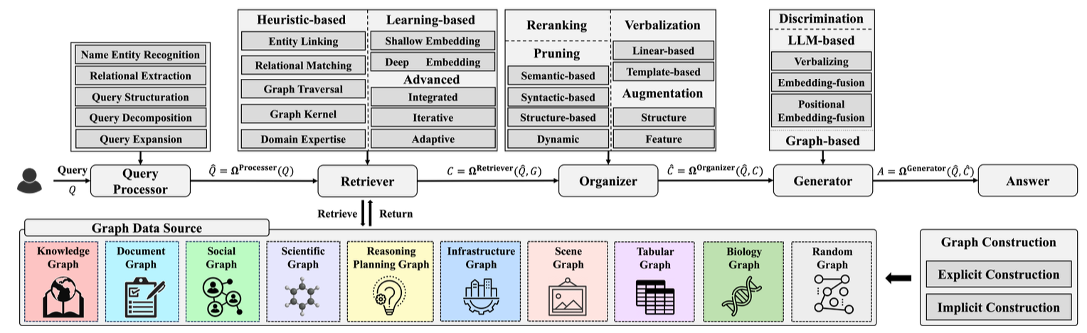
BACKGROUND INFORMATION
The GraphRAG framework
The GraphRAG framework: query processor, retriever, organizer, generator (Han et al., 2025)
GraphRAG research
9

Slide 14
04
Query Processor

Slide 15
QUERY PROCESSOR
Query Processor
You start with a query, then the pipeline goes through a first stage where it formulates the query.
There are a number of different approaches for how the query can be formulated:
entity recognition
relational extraction
query structuration
query decomposition
query expansion
GraphRAG research
10

Slide 16
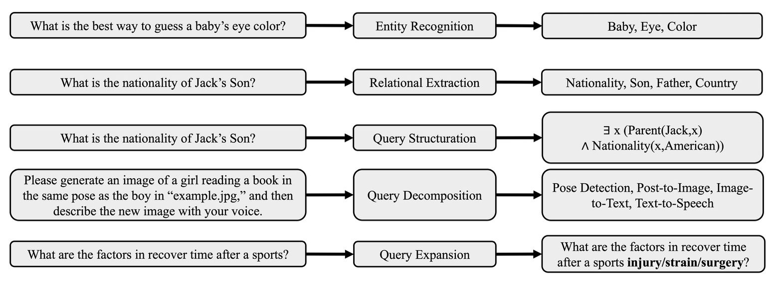
QUERY PROCESSOR
The five query-processing techniques
The five query-processing techniques, with a worked example of each (Han et al., 2025)
GraphRAG research
11

Slide 17
QUERY PROCESSOR
Query Processor (cont.)
Entity Recognition
Relational Extraction
Query Structuration
Can use an LLM, or some other deep learning model to extract named entities (nouns that belong to predefined categories)
Identify a relation, such as 'capital of' from a query such as 'What is the capital of China?' then uses a vector similarity search to find corresponding edges.
This is what we did. Converting a query into Cypher, SQL, SPARQL.
Query Decomposition
Query Expansion
For extra long queries break down into sub queries/sub-tasks
Perform graph retrieval to expand the query, so it can then be used against a naïve RAG retriever
GraphRAG research
12

Slide 18
05
Retriever

Slide 19
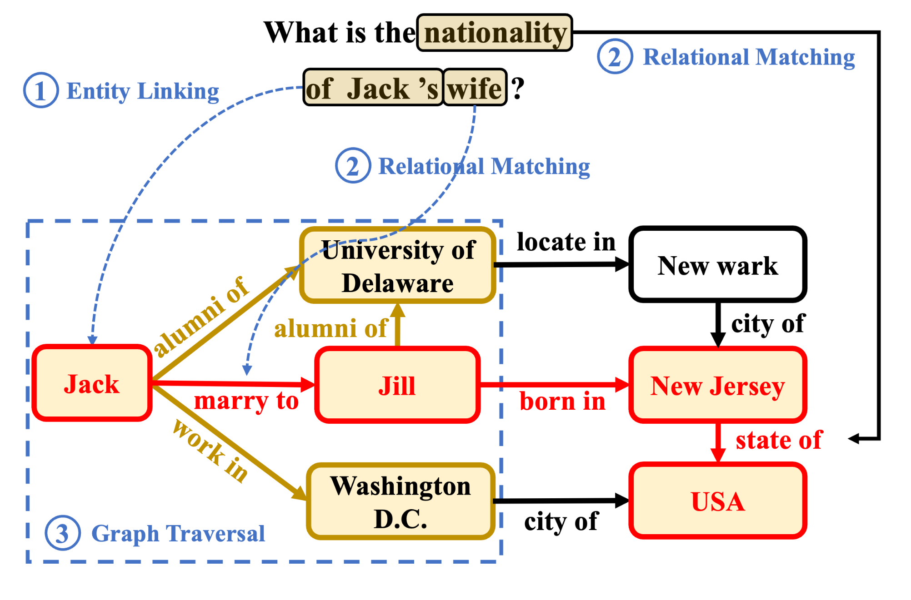
RETRIEVER
Retrieval in three steps
Retrieval in three steps: entity linking, relational matching, then graph traversal (Han et al., 2025)
GraphRAG research
13

Slide 20
RETRIEVER
Heuristic-based (Rule) Retriever
A retriever can use one or a combination of these techniques.
Entity Linking
Relational Matching
We find entities within the query and map them to corresponding seed nodes in the graph. This can be the retriever or can be the foundation for further graph traversal. Accurate entity recognition can be conducted using Top-K nodes computed through vector embeddings and lexical features. For more niche queries additional context can be augmented by an LLM at the query stage (adding extra descriptive text)
Identify edges (relationships) within a graph that correlate to relations in the query. Especially valuable for problems that focus on finding relationships between entities.
GraphRAG research
14

Slide 21
RETRIEVER · HEURISTIC-BASED (RULE) RETRIEVER
Graph Traversal
BFS and DFS are performed on the graph to get query information: extract all paths up to length l between entity linked nodes (e.g. entity1 -> [e₁ … eₗ₋₁] -> entity2), or an l-hop subgraph around the initial entities.
Paths
l-hop subgraph
Both, not either-or
A join operation. Works if there are two or more seed nodes, fails if there is only one. Prunes everything in the l-hop subgraph that is not on the path between those seed entities.
A ball, a full scoop of everything around the seed nodes, nothing is disregarded. This is the fallback when entity linking yields a single seed.
A retriever would normally have both: a subgraph if extracted entities are equal to 1, paths if they are greater. Either way the result is then pruned (top-k relevance, cross-encoder rerank, LLM-as-a-pruner) or fed into a GNN to give candidate answers.
The consensus is that two hops is the ideal — as the number of hops grows beyond that, accuracy dramatically declines.
GraphRAG research
15

Slide 22
RETRIEVER · GRAPH TRAVERSAL
Pruning
Top-K Relevance
Cross-encoder Rerank
LLM as a pruner
Using an LM that calculates probabilities calculate the probability of the node being relevant to the answer.
Use a model specifically built for ranking (e.g. bge-reranker-large). Score the reasoning chain/path such as Ian Rush →PLAYED_FOR→ Liverpool →COMPETES_IN→ Premier League" for a question such Where did Ian Rush play and in which league does that team play in?". In HyKGE the scoring is not performed against the question, the LLM provides a hypothesis for an answer, the entities are extracted from the hypothesis and then the result is chunked. This is compared against the reasoning chains.
Post-hoc - Give all the triples to an LLM and prompt the LLM to rank the triples in terms of relevance to the prompt. The top-K are kept. One call per LLM query.
Inline steering - during traversal the LLM can choose whether to continue, or what to drop. It prunes as it goes, keeps track where the results are and decides whether to continue. The cost for this though is unbounded.
GraphRAG research
16

Slide 23
RETRIEVER
Learning Based Retrieval
There are two forms of embedding, shallow and deep. We're going to focus on deep embeddings.
GNN-RAG
How the GNN learns
An upcoming architecture, published for a conference in 2025 and becoming popular. Needs to be pre-trained on a set of questions and answers (these can be produced synthetically from the graph & an LLM). The maximum number of hops it can comfortably retrieve is three.
It trains paths from each node to l hops by sending messages between the nodes. The weights of a node are its individual weights merged with weights passed through from neighbours. Pre-training needs graph triples from the original graph plus question and node answer pairs.
GraphRAG research
17

Slide 24
RETRIEVER · LEARNING BASED RETRIEVAL
Retrieval steps
Once the graph is trained the retriever takes the following steps:
1
With entity linking find the seed node/s (us)
2
Manually extract a subgraph of n-hops from the seed nodes, transforming into KG-triples (e_id × r × e_id) (us)
3
Pass the query, seed node id/s, flat list of entity strings (these are usually a text id) and subgraph tuples to the retrieval command (GNN-RAG)
4
Receive a list of entity scores (which nodes the GNN predicts answers the question most accurately) (GNN-RAG)
5
Trace the paths (or shortest paths) to the node to return an explanation - tracing all paths up to n-hops then reranking would be the most accurate
6
Output the returned paths as triples to the LLM for context
GraphRAG research
18

Slide 25
RETRIEVER · LEARNING BASED RETRIEVAL
GNN-RAG explanation
GNN-RAG sets all the sub-graph nodes to zeros, then inputs the question embedding into the seed nodes. Imagine it's like ink being added to the seed nodes. The ink then traces it's way through the graph, and based on the question finds its way to the most appropriate answer entities. This leaves a metaphorical ink trail throughout the GNN network...and returns the entities in order of how relevant they are to the question.
GraphRAG research
19

Slide 26
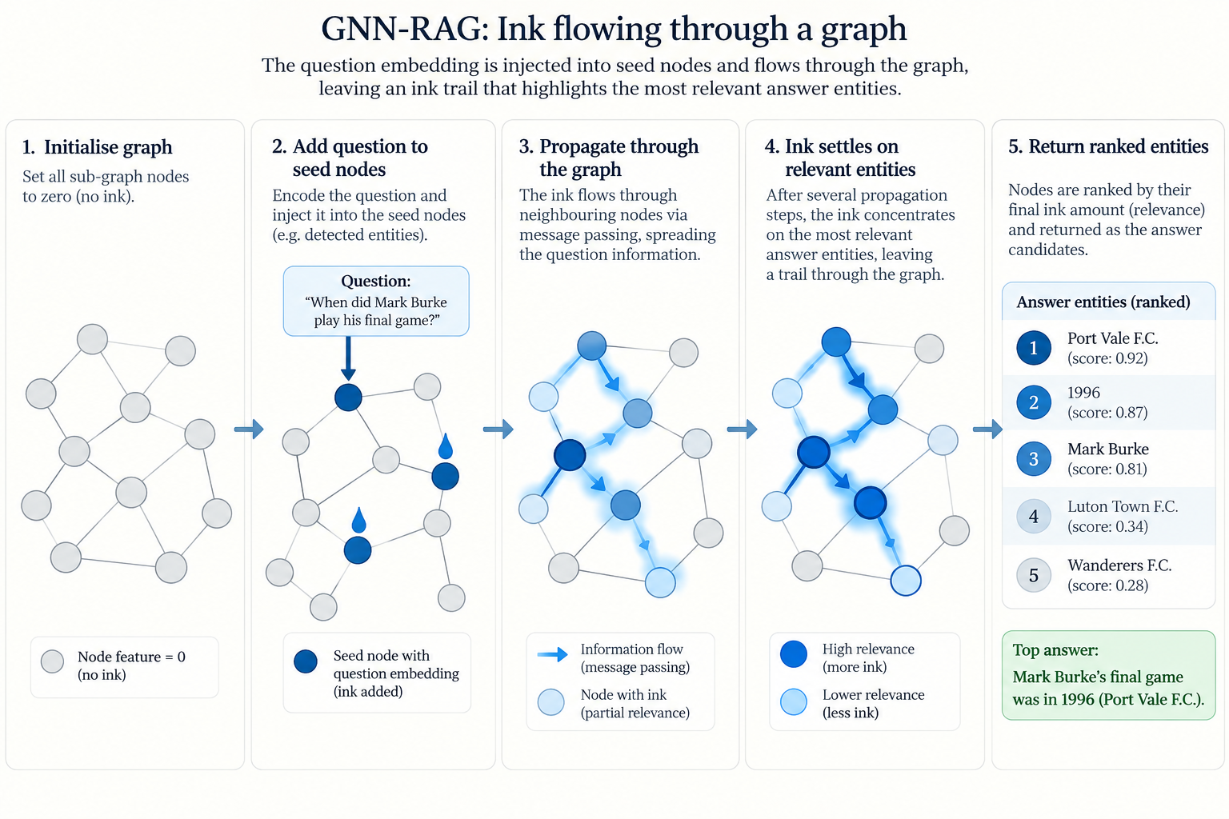
RETRIEVER · LEARNING BASED RETRIEVAL
Ink flowing through a graph
Ink flowing through a graph: the question embedding is injected into the seed nodes, spreads by message passing, and settles on the entities that answer the question
GraphRAG research
20

Slide 27
RETRIEVER · LEARNING BASED RETRIEVAL
Why GNN-RAG over rules
A rule-based/heuristic search walks the graph by matching the words in the question to the labels on the connections — it only works when the right link happens to sound right.
Learns your domain
Complete answer sets
Gets better
GNN-RAG learns from past questions and their correct answers which connections actually lead somewhere useful, even when the wording gives no clue. You bake domain knowledge into the model while training, so it discovers routes that are not understandable at face value to the embeddings alone.
It returns a complete set of answers rather than a fixed top few.
It keeps improving as you collect more examples. The rule-based version never does.
GraphRAG research
21

Slide 28
RETRIEVER · LEARNING BASED RETRIEVAL
Learning Based Retrieval vs purely Heuristics
In every system some level of heuristics is needed, but learning based retrieval will take the subgraph generated from that step and predict a likely destination node (or nodes) based on its prior training. There is an added cost to this, that you need create labelled data - questions and answers and train a dataset. Based on the table below, you can see with supervised training (EmbedKGQA, NSM and UniKGQA) with GNNs hugely outperform untrained LLM retrieval when you get to three hops.
GraphRAG research
22

Slide 29
RETRIEVER · LEARNING BASED RETRIEVAL
Learning Based Retrieval vs purely Heuristics (cont.)
Method | WebQSP | MQA 1-hop | MQA 2-hop | MQA 3-hop
ChatGPT, no KG | 61.2 | 61.9 | 31.0 | 43.2
+ StructGPT (zero-shot) | 72.6 | 94.2 | 93.9 | 80.2
+ StructGPT (few-shot) | 69.6 | 97.1 | 97.3 | 87.0
KV-Mem | 46.7 | 96.2 | 82.7 | 48.9
GraftNet | 66.4 | 97.0 | 94.8 | 77.7
EmbedKGQA | 66.6 | 97.5 | 98.8 | 94.8
NSM | 68.7 | 97.1 | 99.9 | 98.9
UniKGQA (supervised) | 75.1 | 97.5 | 99.0 | 99.1
GraphRAG research
23

Slide 30
RETRIEVER · EXAMPLES - METHODOLOGY
KG-GPT - Relational matching
Query Processor
Sentence segmentation
Break sentence into sub-sentences
For each sub-sentence create a set of entities
Retriever
Relational Matching
Graph lookup to find plausible relations based on the set of entities
LLM pick top-K relations for that sub-sentence
Graph lookup to get all triples with the generated entities and discovered relations
Inference Input all the triples and the query.
Shortfall, validation only. It only manages to find as many hops as are found in the sub-sentence. If the answer is two hops away from the entities in the sub-sentence the algorithm will not find them.
GraphRAG research
24

Slide 31
06
Organiser

Slide 32
ORGANISER
Organiser
The organiser has four main tasks:
Graph pruning - remove noise from the retrieved sub-graphs with
Rerank the sub-graph context so that the most relevant knowledge it towards to the top (to avoid attention bias)
Graph augmentation
Verbalising the graph while still being structurally aware, this is the mapping layer between graph and prose
GraphRAG research
25

Slide 33
ORGANISER
Graph Pruning
Semantic-based pruning
Syntactic-based pruning
Structure-based pruning
Dynamic pruning
Remove semantically irrelevant nodes and edge relationship. We have already discussed this in part. Different units can be scored, node score each entity against query, relation score relations around each entity, expand chosen ones, whole subgraph partition retrieved subgraph into regions, rank the regions, keep top-k. Some will reconnect disconnected entities.
a parse tree is created based on query sentence grammar, seed nodes in the graph are scored based on the span distance (distance between words) within the query, then mean neighbourhood aggregation passes the scores out from the seeds.
use the graph structure, for example by calculating the average PageRank score for each path to extract the most relevant entities. Calculation of -- how reachable is this node from the query's entities?
prune as you go, only available for GNNs on a retrieved subgraph - models own attention weights, when below a certain quantity on a retrieved node are pruned. As the GNN traces the best path to it's predicted target entities, like with our ink example, this extracts nodes that don't have enough ink.
GraphRAG research
26

Slide 34
ORGANISER
Reranker
LLMs tend to give more weight to earlier documents in context than later ones. Results need to be re-ordered such that the most important documents are higher up. This can be done with a cross-encoder, a pre-trained model, a GNN etc.
GraphRAG research
27

Slide 35
ORGANISER
Graph Augmentation
Once the graph has been retrieved, additional information can be supplied by knowledge within LLMs or external data sources (even by naïve RAG retrievers). This is need due to the pruning that happens. There are two main categories:
Graph Structure Augmentation
Graph Feature Augmentation
question chunks are augmented to the subgraph as nodes, or the whole question augmented as a single node or a pre-trained diffusion model generates extra edges for the retrieved graph
the content of the nodes may be too large or two sparse, so the content can be summarised or generated (or pulled in from a cache)
GraphRAG research
28

Slide 36
ORGANISER
Verbalising
Verbalising is the act of turning the retrieved and organised result into something that an LLM can understand. We previously use the LLM to translate the Cypher response into text as part of the generator prompt (this was purely a prompt driven action as part of the generation). The paper discusses a number of mechanisms:
Linear verbalisation
Model-based verbalisation
These include Tuple-based, returning facts as (entity 1, relation 1, entity 2) tuples separated by line-breaks. Template-based verbalisations, use predefined templates to generate more natural sounding text, for example “The {relation} of {entity 1} is/are: {entity 2}”
These include Graph-to-text verbalisation, use graph transformers to generate text from KG, or use fine-tuned LLMs to transform graphs into sentences. Graph Summarisation generates concise summaries based on the retrieved graph and query - directly prompting LLM to summarise facts and query, or fine-tuning an LLM for summarisation.
GraphRAG research
29

Slide 37
07
Generator

Slide 38
GENERATOR
Generator
There are many types of generator depending on the actual task, considering we are looking specifically on Question-Answer style RAG, we are likely using a straight GPT or Bedrock model with chat completions to give a response from the context generated from previous layers of the RAG retrieval process. That is the generator for GraphRAG doesn't differ from a RAG generator.
GraphRAG research
30

Slide 39
08
Changes since 2025

Slide 40
CHANGES SINCE 2025
Changes since 2025
Area | Han et al. baseline | Where the field is moving
Graph construction | KG/document/semantic graphs | Richer heterogeneous and text-attributed graphs
Retrieval | Traversal, semantic retrieval, KG querying | Learned graph retrieval, GNN retrieval, hybrid retrieval
Retrieval unit | Nodes/triples/paths | Query-conditioned subgraphs increasingly important
RAG vs GraphRAG | GraphRAG generally motivated as an improvement | GraphRAG is not universally better than vector RAG
Architecture | Fairly fixed GraphRAG pipeline | Adaptive routing: vector RAG ↔ GraphRAG
Reasoning | LLM reasons over retrieved graph | Graph retriever itself increasingly participates in reasoning
Agents | Relatively peripheral | Agentic GraphRAG becoming a distinct architecture
Evaluation | QA benchmark performance | Latency, cost, retrieval quality, generation quality, production usefulness
Context | Retrieve useful graph information | Context engineering / pruning becomes central
Applications | Mostly research/early systems | Increasingly domain-specific production architectures
GraphRAG research
31

Slide 41
09
Where does GraphRAG outperform naïve RAG?

Slide 42
WHERE DOES GRAPHRAG OUTPERFORM NAÏVE RAG?
Where does GraphRAG outperform naïve RAG?
Corpus level summarisation
Multi-hop and Relational reasoning
Domains with relational data
If a dataset is large, the answer often doesn't exist in a single chunk, so naïve RAG is unable to find the answer.
Naïve RAG can struggle to understand relational concepts, such as if David is the Father of Cherry and Elane is the Mother of David, then Elane is the Grand-mother of Cherry. Where the LLM needs to be able to accurately give such responses GraphRAG by far outperforms naïve RAG, due to its built-in multi-hop relational mapping.
Where data is already relational, flattening to text chunks removes the relational aspect of the data
GraphRAG research
32

Slide 43
10
Comparison

Slide 44
COMPARISON
Comparison
Use case | Naïve RAG | Graph RAG
Quick to set up with AGNO | ✓ | ✗
Flat data structure | ✓ | ✗
Low indexing cost | ✓ | ✗
Single fact lookup where answer exists in a single chunk | ✓ | ✓
Low tolerance for error | ✗ | ✓
Hierarchical data structure | ✗ | ✓
Needs deep understanding of subject matter | ✗ | ✓
Multi-hop and Relational reasoning | ✗ | ✓
Questions where aggregation/enumeration/counting is required | ✗ | ✓
Questions where deterministic answers are required | ✗ | ✓
Explainable retrieval path | ✗ | ✓
GraphRAG research
33

Slide 45
11
Within teams

Slide 46
WITHIN TEAMS
Within teams
We trialed building a Graph with OAS specs, then performing validation based on that, it turned out that a lot of the questions looked at the data as a flat object so graphs were unsuited. But, on conversation with architect on api assistant we found the results to be very accurate and deterministic. We trialed questions where the aggregation and counting was required, and the results were excellent. The API assistant dataset is very relational in nature and a lot of questions are unanswerable with the current system.
Initial trial with a pure translation to Cypher layer resulted in excellent results for simple single hop retrieval. As the number of hops grew, so the model's ability to propose a retrieval route failed. This research has shown that retrieval mechanisms that are more algorithmic in nature are able to overcome this issue by retrieving a larger subgraph and then pruning and expanding iteratively.
GraphRAG research
34

Slide 47
WHERE THIS LEAVES US
Proposal: we spike a more advanced GraphRAG retrieval system that incorporates heuristic traversal up to three hops with a set goal of getting accurate answers to more complex questions. We can also test this against the current system and even experiment with a Graph Neural Network.

Slide 48
GRAPH RAG
References
01
Scalable Multi-Hop Relational Reasoning for Knowledge-Aware Question Answering
Feng et al. · 2020 · arXiv:2005.00646
06
StructGPT: A General Framework for Large Language Model to Reason over Structured Data
Jiang et al. · 2023 · arXiv:2305.09645
02
Graph-augmented Learning to Rank for Querying Large-scale Knowledge Graph
Gao et al. · 2022 · arXiv:2111.10541
07
HyKGE: A Hypothesis Knowledge Graph Enhanced Framework for Accurate and Reliable Medical LLMs Responses
Jiang et al. · 2024 · arXiv:2312.15883
03
KnowledgeNavigator: leveraging large language models for enhanced reasoning over knowledge graph
Guo et al. · Complex &amp; Intelligent Systems · 2024
08
Causal Reasoning in Large Language Models: A Knowledge Graph Approach
Kim et al. · 2024 · arXiv:2410.11588
04
Retrieval-Augmented Generation with Graphs (GraphRAG)
Han et al. · 2025 · arXiv:2501.00309
09
Mitigating Hallucinations in Large Language Models via Self-Refinement-Enhanced Knowledge Retrieval
Niu et al. · 2024 · arXiv:2405.06545
05
G-Retriever: Retrieval-Augmented Generation for Textual Graph Understanding and Question Answering
He et al. · 2024 · arXiv:2402.07630
10
PipeNet: Question Answering with Semantic Pruning over Knowledge Graphs
Su et al. · 2024 · arXiv:2401.17536
GraphRAG research
35

Slide 49
GRAPH RAG
References (cont.)
11
Cross-Domain Graph Data Scaling: A Showcase with Diffusion Models
Tang et al. · 2025 · arXiv:2406.01899
14
QA-GNN: Reasoning with Language Models and Knowledge Graphs for Question Answering
Yasunaga et al. · 2022 · arXiv:2104.06378
12
GrapeQA: GRaph Augmentation and Pruning to Enhance Question-Answering
Taunk et al. · 2023 · arXiv:2303.12320
15
Deep Bidirectional Language-Knowledge Graph Pretraining
Yasunaga et al. · 2022 · arXiv:2210.09338
13
Graph Neural Prompting with Large Language Models
Tian et al. · 2023 · arXiv:2309.15427
16
GreaseLM: Graph REASoning Enhanced Language Models for Question Answering
Zhang et al. · ICLR · 2021 · arXiv:2201.08860
GraphRAG research
36

