Slide 1
MHC Tetramer Technology: Recent Developments
John D. Altman – Emory University

Slide 2
Recent Developments in MHC Tetramer Technology
Contract
Renewed for 7 years
New website
Production of class I MHCp by peptide exchange
High-throughput tetramers (HTT)
Class II – summary of available alleles and technology
Fluorophores
CyTOF tetramers
StvC and StvC6

Slide 3
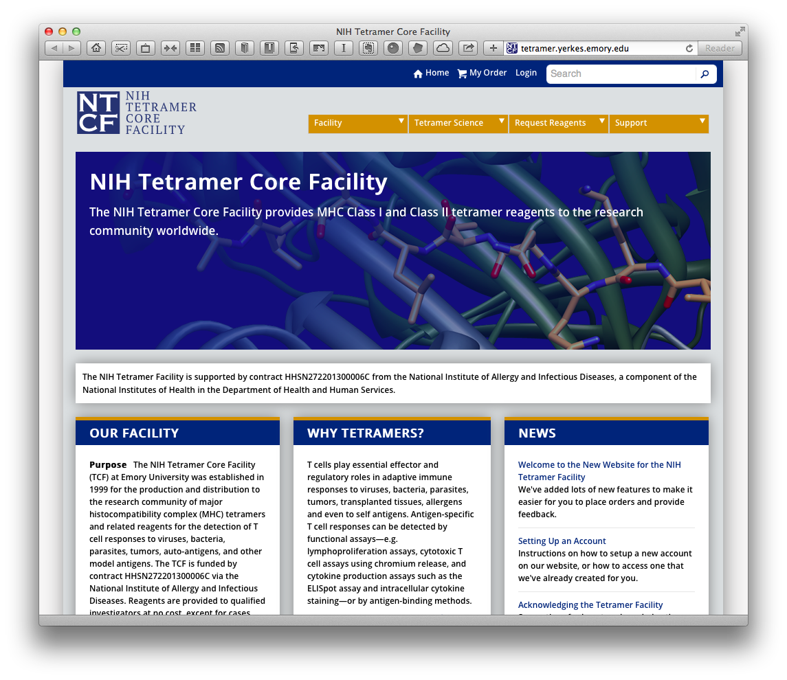

Slide 4
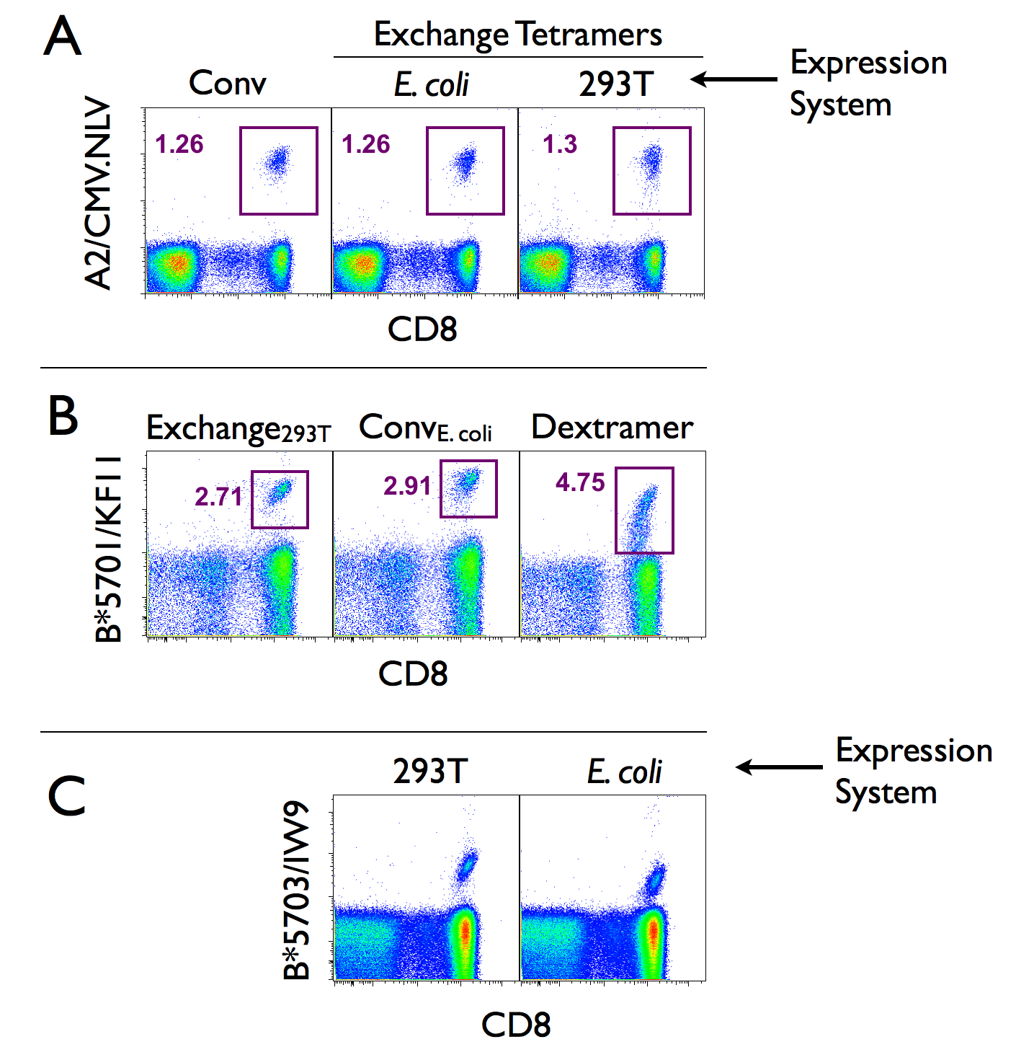
Exchange-competent class I proteins made in 293T cells

Slide 5
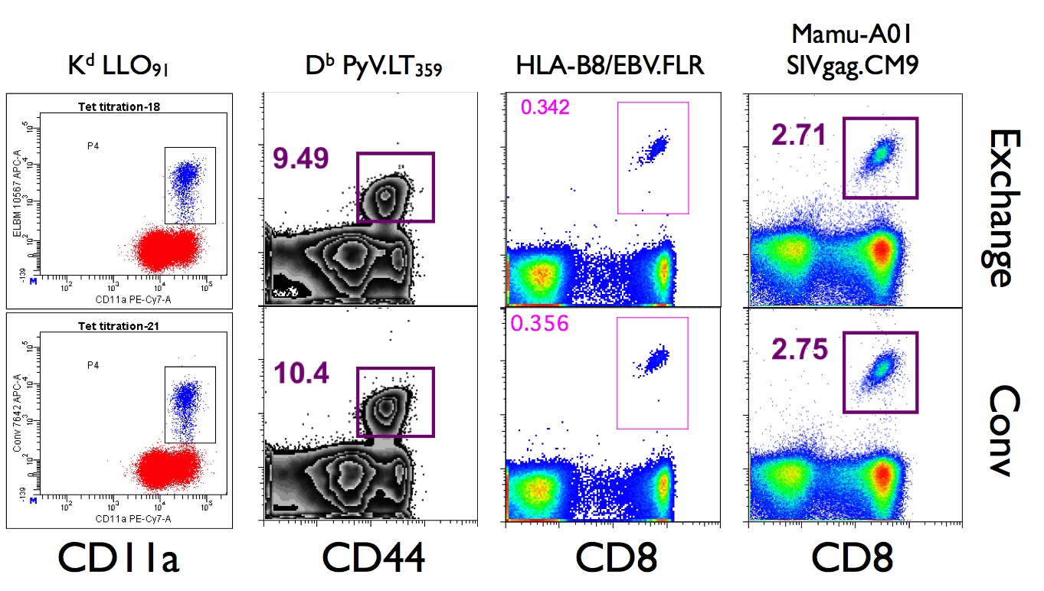
Exchange-competent Class I MHC tetramers for multiple alleles

Slide 6
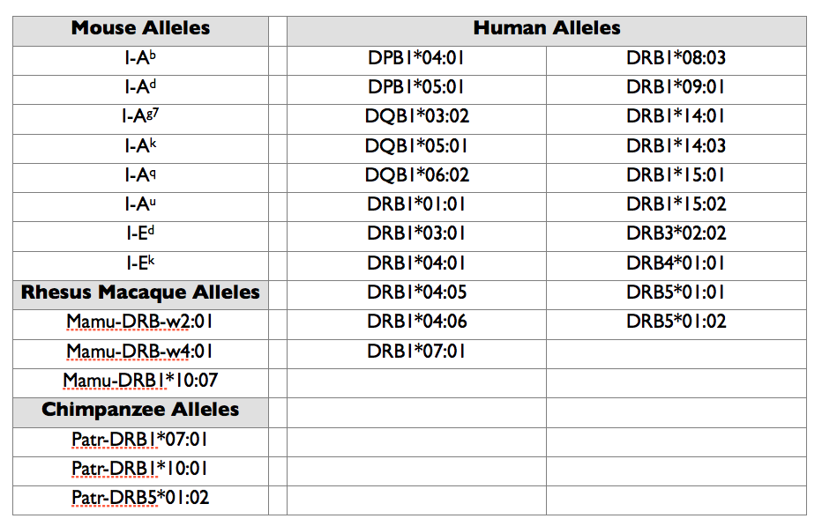
Class II allele table

Slide 7
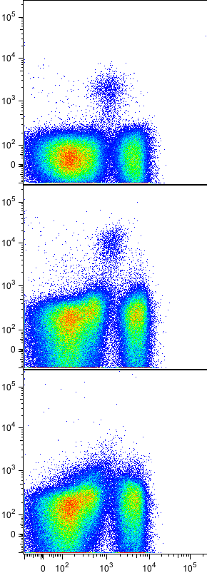
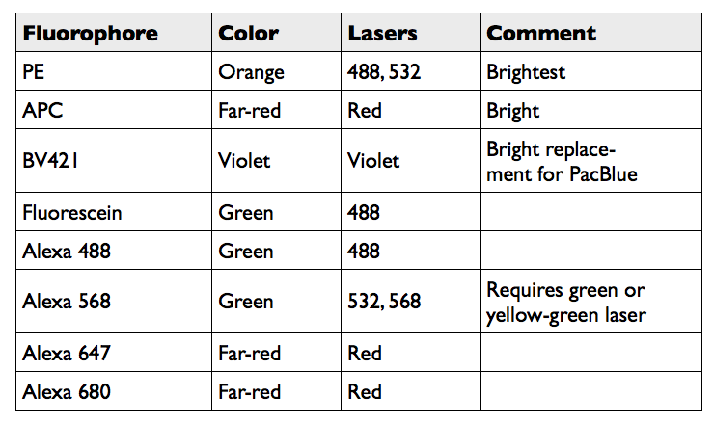
Brilliant Violet 421 – A Bright New Fluorophore for Tetramers
PE
Summary of Fluorophores Used for Tetramers
BV421
mCD1d PBS57 tetramer as shown
Pacific
Blue
CD3 FITC

Slide 8
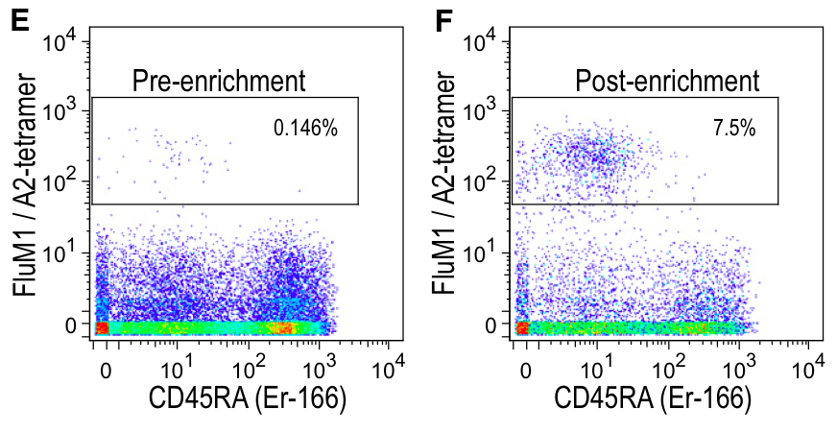
Tetramers for CyTOF
Cys_{(1 or 6)}
Cys_{(1 or 6)}
Cys_{(1 or 6)}
Cys_{(1 or 6)}
Newell et al. Immunity. 36, 142-52 2012 PMID: 22265676

Slide 9
Acknowledgments
John Altman
Rick Willis
John Shires
Vasanthi Govindu
Chris Ibegbu

