Slide 1
Intracellular Cytokine Staining (ICS) Flow Cytometry Assay
Kent J. Weinhold, Duke CFAR Director
November 6th, 2013
CFAR Director’s Meeting
Flow Cytometry Workshop

Slide 2
ICS Assay Overview
1.
2.
3.
4.
5.
6.
7.
Thaw
Stimulate
Surface
Stain
Lyse/Fix
Perm
IC Stain
Acquisition
Analysis
Brefeldin
Monensin
TNFα Alexa700
Rest
6 hrs
6 h
CD107
Wash
Wash
Wash
Wash
cytokine
lymphocyte
erythrocyte
IFN-γ PE-Cy7

Slide 3
Keys to success
Panel design (McLaughlin et. al. Cytometry 73A:400-10, 2008)
Goal – appropriately classify events as positive or negative
Minimize spillover/spreading error
Bright fluorophores conjugated to dim markers
Careful use of tandem dyes
Intracellular stain: CD3, CD8, and CD4
Requires mAb’s made against fixed antigens
Kinetics of functional markers must overlap
Use appropriate protein transport inhibitor
CD4 responses require antigen processing
Reagent Qualification
Titer all reagents using specific measures of performance (Murdoch et. al. Cytometry 81A:281-3, 2012)
Signal-to-noise (SN): positive median/negative median)
Staining index (SI): positive median/negative standard deviation
Negative median
Negative CV
Measure spillover
Bridge reagent lots – especially tandem dyes
Instrument Qualification
Optimize PMT voltages for each type of assay (Perfetto et. a. Nat Pro 1:1522-30, 2006)
Appropriate use of controls
Unstimulated cells – negative control for stimulation
Endogenous responses may be present
FMO’s – negative control for fluorescence
Number of events acquired
Minimum of 120,000 viable CD3+ lymphocytes (Jaimes et. al. JIM 363:143-57, 2011)
Analysis
Up to 50% of assay variability (Maecker et. al. BMC Immunology 6:13, 2005 and McNeil, et. al. Cytometry 83A:728-38, 2013)
Reproducibility dependent upon Operator expertise
Operator training highly recommended

Slide 4
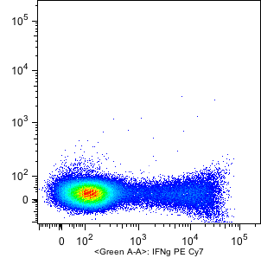
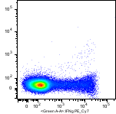
Bridging Study Shows Degradation of Tandem Dye
IFNg PE-Cy7 SS
0.144µg/mL
IFNg PE-Cy7 SS
0.15µg/mL
PE-Cy7 breaking
down into PE & Cy7
Testing Date: 17Feb10
Lot #: 44563
Expiration Date: 31Mar11
Testing Date: 06May11
Lot #: 02587
Expiration Date: 31Oct12
Green E (PE)
Green E (PE)
Green A: IFNg PE-Cy7
Green A: IFNg PE-Cy7

Slide 5
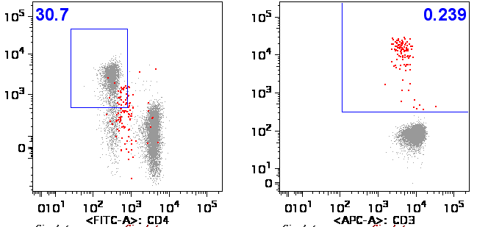
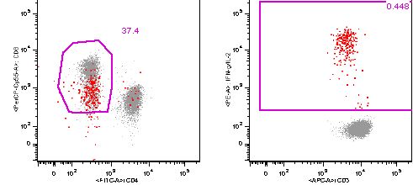
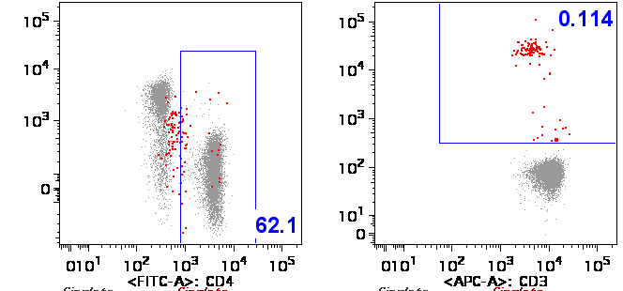
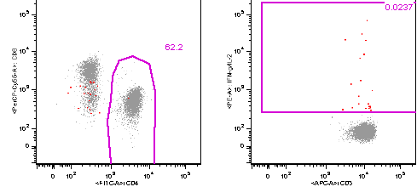
Compensation errors create false positive CD4 CEF response
SA
EOLm
30.8
37.4
0.448
CD8
IL-2+IFNg
CD8
IL-2+IFNg
0.0237
61.9
62.2
CD4
CD3
CD4
CD3
Compensation error &
false positive CD4 CEF response
Compensation corrected &
No false positive CD4 CEF response

Slide 6
Excluding dim CD8+ cells significantly reduces CD8 response to CEF
EOLm
SA
CD8
CD4
SA: Site Analysis; EOLm: Centralized Manual reanalysis

Slide 7
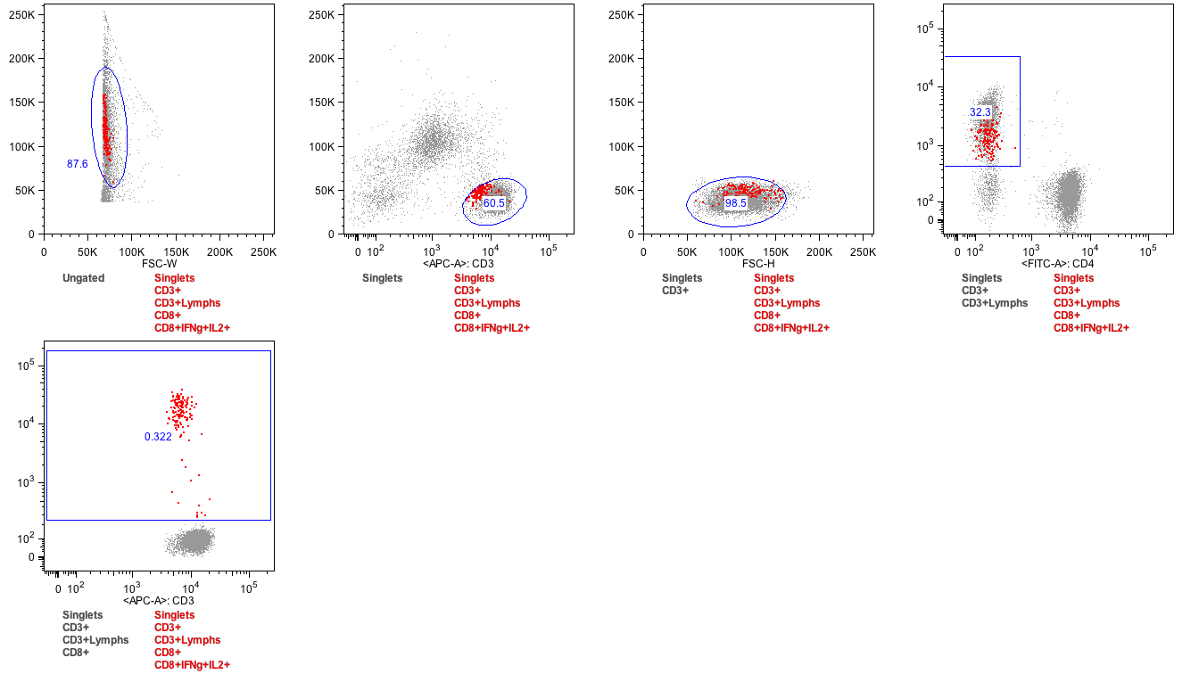
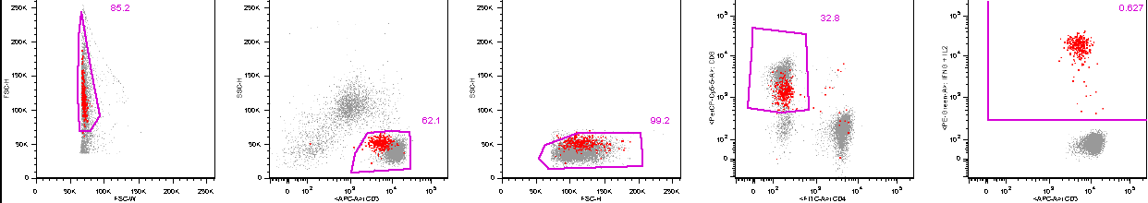
CD3 vs. cytokine in final plot can help visualize missing CD3 dim+
SA
EOLm
SA: Site Analysis; EOLm: Centralized Manual reanalysis

Slide 8
Duke CFAR approaches to improve assay performance
Training
Wet workshops
One-on-one intensive week-long training course offered by Duke CFAR
Collaboration between Duke CFAR Immunology & Biostatistics and Bioinformatics Cores
FlowPET
Automated analysis

Slide 9
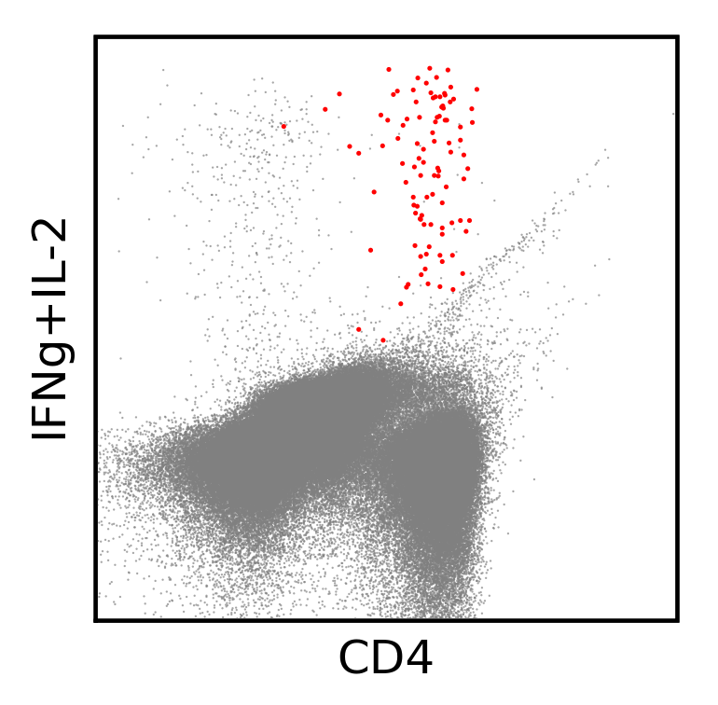
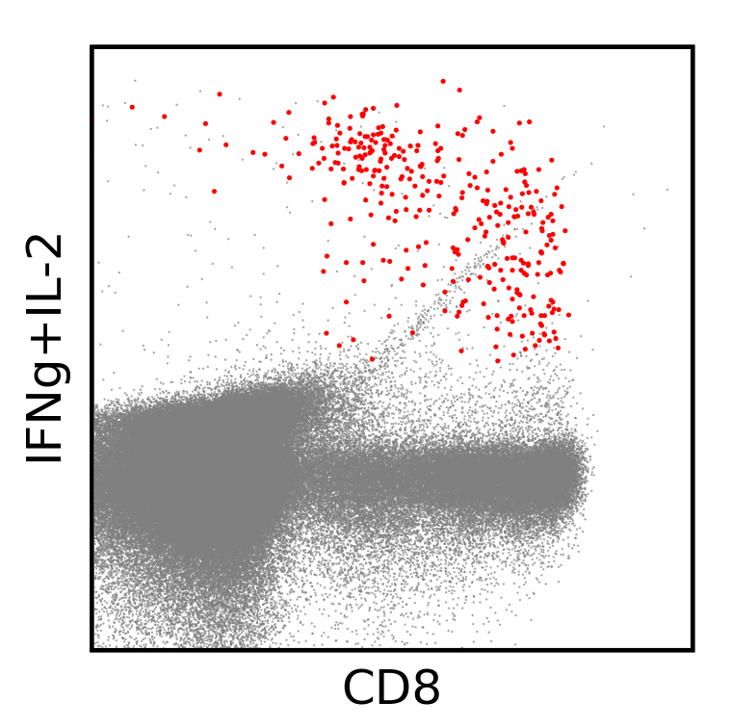

Automated gating tools can improve signal
Expert Gating
Manual
Cluster Gating
Automated
0.18%
0.21%
IFN-γ + IL-2 PE
CD4 FITC
1.65%
1.9%
CD8 PerCP-Cy5.5
Duke University Medical Center
Notes:
The automated procedure seems to be at least as sensitive as manual gating for detecting cytokine positive cells for both CD3+CD4+ and CD3+CD8+ lymphocytes.
9

Slide 10

Acknowledgements
Duke CFAR Immunology Core – Flow Cytometry
Kent Weinold, Duke CFAR Director
Jennifer Enzor
Twan Weaver
Jianling Shi
EQAPOL
Tom Denny
Duke CFAR Biostatistics and Bioinformatics Core
Cliburn Chan, Duke CFAR Core Director
Scott White

