Slide 1


Peripheral T follicular Helper Cells (pTfh)
- A biomarker for vaccine induced responses?
Suresh Pallikkuth & Savita Pahwa
University of Miami

Slide 2
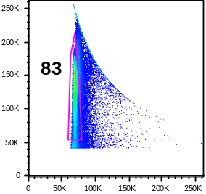
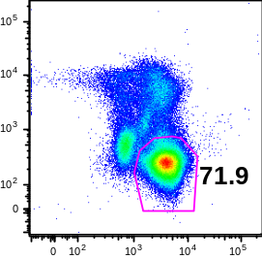
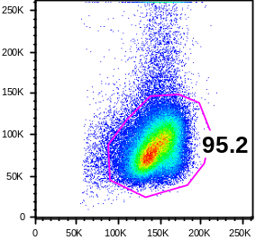
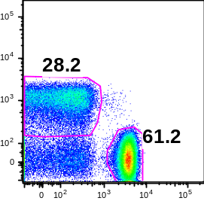
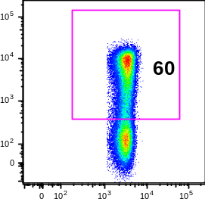
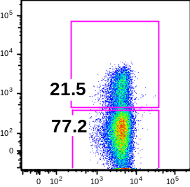
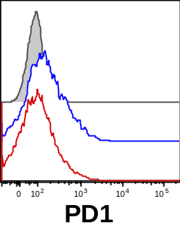
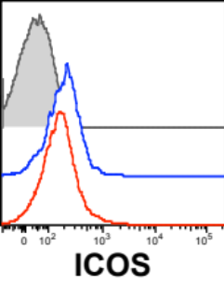
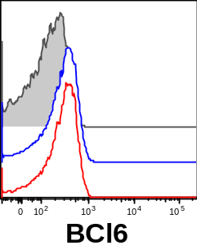
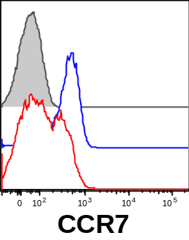
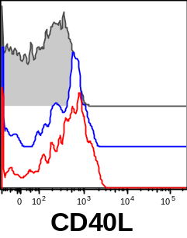
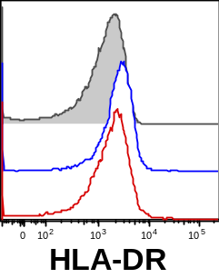
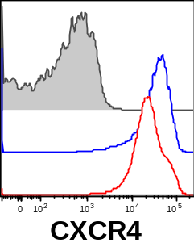
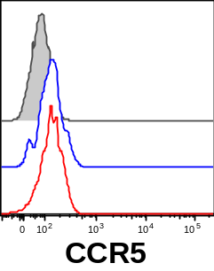
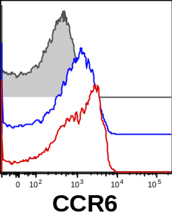
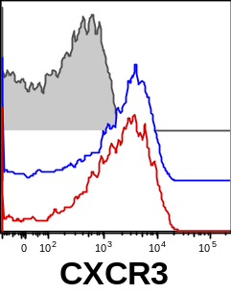
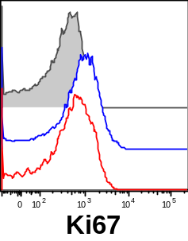
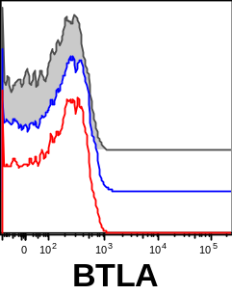
Gating strategy for pTfh cells
Singlets
Exclusion-CD3+
Scatter
CD4 and CD8 T cells
Memory CD4
pTfh
FSC-H
Exclusion
SSC-A
CD8
CD45RO
CXCR5
Non-pTfh
FSC-W
CD3
FSC-A
CD4
CD4
CD4
pTfh cells show higher expression of PD1, ICOS, CCR7, HLA-DR and Ki67 than non-pTfh cells
Isotype
23.3 (141)
22.8 (280)
77.2 (420)
2.1 (122)
2.1 (2368)
pTfh
2.2 (338)
Non-pTfh
11.1 (86)
15.6 (180)
1.8 (304)
58.8 (102)
1.8 (106)
1.7 (1451)
93 (29252)
3.9 (286)
23.3 (701)
20.9 (130)
14,2 (560)
0.63 (51)
81.7 (21727)
2.8 (162)
32.1(7851)
28.3 (320)
8.6 (290)
0.32 (33)
Notes:
Clone of CCR5? Titered mAb? Ctrl for CCR5 expression?
Cryopreserved PBMC obtained at day 28 post-influenza vaccination from a healthy donor were thawed, rested overnight and cultured at 1x10⁶ cells/ml for 12 hrs at 37°C in the presence of 5 µg/ml H1N1 vaccine Ag in the presence of 10µg/ml Brefeldin A. After incubation, cells were stained with markers specific for Tfh cells along with intracellular staining for cytokines IL-21, IL-2, IFNg and TNFa. Flow cytometric dot plots showing the gating strategy and expression of intracellular cytokines in pTfh and non-pTfh cells CD3+CD4+CD45RO+ memory CD4 T cells were gated from live (ViViD-) CD3+ cells. pTfh (CXCR5+) and non-pTfh (CXCR5-) were identified in the memory cells and analyzed for the intracellular expression of IL-21, IL-2, TNFa and IFNg.

Slide 3
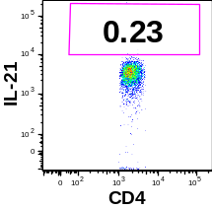
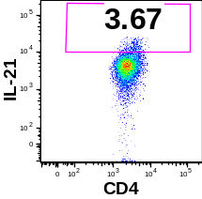
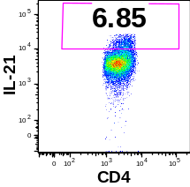
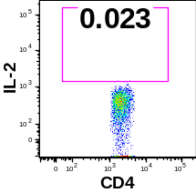
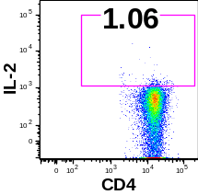
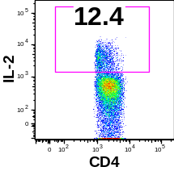
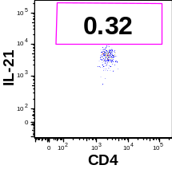
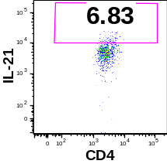
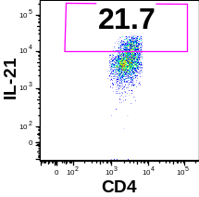
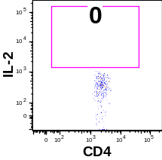
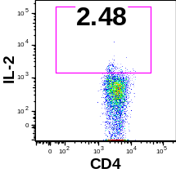
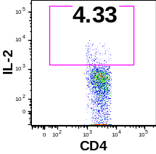
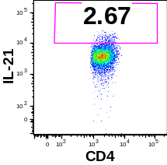
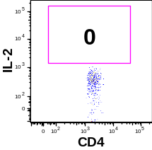
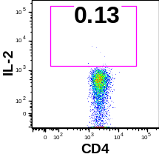
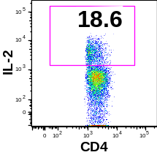
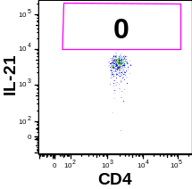

pTfh function by ICC: intracellular IL-21 and IL-2 production by pTfh cells after 12 hrs of stimulation
Intracellular IL-21 by total CD4 T cells and pTfh cells
Intracellular IL-2 by total CD4 T cells and pTfh cells
Medium
H1N1
SEB
Medium
H1N1
SEB
Total CD4
Total CD4
pTfh cells
pTfh cells
Non-pTfh cells
Non-pTfh cells
Notes:
Cryopreserved PBMC obtained 4 weeks after H1N1/09 vaccination were thawed and rested overnight and stimulated with H1N1 antigen (5 µg/ml), SEB (positive control) and medium (negative control) for 12hr. After incubation cells were surface stained for pTfh markers, fixed, permeabilized and stained intracellularly for cytokines and analyzed by flow cytometry. Total CD4, pTfh (ViViD-CD3⁺CD4⁺CD45RO⁺CXCR5⁺) and non-pTfh (ViViD-CD3⁺CD4⁺CD45RO⁺CXCR5⁻) cells were Gating strategy for the identification of pTfh cells. Intracellular expression of IL-21 and IL-2 in total CD4 T cells, pTfh and non-pTfh cells

Slide 4
Literature review: delineation of pTfh
Markers used for pTfh identification | Reference
pTfh: CD3⁺CD4⁺CD45RA^{neg} CXCR5⁺ Subsets within pTfh: Th1: CXCR3⁺CCR6^{neg}CCR4^{neg} Th2: CXCR3^{neg}CCR4⁺CCR6^{neg} Th17: CXCR3^{neg}CCR6⁺CCR4^{neg} | Morita et al, Immunity 2011
pTfh: CD3⁺CD4⁺CD4⁺CXCR5⁺ and CD3⁺CD4⁺CD45RA^{neg}CXCR5⁺ | Pallikkuth et al, Blood 2012
pTfh: CD3⁺CD4⁺CD45RA^{neg}CXCR5⁺ Subsets within pTfh: Th1: CXCR3⁺CCR6^{neg} Th2: CXCR3^{neg}CCR6^{neg} Th17: CXCR3^{neg}CCR6⁺ | Bentebibel et al. Science translational Med 2013
pTfh: CD3⁺CD4⁺CD45RA^{neg}PD1⁺CXCR3^{neg} | Locci et al., Immunity 2013
pTfh: CD3⁺CD4⁺CD45RA^{neg}CCR7^{lo}PD1^{hi} | He et al, Immunity 2013

Slide 5
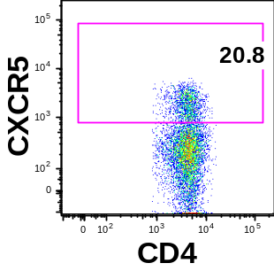
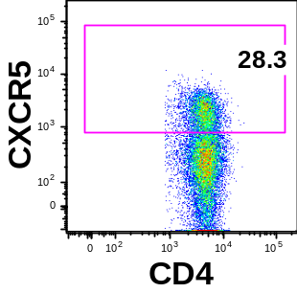
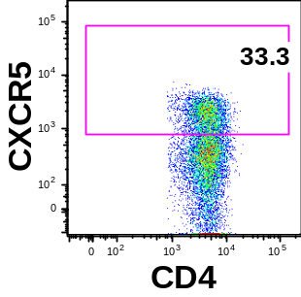
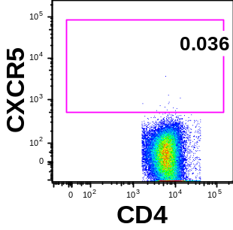
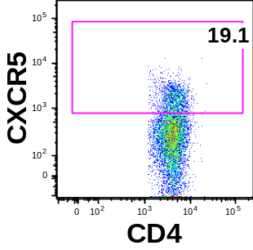
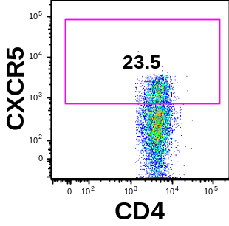
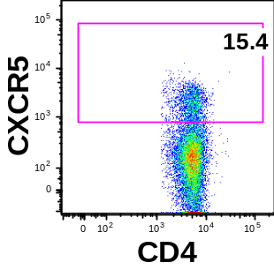
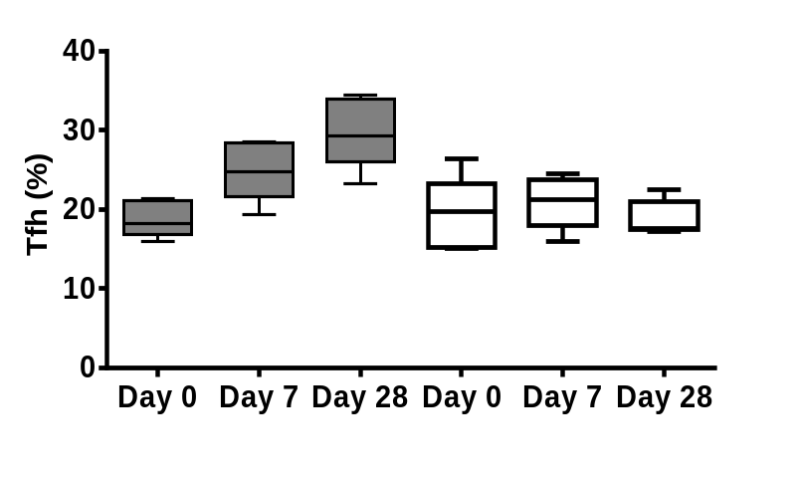
pTfh cells can be used to monitor the immune response against vaccination: expansion of pTfh post-vaccination occurs in vaccine responders
Day 0
Day 7
Day 28
Isotype
Vaccine responder
CD4+CD45RO+
CD4+CD45RO+
CD4+CD45RO+
Vaccine non-responder
CD4+CD45RO+
CD4+CD45RO+
CD4+CD45RO+
P=0.001
Vaccine responder
P=0.013
Vaccine non-responder

Slide 6
Signature Immunological Changes in pTfh and B cells in Vaccine Responders (VR) following H1N1/09 Influenza Vaccine, at T1 (7d), T2 (4 wk)
pTfh cell changes in VR (not seen in Non- pTfh or VNR)
Expansion of pTfh at T1, T2
Ag-stimulated IL-21 production in pTfh (ICC)
“Help” to autologous B cells for Ag-specific IgG production and B cell differentiation in purified pTh plus B cell co-cultures at T2
B cell changes in VR (deficient in VNR)
Increase in plasmablasts at T1
Spontaneous H1N1 influenza Ab secreting cells (ASC) at T1
Increase in total memory B cells and switch memory at T2
Upregulation of IL-21R on total B and memory B cells at T2
Increase in plasma cells at T2
Increase in TACI expression on total B memory B cells at T2
Downregulation of BAFF-R expression on total B and memory B cells at T2
PBMC / plasma findings in VR (deficient in VNR)
Production of IL-21 and CXCL13 in Ag stimulated culture supernatants with increases in plasma IL-21
Increase in plasma BAFF and APRIL levels
Pallikkuth et al, J Immunol 2011, JACI 2011, Blood 2012

