Slide 1
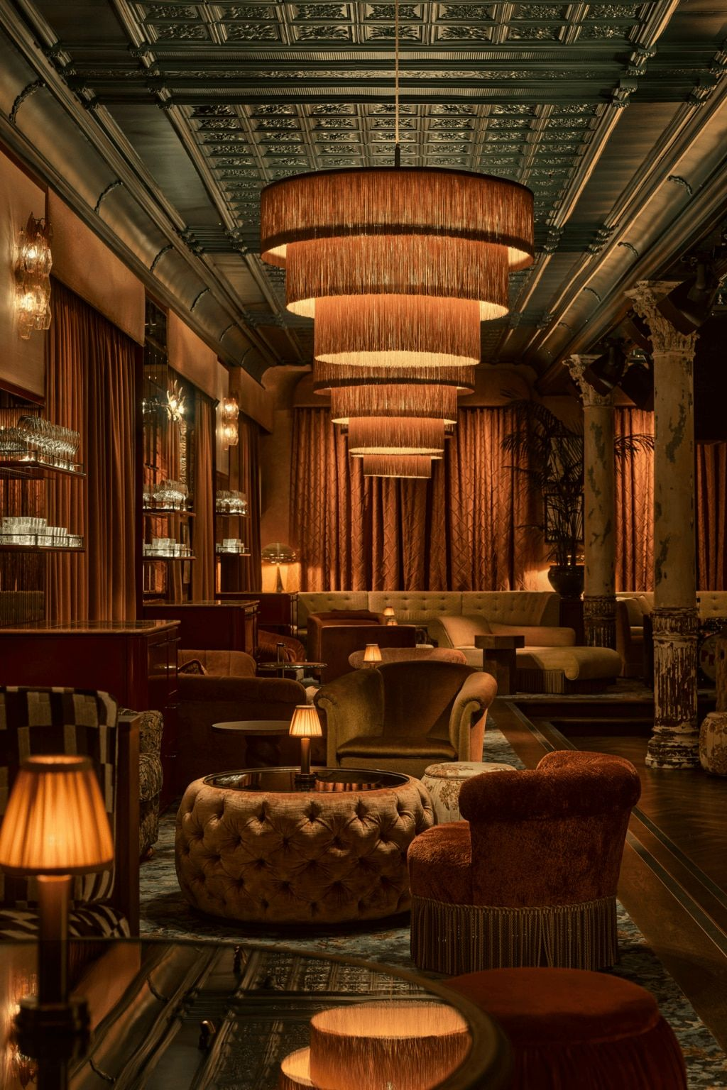
P R I V A T E M E M B E R S G A M I N G & C O C K T A I L S A L O N
1963
C L U B
The Room Beneath The Room
E L C O R T E Z · L A S V E G A S
1963 CLUB · EL CORTEZ · LAS VEGAS

Slide 2
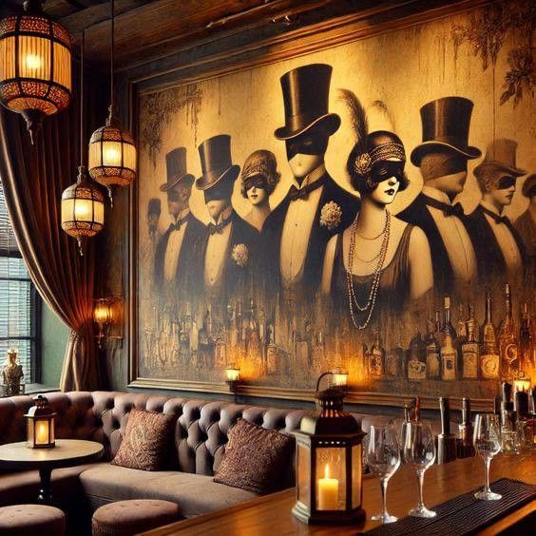
T H E S T O R Y
1963. Before Vegas
Went Corporate.
There was a time when deals were made at small tables. When the bar mattered more than the DJ. When the room was thick with smoke and nobody took photos.
1963 Club is a return to that era.
Inspired by the golden age of Las Vegas and the intimacy of the world's great private clubs, it exists for those who prefer velvet over volume and presence over performance.
1963 CLUB · EL CORTEZ · LAS VEGAS

Slide 3
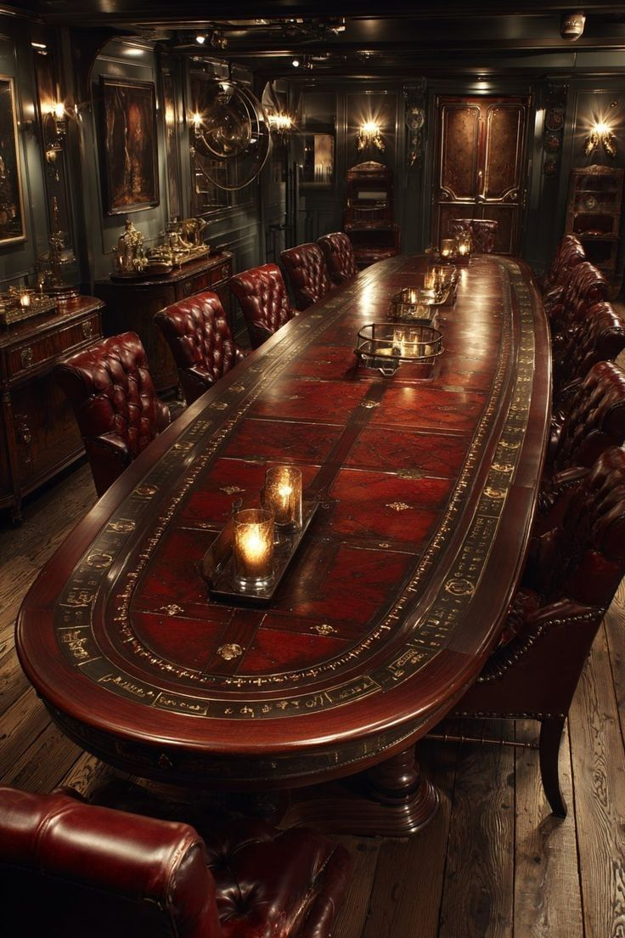
T H E D I N N E R
It Begins Upstairs.
Before the room below, there is the table above. A steakhouse in the El Cortez tradition — prime cuts, candlelight, unhurried service. The kind of dinner where the check is never mentioned and the wine keeps arriving.
The steakhouse is led by Chef David Robbins — Hawaiian-born, globally trained, with a palate shaped by years across Peru, Polynesia, and the great steakhouse traditions of the American West.
The dinner is the invitation. The descent is the reward.
1963 CLUB · EL CORTEZ · LAS VEGAS

Slide 4
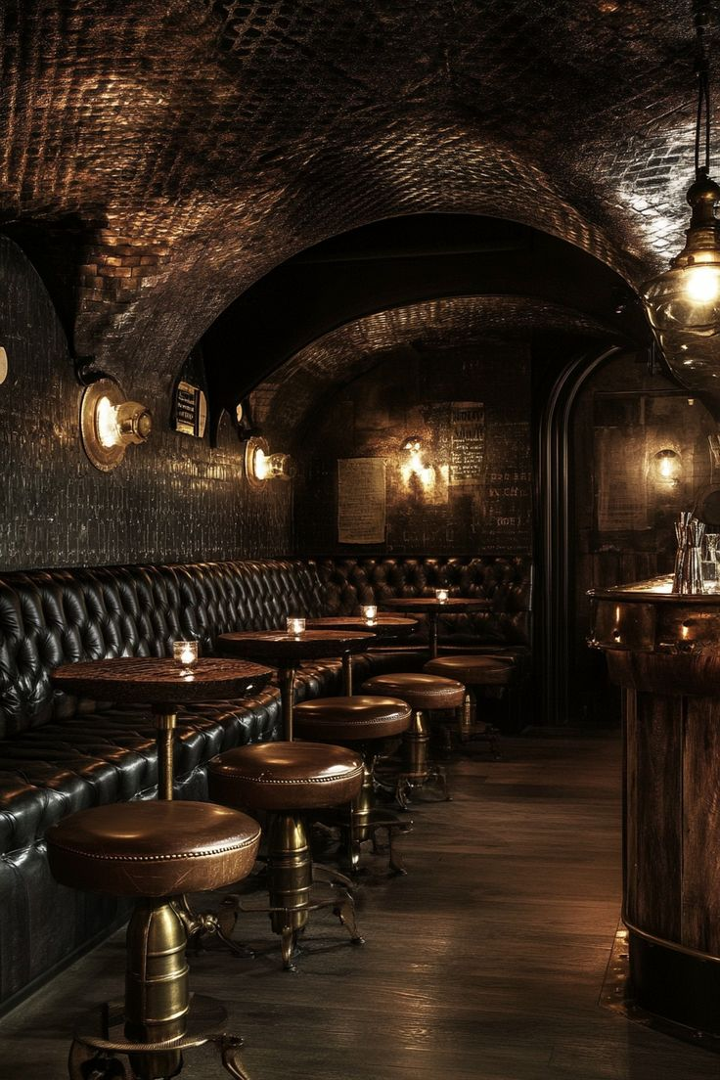
T H E A R R I V A L
The Descent
Dinner upstairs.
A final pour of wine.
Then the question: "Shall we go downstairs?"
A private staircase leads to a low-lit foyer.
Membership verified.
A solid door opens.
The room reveals itself in layers —
never all at once.
1963 CLUB · EL CORTEZ · LAS VEGAS

Slide 5
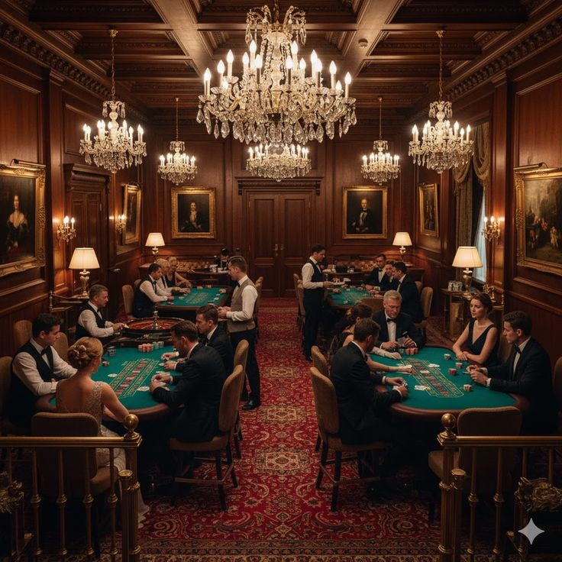
T H E R O O M
Designed for Spending
Time — and Money.
4,000 square feet of layered intimacy.
The Bar
The Baccarat Salon
An oval bar wrapped in leather and brass. Backlit shelves of rare Scotch, bourbon, and vintage wine. Tableside martini service.
A statement table at the center of the room. A private high-limit salon just beyond. Reservations accepted.
The Pool Room
Passed Apps
One tournament-grade table. Deep leather seating. Cigars permitted. The kind of game that lasts all night.
Chef Robbins' kitchen sends down wagyu sliders, chilled shellfish, steak tartare, truffle fries. Nothing plated, everything passed.
The Humidor
Climate-controlled. Curated global selection. Member lockers available. A place to sit, smoke, and say nothing for a while.
No dance floor. No DJ. No velvet rope.
1963 CLUB · EL CORTEZ · LAS VEGAS

Slide 6
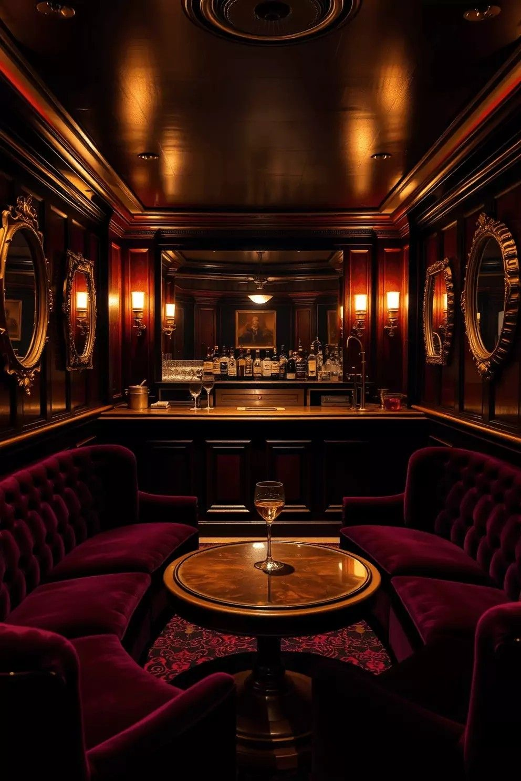
T H E P O U R
The Cellar & The Cabinet
The program is classic, not clever.
Scotch & Whisky
Macallan 25, Dalmore Cigar Malt, closed-distillery bottlings. Poured two fingers at a time.
Bourbon
Pappy Van Winkle, George T. Stagg, allocated pours. Ask the bartender what just arrived.
Wine
First-growth Bordeaux. Elite Napa Cabernets. Burgundy by the bottle. Large-format magnums.
Cocktails
Martini. Manhattan. Negroni. Vesper. Old Fashioned. Five drinks, executed precisely.
The bartender remembers your drink. The second one arrives without asking.
1963 CLUB · EL CORTEZ · LAS VEGAS

Slide 7
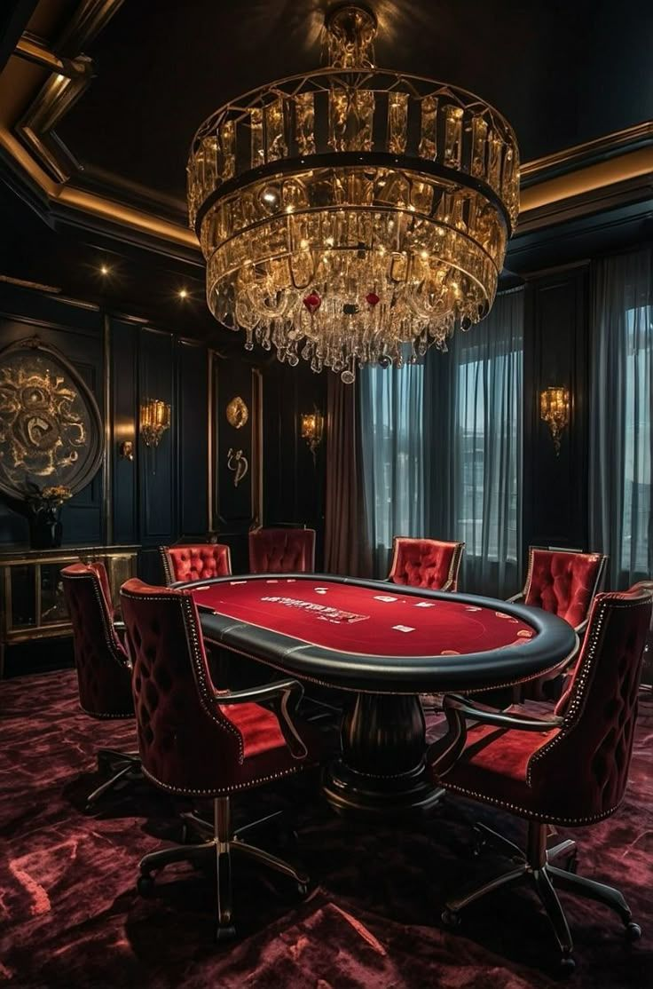
T H E T A B L E
Gaming, Without the Floor.
1963 Club is not a public casino. It is a private gaming salon designed for discretion and elevated play.
Baccarat anchors the room.
Private reservations available. No crowds. No chaos. Just felt, chips, and silence when it matters.
1963 CLUB · EL CORTEZ · LAS VEGAS

Slide 8
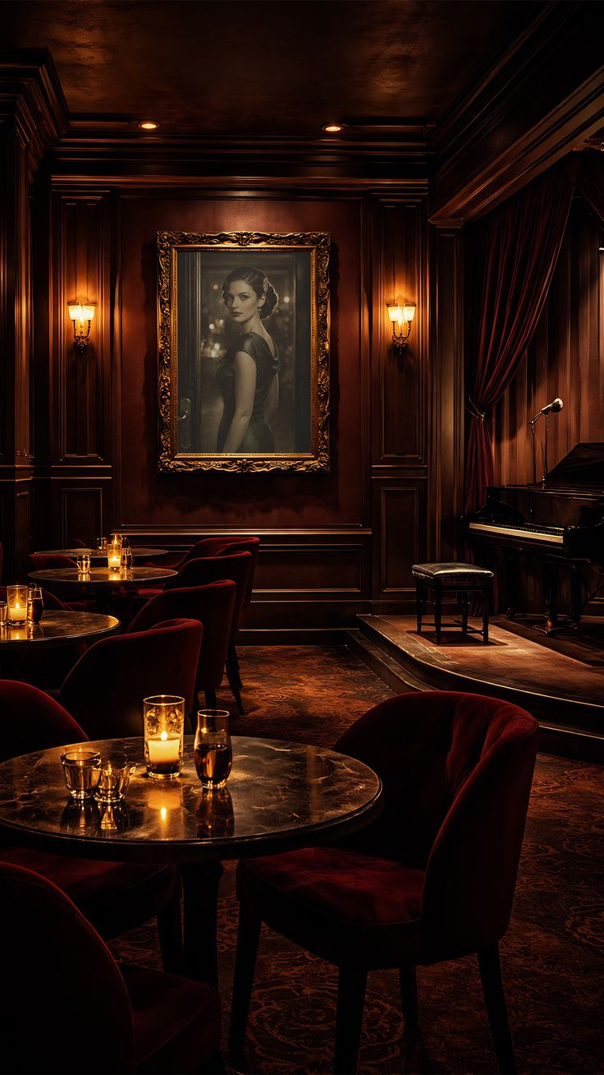
T H E C O D E
Membership Is Not Purchased.
It Is Considered.
1963 Club operates under a simple code:
Discretion.
Respect.
No photography.
Dress expectations enforced.
Referral required.
Members may host guests.
The room exists for those who understand it.
1963 CLUB · EL CORTEZ · LAS VEGAS

Slide 9
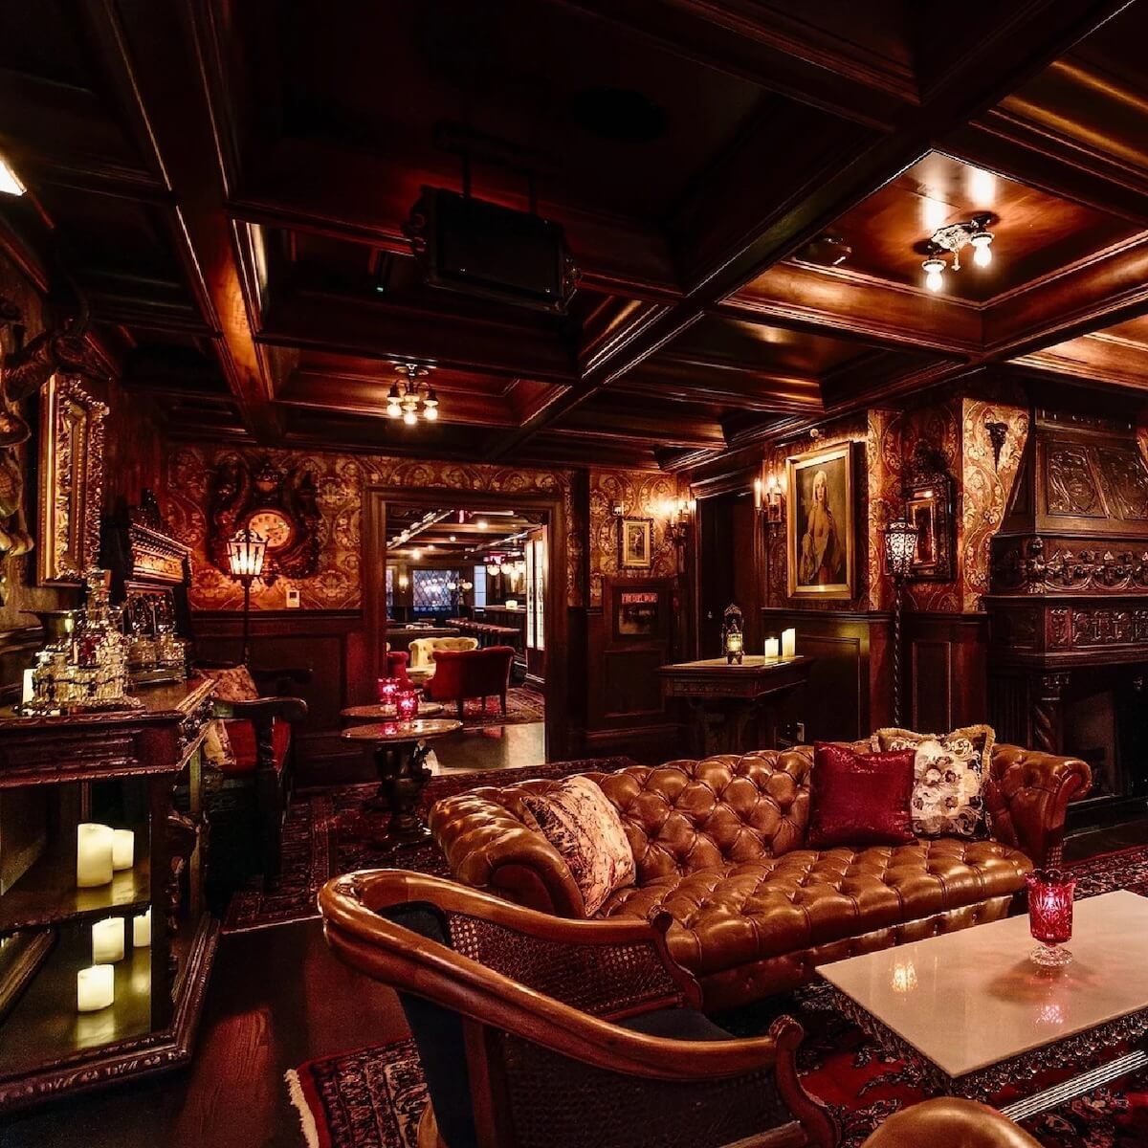
The Room Beneath
The Room.
P R I V A T E M E M B E R S S A L O N
L A S V E G A S
Presented by Corner Bar Management
cornerbarmgmt.com
1963 CLUB · EL CORTEZ · LAS VEGAS

