Slide 1
MANET Routing in ns-3: AODV vs OLSR vs DSDV
Midterm presentation – Data Communications, Project 3
Member | Part | Presents
Lupu Gabriel-Irinel | simulation (C++) | scenario, pipeline, fairness
Filimon Alexandra-Elena | instrumentation, batch | logs, progress, demo
Ermilios Ilias-Alexandros | analysis, report | KPIs, results
Academic year 2026–2027
Project 3 – MANET routing in ns-3
1 / 13

Slide 2
Objective and scenario
Goal: compare reactive (AODV), proactive link-state (OLSR) and proactive distance-vector (DSDV) routing on identical topology and traffic, under varying density and mobility.
Parameter | Value
Area | 500 m × 500 m (fixed)
Radio | 100 m range (RangePropagationLossModel)
PHY / MAC | 802.11g, fixed 6 Mbps, ad-hoc
Traffic | 10 CBR/UDP flows, 128 B, 2 pkt/s
Offered load | 20 pkt/s = 20.48 kbps
Mobility | RandomWaypoint, pause 2 s
Duration | 200 s simulated, 20 s warm-up
Density = neighbours per node
k = n·π·r² / A
Nodes | 25 | 50 | 100
k | 3.1 | 6.3 | 12.6
Speeds: 0, 1, 10 m/s (at 50 nodes)
Project 3 – MANET routing in ns-3
2 / 13

Slide 3
Pipeline: one command from simulation to plots
run_midterm.sh: link → build → run → analyse
manet-compare.cc
ns-3.48 scenario
protocol, nodes,
speed, seed
Per-packet CSV
_tx _rx _ctrl
_flows _summary
FlowMonitor
analyze_midterm.py
warm-up filter
KPIs per run
mean over seeds
Outputs
pdr.png
delay.png
control_time.png
NS3_DIR=~/project_dc/ns-3-dev ./run_midterm.sh options: SEEDS, NODES, SPEED
Every plot is produced by a script from the raw logs – nothing is typed by hand.
Project 3 – MANET routing in ns-3
3 / 13

Slide 4
Fair comparison: same topology, same traffic
Problem with OnOffApplication
Stops generating packets while the source has no route.
Offered load depended on the protocol: OLSR 3431 vs AODV/DSDV 3954 packets.
Our fix: custom CbrSend
One packet every 0.5 s, whatever the routing state.
No route at the source ⇒ packet lost, counted in src_drops.
Same offered load for every protocol.
Fixed random-number streams
Random variable | Stream
Wi-Fi (backoff, …) | 100000
Initial positions | 200000
Mobility | 300000
Source/sink pairs | 400000
Flow start times | 400001
RngSeed 12345, RngRun = seed index.
Verified: diff of _flows.csv is empty for all three protocols.
Project 3 – MANET routing in ns-3
4 / 13

Slide 5
Instrumentation and sanity checks
Data packets
SeqTsSizeHeader: sequence number + send time in every packet.
Delay = t_{rx} − t_{tx} on one clock (simulated time).
One CSV line per packet sent and received.
Routing control packets
IPv4 Tx trace on every node.
Classified by UDP port: AODV 654, OLSR 698, DSDV 269.
Originated and forwarded ⇒ real channel load.
Same method for all three protocols.
Sanity checks (seed 1)
Test | Result
2 nodes, 1 flow, 30 s | 56/56 delivered, ≈ 2 ms
Control ports | only the port of the selected protocol
Flow tables | identical for all three protocols
rx ≤ tx per flow | always
Offered after warm-up | 10 × 2 × 179 s = 3580 ✓
Project 3 – MANET routing in ns-3
5 / 13

Slide 6
KPI definitions and measurement rules
KPI | Definition
PDR (%) | data packets received / data packets offered by the sources
Delay (ms) | t_{rx} − t_{tx} from the packet header; mean, p50, p95
Jitter (ms) | mean |d_{i} − d_{i−1}| over consecutive received packets of a flow, averaged over flows
Normalized routing load | routing control packets transmitted (all nodes) / data packets delivered
Hop count | planned: from IP TTL at reception, after the warm-up
Rules
Warm-up 20 s, filtered by send time – applied identically to all protocols.
Packets dropped at the source (no route) count as lost.
Every result is reported with offered load, duration and number of samples.
Final matrix: mean ± 95 % CI over 5 seeds (Student t, t = 2.776 for 4 degrees of freedom).
Project 3 – MANET routing in ns-3
6 / 13

Slide 7
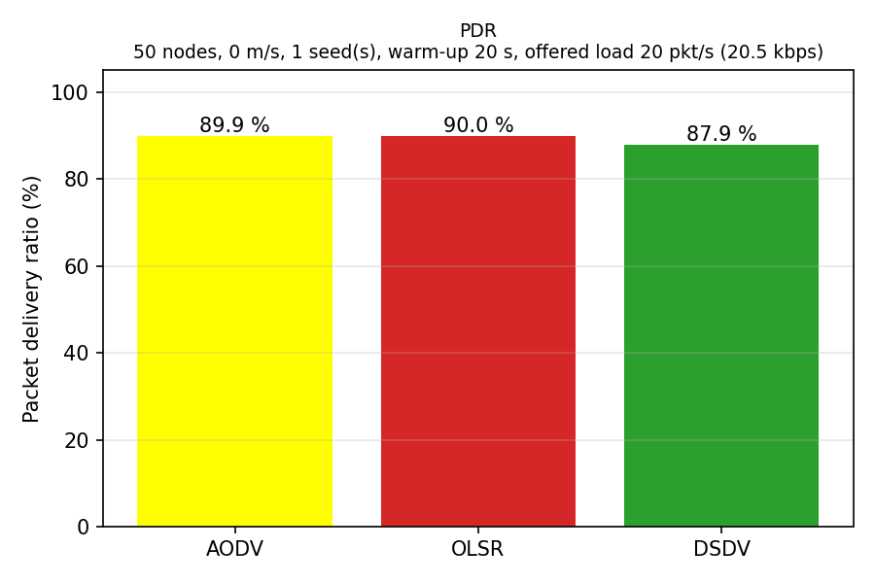
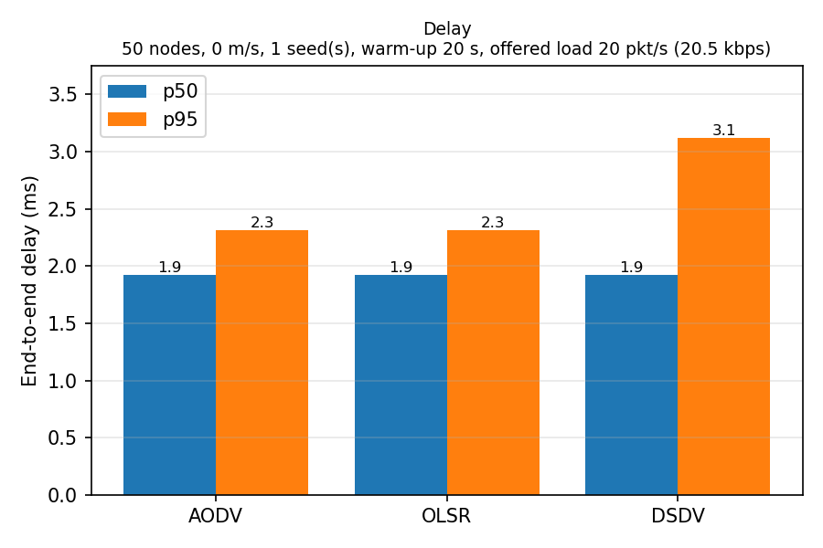
Baseline: 50 nodes, static, seed 1
 | Sent | Recv. | PDR % | p50 ms | p95 ms | Jitter ms | NRL
AODV | 3580 | 3217 | 89.9 | 1.92 | 2.32 | 0.51 | 4.14
OLSR | 3580 | 3222 | 90.0 | 1.92 | 2.32 | 0.10 | 2.30
DSDV | 3580 | 3148 | 87.9 | 1.92 | 3.12 | 8.46 | 6.34
Offered load 20 pkt/s (20.48 kbps) · 180 s measured after 20 s warm-up · 1 seed (no CI yet)
Project 3 – MANET routing in ns-3
7 / 13

Slide 8
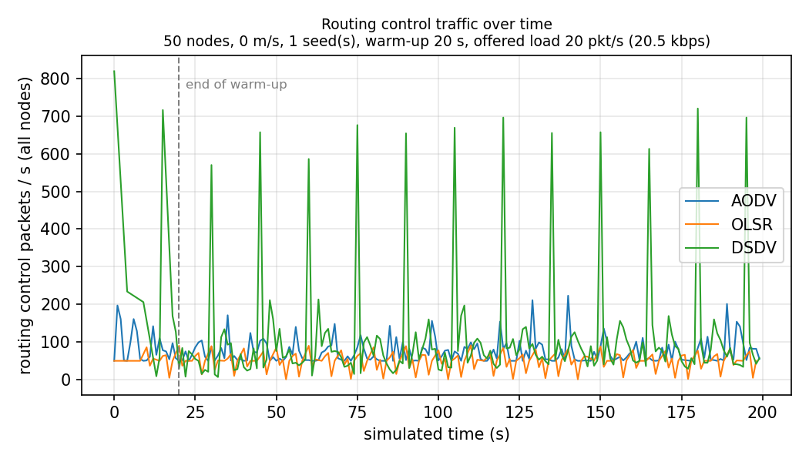
Routing control overhead
Whole run (0–200 s), IP level:
 | pkt/s | kbps | B/pkt | NRL
AODV | 75.6 | 29.6 | 49 | 4.25
OLSR | 40.4 | 46.9 | 145 | 2.36
DSDV | 111.4 | 61.5 | 69 | 6.75
Control > data (24.96 kbps at IP level): 1.2× / 1.9× / 2.5×.
OLSR: fewest packets, but the largest ⇒ NRL in bytes tells a different story.
DSDV: peaks every ≈ 15 s (full-table dumps).
Project 3 – MANET routing in ns-3
8 / 13

Slide 9
Why the results look like this
PDR ≈ 90 % for all three: flow 2 (node 23 → node 1) delivers nothing – node 1 is isolated (partition). Without flow 2: AODV 99.9 %, OLSR 96.4 %, DSDV 92.8 %. Partitions are reported; seeds are never discarded.
DSDV converges slowly: 181 losses in 0–20 s, 57 in 20–40 s, 10 in 40–60 s ⇒ losses continue after the warm-up; highest p95 and jitter.
OLSR loses only in 0–20 s, then has stable routes and the lowest jitter (0.10 ms).
Source drops only for OLSR (524): AODV/DSDV show 0 – likely they buffer packets while no route exists. Hypothesis, to be verified per flow.
One seed: AODV vs OLSR PDR differs by 0.1 pp – not significant. Conclusions need 5 seeds + CI.
Project 3 – MANET routing in ns-3
9 / 13

Slide 10
Progress against the roadmap
Phase | Status
P0 Foundations | Done
P1 Scenario script | Done
P2 Baseline | Done
P3 Core matrix | Planned (week 8)
P4 Analysis/report | Planned
Run time: estimate vs measured
 | Estimated | Measured
50 nodes | 3 min | 5–6 s
100 nodes | 15 min | ≈ 33 s
Matrix (serial) | 375 min | ≈ 20 min
Changes
CbrSend instead of OnOff
Hop count from TTL (not FlowMonitor)
Partition classification from positions
Warm-up check: 20 s vs 40 s
Cut: nothing – 75 runs, 5 seeds, all KPIs, extensions B and C kept.
Project 3 – MANET routing in ns-3
10 / 13

Slide 11
Plan to the final
Week | Work item | Owner
8 | Parallel resumable batch script; launch of the 75-run matrix | Filimon
8 | Hop count from TTL; position log | Lupu
8–9 | Warm-up sensitivity (20 s vs 40 s) on 5 seeds | Ermilios
9–10 | Matrix analysis with 95 % CI; partition classification; one-command reproduction | Ermilios, Filimon
10 | Extension B: energy per delivered packet (WifiRadioEnergyModel) | Lupu
11–12 | Extension C: bursty traffic (10 Hz for 3 s every 30 s) | Ermilios
13–14 | Report, final presentation and live demo | all
Project 3 – MANET routing in ns-3
11 / 13

Slide 12
Live demo
Clone and run the baseline with one command:
git clone https://github.com/whitezxx/project_3_manet-ns3_unstpb_etti.git
cd project_3_manet-ns3_unstpb_etti
NS3_DIR=~/project_dc/ns-3-dev ./run_midterm.sh
Inspect a raw log: head results/midterm/aodv_n50_s0_r1_rx.csv
Open the generated plots in plots/midterm/
Project 3 – MANET routing in ns-3
12 / 13

Slide 13
Questions?
github.com/whitezxx/project_3_manet-ns3_unstpb_etti
Project 3 – MANET routing in ns-3
13 / 13

