Slide 1
Ch. 5: Query Processing and Optimization
5.1 Evaluation of Spatial Operations
5.2 Query Optimization
5.3 Analysis of Spatial Index Structures
5.4 Distributed Spatial Database Systems
5.5 Parallel Spatial Database Systems
5.6 Summary

Slide 2

Learning Objectives
Learning Objectives (LO)
  LO1: Understand concept of query processing and optimization (QPO)
    What is a QPO ?
    Why learn about QPO ?
  LO2 : Learn about alternative algorithms to process spatial queries
  LO3: Learn about query optimizer
  LO4: Learn about trends
Focus on concepts not procedures!
Mapping Sections to learning objectives
  LO2 - 5.1
  LO3 - 5.2, 5.3
  LO4 - 5.4, 5,5

Slide 3
Analogy of Automatic Transmission in Cars
Manual transmission : automatic :: Java : SQL
Recall Java program (Section 2.1.6, pp. 32-34)
    Algorithm to answer the query was coded in the program
    Similar to manual gear change at start and stop in Cars
In contrast, SQL queries are declarative
    Users do not specify the procedure to answer it
    DBMS needs to pick an algorithm to answer query
    Analogy: automatic transmission choosing gear (1, 2, 3, …)
Relevant SDBMS component
  Query processing and optimization (QPO)
    Picks algorithms to process a SQL query
  Physical data model : QPO :: engine : automatic transmission

Slide 4
What is Query Processing and Optimization (QPO)?
Basic idea of QPO
  In SQL, queries are expressed in high level declarative form
  QPO translates a SQL query to an execution plan
    over physical data model
    using operations on file-structures, indices, etc.
  Ideal execution plan answers Q in as little time as possible
  Constraints: QPO overheads are small
    Computation time for QPO steps << that for execution plan

Slide 5
Why learn about QPO?
Why learn about automatic transmission in a car?
  Identify cause of lack of power in a car
    Is it the engine or the transmission ?
  Solve performance problem with manual override
    Uphill, downhill driving => lower gears
Why learn about QPO in a SDBMS?
  Identify performance bottleneck for a query
    Is it the physical data model or QPO ?
  How to help QPO speed up processing of a query ?
    Providing hints, rewriting query, etc.
  How to enhance physical data model to speed up queries?
    Add indices, change file- structures, …

Slide 6

Three Key Concepts in QPO
1. Building blocks
  Most cars have few motions, e.g. forward, reverse
  Similar most DBMS have few building blocks:
    select (point query, range query), join, sorting, ...
  A SQL queries is decomposed in building blocks
2. Query processing strategies for building blocks
  Cars have a few gears for forward motion: 1st, 2nd, 3rd, overdrive
  DBMS keeps a few processing strategies for each building block
    e.g. a point query can be answer via an index or via scanning data-file
3. Query optimization
  Automatic transmission tries to picks best gear given motion parameters
  For each building block of a given query, DBMS QPO tries to choose
    “Most efficient” strategy given database parameters
    Parameter examples: Table size, available indices, …
    Ex. Index search is chosen for a point query if the index is available

Slide 7
QPO Challenges
Choice of building blocks
  SQL Queries are based on relational algebra (RA)
  Building blocks of RA are select, project, join
    Details in section 3.2 (Note symbols sigma, pi and join)
  SQL3 adds new building blocks like transitive closure
    Will be discussed in chapter 6
Choice of processing strategies for building blocks
  Constraints: Too many strategies=> higher complexity
  Commercial DBMS have a total of 10 to 30 strategies
    2 to 4 strategies for each building block
How to choose the “best” strategy from among the applicable ones?
  May use a fixed priority scheme
  May use a simple cost model based on DBMS parameters

Slide 8
QPO Challenges in SDBMS
Building Blocks for spatial queries
  Rich set of spatial data types, operations
  A consensus on “building blocks” is lacking
  Current choices include spatial select, spatial join, nearest neighbor
Choice of strategies
  Limited choice for some building blocks, e.g. nearest neighbor
Choosing best strategies
  Cost models are more complex since
    Spatial Queries are both CPU and I/O intensive
    while traditional queries are I/O intensive
  Cost models of spatial strategies are in not mature.

Slide 9
QPO Challenges in SDBMS - Exercise
Learning Aid
  Often helpful for readers to try to solve the QPO problem
  Before looking at the current solutions
  Particularly when solutions are not mature
Try following exercise to get an insight into chapter 5 topics
Exercise:
  Propose a few additional building blocks for spatial queries
    besides spatial selection, spatial join and nearest neighbor
    Use GIS operations (Table 1.1, pp. 3) as a guide if needed
  Justify the proposal by listing spatial queries needing the component
  Detail the proposal by listing a few algorithms for the building block
  How would one choose between the available algorithms?

Slide 10
Scope of Discussion
Chapter 5 will discuss
  Choice of building blocks for spatial queries
  Choice of processing strategies for building blocks
  How to choose the “best” strategy from among the applicable ones?
Focus on concepts not procedures
  Procedures change with change in computer hardware
  Concepts do not change as often
  Readers are more likely to remember the concepts after the course

Slide 11
Learning Objectives
Learning Objectives (LO)
  LO1: Understand concept of query processing and optimization (QPO)
  LO2 : Learn about alternative algorithms to process spatial queries
    What are the building blocks of spatial queries?
    What are common strategies for each building block?
  LO3: Learn about query optimizer
  LO4: Learn about trends
Focus on concepts not procedures!
Mapping Sections to learning objectives
  LO2 - 5.1
  LO3 - 5.2, 5.3
  LO4 - 5.4, 5,5

Slide 12
Building Blocks for Spatial Queries
Challenges in choosing building blocks
  Rich set of data types - point, line string, polygon, …
  Rich set of operators - topological, euclidean, set-based, …
  Large collection of computation geometric algorithms
    for different spatial operations on different spatial data types
  Desire to limit complexity of SDBMS
How to simplify choice of data types and operators?
  Reusing a Geographic Information System (GIS)
    which already implements spatial data types and operations
    however may have difficulties processing large data set on disk
  SDBMS reduces set of objects to be processed by a GIS
  SDBMS is used as a filter
  This is filter and refinement approach

Slide 13
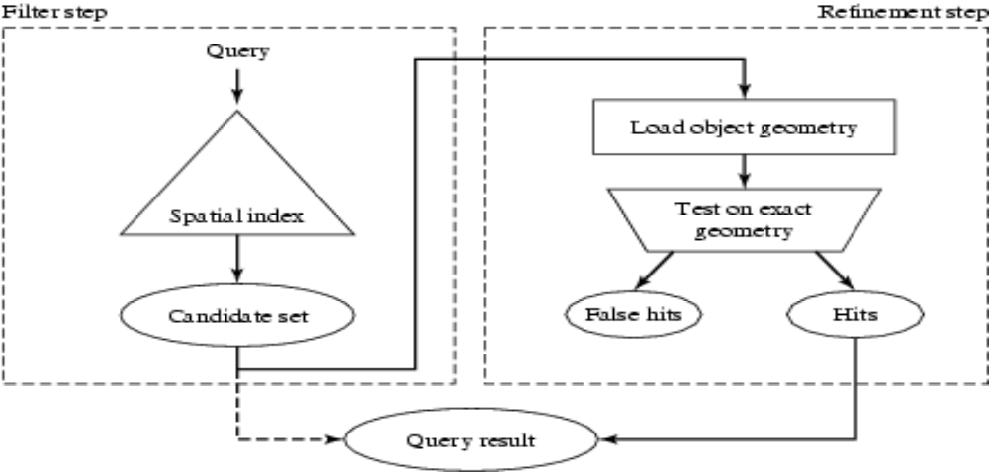
The Filter-Refine Paradigm
Processing a spatial query Q
  Filter step : find a superset S of object in answer to Q
    Using approximate of spatial data type and operator
  Refinement step : find exact answer to Q reusing a GIS to process S
    Using exact spatial data type and operation
Fig 5.1

Slide 14
Approximate Spatial Data types
Approximating spatial data types
  Minimum orthogonal bounding rectangle (MOBR or MBR)
    approximates line string, polygon, …
    See Examples below (Bblack rectangle are MBRs for red objects)
  MBRs are used by spatial indexes, e.g. R-tree
  Algorithms for spatial operations MBRs are simple
Q? Which OGIS operation (Table 3.9, pp. 66) returns MBRs ?

Slide 15
Approximate Spatial Operations
Approximating spatial operations
  SDBMS processes MBRs for refinement step
  Overlap predicate used to approximate topological operations
  Example: inside(A, B) replaced by
    overlap(MBR(A), MBR(B)) in filter step
    See picture below - Let A be outer polygon and B be the inner one
    inside(A, B) is true only if overlap(MBR(A), MBR(B))
    However overlap is only a filter for inside predicate needing refinement later

Slide 16
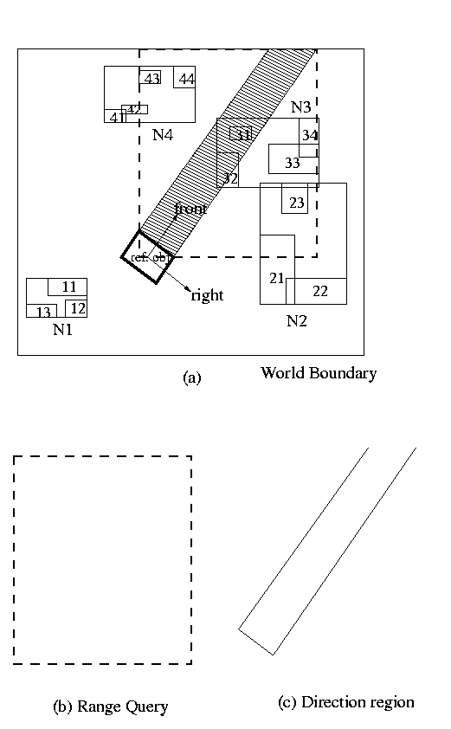
Filter Step Example
Query:
  List objects in front of a viewer V
Equivalent overlap query
  Direction region is a polygon
  List objects overlapping with
    polygon( front(V))
Approximate query
  List objects overlapping with
    MBR(polygon (front (V)))

Slide 17
Approximate Spatial Operations - 2
Exercise: Approximate following using overlap predicate
  Cross(A, B), Touch(A, B), Disjoint(A, B)
  See Table 3.9, pp. 66 for definition of these operations.
Exercise: Given MBRs R and S, Provide conditions to test
  Overlap(A, B)
  Use coordinates of left-lower and upper-right corners of MBRs

Slide 18
Choice of building blocks
Choice of building blocks
  Varies across software vendors and products
  Representative building blocks are listed here
List of building blocks
  Point Query- Name a highlighted city on a digital map.
    Return one spatial object out of a table
  Range Query- List all countries crossed by of the river Amazon.
    Returns several objects within a spatial region from a table
  Spatial Join: List all pairs of overlapping rivers and countries.
    Return pairs from 2 tables satisfying a spatial predicate
  Nearest Neighbor: Find the city closest to Mount Everest.
    Return one spatial object from a collection

Slide 19
Strategies for Each Building Block
Choice of strategies
  Varies across software vendors and products
  Representative strategies are listed here
  Some strategies need special file-structures or indices
Description of strategies
  Main message: there are multiple strategies for each building block!
  Focus on concepts rather than procedures
  Readers interested in procedural details (e.g. algorithms)
    Refer to papers in Bibliographic notes
    Note: better algorithms appear in literature every year!

Slide 20
Strategies for Point Queries
Recall Point Query Example
  Name a highlighted city on a digital map.
  Return one spatial object out of a table
List of strategies
  Scan all B disk sectors of the data file
  If records are ordered using space filling curve (say Z-order)
    then use binary search on the Z-order of search point
    to examine about log(B, base = 2) disk sectors
  If an index is available on spatial location of data objects,
    then use find() operation on the index
    number of disk sector examined = depth of index (typically 4 to 5)

Slide 21
Strategies for Range Queries
Recall Range Query Example-
  List all countries crossed by of the river Amazon.
  Returns several objects within a spatial region from a table
List of strategies
  Scan all B disk sectors of the data file
  If records are ordered using space filling curve (say Z-order)
    then determine range of Z-order values satisfying range query
    Use binary search to get lowest Z-order within query answer
    Scan forward in the data file till the highest z-order satisfying query
  If an index is available on spatial location of data objects,
    then use range-query operation on the index

Slide 22
Strategies for Spatial Joins
Recall Spatial Join Example:
  List all pairs of overlapping rivers and countries.
  Return pairs from 2 tables satisfying a spatial predicate
List of strategies
  Nested loop:
    Test all possible pairs for spatial predicate
    All rivers are paired with all countries
  Space Partitioning:
    Test pairs of objects from common spatial regions only
    Rivers in Africa are tested with countries in Africa only!
  Tree Matching
    Hierarchical pairing of object groups from each table
  Other, e.g. spatial-join-index based, external plane-sweep, …

Slide 23
Strategies for Nearest Neighbor Queries
Recall Nearest Neighbor Example
  Find the city closest to Mount Everest.
  Return one spatial object from city data file C
List of strategies
  Two phase approach
    Fetch C’s disk sector(s) containing the location of Mt. Everest
    M = minimum distance( Mt. Everest, cities in fetched sectors)
    Test all cities within distance M of Mt. Everest (Range Query)
  Single phase approach
    Recursive algorithm for R-tree
    Eliminate candidates dominated by some other candidate

Slide 24
Learning Objectives
Learning Objectives (LO)
  LO1: Understand concept of query processing and optimization (QPO)
  LO2 : Learn about alternative algorithms to process spatial queries
  LO3: Learn about query optimizers (QOs)
    Steps in Query processing and optimization
    How to compare strategies for a building block?
  LO4: Learn about trends
Focus on concepts not procedures!
Mapping Sections to learning objectives
  LO2 - 5.1
  LO3 - 5.2, 5.3
  LO4 - 5.4, 5,5

Slide 25
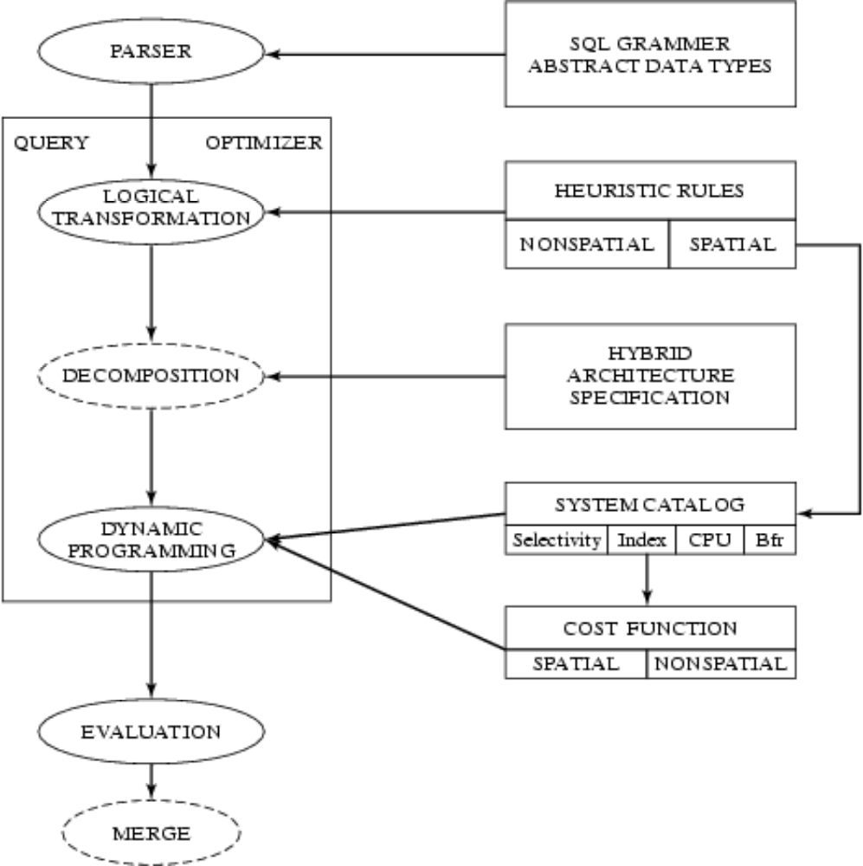
Query Processing and Optimizer process
A site-seeing trip
  Start : A SQL Query
  End: An execution plan
  Intermediate Stopovers
    query trees
    logical tree transforms
    strategy selection
What happens after the journey?
  Execution plan is executed
  Query answer returned
Fig 5.2

Slide 26
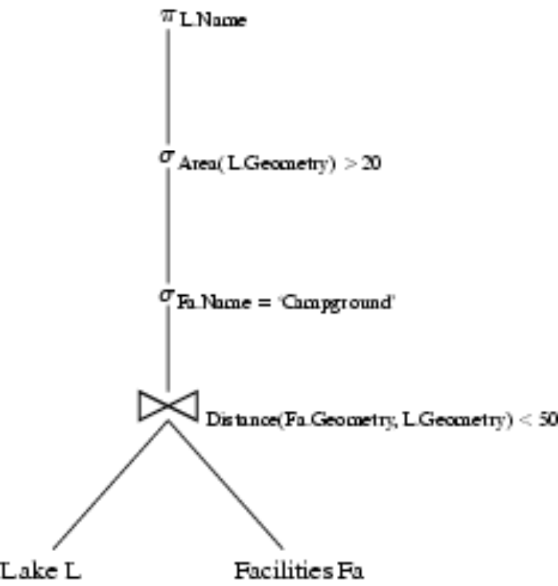

Query Trees
Nodes = building blocks of (spatial) queries
  See section 3.2 (pp.55) for symbols sigma, pi and join
Children = inputs to a building block
Leafs = Tables
Example SQL query and its query tree follows:
Fig 5.3

Slide 27
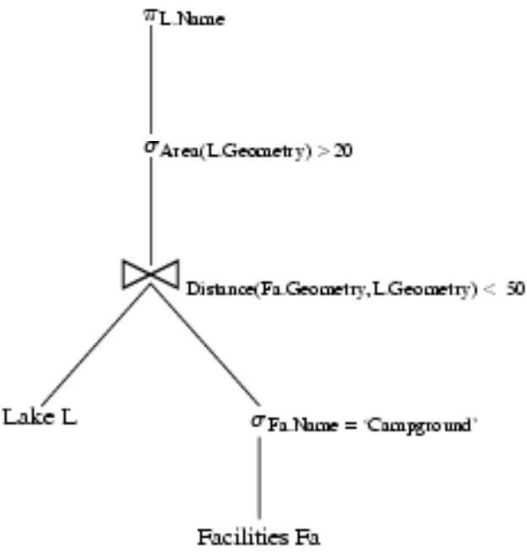
Logical Transformation of Query Trees
Motivation
  Transformation do not change the answer of the query
  But can reduce computational cost by
    reducing data produced by sub-queries
    reducing computation needs of parent node
Example Transformation
  Push down select operation below join
  Example: Fig. 5.4 (compare w/ Fig 5.3, last slide)
  Reduces size of table for join operation
Other common transformations
  Push project down
  Reorder join operations
  ...
Fig 5.4

Slide 28
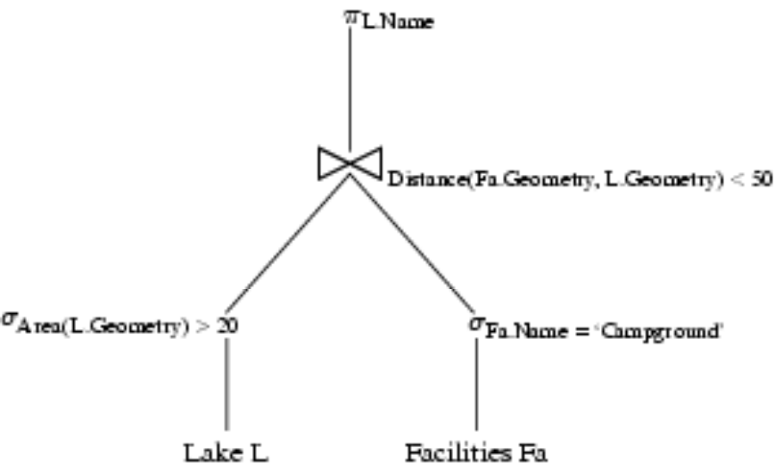
Logical Transformation and Spatial Queries
Traditional logical transform rules
  For relational queries with simple data types and operations
    CPU costs are much smaller and I/O costs
  Need to be reviewed for spatial queries
    complex data types, operations
    CPU cost is hgher
Example:
  Push down spatial selection beow join
  May not decrease cost if
    area() is costlier than distance()
Fig 5.5

Slide 29
Execution Plans
An execution plan has 3 components
  A query tree
  A strategy selected for each non-leaf node
  An ordering of evaluation of non-leaf nodes
Example
  Strategies for Query tree in Fig. 5.5
    Use scan for Area(L.Geometry) > 20
    Use index for Fa.Name = ‘Campground’
    Use space-partitioning join for
      Distance(Fa, L) < 50
    Use on-the-fly for projection
  Ordering
    As listed above
Fig 5.5

Slide 30
Choosing strategies for building blocks
A priority scheme
  Check applicability of each strategies given file-structures and indices
  Choose highest priority strategy
  This procedure is fast, Used for complex queries
Rule based approach
  System has a set of rules mapping situations to strategy choices
  Example: Use scan for range query if result size > 10 % of data file
Cost based approach
  See next slide

Slide 31
Choosing strategies for building blocks - 2
Cost model based approach
  Single building block
    Use formulas to estimate cost of each strategy, given table size etc.
    Choose the strategy with least cost
    Example cost models for spatial operation in section 5.3
  A query tree
    Least cost combination of strategy choices for non-leaf nodes
    Dynamic programming algorithm
Commercial practice
  RDBMS use cost based approach for relational building blocks
  But cost models for spatial strategies are not mature
  Rule based approach is often used for spatial strategies

Slide 32
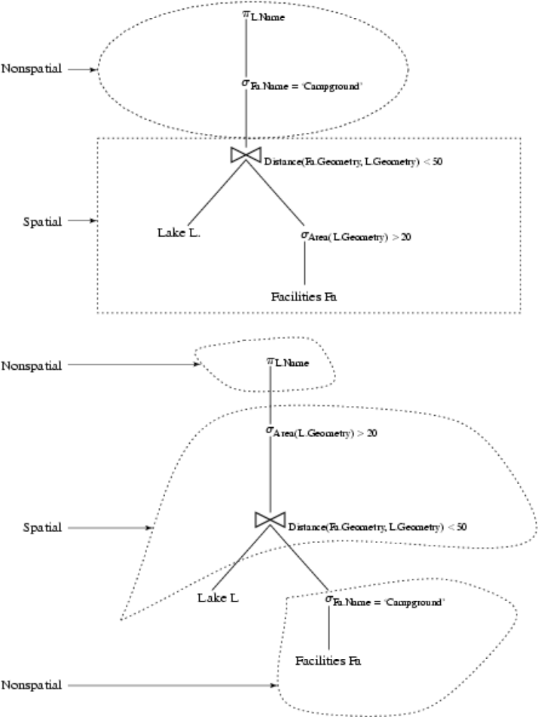
Query Decomposition
Fig 5.8

Slide 33
Learning Objectives
Learning Objectives (LO)
  LO1: Understand concept of query processing and optimization (QPO)
  LO2 : Learn about alternative algorithms to process spatial queries
  LO3: Learn about query optimizer
  LO4: Learn about trends
    Impact of Distributed, Web-based, Parallel Computing Environment
Focus on concepts not procedures!
Mapping Sections to learning objectives
  LO2 - 5.1
  LO3 - 5.2, 5.3
  LO4 - 5.4, 5,5

Slide 34
Trends in Query Processing and Optimization
Motivation
  SDBMS and GIS are invaluable to many organizations
  Price of success is to get new requests from customers
    to support new computing hardware and environment
    to support new applications
New computing environments
  Distributed computing (Section 5.4)
  Internet and web (Section 5.4)
  Parallel computers (Section 5.5)
New applications
  Location based services, transportation (Chapter 6)
  Data Mining (Chapter 7)
  Raster data (Chapter 8)

Slide 35
5.4 Distributed Spatial Databases
Distributed Environments
  Collection of autonomous heterogeneous computers
  Connected by networks
  Client-server architectures
    Server computer provides well-defined services
    Client computers use the services
New issues for SDBMS
  Conceptual data model -
    Translation between heterogeneous schemas
  Logical data model
    Naming and querying tables in other SDBMSs
    Keeping copies of tables (in other SDBMs) consistent with original table
  Query Processing and Optimization
    Cost of data transfer over network may dominate CPU and I/O costs
    New strategies to control data transfer costs

Slide 36
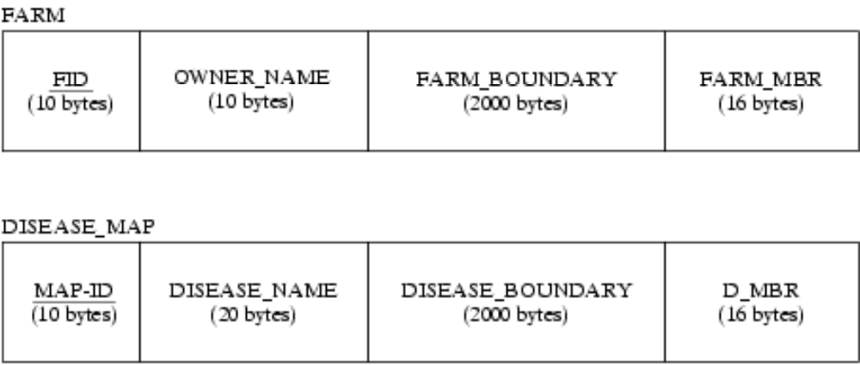
Distributed SDBMS - 2
Data-transfer strategies for joining 2 table at different sites
  Transfer one table to the other site
  Semi-join strategy
    Transfer join column of one table to the other site
    Transfer back the matching rows of the other table back to first site
  Semi-join often is cheaper than transferring a table to other site
    Detailed Example in section 5.4.2 (pp. 135)
Fig 5.9: Two table at
different sites to be
joined on overlap of
D_MBR overlap
FARM_MBR

Slide 37
5.4 Internet and (World-wide-)web
Internet and Web Environments
  Very popular medium of information access in last few years
  A distributed environment
  Web servers, web clients
    Common data formats (e.g. HTML, XML)
    Common communication protocols (e.g. http)
    Naming - uniform resource locator (url), e.g. www.cs.umn.edu
New issues for SDBMS
  Offer SDBMS service on web
  Use Web data formats, communication protocols etc.
    Example on next slide
  Evaluate and improve web for SDBMS clients and servers

Slide 38
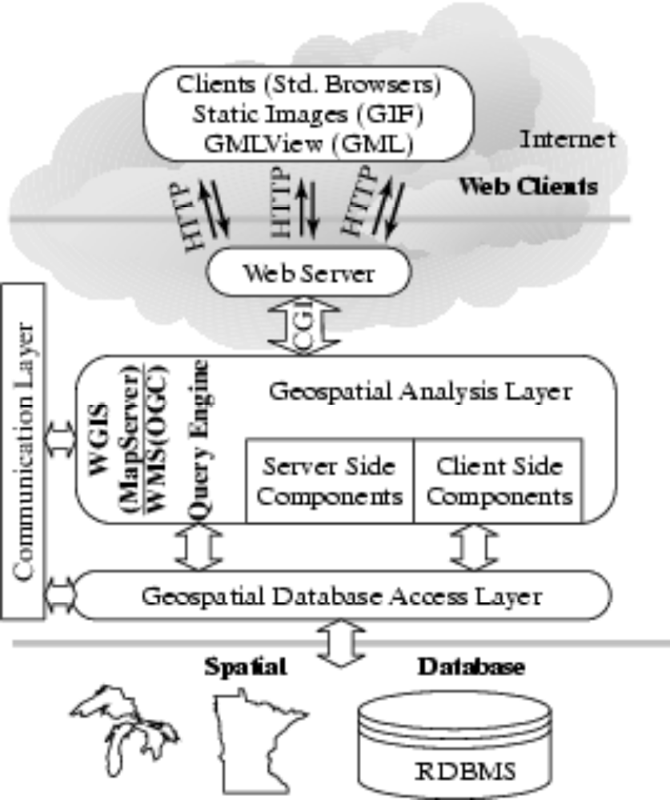
5.4 Web-based Spatial Database Systems
SDBMS on web
  MapServer case study
  SDBMS talks to a web server
  web server talks to web clients
Commercial practice
  Several web based products
  Web data formats for spatial data
    GML
    WMS
Fig 5.10

Slide 39
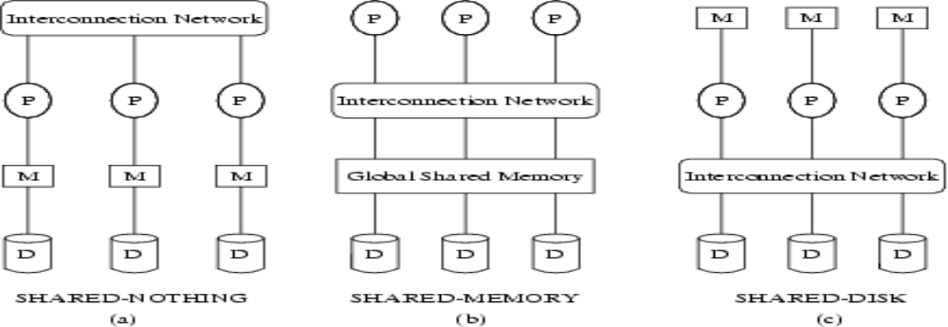
5.5 Parallel Spatial Databases
Parallel Environments
  Computer with multiple CPUs, Disk drives (See Fig. 5.11 for examples)
  All CPUs and disk available to a SDBMS
  Can speed-up processing of spatial queries!
Fig 5.11

Slide 40
5.5 Parallel Spatial Databases - 2
New issues for DBMS
  Physical Data Model
    Declustering: How to partition tables, indices across disk drives?
  Query Processing and Optimization
    Query partitioning: How to divide queries among CPUs?
    Cost model of strategies on parallel computers
Exmaple: Techniques for declustering (Fig. 5.12)
  Simple technique: round robin based on an order (space filling curve)
  Disk

Slide 41
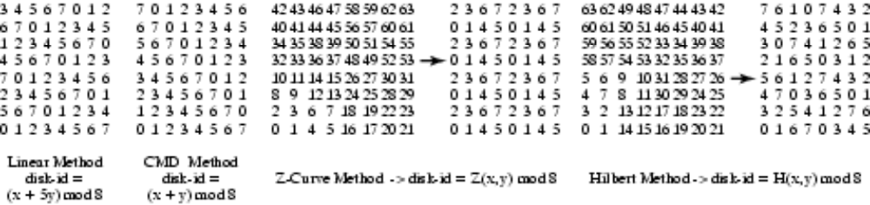
Declustering for Data Partitioning
Exmaple
  A Simple Techniques for declustering (Fig. 5.12)
    1. Order the spatial objects using a space filling curve
    2. Allocate to disk drives in a round robin manner
  Effective for point objects, e.g. pixels in an image
  Many queries, e.g. large MBRs are parallelized well
    Ex. Consider a query to retrieve dat in bottom-left quarter of the space
      Two data points retrieved fromeach disk drive for Z-curve

Slide 42
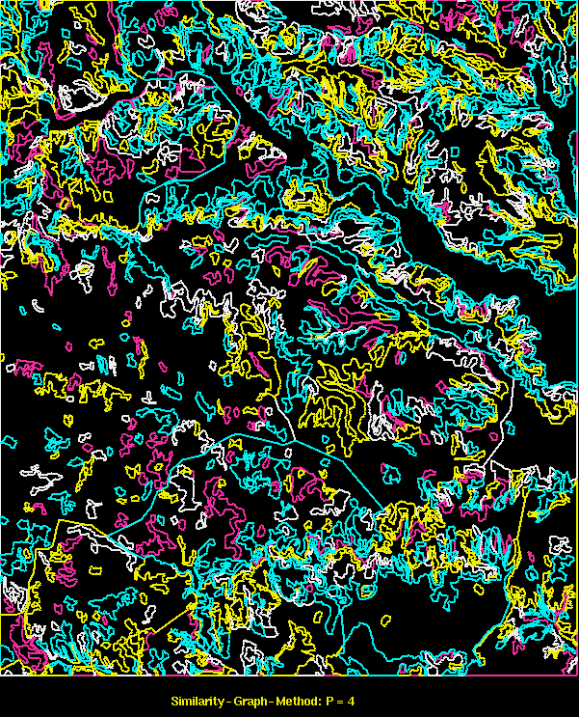
A Case Study: High Performance GIS
Goal: Meet the response time constraint for real time battlefield terrain visualization in flight simulator.
Methodology:
Data-partitioning approach
Evaluation on parallel computers,
  e.g. Cray T3D, SGI Challenge.
Significance:
A major improvement in capability of geographic information systems for determining the subset of terrain polygons within the view point (Range Query) of a soldier in a flight simulator using real geographic terrain data set.
Dividing a Map among 4 processors. Polygons within a processor have common color

Slide 43
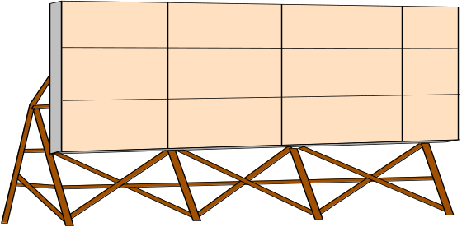





A Case Study: High Performance GIS
(1/30) second Response time constraint on Range Query
Parallel processing necessary since best sequential computer cannot meet requirement
Green rectangle = a range query, Polygon colors shows processor assignment
Set of Polygons
Set of Polygons
Graphics Engine
Local Terrain Database
Remote Terrain Databases
Display
2Hz.
8Km X 8Km Bounding Box
25 Km X 25 Km
Bounding Box
30 Hz. View Graphics
High Performance GIS Component
Dividing a Map among 4 processors. Polygons within a processor have common color

Slide 44
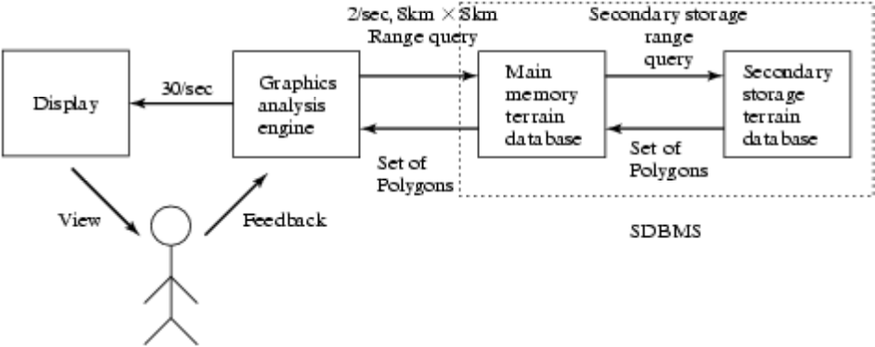
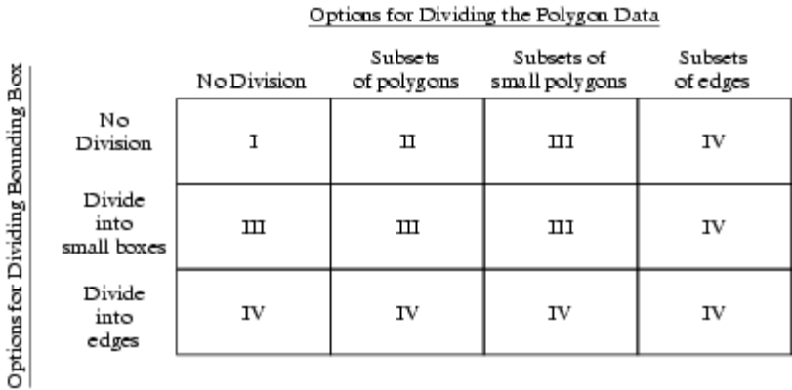
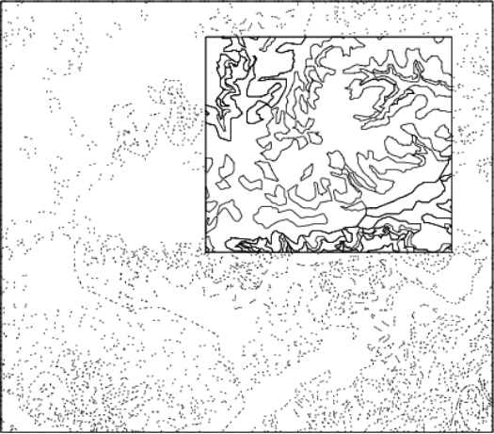
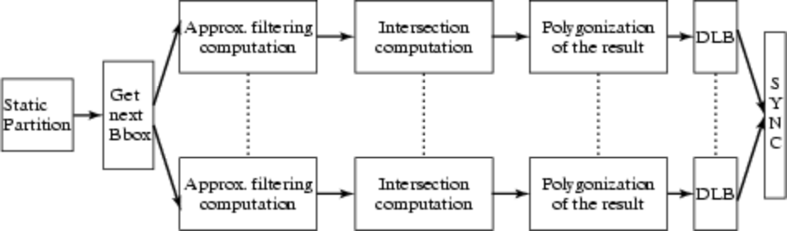
Real Time Visualization: A Case Study
Fig 5.13
Fig 5.16
Fig 5.14
Range Query
Fig 5.15

Slide 45
Summary
Query processing and optimization (QPO)
  translates SQL Queries to execution plan
QPO process steps include
  Creation of a query tree for the SQL query
  Choice of strategies to process each node in query tree
  Ordering the nodes for execution
Key ideas for SDBMS include
  Filter-Refine paradigm to reduce complexity
  New building blocks and strategies for spatial queries

