Slide 1
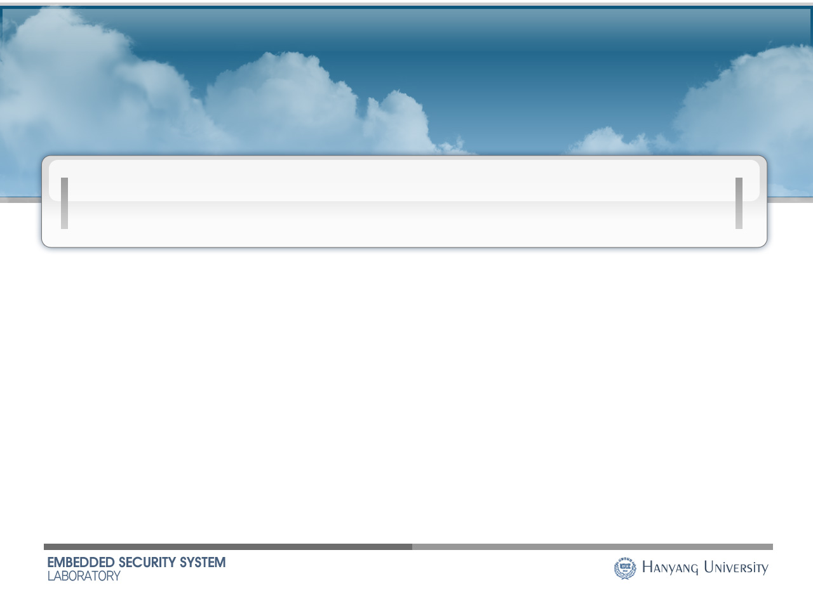
A simple construction of two-dimensional suffix trees in linear time
Dong Kyue Kim*, Joong Chae Na
Jeong Seop Sim, Kunsoo Park
* Division of Electronics and Computer Engineering
Hanyang University, Korea

Slide 2
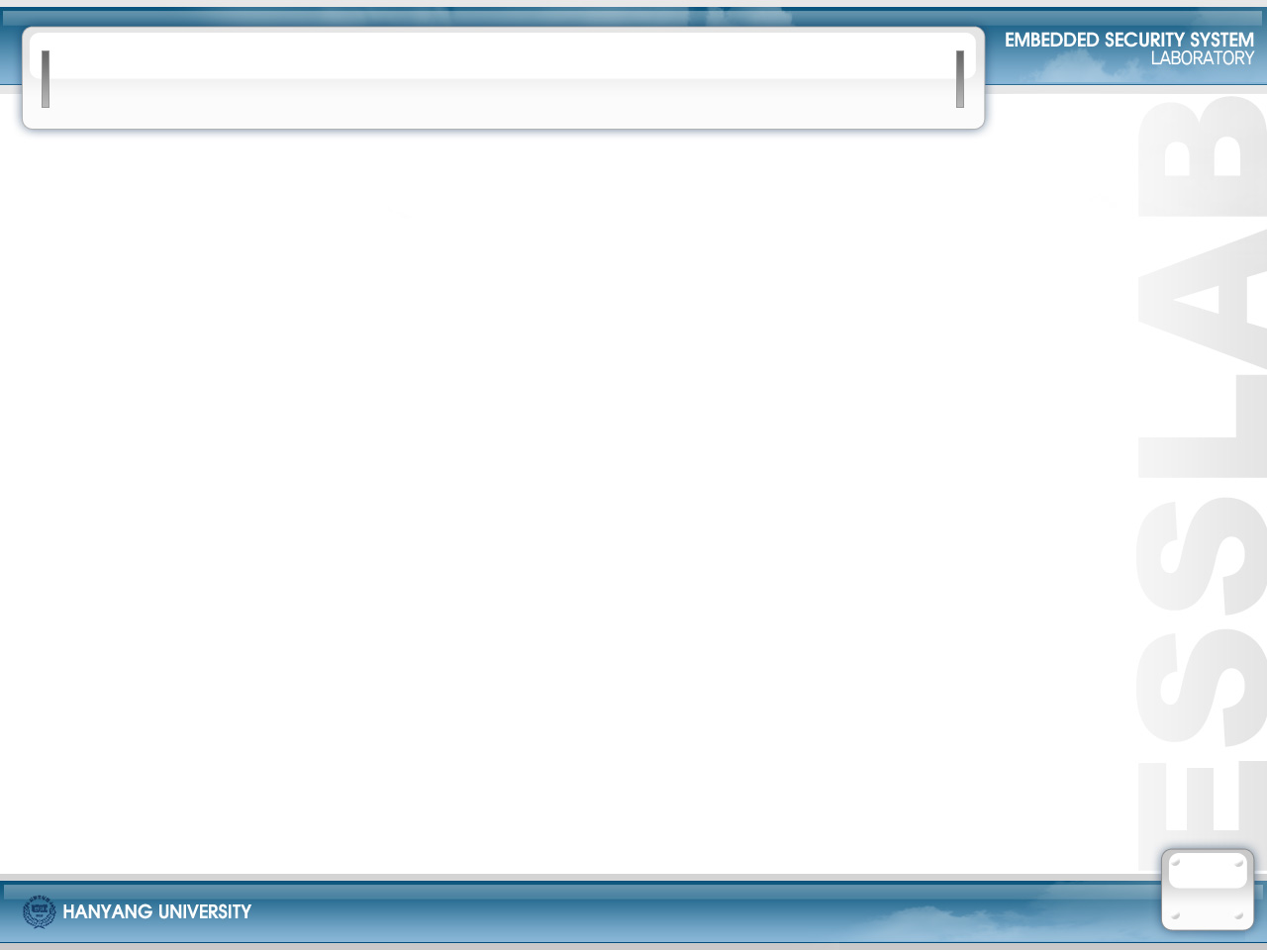
Suffix Tree & 2-D Suffix Tree
Suffix tree of a string S is a compacted trie that represents all substrings of S.
  It has been a fundamental data structure not only for computer science, but also for engineering and bioinformatics applications
Two dimensional suffix tree of a matrix A is a compacted trie that represents all square submatrices of A.
  Useful for 2-D pattern retrieval
    low-level image processing, data compression,
    visual databases in multimedia systems

Slide 3
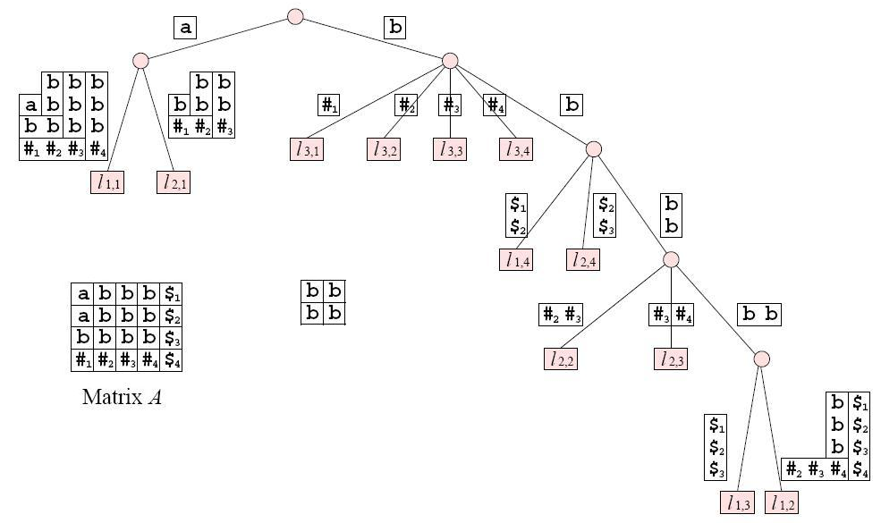
2-D pattern retrieval
2-D suffix tree of Matrix A
Pattern

Slide 4
Problem Definition
Problem Definition
  Given an matrix A over an integer alphabet,
  construct a two-dimensional suffix tree of A in linear time

Slide 5
Previous Works (1)
Gonnet[88] :
  First introduced a notion of suffix tree for a matrix, called the PAT-tree.
Giancarlo[95] :
  Proposed Lsuffix tree (2-D suffix trees), compactly storing all square submatrices of an n×n matrix.
  Construction : O(n² log n) time and O(n²) space.
Giancarlo & Grossi [96,97] :
  Introduced the general frameworks of 2-D suffix tree families and proposed an expected linear-time construction algorithm.

Slide 6
Previous Works (2)
Kim & Park [99]
  Proposed the first linear-time construction algorithm, called Isuffix tree, for integer alphabets
  Using Farach’ the paradigm [Farach97].
Cole & Hariharan [2000]
  Proposed a randomized linear-time construction algorithm
Giancarlo & Guaina [99], and Na et al. [2005]
  Presented on-line construction algorithms.

Slide 7

Motivations
&
Contributions

Slide 8
Divide-and-Conquer Approach
Widely used for linear-time construction algorithms for index structures such as suffix trees and suffix arrays
Divide-and-conquer approach for the suffix tree of a string S
  Partition the suffixes of S into two groups X and Y, and generate a string S’ whose suffixes correspond to the suffixes in X.
  Construct the suffix tree of S’ Recursively.
  Construct the suffix tree for X from the suffix tree of S’.
  Construct the suffix tree for Y using the suffix tree for X
  Merge the two suffix trees for X and Y to get the suffix tree of S

Slide 9
Odd-Even Scheme vs. Skew Scheme
There are two kinds of scheme according to the method of partitioning the suffixes.
The odd-even scheme (Suffix tree-Farach [97], suffix array-Kim et al. [03])
  Divide the suffixes of S into odd suffixes (group X) and even suffixes (group Y) ( ½-recursion)
  Most of steps in the odd-even scheme are simple,
  but its merging step is quite complicated.
The skew scheme (Kärkkäinen and Sanders [03])
  Divide the suffixes of S into three sets, and regard two sets as group X and the remaining set as group Y ( ⅔-recursion)
  Its merging step is simple and elegant.

Slide 10
2-D Case
In constructing two-dimensional suffix trees,
Kim and Park [99] : extended the odd-even scheme to an n×n (=N) matrix.
  Partition the suffixes into 4 sets of size ¼ (= ½×½) N each, i.e., three sets of suffixes are regarded as group X and the remaining set as group Y,
  and performs ¾-recursion.
  Since this algorithm uses the odd-even scheme,
  the merging step is performed three times for each recursion
  and quite complicated.

Slide 11


Motivations (¾ -recursion is already skewed!!)
How can we apply the skew scheme for constructing two-dimensional suffix trees?
  Partition the suffixes into 9 sets of size (=⅓×⅓) N each?, or
  Partition the suffixes into 16 sets of size (=¼×¼) N each?
  ⇒ Not easy and quite complicated!!
  Our viewpoint for this problem is that
  “partitioning the suffixes into 4 sets” itself can be the skew scheme.

Slide 12
Contributions
A new and simple algorithm for constructing two-dimensional suffix trees in linear time.
  By applying the skew scheme to matrices
  Thus, the merging step is quite simple.

Slide 13
Overview of our algorithm

Slide 14
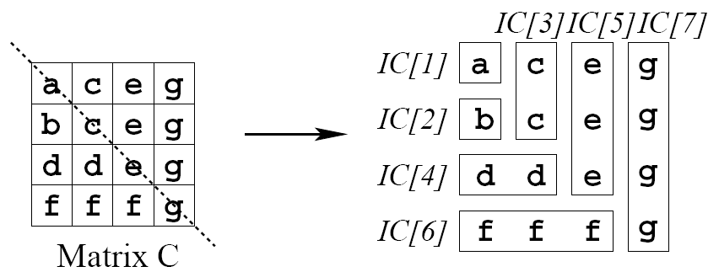
Icharacters
C : an n×n square matrix
Icharacters : When cutting a matrix along the main diagonal,
  IC[1] = C[1,1];
  IC[2i] = r(i), for each subrow r(i) = C[i+1, 1 : i ];
  IC[2i+1] = c(i), for each subcolumn c(i) = C[1: i+1, i+1].

Slide 15
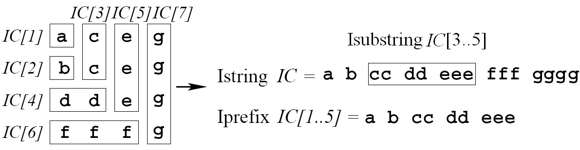
Linearization of square matrices
Istring IC of square matrix C
  the concatenation of Icharacters IC[1], … , IC[2n+1]
Ilength of IC : the number of Icharacters in IC
Iprefix IC [1..k], Isubstring IC [ j..k]

Slide 16
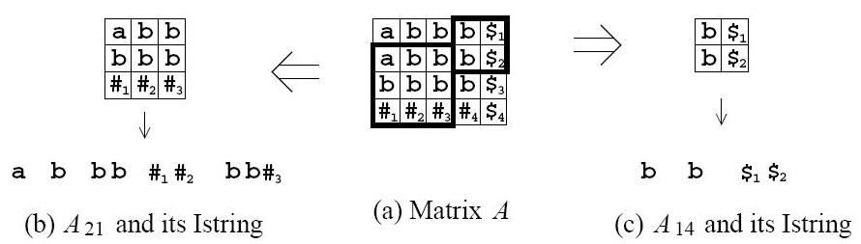
Suffixes of a matrix
A : an n×m matrix over an integer alphabet
  Assume that the entries of the last row and column are distinct and unique
Suffix A_{ij} of a matrix A
  The largest square submatrix of A that starts at position (i,j)
Isuffix IA_{ij} of A is the Istring of A_{ij}

Slide 17
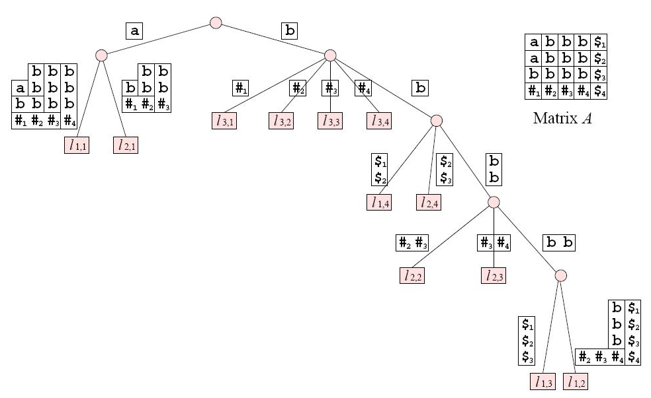
The Isuffix Tree
A suffix tree of all Isuffixes of A, denoted by IST(A)
Edge : Isubstring
Sibling : first Icharacters
Leaf : index of an Isuffix

Slide 18
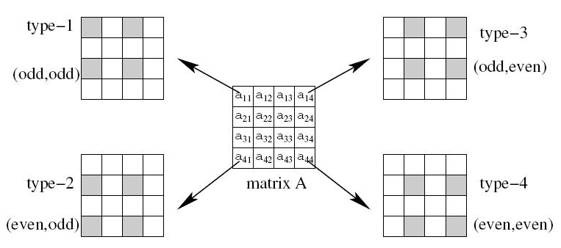
4 Types of Isuffixes
Dividing Isuffixes of A into 4 types according to their start positions
An Isuffix is type-123 if it is a type-1, type-2, or type-3 Isuffix.

Slide 19
4 Types of Matrices
A
A₁ = A
A₃ = A [1:n , 2:m]
dummy
column
dummy
column
dummy row
dummy row
A₂ = A [2:n , 1:m]
A₄ = A [2:n , 2:m]
* Type-1 Isuffixes of A_{r} correspond to type-r Isuffixes of A

Slide 20
Difference from the previous algorithm
In previous algorithm (Kim&Park[99]),
  Isuffix tree for each A_{r}, (1 ≤ r ≤ 3)
  is constructed recursively, i.e.,
  Three Isuffix trees are constructed separately in a recursion step.
In our algorithm,
  Isuffix tree for the concatenation of A₁, A₂, and A₃
  will be constructed recursively, i.e.,
  One Isuffix tree is constructed in a recursion step

Slide 21
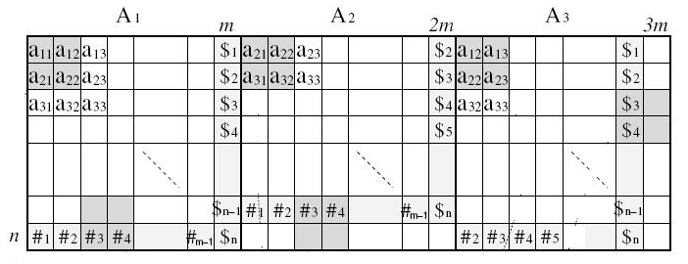
Concatenated Matrix A₁₂₃
A₁₂₃ : the concatenation of A₁, A₂, and A₃
  Its size : n×3m
  Type-1 Isuffixes of A₁₂₃ correspond to type-123 Isuffixes of A.
  Partial Isuffix tree pIST(A₁₂₃) : a compacted trie that represents all type-1 Isuffixes of A₁₂₃, and thus represents all type-123 Isuffixes of A.

Slide 22
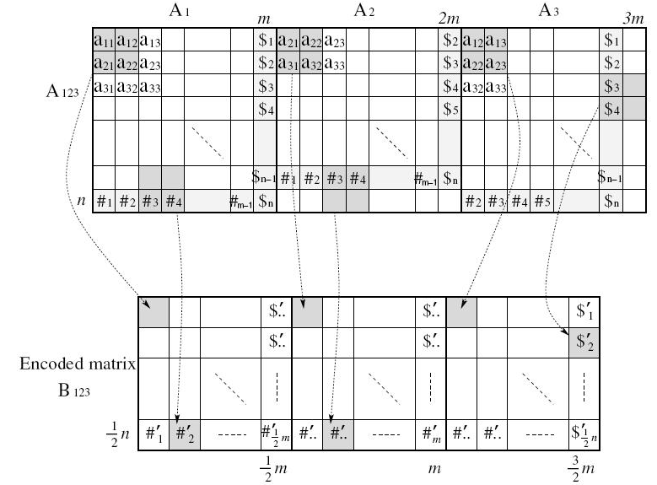
Encoded Matrix B₁₂₃
Encoding A₁₂₃ into B₁₂₃ by combining characters in A₁₂₃ 4 by 4, which is used in next recursion step
  Isuffixes of B₁₂₃ correspond one-to-one with type-1 Isuffixes of A₁₂₃
  Size : ¾ n×m

Slide 23
Outline of Our Algorithm
Compute IST(B ₁₂₃) recursively.
  Isuffixes of B₁₂₃ correspond to type-1 Isuffixes of A₁₂₃.
Construct pIST(A₁₂₃) from IST(B₁₂₃)
  using decoding algorithm, which is similar to that in [Kim&Park99].
  Isuffixes of A₁₂₃ correspond to type-123 Isuffixes of A.
Construct pIST(A₄) from pIST(A₁₂₃) without recursion
  using the results in [Kim&Park99]
Merge pIST(A₁₂₃) and pIST(A₄) into IST(A).

Slide 24
Step 4: Merging

Slide 25
Overview
Instead of merging pIST(A₁₂₃) and pIST(A₄) directly,
We merge their list forms:
  Lst₁₂₃ and Lst₄ : the list of type-123 and type-4 Isuffixes of A in lexicographically sorted order, respectively
  Lst₁₂₃ and Lst₄ can be obtained from pIST(A₁₂₃) and pIST(A₄).
Lst₁₂₃ :
type-1, type-2, type-3 Isuffixes
A₁₂₃
Lst₄ :
type-4 Isuffixes
A₄

Slide 26
Merging procedure
Merging procedure
  Construct Lst₁₂₃ and Lst₄.
  Merge the two lists using a way similar to generic merge.
    Choose the first Isuffixes IA_{ij} and IA_{kl} from Lst₁₂₃ and Lst₄, respectively.
    Determine the lexicographical order of IA_{ij} and IA_{kl}.
    Remove the smaller one from its list and add it into a new list.
    Do this until one of the two lists is exhausted.
  Compute Ilcp’s (the longest common Iprefix) between adjacent Isuffixes in the merged list [Kasai et al. 2001]
  Construct IST(A) using the merged list and the computed Ilcp’s [Farach & Muthukrishnan 96].

Slide 27
Determining lexicographical order
How to compare a type-123 Isuffix IA_{ij} and a type-4 Isuffix IA_{kl}
  Since they are in different partial Isuffix trees, it is not easy to compare the directly.
  Instead, compare either IA_{i+1, j} and IA_{k+1,l} , or IA_{i, j+1} and IA_{k,l+1} , which are in the same tree.
types of
IA_{ij} & IA_{kl}
types of compared Isuffixes
⇒
1 3 1
2 4 2
1 3 1
1 3 1
2 4 2
1 3 1
1 3 1
2 4 2
1 3 1
1 & 4 ⇒ 2 & 3
or 3 & 2
1 3 1
2 4 2
1 3 1
1 3 1
2 4 2
1 3 1
1 3 1
2 4 2
1 3 1
2 & 4 ⇒ 1 & 3
3 & 4 ⇒ 1 & 2

Slide 28
One Case of Comparing
type-1 Isuffix
Compared Suffixes
Matching areas
X
type-4 Isuffix
X
Matching area of
compared suffixes

Slide 29
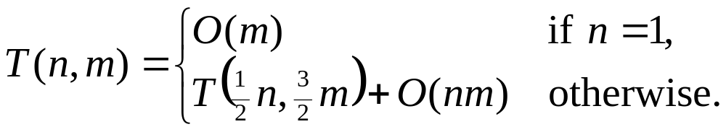
Time complexity
All steps except the recursion take linear time.
If n = 1, matrix A is a string and the Isuffix tree can be constructed in O(m) time [Farach97].
Thus, the worst-case running time T(n, m) of our algorithm can be described by the recurrence
Its solution is T(n, m) = O(nm).

Slide 30
Conclusion
A new and simple algorithm to construct two-dimensional suffix trees in linear time
  How to apply the skew scheme to matrices.
  How to merge Isuffixes in two groups
Future works
  Directly constructing the 2-D suffix array in linear time.
  On-line constructing the 2-D suffix tree in linear time.

