Slide 1
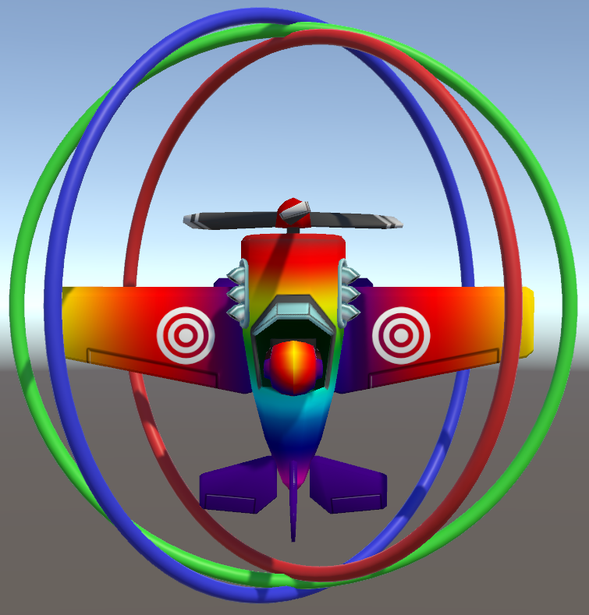
In Defense of Euler Angles in Game Programming
Matthew Whiting
University of Southern California
Los Angeles, California, USA
whitingm@usc.edu

Slide 2
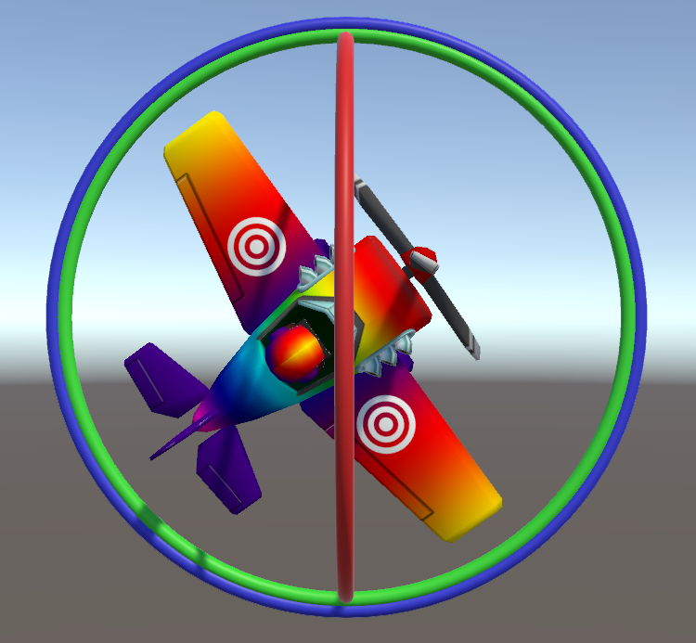
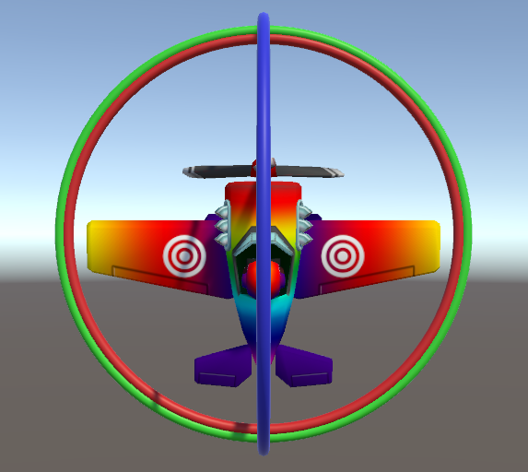
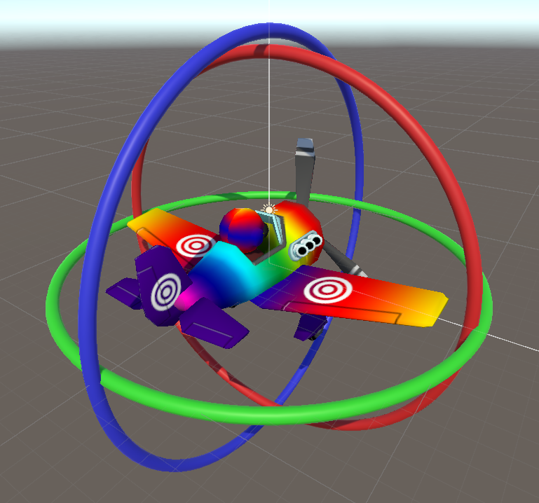
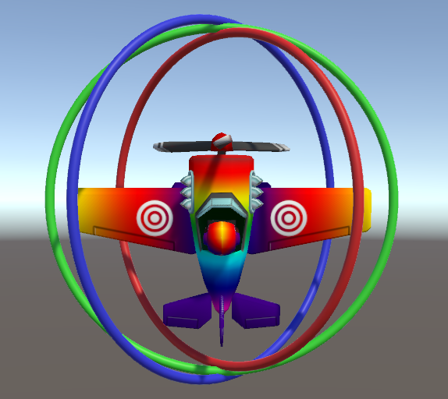
Gimbal Lock
Suffer from “Gimbal Lock”
Euler Angles are Intuitive
Lost “Degree of Freedom”
Euler Angles are Discontinuous at the Poles

Slide 3

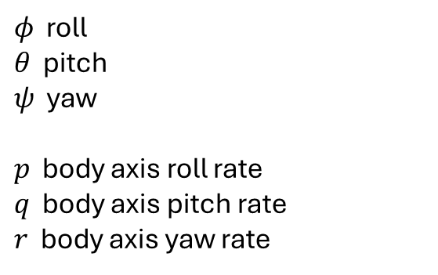

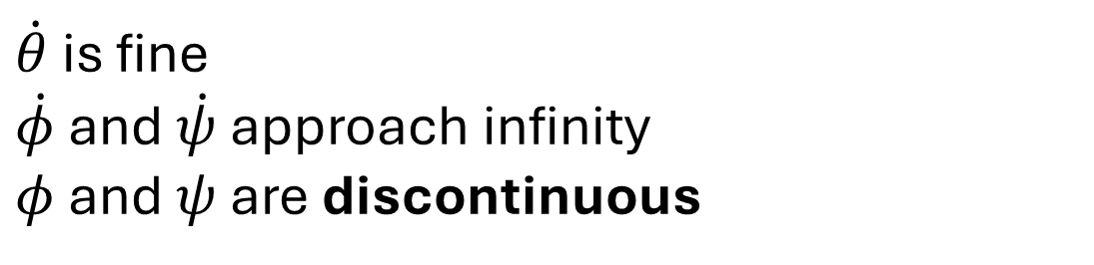

Gimbal Lock
$φ$ roll
$θ$ pitch
$ψ$ yaw
$p$ body axis roll rate
$q$ body axis pitch rate
$r$ body axis yaw rate
$$\dot{θ}=q\cos{φ}−r\sin{φ}$$
$$\dot{ψ}=q\frac{\sin{φ}}{\cos{θ}}+r\frac{\cos{φ}}{\cos{θ}}$$
$$\dot{φ}=p+q\sin{φ}\tan{θ}+r\cos{φ}\tan{θ}$$
When $θ$ hits $±\frac{π}{2}$, we get singularities here
$\dot{θ}$ is fine
$\dot{φ}$ and $\dot{ψ}$ approach infinity
$φ$ and $ψ$ are discontinuous

Slide 4


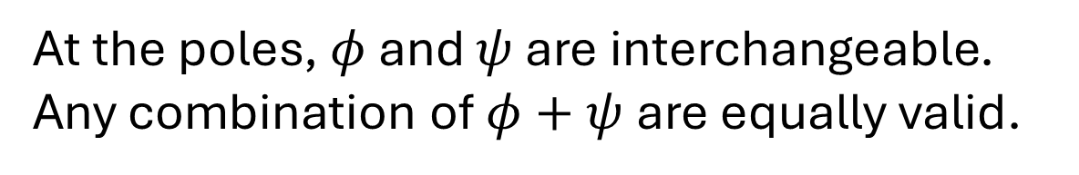
Gimbal Lock
$φ$ roll
$θ$ pitch
$ψ$ yaw
$p$ body axis roll rate
$q$ body axis pitch rate
$r$ body axis yaw rate
$$\dot{θ}=q\cos{φ}−r\sin{φ}$$
$$\dot{ψ}=0$$
$$\dot{φ}=p+r$$
$$\dot{θ}=q\cos{φ}−r\sin{φ}$$
$$\dot{ψ}=q\frac{\sin{φ}}{\cos{θ}}+r\frac{\cos{φ}}{\cos{θ}}$$
$$\dot{φ}=p+q\sin{φ}\tan{θ}+r\cos{φ}\tan{θ}$$
At the poles, $φ$ and $ψ$ are interchangeable. Any combination of $φ+ψ$ are equally valid.

Slide 5
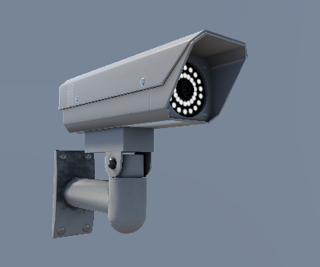
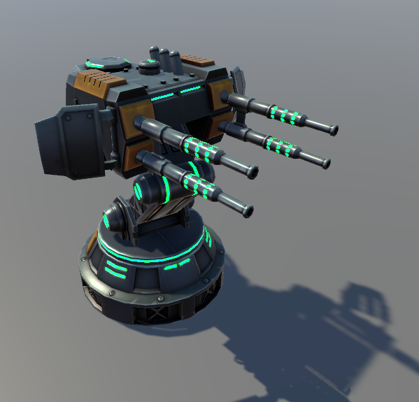
Altazimuth (Az/El) Mounts
Security Camera
Some Typical Game Scenarios
Laser Turret
They only have 2 degrees of freedom
Physically, Specifically
Azimuth (Yaw)
Altitude/Elevation (Pitch)

Slide 6
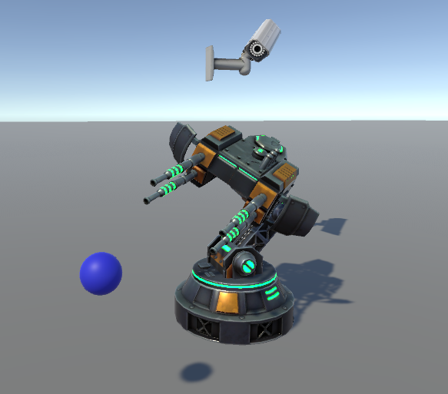
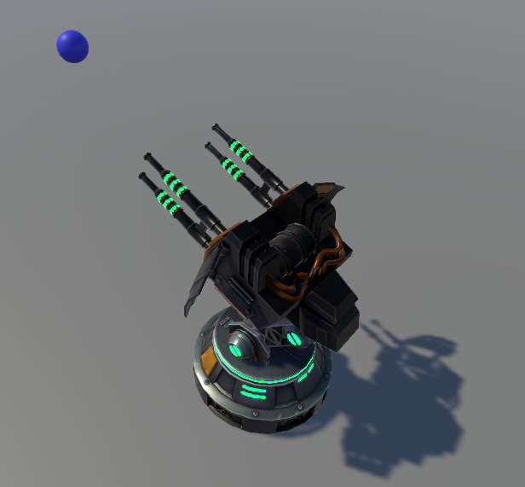
Altazimuth (Az/El) Mounts
Some Typical Game Scenarios
Quaternions Allow Roll
Quaternions
Unrestricted
3 Degrees of Freedom
On a Single Joint
Need Constraints

Slide 7
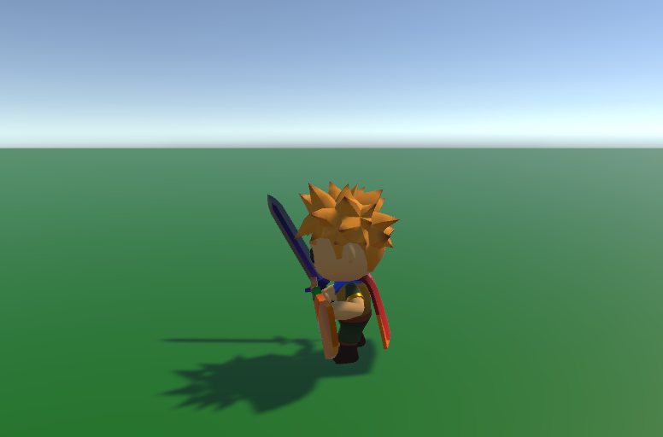
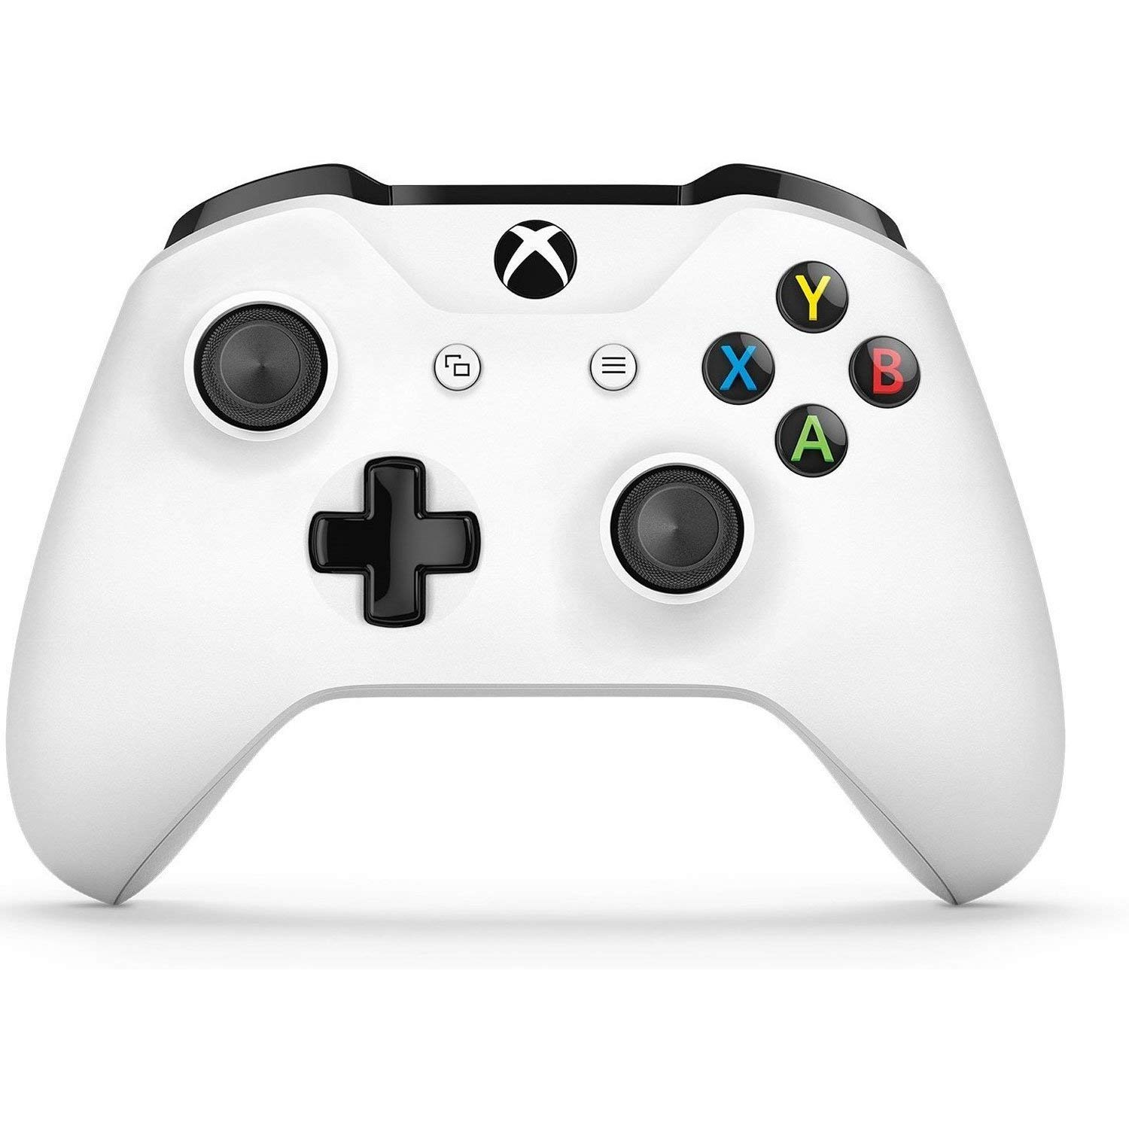
In-Game Camera
Spherical Polar Coordinates

Slide 8
In-Game Camera
Spherical Polar Coordinates

Slide 9



In-Game Camera
Spherical Polar Coordinates
$$d$$
$$θ$$
$$Ψ$$

Slide 10

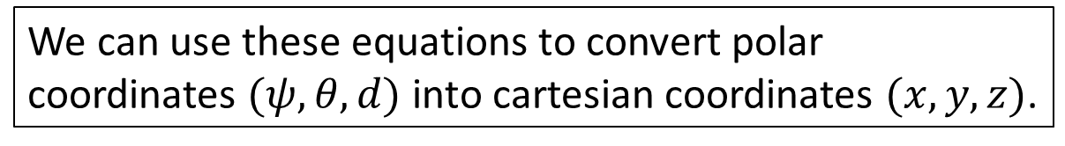








Spherical Polar Coordinates
$\sin{θ}=\frac{P_{y}}{d}$
$P_{y}=d\sin{θ}$
$\cos{θ}=\frac{d_{xz}}{d}$
$d_{xz}=d\cos{θ}$
$\sin{ψ}=\frac{P_{x}}{d_{xz}}$
$P_{x}=d_{xz}\sin{ψ}$
$\cos{ψ}=\frac{P_{z}}{d_{xz}}$
$P_{z}=d_{xz}\cos{ψ}$
$$P$$
$$d$$
$$P_{y}$$
$$θ$$
$$P_{x}$$
$$Ψ$$
$$d_{xz}$$
$$P_{z}$$
We can use these equations to convert polar coordinates $(ψ,θ, d)$ into cartesian coordinates $(x, y, z)$.

Slide 11


Spherical Polar Coordinates
atan2
$$P$$
$\tan{ψ}=\frac{P_{x}}{P_{z}}$
$ψ=\operatorname{atan}{\frac{P_{x}}{P_{z}}}$
What about the other quadrants?
What if $P_{z}$ is zero?
$ψ=atan2{(P_{x},P_{z})}$
$$d$$
$$P_{y}$$
$$P_{x}$$
$$Ψ$$
$$P_{z}$$

Slide 12
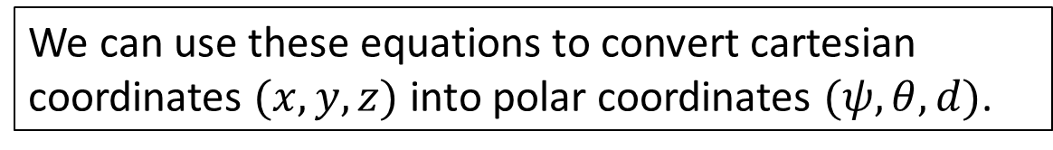

Spherical Polar Coordinates
$d=\sqrt{{P_{x}}^{2}+{P_{y}}^{2}+{P_{z}}^{2}}$
$d_{xz}=\sqrt{{P_{x}}^{2}+{P_{z}}^{2}}$
$\tan{ψ}=\frac{P_{x}}{P_{z}}$
$ψ=atan2(P_{x}, P_{z})$
$\tan{θ}=\frac{P_{y}}{d_{xz}}$
$θ=atan2(P_{y}, d_{xz})$
$$P$$
$$d$$
$$P_{y}$$
$$θ$$
$$P_{x}$$
$$Ψ$$
$$d_{xz}$$
$$P_{z}$$
We can use these equations to convert cartesian coordinates $(x, y, z)$ into polar coordinates $(ψ,θ, d)$.

Slide 13
What About Quaternions?
Quaternions are Great!
Most Things in Games are Based on Single-Axis Rotations
Often 2 of these on separate hinges linked together (Altazimuth)
In-Game Cameras are Azimuth, Elevation, and Distance
Polar Coordinates (Spherical or Cylindrical)
We CAN do these rotations with Quaternions
But you’d be making single-axis rotations with quaternions
Overkill!
Why not just use the Euler Angles?
Is it because you were told Gimbal Lock is Bad?
What About Full-Motion 3D?
Use a Quaternion or a Rotation Matrix
What About Animation?
You can use Euler (Maya does)
But I recommend Quaternions

