Slide 1

Making Music with variational autoencoders
Devin Whitlock | Honors Project
December 14th, 2022

Slide 2
Introduction
AI-generated artwork is BOOMING
Really enjoy Google DeepDream, DALL-E, etc
Given that the algorithms are fairly blind to data type (not concerned)…
Can they create music?
Has been explored before, though the results are pretty underwhelming
LSTMs (Long Short Term Memory): Generate boring, predictable music
GANs (Generative Adversarial Networks): Generate unhinged, incomprehensible music

Slide 3
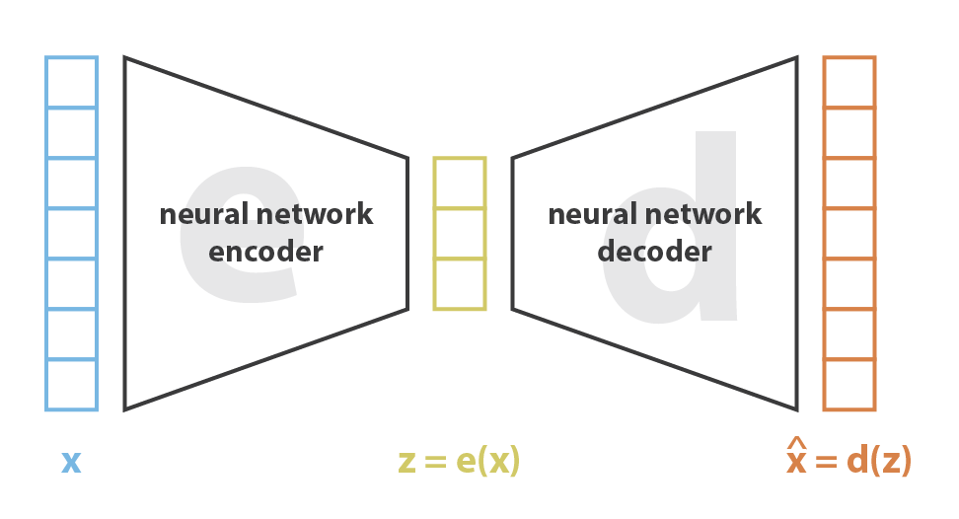
What is a VAE?
A variational autoencoder is a machine learning algorithm with the following parts:
Encoder : The part that compresses the data into a smaller form
Decoder : The part that decompresses the compressed data back into its original form.
What’s the “auto” part?
Many encoder/decoder combos can exist (maximize compression, minimize loss)
Autoencoders attach neural networks to the encoder and decoder such that training on a dataset will find the optimal encoder/decoder combo.

Slide 4
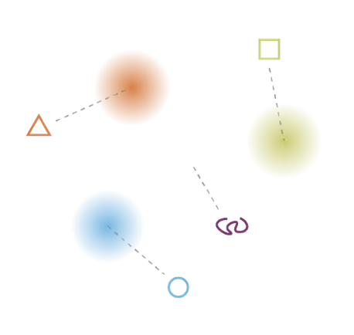
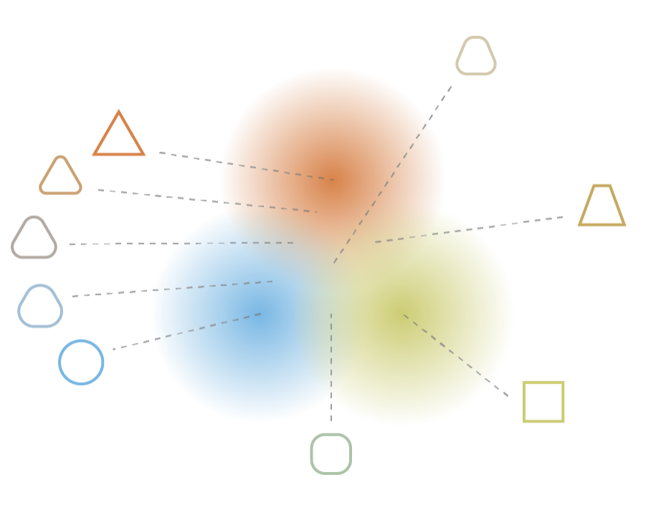
What is a VAE?
Irregular Latent Space
When something is encoded, its representation exists within the latent space.
Like change of basis (point moved to a new grid)
If an autoencoder optimized itself, it would overfit (top photo)
Latent space sparsely populated
Random sample means nothing (squiggle in photo)
Regular Latent Space
Variational: Autoencoder that forces inputs to be encoded as a distribution of points in latent space (regularization).
Increases size of “nets” in space (bottom photo)
Increases chance that random sample is meaningful
Point between triangle and circle = rounded triangle
Regularization allows us to get novel output from a random point in the encoded space.
Hence, if it is trained on music, it outputs novel music!

Slide 5

Results
The following six samples were generated using three different pre-trained algorithms of the Magenta library
2-bar Melody
2-bar Drums
16-bar Trio
Only keyboard
Pretty musical
Drums (61 different “types”)
Also pretty musical
Drums, Keyboard, and Bass
Struggles at start but can keep a musical ”theme”
A little busy-sounding

Slide 6
Disastrous Results
The following sample was created by training a VAE on music I enjoy… Apologies in advance.
No need for other samples — they all turned out the same.
No musicality
Nonsense
Way too busy
What happened?
Sample size too small (around 1,400 songs)
Couldn’t populate the latent space densely enough
Samples too varied (Fleetwood Mac, Nirvana, Herb Alpert)
Did not help to fill gaps in latent space

Slide 7
Conclusions
VAEs work for music generation, if you train them correctly
Need a ton of data for populous latent space
May be bad for singular-genre/theme generation (unless large dataset)

Slide 8
References
https://towardsdatascience.com/understanding-variational-autoencoders-vaes-f70510919f73
https://github.com/magenta/magenta/tree/main/magenta/models/music_vae

