Slide 1
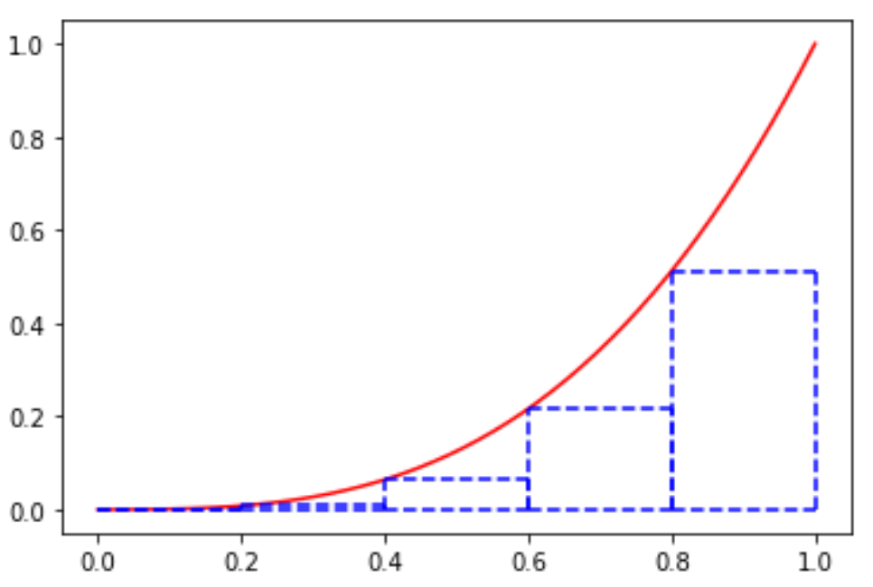
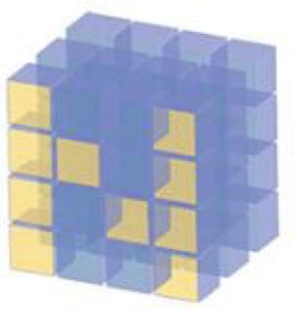
Numerical Integration

Slide 2
Reference
Youtube
Code

Slide 3
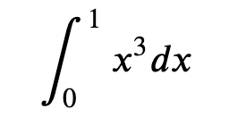

Slide 4
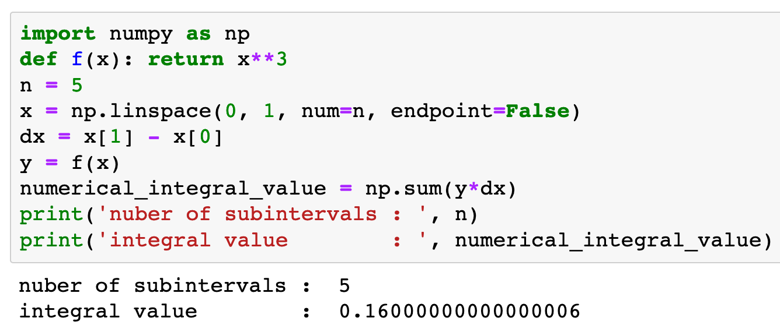

Slide 5
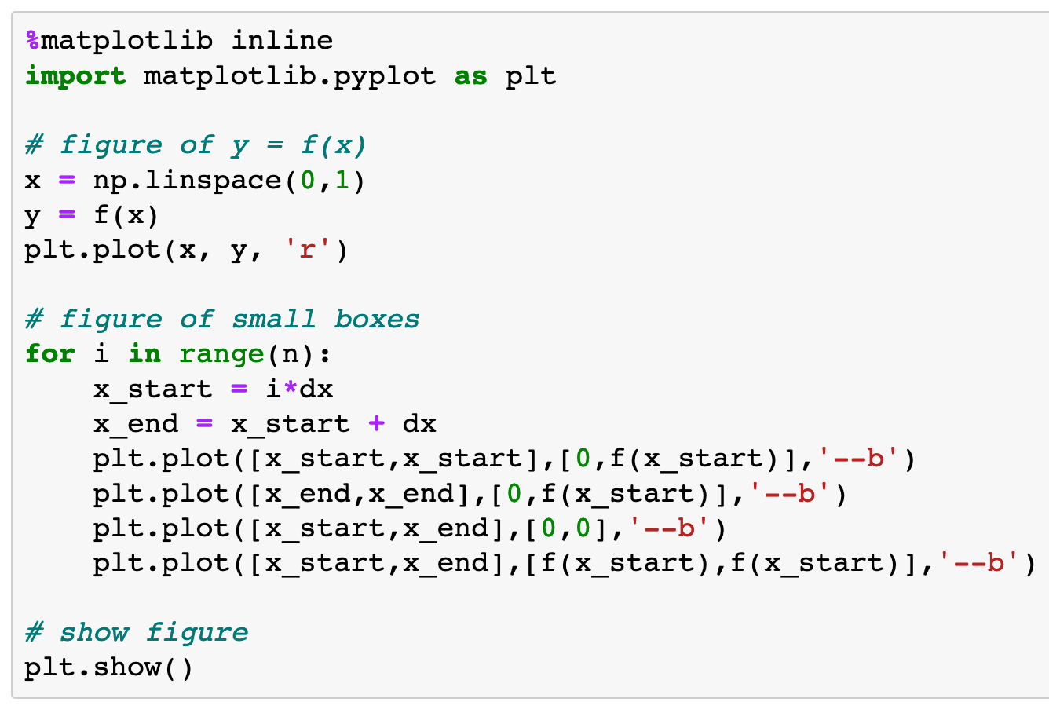

Slide 6
Speed of Convergence

Slide 7
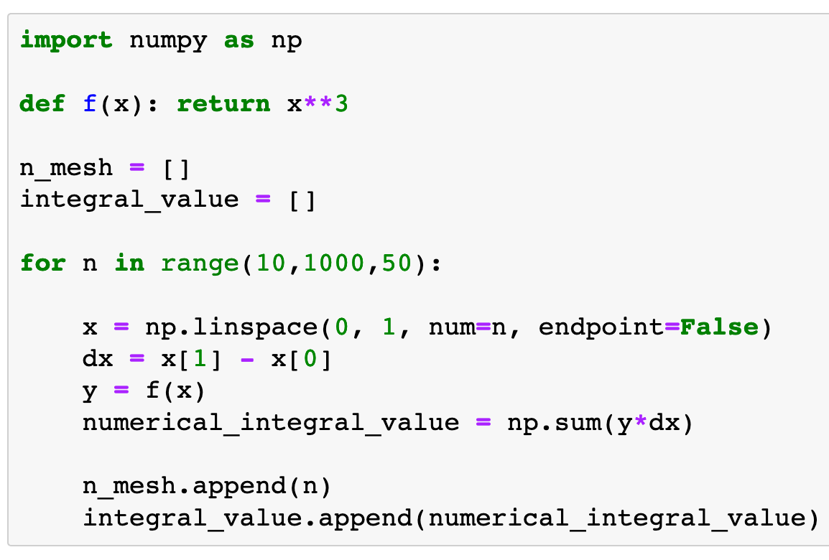

Slide 8
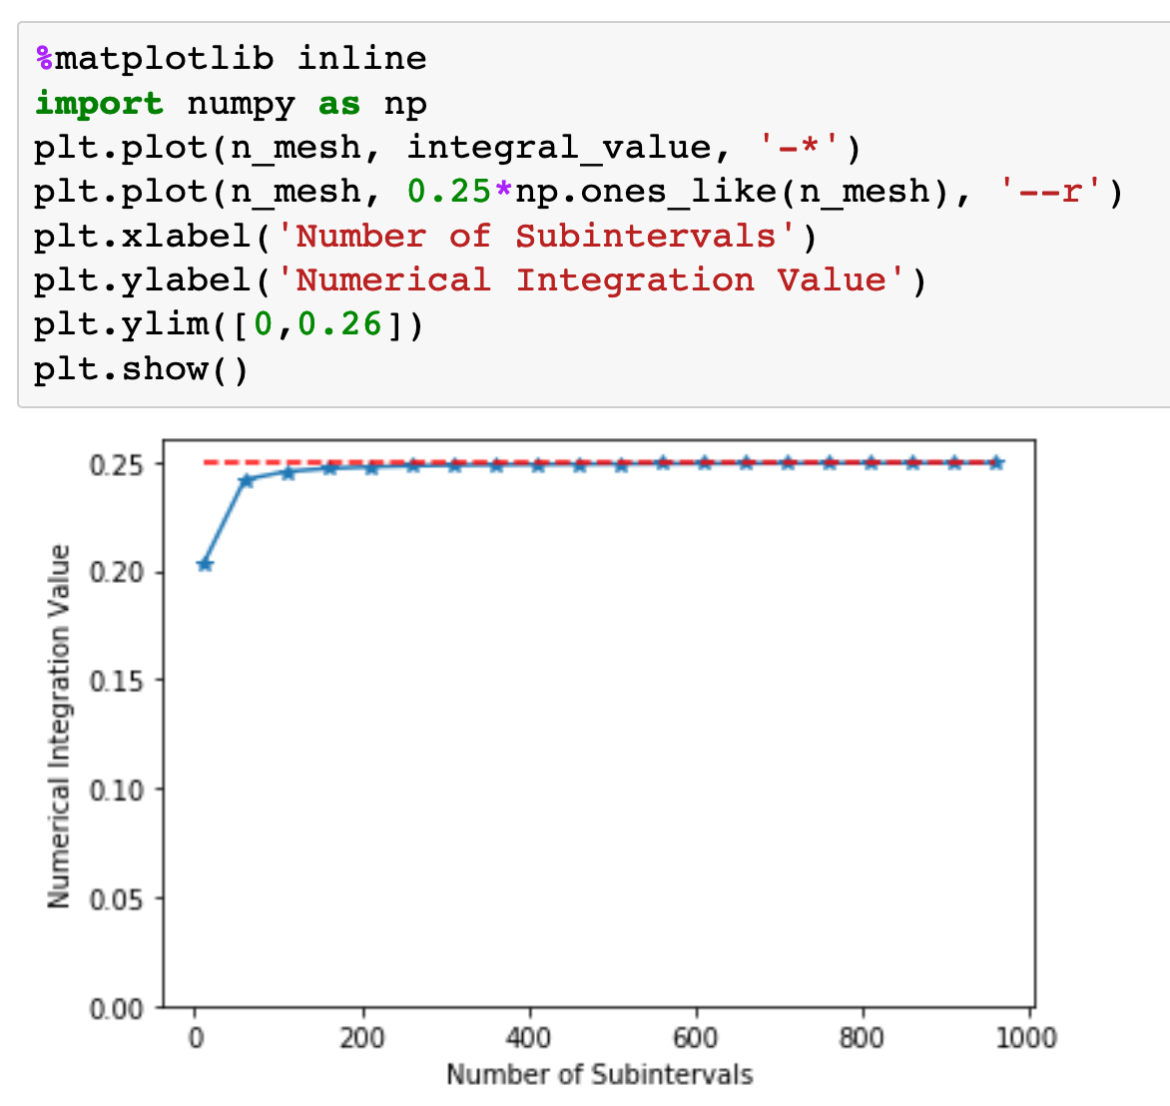

Slide 9
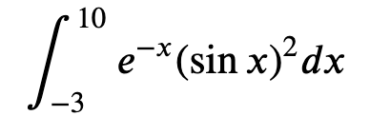
Exercise
1. Do the following integral using 20 subintervals.
2. Study it’s speed of convergence.

Slide 10
Now
Let’s Play with Code

