Slide 1
Mapping Community Health
Prepared for DATA824 Data Acquisition and Visualization
University of Kansas Medical Center | December 1, 2022

Slide 2
About the Data
The County Health Rankings & Roadmaps is a program of the Population Health Institute at the University of Wisconsin. County level data are collected annually from national and state-level public data sources, then standardized and combined.
I use the 2022 vintage of the CHR&R to visualize regional variation in measures of environmental and behavioral health

Slide 3
Measures of Interest
Adult smoking | Percentage of adults who are current smokers (age-adjusted).
Adult obesity | Percentage of the adult population (age 18 and older) that reports a body mass index (BMI) greater than or equal to 30 kg/m2 (age-adjusted).
Physical inactivity | Percentage of adults age 18 and over reporting no leisure-time physical activity (age-adjusted).
Excessive drinking | Percentage of adults reporting binge or heavy drinking (age-adjusted).
Food insecurity | Percentage of population who lack adequate access to food.
Broadband access | Percentage of households with broadband internet connection.
I have created a simple interactive web application that maps behavioral and environmental health measures at the county level (right). All maps present data for each health measure as either the percentages of the total population or the percentage of affected households. The data documentation and full data dictionary is available from:
https://www.countyhealthrankings.org/explore-health-rankings/measures-data-sources/2022-measures

Slide 4
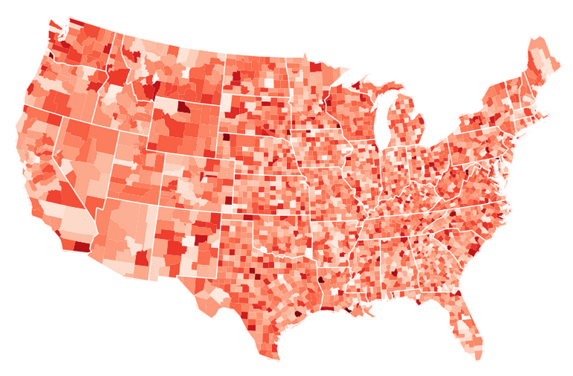
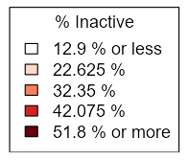
Using the App
Select a health indicators of interest from the dropdown list in the sidebar to display a choropleth map of the data. A choropleth map is a map uses color to display the regional variation of for a variable. Here for example, the app has plotted percentage of the adult population who report no leisure-time physical activity.
Percentage of adults aged 18+ reporting no leisure-time physical activity (age-adjusted).

Slide 5
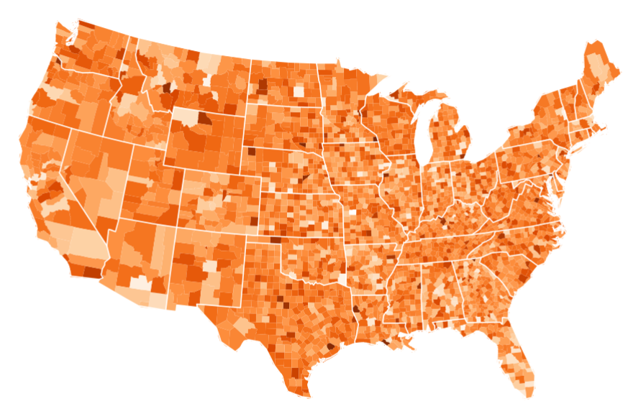
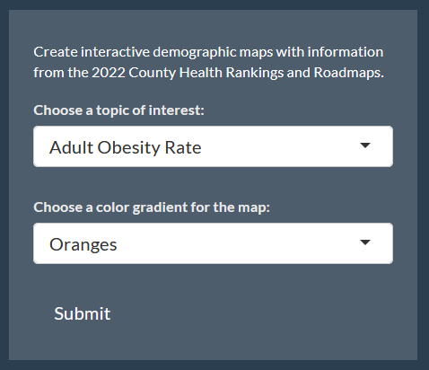
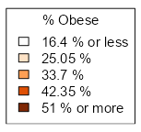
Percentage of the adult population (18+) that report a body mass index (BMI) > 30.
Map Aesthetics
After selecting a health indicator, users can change the aesthetics of the map by selecting a color gradient from the dropdown list. The legend is generated from the minimum and maximum values for each indicator.

Slide 6
Why Maps?
These maps allow users to see regional variation in key health indicators at-a-glance. Counties with exceptionally high percentages of excessive drinking, smoking, physical inactivity and obesity and stand out in sharp contrast to neighboring communities.
We can see from the preceding maps, for example, that there are “hotspot” counties with very high rates of obesity – and corresponding high rates of self-reported physical inactivity – in a cluster of counties central Texas, southeast Colorado, and the Oklahoma panhandle.

Slide 7
Download the App
Data files, app code and documentation have been posted to GitHub for download using the link below.
https://github.com/whitnerk/Data_824

