Slide 1

Predicting multiple drug use patterns by machine learning models
Whitney Chiu
Notes:
Hello everyone, Im Whitney from University of Toronto,
Drug use is a major problem affecting many people that are experiencing mental health issues, social insecure and even homelessness.
As well, together with other social and demographic risk factors, multiple drug use are likely mutually implicated.
Cocaine, one of the most addictive stimulant drug, has affected all levels of society across a wide range of age. According to the Advisory Council on the Misuse of Drugs (ACMD) in the UK, compared to other drugs, cocaine has been used up to the age of 54.
In this project, we aim to predict the cocaine consumption frequency with demographic data combined with other drug usage frequency. We aim to apply numerous machine learning techniques to see which model would accurately predict a person’s cocaine consumption frequency.
Final deliverable would include an interactive web page or app that enables prediction of a person’s cocaine usage. Other extensions would be included later on when the project moves forward and ideas spawn.
assess whether the use of substance use would prolong the experience of homelessness. In this project, I aim to test the association between substance use and stage of homelessness. Findings would assist in preventing people from relapsed and prolonged homelessness as well as inform policy for intervention of social assistance in targeted groups.

Slide 2
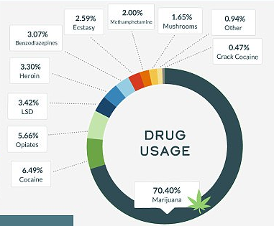

Drug usage in the US
6.49% Cocaine
70.40% Marijuana
Source: https://www.dailymail.co.uk/health/article-4647780/America-s-drug-addiction-revealed-new-report.html
Whitney Chiu |

Slide 3
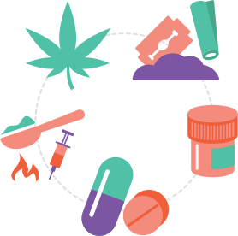
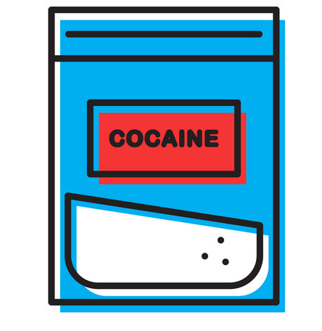


Project goal
introduction
Whitney Chiu |
Notes:
Drug use is a major problem affecting many people that are experiencing mental health issues, social insecure and even homelessness.
As well, together with other social and demographic risk factors, multiple drug use are likely mutually implicated.
Cocaine, one of the most addictive stimulant drug, has affected all levels of society across a wide range of age. According to the Advisory Council on the Misuse of Drugs (ACMD) in the UK, compared to other drugs, cocaine has been used up to the age of 54.
In this project, we aim to predict the cocaine consumption frequency with demographic data combined with other drug usage frequency. We aim to apply numerous machine learning techniques to see which model would accurately predict a person’s cocaine consumption frequency.
Final deliverable would include an interactive web page or app that enables prediction of a person’s cocaine usage. Other extensions would be included later on when the project moves forward and ideas spawn.
assess whether the use of substance use would prolong the experience of homelessness. In this project, I aim to test the association between substance use and stage of homelessness. Findings would assist in preventing people from relapsed and prolonged homelessness as well as inform policy for intervention of social assistance in targeted groups.

Slide 4
Objective
The Physician Payment Sunshine Act
Train a classifier to predict cocaine consumption frequency with demographic data combined with other drug usage frequency
Apply multiple deep learning models to optimize accuracy
K- nearest neighbors
Multilayer perceptron with gradient descent
Decision tree
Support vector machine
Whitney Chiu |
Notes:
Drug use is a major problem affecting many people that are experiencing mental health issues, social insecure and even homelessness.
As well, together with other social and demographic risk factors, multiple drug use are likely mutually implicated.
Cocaine, one of the most addictive stimulant drug, has affected all levels of society across a wide range of age. According to the Advisory Council on the Misuse of Drugs (ACMD) in the UK, compared to other drugs, cocaine has been used up to the age of 54.
In this project, we aim to predict the cocaine consumption frequency with demographic data combined with other drug usage frequency. We aim to apply numerous machine learning techniques to see which model would accurately predict a person’s cocaine consumption frequency.
Final deliverable would include an interactive web page or app that enables prediction of a person’s cocaine usage. Other extensions would be included later on when the project moves forward and ideas spawn.
assess whether the use of substance use would prolong the experience of homelessness. In this project, I aim to test the association between substance use and stage of homelessness. Findings would assist in preventing people from relapsed and prolonged homelessness as well as inform policy for intervention of social assistance in targeted groups.
Backpropagation, Perceptron, Decision tree, Support Vector Machine(SVM), k-nearest neighbors

Slide 5
Dataset: UCI ML Repository
1885 respondents; 32 categorical features
12 Personality measurements Age, gender, education, country of residence, ethnicity, impulsivity, sensation seeking, neuroticism, extraversion, openness to experience, agreeableness, conscientiousness
18 legal and illegal drugs Alcohol, amphetamines, amyl nitrite, benzodiazepines, cannabis, chocolate, cocaine, caffeine, crack, ecstasy, heroin, ketamine, legal highs, LSD, methadone, mushrooms, nicotine, volatile
Whitney Chiu |
Notes:
Database contains records for 1885 respondents. For each respondent 12 attributes are known: Personality measurements which include NEO-FFI-R (neuroticism, extraversion, openness to experience, agreeableness, and conscientiousness), BIS-11 (impulsivity), and ImpSS (sensation seeking), level of education, age, gender, country of residence and ethnicity. All input attributes are originally categorical and are quantified. After quantification values of all input features can be considered as real-valued. In addition,
participants were questioned concerning their use of 18 legal and illegal drugs (alcohol, amphetamines, amyl nitrite, benzodiazepine, cannabis, chocolate, cocaine, caffeine, crack, ecstasy, heroin, ketamine, legal highs, LSD, methadone, mushrooms, nicotine and volatile substance abuse and one fictitious drug (Semeron) which was introduced to identify over-claimers. For each drug they have to select one of the answers: never used the drug, used it over a decade ago, or in the last decade, year, month, week, or day. Database contains 18 classification problems. Each of independent label variables contains seven classes: "Never Used", "Used over a Decade Ago", "Used in Last Decade", "Used in Last Year", "Used in Last Month", "Used in Last Week", and "Used in Last Day".

Slide 6
Explanatory analyses
HT Derek Liu |

Slide 7
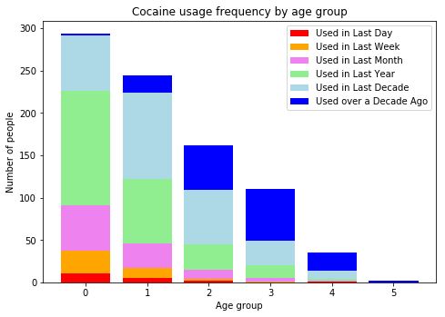
The Health Sector Payment Transparency Act
18-24
25-34
35-44
45-54
55-64
65+
Whitney Chiu |
Notes:
Number of total users decreased as age increases
Those ages
-0.95197 18-24 643 34.11%
-0.07854 25-34 481 25.52%
0.49788 35-44 356 18.89%
1.09449 45-54 294 15.60%
1.82213 55-64 93 4.93%
2.59171 65+ 18 0.95%
Portion of people never used cocaine

Slide 8
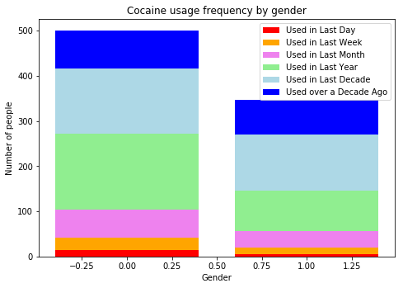
The Health Sector Payment Transparency Act
Male
Female
Whitney Chiu |
Notes:
There were approximately the same number of males and females in the

Slide 9
Conclusion
Final deliverables
An interactive web page or app enables prediction of a person’s cocaine usage
Similar method applied to predicting other drug usage frequency classification
Whitney Chiu |
Notes:
The impact of the Act on decision making Are still unknown and

Slide 10
Predicting multiple drug use patterns by machine learning models
Whitney Chiu
whitney.chiu@mail.utoronto.edu

