Slide 1

Predicting multiple drug use patterns by machine learning models
Whitney Chiu

Slide 2
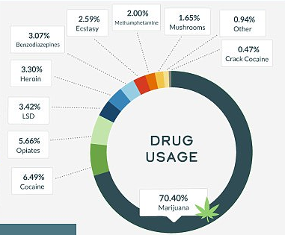

Drug usage in the US
6.49% Cocaine
70.40% Marijuana
Source: https://www.dailymail.co.uk/health/article-4647780/America-s-drug-addiction-revealed-new-report.html
Whitney Chiu |

Slide 3
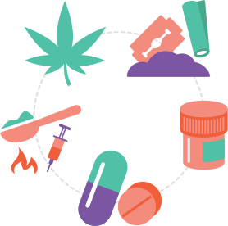
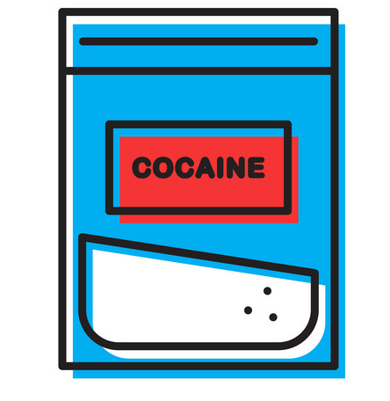


Project goal
introduction
Whitney Chiu |

Slide 4
Objective
The Physician Payment Sunshine Act
Train a classifier to predict cocaine consumption frequency with demographic data combined with other drug usage frequency
Apply multiple deep learning models to optimize accuracy
K- nearest neighbors
Multilayer perceptron with gradient descent
Decision tree
Support vector machine
Whitney Chiu |

Slide 5
Dataset: UCI ML Repository
1885 respondents; 32 categorical features
12 Personality measurements Age, gender, education, country of residence, ethnicity, impulsivity, sensation seeking, neuroticism, extraversion, openness to experience, agreeableness, conscientiousness
18 legal and illegal drugs Alcohol, amphetamines, amyl nitrite, benzodiazepines, cannabis, chocolate, cocaine, caffeine, crack, ecstasy, heroin, ketamine, legal highs, LSD, methadone, mushrooms, nicotine, volatile
Whitney Chiu |

Slide 6
Explanatory analyses
HT Derek Liu |

Slide 7
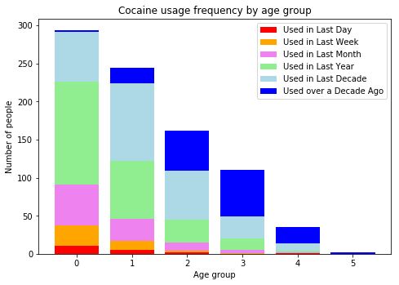
The Health Sector Payment Transparency Act
18-24
25-34
35-44
45-54
55-64
65+
Whitney Chiu |

Slide 8
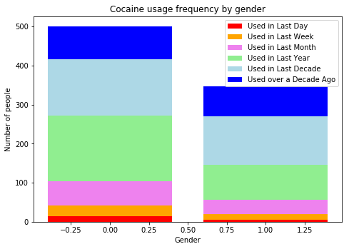
The Health Sector Payment Transparency Act
Male
Female
Whitney Chiu |

Slide 9
Conclusion
Final deliverables
An interactive web page or app enables prediction of a person’s cocaine usage
Similar method applied to predicting other drug usage frequency classification
Whitney Chiu |

Slide 10
Predicting multiple drug use patterns by machine learning models
Whitney Chiu
whitney.chiu@mail.utoronto.edu

