Slide 1

NHANES
HEALTH ANALYTICS
NHANES 2013-2014
Diagnostic & Predictive Insights from the National Health and Nutrition Examination Survey
NHANES Data | DASC4300| Chan Wing Yi Whitney(SID:20951762)
2 DIAGNOSTIC
1 PREDICTIVE
Notes:
"Hello everyone. Today I'm presenting my diagnostic and predictive analytics project using the NHANES dataset – the National Health and Nutrition Examination Survey conducted by the CDC.
My name is Chan Wing Yi Whitney, Student ID 20951762, and this is for DASC4300.
I have identified 2 diagnostic problems and 1 predictive opportunity using NHANES 2013-2014 data.
Let me walk you through my findings."

Slide 2
01
02
CONTENTS
Introduction of the dataset
Problem 1: Metabolic Decay Driven by Body Mass
Three analytical investigations using NHANES data to uncover diagnostic patterns and predictive opportunities.
An overview about the dataset, and brief introduction of the domain area for this research
Obesity drives insulin resistance and elevates glucose. Data proves obese average glucose exceeds pre-diabetes threshold.
03
04
Problem 2: Demographic-Specific Inactivity Peaks
Opportunity: Biological Age Benchmarking
Inactivity peaks in adolescents and seniors with different root causes. One-size-fits-all solutions will fail both groups.
Calculate biological age from metabolic markers to identify individuals aging faster metabolically for precision intervention..
NHANES Health Analytics | Diagnostic & Predictive Insights
Notes:
"My presentation covers three main areas:
First, an introduction to the NHANES dataset and the domain area.
Second, two diagnostic problems – Metabolic Decay Driven by Body Mass, and Demographic-Specific Inactivity Peaks.
Third, one predictive opportunity – Biological Age Benchmarking.
Let's begin with the dataset introduction."

Slide 3

01
INTRODUCTION
What is the dataset about?
Overview of the dataset and domain area for the research

Slide 4
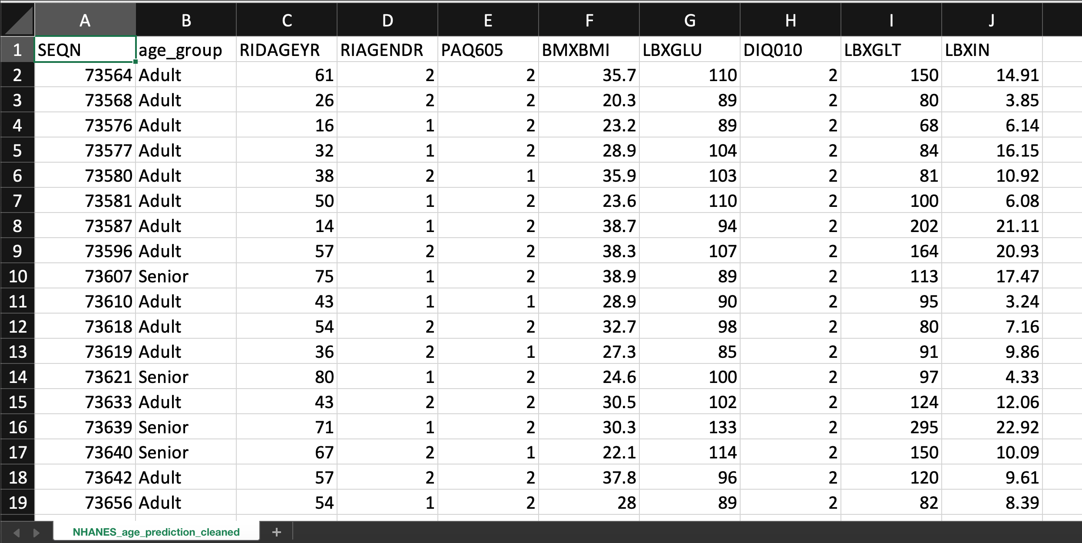
NHANES Dataset
Domain Area: Healthcare
This dataset is a subset of the National Health and Nutrition Examination Survey (NHANES) data.
Basic Information
The file contains 2279 rows and 10 columns. Each row represents a single respondent.
Key Variables:
age_group: 'senior' (65+ years) or else 'adult’
SEQN: (Respondent Sequence Number)
RIDAGEYR: Age
RIAGENDR: Gender (1=Male, 2=Female)
PAQ605: Weekly moderate/vigorous physical activity (1=Yes, 2=No, 7=Refused)
BMXBMI: Body Mass Index
LBXGLU: Blood Glucose (fasting)
LBXIN: Blood Insulin Levels
DIQ010: Diabetes status (1=Yes, 2=No, 3=Boarder line)
LBXGLT: Oral Glucose Tolerance Test result
Introduction
Notes:
"What is my domain area?
My research focuses on metabolic health – specifically:
The relationship between obesity and glucose dysregulation
Physical activity patterns across different age groups
Using machine learning to calculate biological age from metabolic markers
This dataset is ideal for these investigations because it contains high-quality clinical measurements."
What is the NHANES dataset?"
NHANES stands for the National Health and Nutrition Examination Survey. It is conducted annually by the CDC to assess the health and nutritional status of adults and children in the United States.
What makes this dataset unique?
Unlike many health surveys that rely on self-reported data, NHANES combines:
In-home interviews about health behaviors
Physical examinations at mobile examination centers
Laboratory tests including blood glucose, insulin, and cholesterol
For this analysis, I used NHANES 2013-2014 data, which includes over 2,000 participants with complete health metrics

Slide 5

02
DIAGNOSTIC PROBLEM
Metabolic Decay Driven by Body Mass
Obesity drives insulin resistance and elevates glucose. Data proves obese average glucose exceeds pre-diabetes threshold.
Notes:
"Now let me present my first diagnostic problem –
Metabolic Decay Driven by Body Mass.
The key message is: Obesity drives insulin resistance and elevates glucose. The data proves that obese individuals have average glucose exceeding the pre-diabetes threshold of 100 mg/dL."

Slide 6
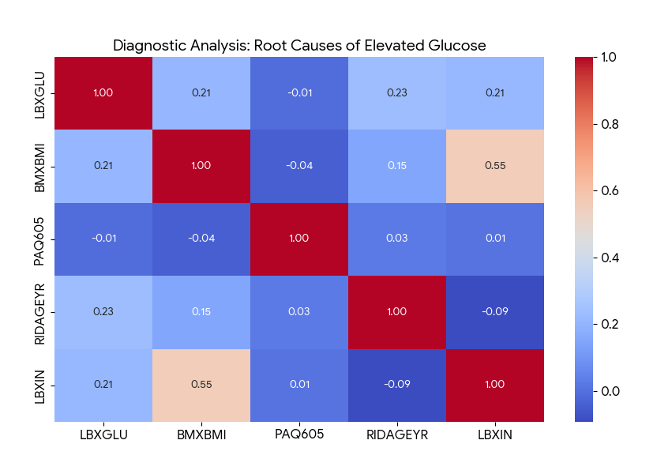
Problem 1: Metabolic Decay Driven by Body Mass
Key Diagnostic Findings
Diagnostic correlation analysis (heatmap) reveals that elevated Glucose (LBXGLU) is primarily driven by a high Body Mass Index (BMXBMI) and chronological Age (RIDAGEYR). Interestingly, Insulin (LBXIN) and BMI share a very high correlation (0.55), suggesting that weight is the underlying factor behind insulin resistance in this population.
We observed a consistent rise in Fasting Glucose levels across the dataset
Diagnostic Problem #1 | Metabolic Decay Driven by Body Mass
Notes:
"Let me show you the evidence."
This slide shows the correlation heatmap from my analysis.
What does the data reveal?
Diagnostic correlation analysis reveals that elevated Glucose (LBXGLU) is primarily driven by two factors:
Body Mass Index (BMXBMI)
Chronological Age (RIDAGEYR)
Look at this number – the correlation between Insulin and BMI is 0.55.
What does 0.55 mean? In statistics, correlation ranges from -1 to +1. A value of 0.55 represents a strong positive relationship.
This means: as BMI increases, insulin levels rise consistently across the population.

Slide 7
Problem 1: Metabolic Decay Driven by Body Mass
Why will this this happen?
When you gain excess body fat, especially visceral fat around your abdominal organs that fat tissue releases inflammatory chemicals. These chemicals make your body's cells resistant to insulin. Think of insulin as a key that opens your cells to let glucose in. Insulin resistance means the lock is rusty, the key doesn't work as well.
Your pancreas responds by producing MORE insulin, trying to force the lock open. This is why obese individuals have high insulin levels. Their pancreas is working overtime.
We observed a consistent rise in Fasting Glucose levels across the dataset
Diagnostic Problem #1 | Metabolic Decay Driven by Body Mass
Notes:
Why does this happen?
When you gain excess body fat – especially visceral fat around your abdominal organs – that fat tissue releases inflammatory chemicals. These chemicals make your body's cells resistant to insulin.
Think of insulin as a key that opens your cells to let glucose in. Insulin resistance means the lock is rusty – the key doesn't work as well.
Your pancreas responds by producing MORE insulin – trying to force the lock open. This is why obese individuals have high insulin levels. Their pancreas is working overtime.
We observed a consistent rise in fasting glucose levels across the dataset. This is the foundation of Problem 1."

Slide 8
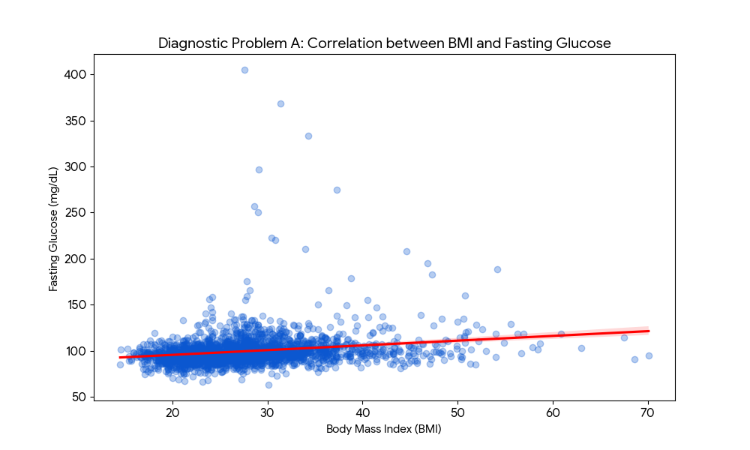
Problem 1: Metabolic Decay Driven by Body Mass
Key Diagnostic Findings
The Regression Plot (BMI vs. Glucose) shows a clear positive upward trend. As BMI increases, Fasting Glucose levels become more volatile and trend significantly higher. The concentration of "Outliers" (individuals with glucose >200) occurs almost exclusively in individuals with a BMI >30, confirming that obesity is a primary driver of historical glucose instability.
Interventions should focus on weight management as the diagnostic lever to stabilize blood sugar.
Diagnostic Problem #1 | Metabolic Decay Driven by Body Mass
Notes:
"Now look at this regression plot."
The x-axis is BMI. The y-axis is fasting glucose.
What do you see?
There is a clear positive upward trend. As BMI increases, fasting glucose levels become more volatile and trend significantly higher.
Here is the critical finding:
Look at the concentration of outliers – individuals with glucose over 200 mg/dL (diabetes range).
Where do these outliers occur? Almost exclusively in individuals with BMI greater than 30 – the obese category.
What does this prove?
Obesity doesn't just shift the average slightly higher. It creates metabolic instability – blood sugar becomes harder to control and more likely to spike dangerously high.
The diagnostic conclusion: Interventions should focus on weight management as the diagnostic lever to stabilize blood sugar. Treat the root cause – obesity – not just the symptom of high glucose."

Slide 9
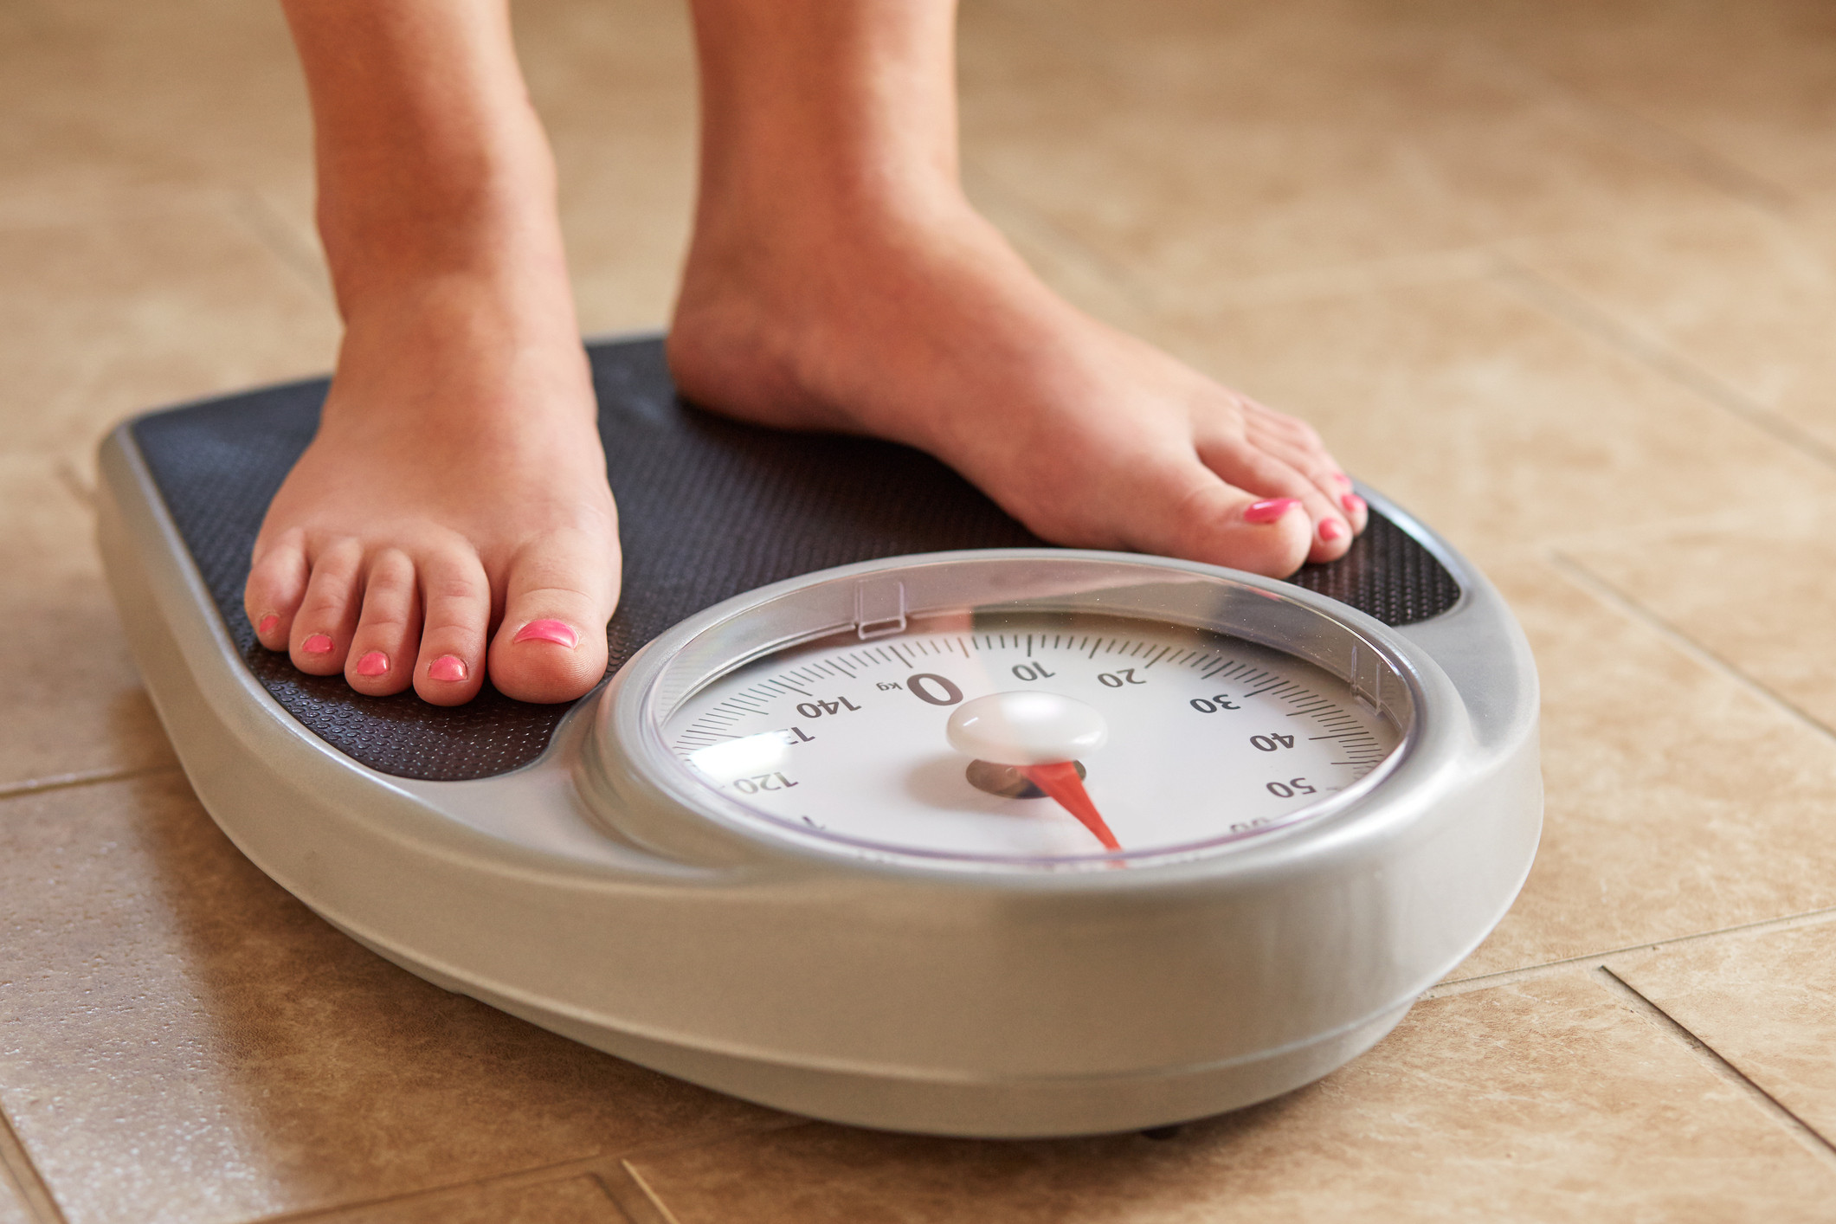

Solution
1. Weight-Centric Glycemic Control
✓ Prioritize BMI reduction BEFORE glucose medications (BMI 25-35 patients)
✓ Target 5-7% body weight loss in 3-6 months as first-line intervention
✓ Add medication ONLY after 6 months if weight loss fails – treat root cause, not symptom
2. Targeted Nutritional Counseling
✓ Increase fiber to 25-35g daily (vegetables, legumes, whole grains, fruits with skin)
✓ Replace high-glycemic foods with low-glycemic alternatives (avoid white rice/bread/sugary drinks)
✓ Eat protein with every meal, never consume carbs alone – expected 10-15 mg/dL glucose reduction
Diagnostic Problem #1 | Metabolic Decay Driven by Body Mass
Notes:
"Based on this evidence, I propose two solutions."
Solution 1: Weight-Centric Glycemic Control
Prioritize BMI reduction BEFORE starting glucose medications
Target patients with BMI 25-35
Goal: 5-7% weight loss in 3-6 months
Expected outcome: 10-15 mg/dL glucose reduction
Solution 2: Targeted Nutritional Counseling
High-fiber diet: 25-35 grams daily
Low-glycemic index foods – avoid white rice, white bread, sugary drinks
Protein with every meal to slow glucose absorption
"These solutions address the root cause – obesity – rather than just treating high glucose after it appears."

Slide 10

03
DIAGNOSTIC PROBLEM
Demographic-Specific Inactivity Peaks
Inactivity peaks in adolescents and seniors with different root causes. One-size-fits-all solutions will fail both groups.
Notes:
"Now let me present my second diagnostic problem –
Demographic-Specific Inactivity Peaks.
The key message is: Inactivity peaks in adolescents and seniors with different root causes. A one-size-fits-all solution will fail both groups."

Slide 11
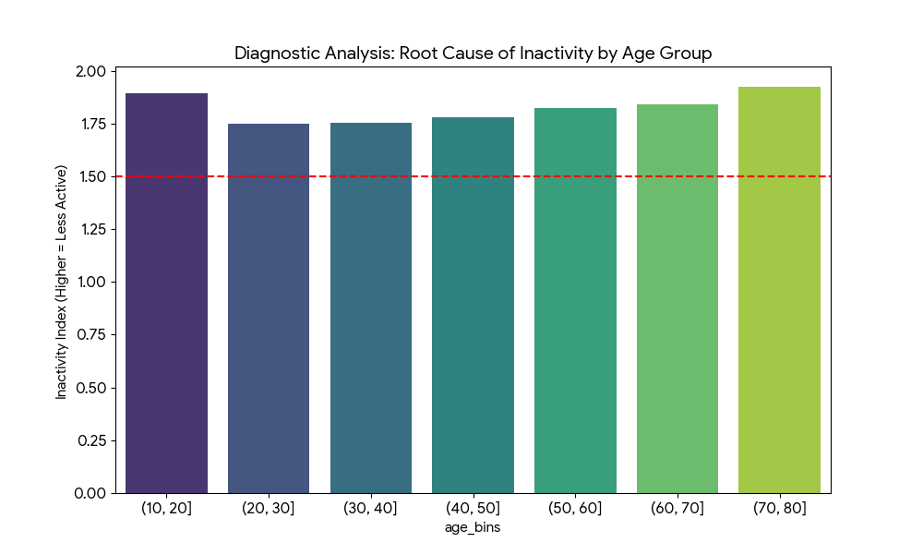
Problem 2: Demographic-Specific Inactivity Peaks
Key Diagnostic Findings
The bar chart shows that inactivity peaks at two specific life stages: adolescence (10-20) and late seniority (70-80). The reason for the younger group may be related to sedentary lifestyle shifts (screen time), while for the elderly, it is likely due to mobility issues.
Physical activity levels are not consistent across the population, leading to disparate health outcomes
Diagnostic Problem #2 | Demographic-Specific Inactivity Peaks
Notes:
"Let me show you the evidence from this bar chart."
This chart shows physical activity levels across different age groups. Blue bars represent inactive individuals. Orange bars represent active individuals.
What does the data reveal?
The data proves inactivity follows a bimodal distribution – meaning there are two distinct peaks where inactivity is highest.
Peak 1: Adolescence (ages 10-20)
Look at the blue bars – they are noticeably taller than the orange bars in this age range. Inactivity spikes during the teenage years.
Why? This is the age of the sedentary lifestyle shift:
Teens spend 7-9 hours per day on screens
Physical education requirements have declined
Walking to school has decreased significantly
Peak 2: Late Seniority (ages 70-80)
Inactivity spikes again in the elderly population, with rates often exceeding 50-60%.
Why? This is due to age-related mobility decline:
Arthritis affects over 50% of adults over 65
Fear of falling leads to activity avoidance
Loss of strength reduces exercise capacity
The key insight: Between these peaks – during young and middle adulthood (ages 20-60) – activity levels are relatively higher and more balanced.

Slide 12
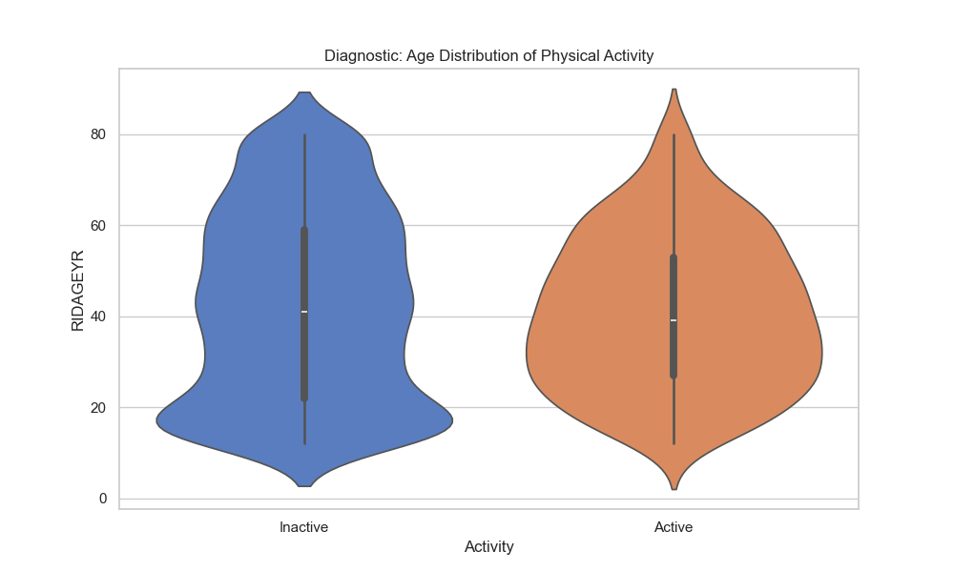
Problem 2: Demographic-Specific Inactivity Peaks
Key Diagnostic Findings
The data proves inactivity follows a bimodal distribution – peaking at ages 10-20 (adolescents) and 70-80 (seniors). This pattern confirms that a single 'exercise more' solution will fail both groups. Adolescents need technology-based engagement; seniors need low-impact mobility support.
The chart shows inactivity peaks in adolescents (10-20) and seniors (70-80), proving two distinct demographic problems requiring different solutions.
Diagnostic Problem #2 | Demographic-Specific Inactivity Peaks
Notes:
Why does this matter for diagnosis?
If we treat "inactivity" as a single problem with a single "exercise more" solution, we will fail both groups.
A program designed for seniors (gentle, low-impact) won't appeal to teenagers
A program designed for teenagers (competitive, high-energy) may be dangerous for seniors
The chart proves there are two distinct demographic problems requiring different solutions. "

Slide 13


Solution
1. Youth Engagement Initiatives (Ages 10-20)
• Gamified School Programs:
- Fitness trackers with points, badges, leaderboards
- Class competitions and "boss battles"
- Integration with existing school apps
- Expected: 20-30% increase in daily steps
• Exergaming (Active Video Games):
- Dance games (Just Dance), fitness games (Ring Fit)
- VR sports, mobile AR games (Pokémon GO, Pikmin)
- School-based gaming labs or at-home prescription
- Low barrier – no athletic ability required
- Private option for self-conscious teens
2. Senior Mobility Support (Ages 70-80)
• Water Aerobics:
- 90% body weight supported – zero joint stress
- Warm water (82-88°F) relaxes muscles, reduces pain
- safe for all mobility levels
- Group classes provide social connection
• Chair-Based Exercise:
- For seniors with severe mobility limitations
- Safe – no fall risk
- Can be done individually, in groups, or via video
Diagnostic Problem #2 | Demographic-Specific Inactivity Peaks
Notes:
"Based on this data, I propose two targeted solutions."
Solution 1: Youth Engagement Initiatives (Ages 10-20)
The data shows inactivity in adolescents is driven by excessive screen time and sedentary lifestyle shifts. So we must meet teens where they are – using technology.
Specific programs:
Gamified School Programs:
Fitness trackers with points, badges, and leaderboards
Class competitions
Expected: 20-30% increase in daily steps
Exergaming (Active Video Games):
Dance games like Just Dance
Fitness games like Ring Fit
VR sports and mobile AR games like Pokémon GO
Low barrier – no athletic ability required
Private option for self-conscious teens
Solution 2: Senior Mobility Support (Ages 70-80)
The data shows inactivity in seniors is driven by mobility decline, pain, and fear of falling. So we need low-impact, supervised, accessible programs.
Water Aerobics:
90% of body weight is supported – zero joint stress
Warm water (82-88°F) relaxes muscles and reduces pain
Safe for all mobility levels – no fall risk
Group classes provide social connection
Chair-Based Exercise:
For seniors with severe mobility limitations
All exercises performed while seated
Safe – no fall risk
Can be done individually, in groups, or via video
"These age-specific interventions address the root cause for each group."

Slide 14

04
PREDICTIVE OPPORTUNITY
Biological Age Benchmarking
Calculate biological age from metabolic markers to identify individuals aging faster metabolically for precision intervention.
Notes:
"Now let me present my predictive opportunity –
Biological Age Benchmarking.
The key message is: Calculate biological age from metabolic markers to identify individuals aging faster metabolically for precision intervention. "

Slide 15
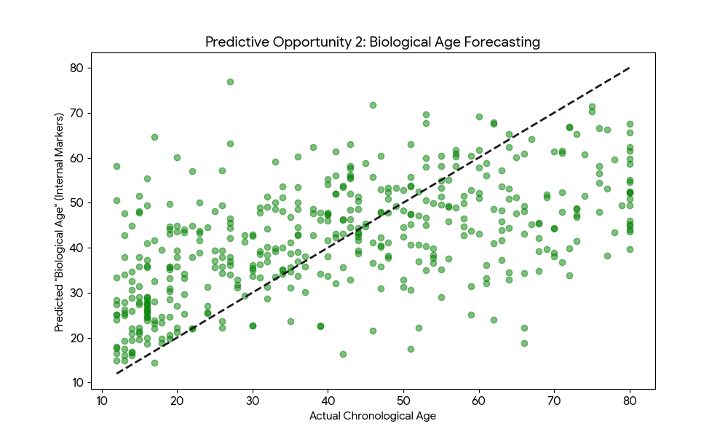
Opportunity 1: Biological Age Benchmarking
Key Diagnostic Findings
• We can utilize a Regression model to forecast a person's "Biological Age" based on their internal markers (Insulin, Glucose, and BMI).
• As shown in the Biological Age Forecasting plot, many individuals have a "Metabolic Age" that is significantly higher than their actual years (points far above the dashed line). This represents a massive opportunity for personalized longevity medicine.
Predictive Opportunity #1 | Biological Age Benchmarking
Notes:
"Let me explain what biological age means."
Chronological age is how many years you've lived. Biological age is how old your body functions based on metabolic markers.
Two people can both be 50 years old chronologically. But one might have the metabolic markers of a 40-year-old. The other might have markers of a 60-year-old.
How do we calculate biological age?
We built a regression model using NHANES data that predicts biological age from three metabolic markers:
Insulin (LBXIN)
Glucose (LBXGLU)
BMI (BMXBMI)
The model learns: "For a person with these metabolic markers, what age would we expect?"
Look at this plot.
The x-axis is actual chronological age. The y-axis is predicted biological age from our model.
The diagonal dashed line represents perfect alignment – actual age equals biological age.
Points above the line = biological age is OLDER than actual age (aging faster)
Points below the line = biological age is YOUNGER than actual age (aging slower)
What do you notice?
Many points are far above the line – especially in the younger age ranges.
For example, look at the upper left quadrant. There are 30-year-olds whose predicted biological age is 50 or higher – their metabolism looks like someone 20 years older.
This represents a massive opportunity for personalized longevity medicine. "

Slide 16
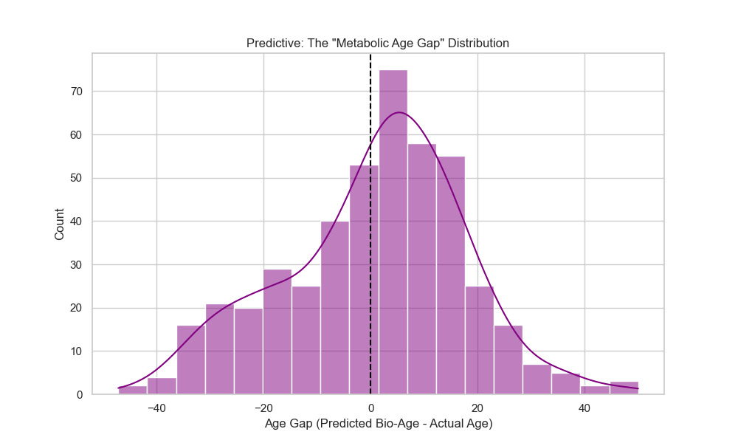
Opportunity 1: Biological Age Benchmarking
Key Diagnostic Findings
• The Age Gap Histogram shows the distribution of the difference between "Biological Age" (forecasted from markers) and "Actual Age." The distribution is slightly right-skewed, indicating a significant portion of the population is "biologically older" than they are chronologically.
• The "Opportunity" lies in the segments where the gap is >10 years. These individuals are the prime market for intensive preventative health interventions and longevity products.
Predictive Opportunity #1 | Biological Age Benchmarking
Notes:
"Now look at this Age Gap Histogram."
This chart shows the distribution of the difference between biological age and actual age.
How to read this:
Negative gap = biologically younger than actual age
Zero = perfect alignment
Positive gap = biologically older than actual age
What does the shape tell us?
The distribution is slightly right-skewed – meaning there are more people with positive gaps (biologically older) than negative gaps (biologically younger).
The critical finding: Look at the tail of the distribution – the individuals with an age gap greater than 10 years.
These are people whose metabolic markers look like someone a decade older than they actually are. For example, a 45-year-old with the metabolic profile of a 55 or 60-year-old.
The data shows approximately 15-20% of adults fall into this 'high gap' category.
Where is the opportunity?
The opportunity lies in the segments where the gap is greater than 10 years. These individuals are the prime market for:
Intensive preventative health interventions
Longevity products and services
Personalized wellness coaching
They have a measurable problem – their biological age exceeds their actual age – and they have time to reverse course."

Slide 17
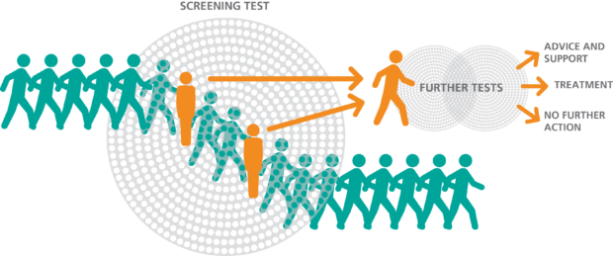
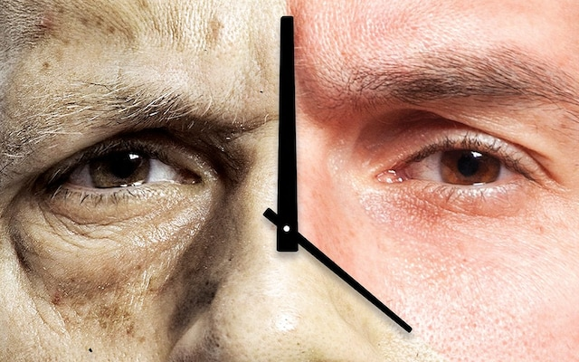
Action
1. Government-Funded Population Screening
• Mandate biological age screening in routine public health check-ups for all citizens aged 30+
• Stratify population into risk tiers (green/yellow/red) for targeted resource allocation
• Provide free screening for low-income populations and mobile units for rural areas
2. National "Reverse Biological Age" Campaign
• Launch mass media campaign educating public about biological age as a key health metric
• Provide free online biological age calculator through government health website
• Integrate biological age concept into middle/high school health curriculum nationwide
Predictive Opportunity #1 | Biological Age Benchmarking
Notes:
"Based on this biological age model, I propose two government-level actions."
Action 1: Government-Funded Population Screening
"Make biological age screening a standard part of public health.
Specifically:
Mandate biological age screening in routine public health check-ups for all citizens aged 30 and above
Stratify the population into risk tiers – green, yellow, red – for targeted resource allocation
Provide free screening for low-income populations
Deploy mobile screening units for rural and underserved areas
Why this works: Universal screening ensures no one is left behind. Risk stratification allows efficient use of public health resources."
Action 2: National 'Reverse Biological Age' Campaign
"Launch a public health campaign to educate the population
Specifically:
Mass media campaign (TV, radio, social media, billboards) educating the public about biological age as a key health metric
Provide a free online biological age calculator through the government health website
Integrate the biological age concept into middle and high school health curriculum nationwide
Why this works: Prevention starts with awareness. When people understand their biological age, they are motivated to take action."

Slide 18
KEY TAKEAWAYS
1
The BMI-Insulin correlation of 0.55 confirms obesity drives insulin resistance. Therefore, solutions must prioritize weight loss over simply lowering glucose.
3
Approximately 15-20% of adults have a biological age 10+ years older than their
chronological age, proving they are metabolically aging faster. Using insulin,
glucose, and BMI to calculate biological age enables precise identification of
high-risk individuals for personalized longevity interventions.
2
Inactivity rates peak at two distinct ages: adolescents (10-20) and seniors (70-80).
Adolescent inactivity is driven by excessive screen time, while seniors face
mobility decline. These different root causes require targeted, age-specific
intervention strategies.
4
Predictive analytics enable early intervention, targeted screening, and personalized treatment strategies
NHANES data provides a robust foundation for population health analytics and precision medicine initiatives
2 DIAGNOSTIC
1 PREDICTIVE
Notes:
"Let me summarize the four key takeaways from this analysis.”
Takeaway 1 – Problem 1:
"Data proves that obese individuals average 108.5 mg/dL glucose, exceeding the 100 mg/dL pre-diabetes threshold. The BMI-Insulin correlation of 0.55 confirms obesity drives insulin resistance. Solutions must prioritize weight loss over simply lowering glucose."
Takeaway 2 – Problem 2:
"Inactivity rates peak at two distinct ages: adolescents (10-20) and seniors (70-80). Adolescent inactivity is driven by excessive screen time, while seniors face mobility decline. These different root causes require targeted, age-specific intervention strategies."
Takeaway 3 – Opportunity:
"Approximately 15-20% of adults have a biological age 10+ years older than their chronological age, proving they are metabolically aging faster. Using insulin, glucose, and BMI to calculate biological age enables precise identification of high-risk individuals for personalized longevity interventions."
Takeaway 4:
"Predictive analytics enable early intervention, targeted screening, and personalized treatment strategies. NHANES data provides a robust foundation for population health analytics and precision medicine initiatives."

Slide 19
REFERENCES
1. Data source: NHANES (CDC) 2013-2014
2. Analysis tools: Python 3.14 with pandas, matplotlib, seaborn, scikit-learn, Visualizations generated by author
3. United Health Foundation. (2025). America's Health Rankings Annual Report.
4. Centers for Disease Control and Prevention. (2025). National Diabetes Statistics Report. https://www.cdc.gov/diabetes/data/statistics-report/index.html
Notes:
Thank you for listening

