Slide 2
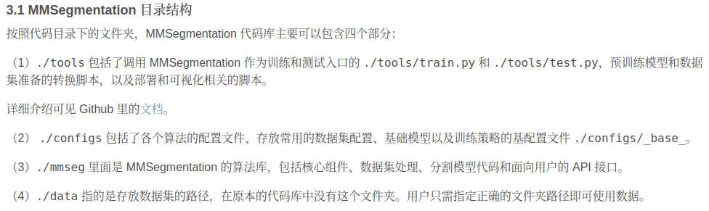
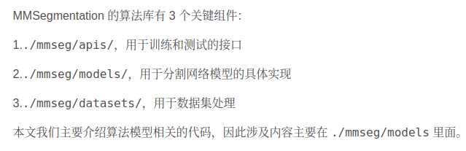

Slide 3
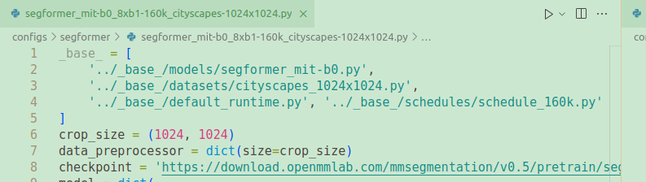
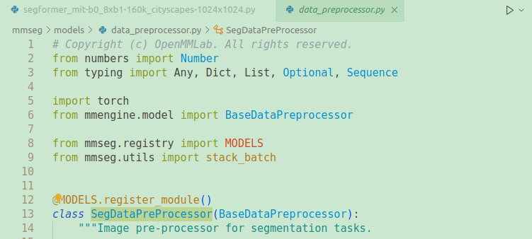
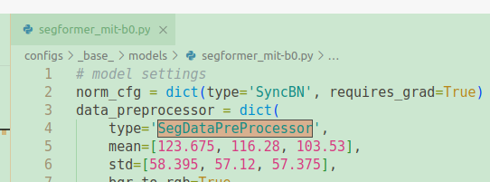
basic settle file
preprocessing model

Slide 4
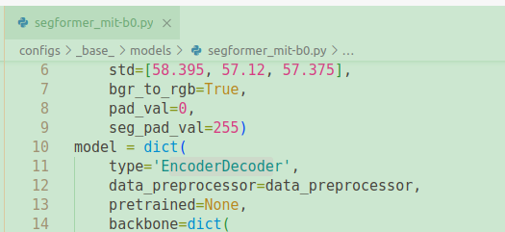

Slide 5
verify the inference demo
python demo/image_demo.py demo/demo.png configs/pspnet/pspnet_r50-d8_4xb2-40k_cityscapes-512x1024.py pspnet_r50-d8_512x1024_40k_cityscapes_20200605_003338-2966598c.pth --device cuda:0 --out-file result.jpg

Slide 6
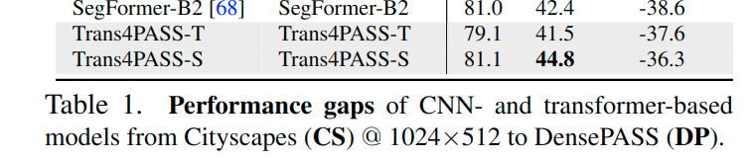
trans4pass revisit
performance on DP without UDA
*mind the image size

Slide 7
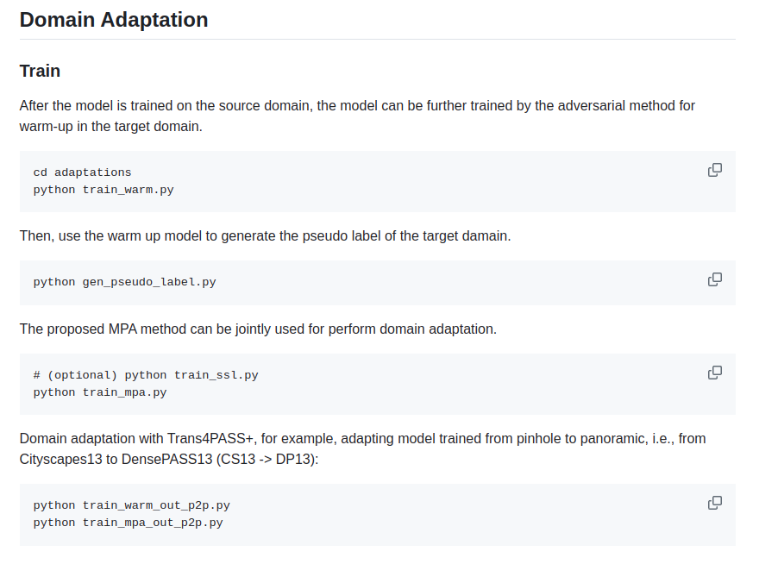
trans4pass code
supervised training:
python -m torch.distributed.launch --nproc_per_node=4 tools/train_cs.py --config-file configs/cityscapes/trans4pass_tiny_512x512.yaml
UDA:

Slide 8
important file location

Slide 9
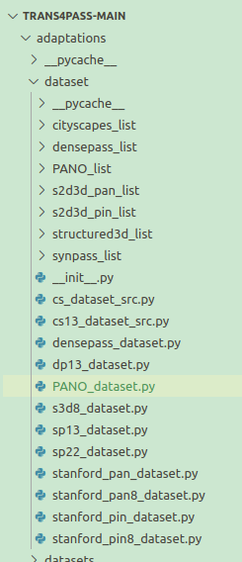
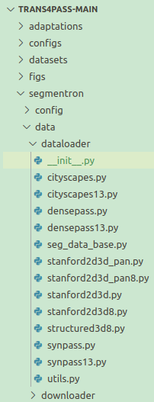
dataset define files are put equally into 2 folders：
for supervised training
for uda&evaluation：
*I suppose it belong to the original mmseg
since PANO does not have anno
we give a random pic to the anno set

Slide 10
change uda to multi-card training

Slide 11
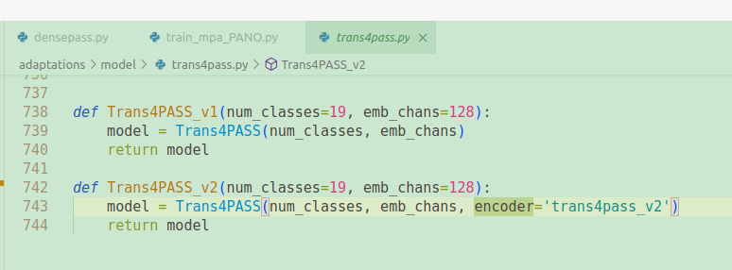
model structure：
1.difference between trans4passv1&v2: the encoder

Slide 12
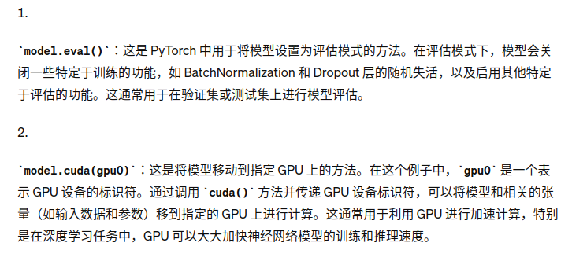
Code explanation：

Slide 13

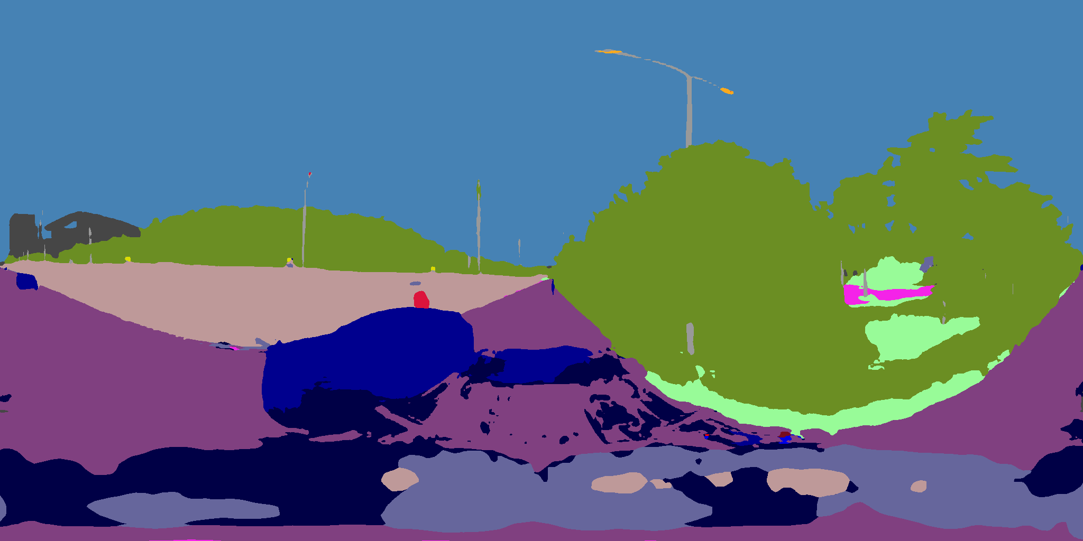
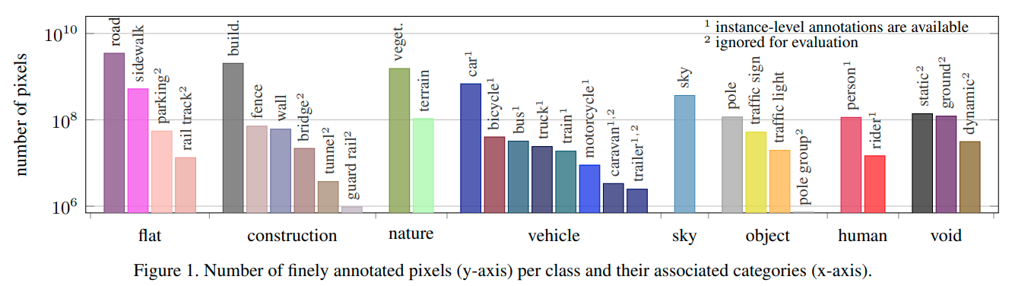
PROBLEMS
1.EVALUATION MEMORY MAX=2048X1024
1.need mask(how?);2.need higher precision

Slide 14
Review of Segformer

Slide 15
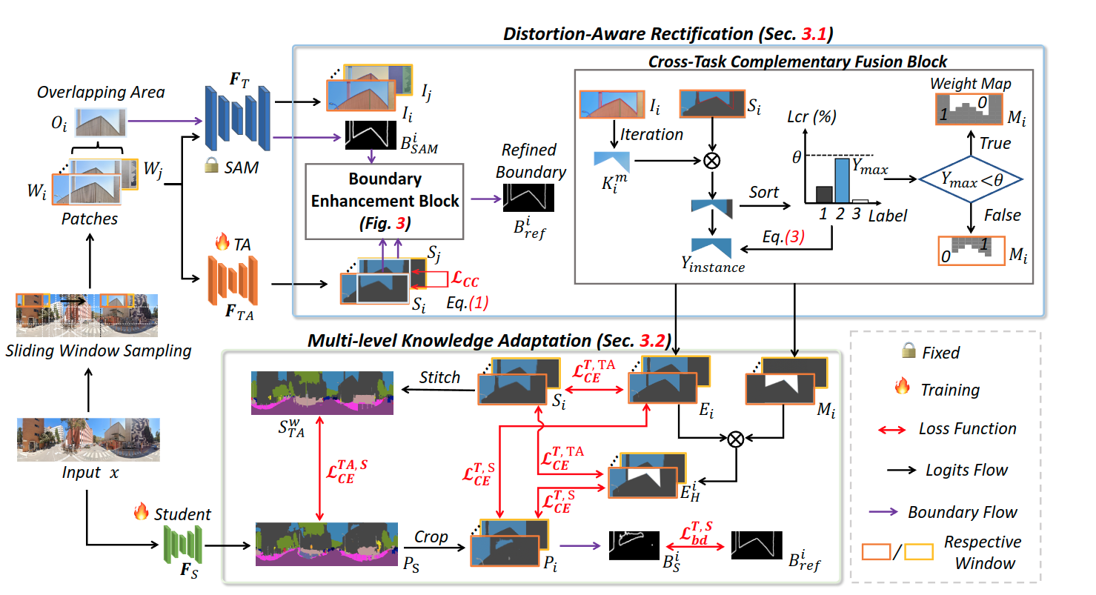
Review of GoodSAM
1. idea from Semantic Segment everything (SAM segmentation+semantic class voting from semantic segmentation model)

Slide 16
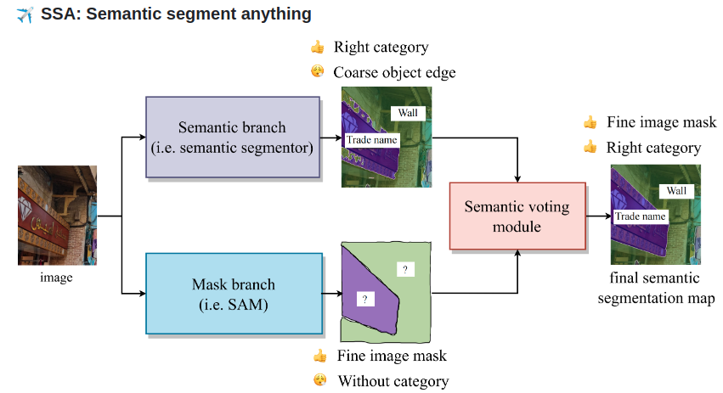

Slide 17

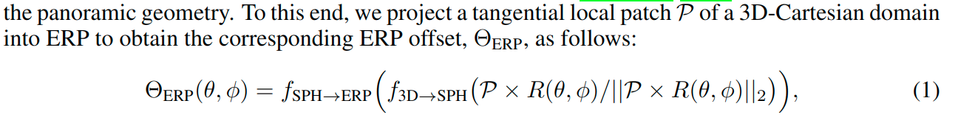
Revisit of PANO-I2I

Slide 18
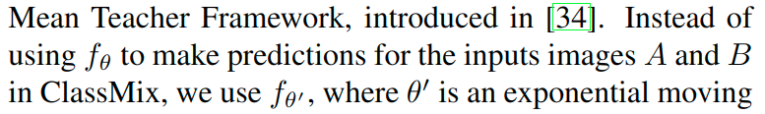
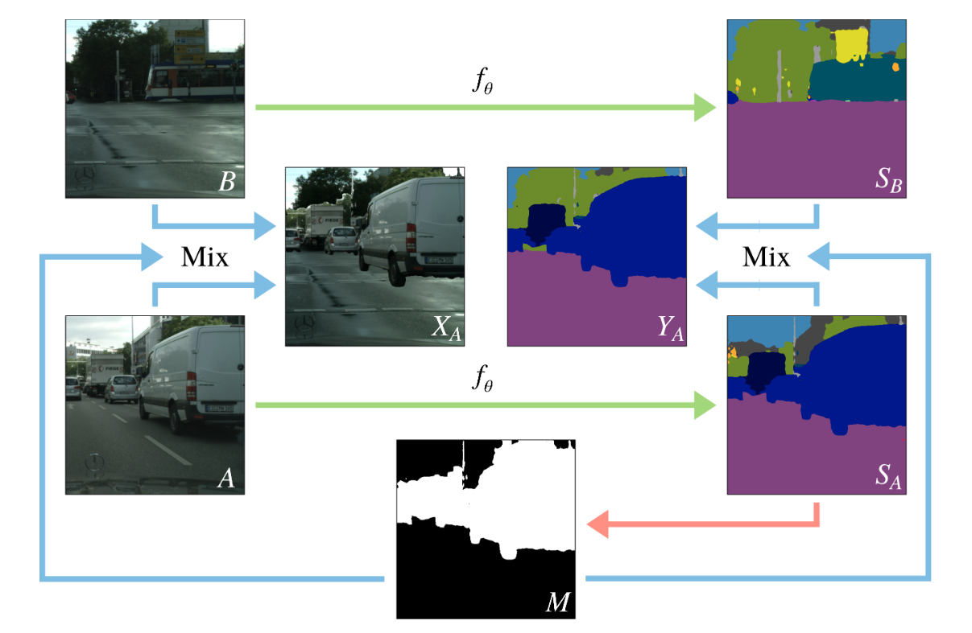
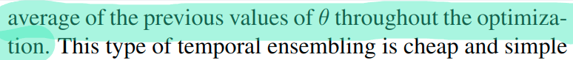
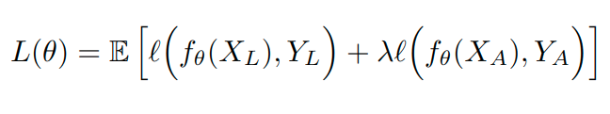
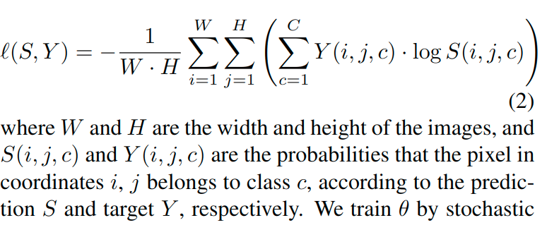

Review of ClassMix（mixing method for data augmentation）
ClassMix: Segmentation-Based Data Augmentation for Semi-Supervised Learning
(L:labeled;A:augmented)
↓
Loss:
half classes =0
half =1
(random selection)
times
Notes:
theta' unclear

Slide 19
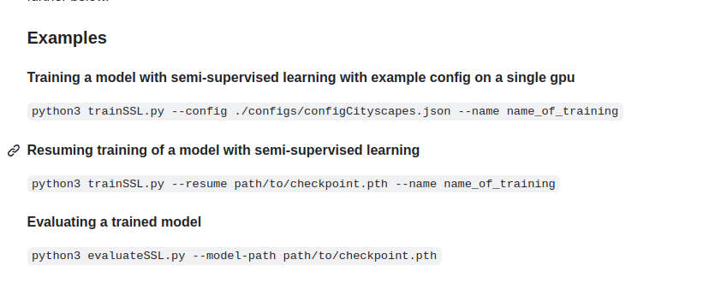

Slide 20
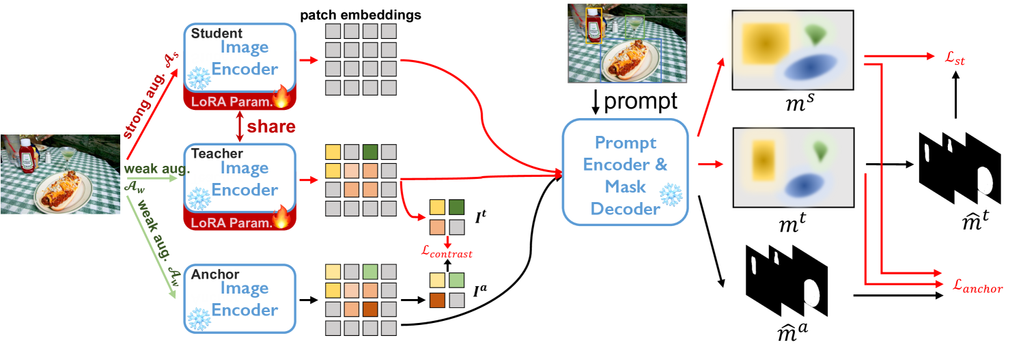
new
?network for student model?
decoder
teacher-student model
weak supervision

Slide 21
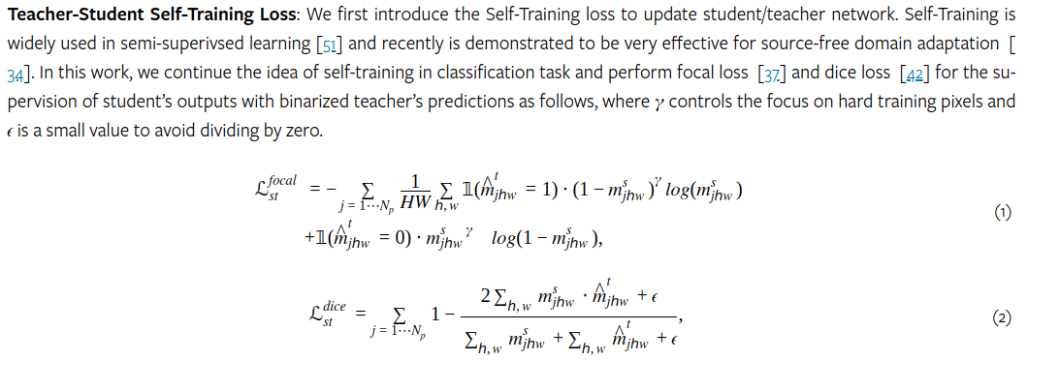
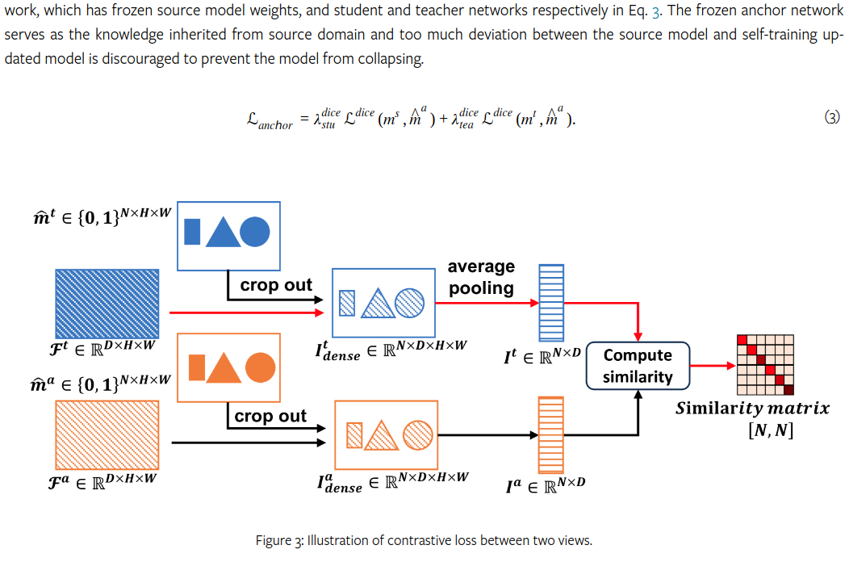

setting

Slide 23
Ideas
Other style transfer for semantic segmentation？&articles for patch mixing || how to mix.?
mask part of the pic
Read Semantic-SAM

