Slide 1
Discussion 7th October

Slide 2
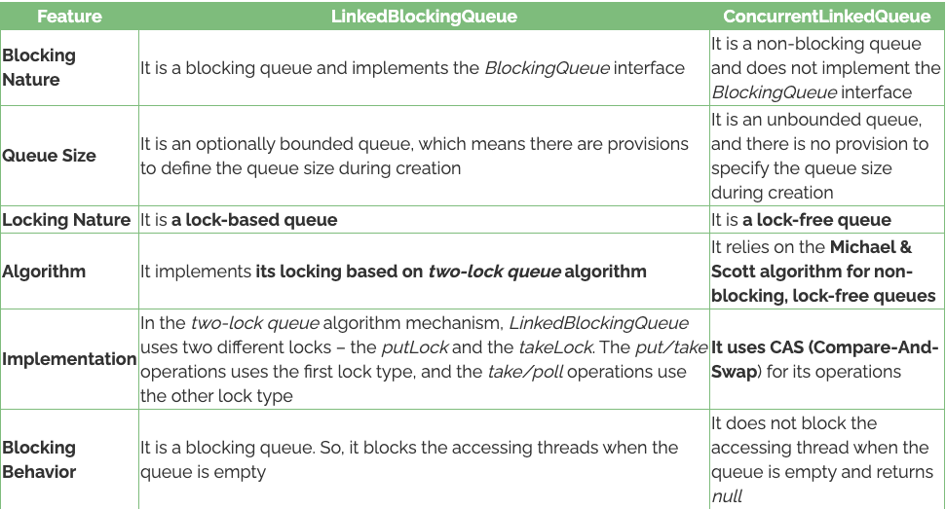
Similarities and differences between LBQ and CLQ
Differences
Similarities
Both implement Queue interface
Both used Linked nodes to store elements
Suitable for concurrent access scenarios

Slide 3
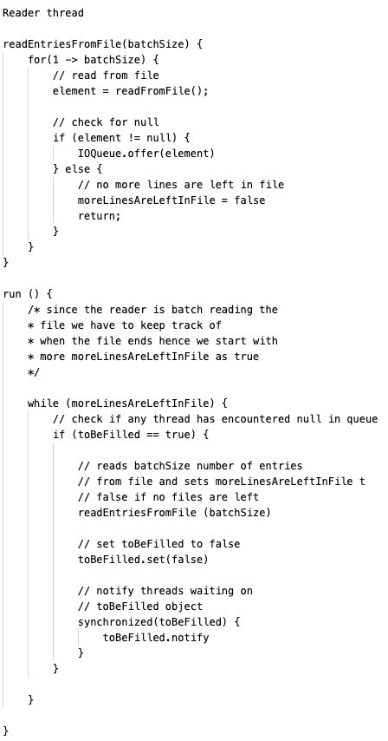
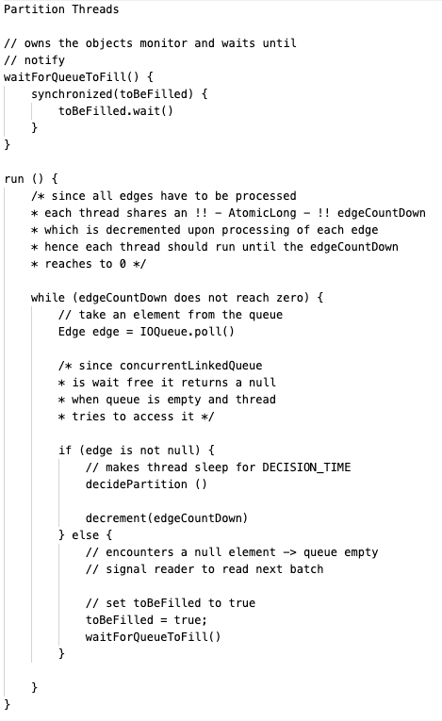
ConcurrentLinkedQueue - Pseudo Code

Slide 4
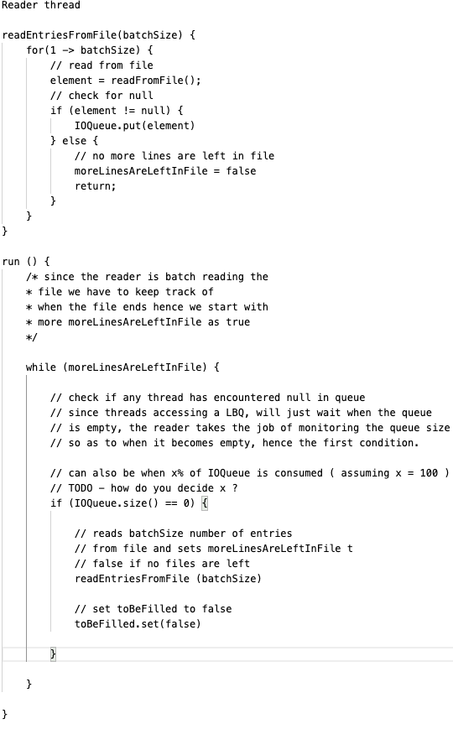
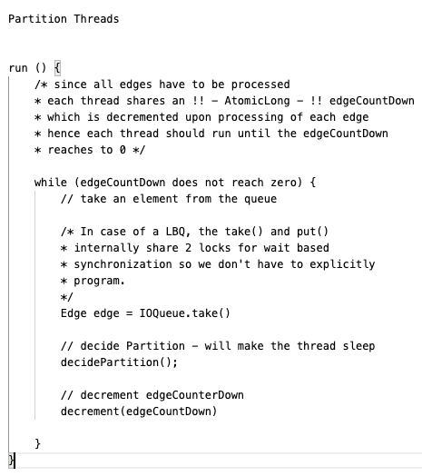
LinkedBlockingQueue - Pseudo Code

Slide 5
Experimental Setup

Slide 6
Github Social Network
|V| - 37700, |E| - 289003
Batch size is decided by x% of the order of total edges x = 1, 10, 100
eg. number of edges in above network is in order of 100k, hence the batch size taken are 1000, 10000, 100000
Number of threads = 4
All time data is measured in (ms)

Slide 7
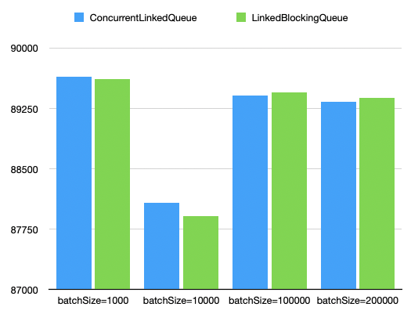
Processing Time Comparison
GRAPH - Github Social Network |V| - 37700, |E| - 289003
As the batch size increases
there is an inflection point
In CLQ’s processing time

Slide 8
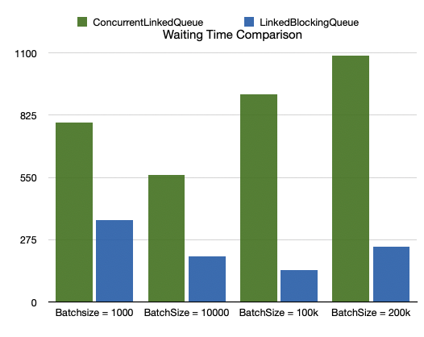
Processing Time = wait (for queue) time + other ops time
The waiting time for CLQ
increases as the batch size
Increases

Slide 9
Youtube Social Network
|V| -1134890 (~1 million ) , |E| - 2987624 (~ 2 million)
Batch size is decided by x% of the order of total edges x = 1, 10, 100
eg. number of edges in above network is in order of millions, hence the batch size taken are 10000, 100k, 1million
Number of threads = 10
All time data is measured in (ms)

Slide 10
Processing Time Comparison
GRAPH - Github Social Network |V| - 37700, |E| - 289003
As the batch size increases
there is an inflection point
In CLQ’s processing time

Slide 11
Processing Time = wait (for queue) time + other ops time
The waiting time for CLQ
increases as the batch size
Increase
but in this case there is a spike

Slide 12
Limits on the queue size -
LinkedBlockingQueue
As per docs, since LBQ is optionally bounded, if capacity is not specified the maximum capacity is INTEGER.MAX_VALUE (2^31-1) ~ 2 billion
ConcurrentLinkedQueue
- ?? ( how to get OutOfMemory )

