Slide 1
CS118 - Programming Fundamentals Lecture#03: Programming Introduction
Waqas Ali
Lecturer (CS)
National University of Computer and Emerging Sciences
waqas.ali@nu.edu.pk

Slide 2
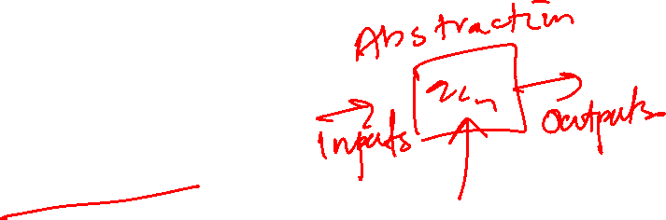
Recall from last time
Computer Science is about problem solving
To solve problems, we first need to be able to formalize it

Slide 3
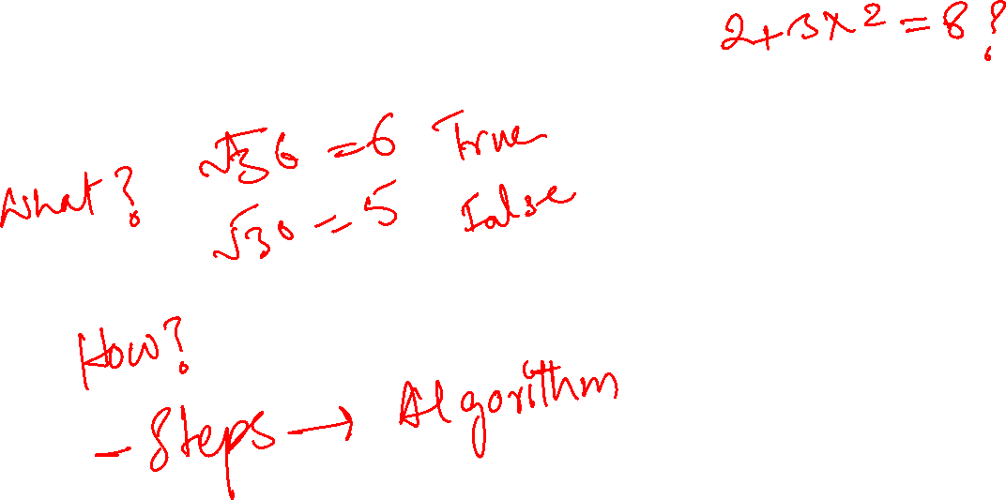
Types of knowledge
Declarative
Imperative

Slide 4
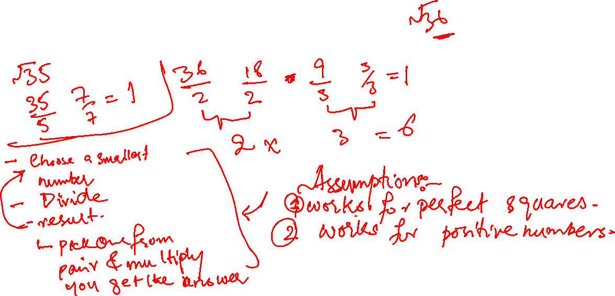
Case study: square roots
How do you calculate the square root?

Slide 5
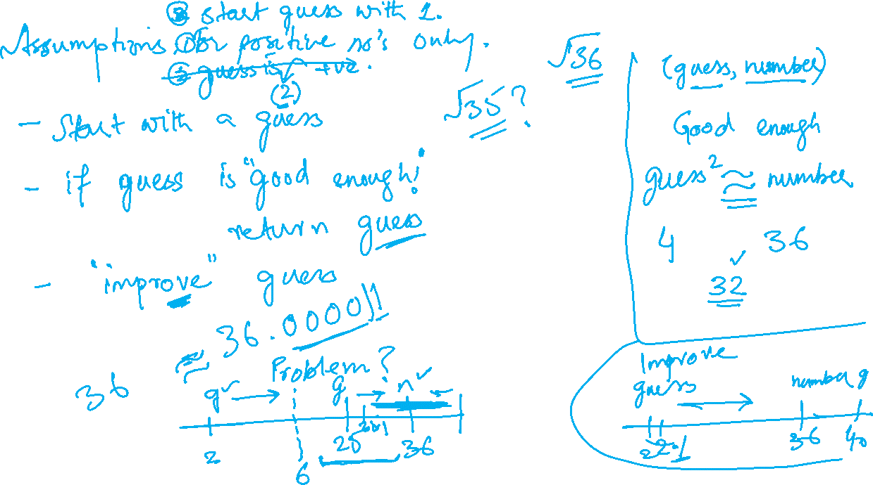

Slide 6
How to talk to computers
Programming languages
Interpreter
Flow of control
Instructions (steps) modify data in locations

