Slide 1
CS118 - Programming Fundamentals Lecture#07: Square Root Execution
Waqas Ali
Lecturer (CS)
National University of Computer and Emerging Sciences
waqas.ali@nu.edu.pk

Slide 2
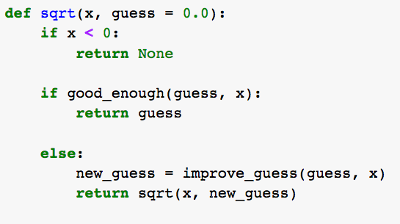
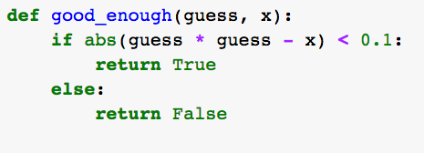
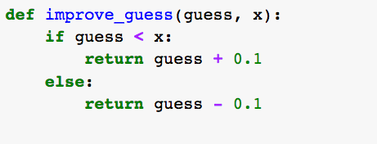

1

Slide 3
2

Slide 4
3

Slide 5

2

Slide 6

1

