Slide 1

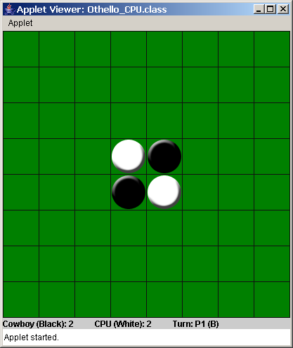
CPU and 2 Player Versions
Tyrone Cheng
AP Computer Science, Period 2
Mr. Lew
4 March 2004

Slide 2
How to Play: Background
64 squares in 8 x 8 grid
2 players
Simple rules involving both skill and luck
Player 1 gets black piece
Player 2 gets white piece
Black piece always goes first
Players alternate turns

Slide 3
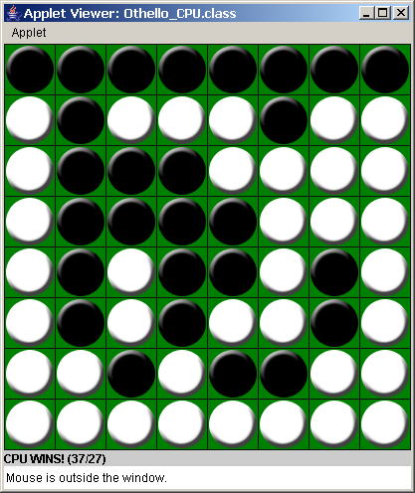
How to Play: P.1
Objective: Get as many pieces of your color as you can

Slide 4
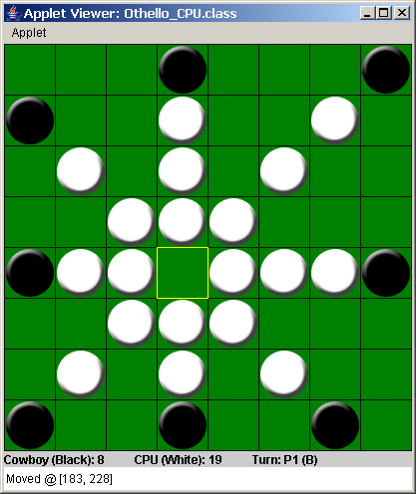
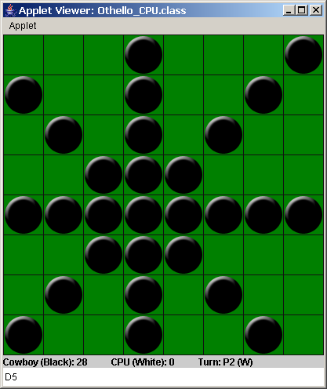
How to Play: P.2
Rules:
  Surround your opponent’s pieces with your piece horizontally, vertically, and/or diagonally to flip their pieces to your color

Slide 5
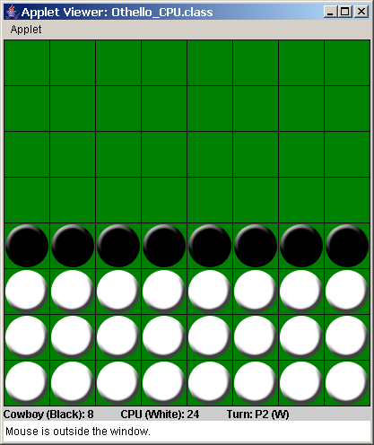
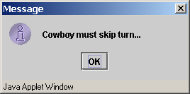
How to Play: P.3
Rules (cont’d):
  If no legal moves exist, then the player must skip a turn

Slide 6
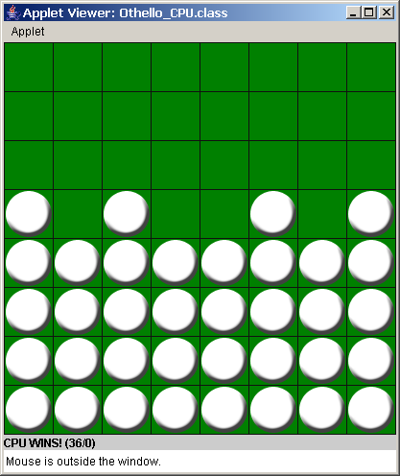
How to Play: P.4
Rules (cont’d):
  The game can end when one player has no possible moves left

Slide 7
UML Diagrams:
Othello (CPU/2P)
Othello_CPU
- boardImage: Image
- blackPieceImage: Image
- whitePieceImage: Image
- buffer: Image
- bufferg: Grahpics
- status: JLabel
- allPieces: ArrayList
- p1Turn: boolean
- p2Turn: boolean
- p1Skip: boolean
- p2Skip: boolean
- boardClicked: boolean
- mouseOver: boolean
- xClick: Integer
- yClick: Integer
- xOver: Integer
- yOver: Integer
- currentColor: Integer
Othello_2P
- boardImage: Image
- blackPieceImage: Image
- whitePieceImage: Image
- buffer: Image
- bufferg: Grahpics
- status: JLabel
- allPieces: ArrayList
- p1Turn: boolean
- p2Turn: boolean
- p1Skip: boolean
- p2Skip: boolean
- boardClicked: boolean
- mouseOver: boolean
- xClick: Integer
- yClick: Integer
- xOver: Integer
- yOver: Integer
- currentColor: Integer

Slide 8
UML Diagrams:
Othello (CPU/2P) (cont’d)
- h: Human
- c: Computer
- b: Board
- p1Name: String
- CAPTIONS: String[][]
+ init(): void
+ paint(): void
+ update(): void
- getTurn(): String
- updateStatus(): void
- roundN(): Integer
- translateLocation(): String
+ mouseClicked(): void
+ mouseEntered(): void
+ mouseExited(): void
+ mouseMoved(): void
- h1: Human
- h2: Human
- b: Board
- p1Name: String
- p2Name: String
- CAPTIONS: String[][]
+ init(): void
+ paint(): void
+ update(): void
- getTurn(): String
- updateStatus(): void
- roundN(): Integer
- translateLocation(): String
+ mouseClicked(): void
+ mouseEntered(): void
+ mouseExited(): void
+ mouseMoved(): void

Slide 9
UML Diagrams:
MouseAction (interface)
Othello_CPU
Othello_2P
MouseAction
+ mouseClicked(): void
+ mouseEntered(): void
+ mouseExited(): void

Slide 10
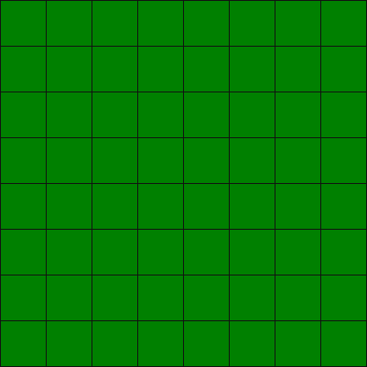
UML Diagrams:
Board & Rules
Board
- board: int[][]
- output: String
- allPieces: ArrayList
+ getArrayList: ArrayList
+ updateBoard: void
+ updateArrayList: void
+ printBoard: void
+ searchHorizontal: void
+ searchVertical: void
+ searchDiagonalDLUR: void
+ searchDiagonalULDR: void
- flipHorizontal: void
- flipVertical: void
- flipDiagonalDLUR: void
- flipDiagonalULDR: void
Rules
+ checkDuplicate(): boolean
+ validateHorizontal(): boolean
+ validateVertical(): boolean
+ validateDiagonalDLUR(): boolean
+ validateDiagonalULDR(): boolean
+ searchLegalMoves(): boolean
+ changePieceColor(): Integer
+ validateMove(): boolean

Slide 11
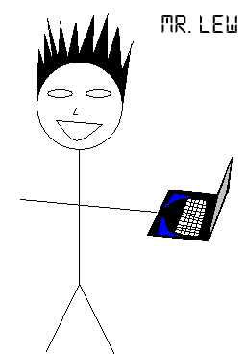
UML Diagrams:
Player, Computer, & Human (inheritance)
Player
- name: String
- color: Integer
+ getName(): String
+ getColor(): Integer
+ getColorString(): String
+ getPieceCount(): Integer
+ move(): void
Computer
moves: ArrayList
+ getName(): String
+ getColor(): Integer
+ getColorString(): String
+ getPieceCount(): Integer
+ move(): void
+ getAllLegalMoves(): ArrayList
+ randomNumber(): Integer
+ randomMoveRow(): Integer
+ randomMoveColumn(): Integer
Human
+ getName(): String
+ getColor(): Integer
+ getColorString(): String
+ getPieceCount(): Integer
+ move(): void

Slide 12


UML Diagrams:
Piece, blackPiece, & whitepiece (inheritance)
Piece
- xPosition: Integer
- yPosition: Integer
- color: Integer
- pieceImage: Image
+ setXPosition(): void
+ setYPosition(): void
+ getXPosition(): Integer
+ getYPosition(): Integer
+ getColor(): Integer
+ getPieceImage: Image
BlackPiece
- COLOR: Integer = 1 {frozen}
+ setXPosition(): void
+ setYPosition(): void
+ getXPosition(): Integer
+ getYPosition(): Integer
+ getColor(): Integer
+ getPieceImage: Image
WhitePiece
- COLOR: Integer = 2 {frozen}
+ setXPosition(): void
+ setYPosition(): void
+ getXPosition(): Integer
+ getYPosition(): Integer
+ getColor(): Integer
+ getPieceImage: Image

Slide 13
Class interaction
Othello_CPU and Othello_2P create the objects and direct the game.
MouseAction is implemented by the Othello classes to insure that they both use certain MouseListener methods.
Rules is used primarily by the Othello class files and Computer for “random” move generation.
Board carries Piece objects WhitePiece and BlackPiece.
BlackPiece and WhitePiece inherit methods from Piece.
Computer and Human inherit methods from Player.
Both types of Players “move” by updating the Board object.

Slide 14
Classes/objects
Othello_CPU and Othello_2P are not objects. As mentioned earlier, they simply create the objects, progress the game, and paint the graphics.
Rules is also not an object. Rather, it is a collection of static methods that any class can call.
Board is comprised of a 2D integer array and ArrayList representation of itself. The ArrayList holds the actual Piece objects for easy painting.
BlackPiece and WhitePiece hold their respective Images and Board coordinates.
Computer and Human Players possess a name and the color of his/her/its Piece.

Slide 15
Inheritance hierarchy
Computer and Human inherit the methods of Player (name, color, move). Computer has additional methods for its pseudo-random moves.
BlackPiece and WhitePiece inherit the methods of Piece (x, y, color, Image). They are differentiated by their COLOR variable (1 = black; 2 = white).

Slide 16
polymorphism
Polymorphism is used in the Othello class files when the Pieces are being painted.
for( int counter = 0; counter < allPieces.size(); counter++ )
{
if( ( ( Piece )allPieces.get( counter ) ).getColor() != 0 )
{
[…]
}
}
The if statement cycles through the ArrayList allPieces which contains BlackPieces and WhitePieces. The getColor() method is differentiating between these two Piece types and returning their respective colors.

Slide 17
Special features
Double Buffering
  Removes dreaded applet flickering
  When the repaint() method is called, the update() method is called, which clears the screen. Then, the paint() method is called. The flicker is caused by the clearing and repainting occurring at different times.
  Double buffering paints everything to a separate image. Then, that image is painted to the applet.
MouseListener and MouseMotionListener
  Detects mouse actions and movement

Slide 18
Questions?

Slide 19
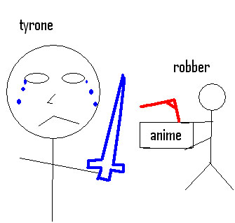
conclusion
Difficulty Level: 8
“Fun” Level: 9
Final Evaluation: Works fairly well for single player mode. Multiplayer and a smarter AI?
Thanks to Thomas for help with…
everything.
Double buffering taken from http://www.freejavahelp.com/tutorial/threads/doublebuffer.html

