Slide 1
6. sums & asymptotics
CSI 2101: Discrete Structures
Andrej Bogdanov

Slide 2
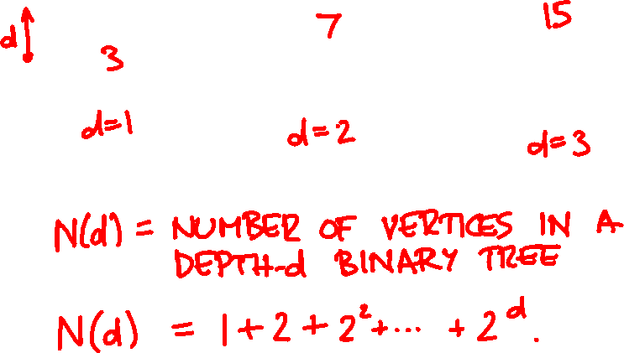
perfect binary tree

Slide 3
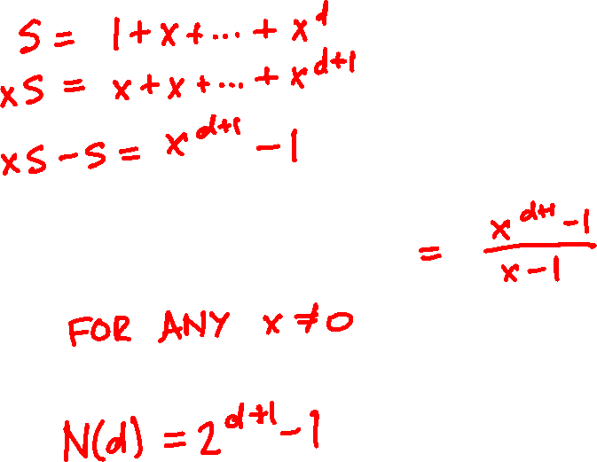

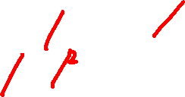
geometric sums

Slide 4
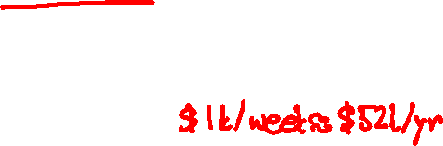
A 20-year-old won the lottery.
What she did next lit up social media.
Medora Lee, USA TODAY, Jan. 9, 2026
A 20-year-old Canadian lit up social media after she won the lottery in the summer of 2025 and (gasp!) chose to accept her winnings in an annuity rather than a lump sum.
Instead of taking a tax-free lump sum of $1 million (Canadian lottery wins aren't taxed like U.S. jackpots), Brenda Aubin-Vega, of Quebec, chose to receive $1,000 a week for life. Her decision contrasts with what the vast majority of lottery winners choose and drew criticism. Everyone seemed to have an opinion, even Binance founder Changpeng Zhao.

Slide 5
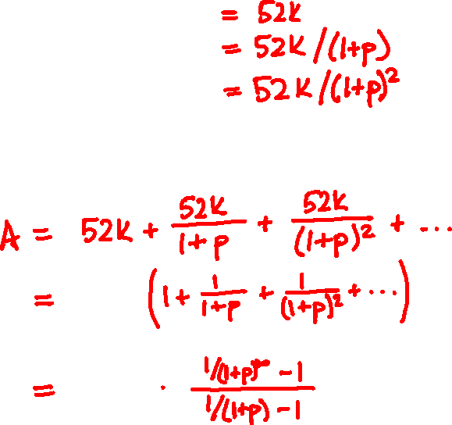


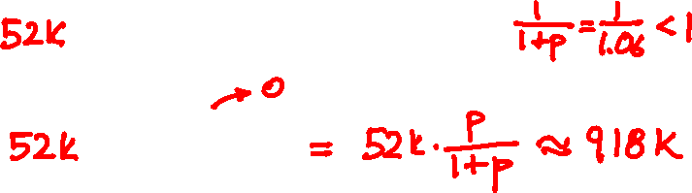

annuities
1 Jan 2026 → $52k
$1m
1 Jan 2027 → $52k
1 Jan 2028 → $52k
…
A
B

Slide 6
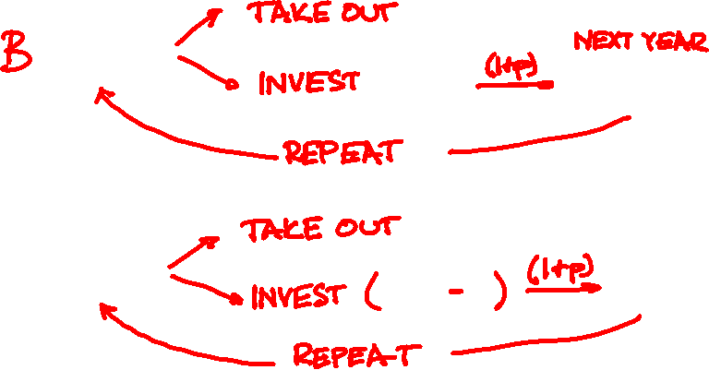
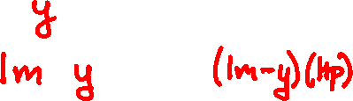
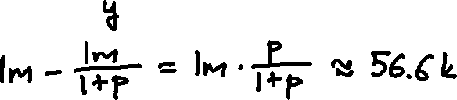
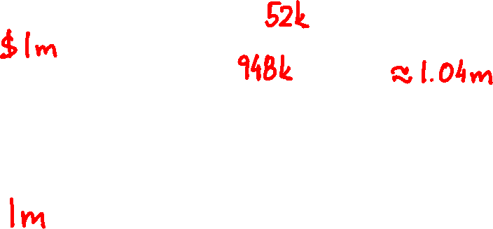
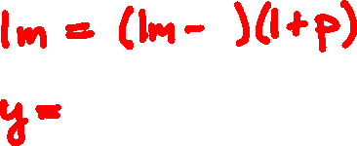

Slide 7
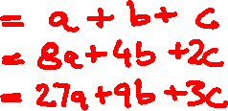
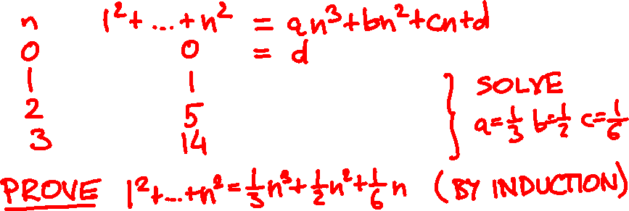
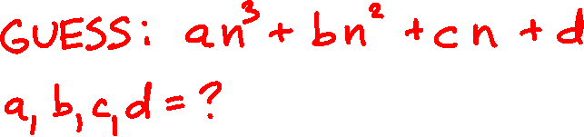
polynomial sums
1² + 2² + … + n² = ?

Slide 8









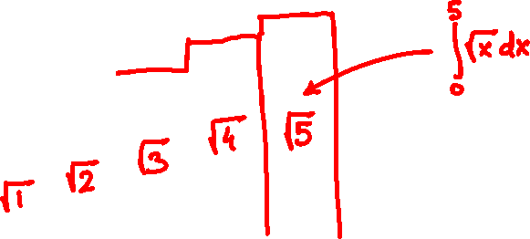
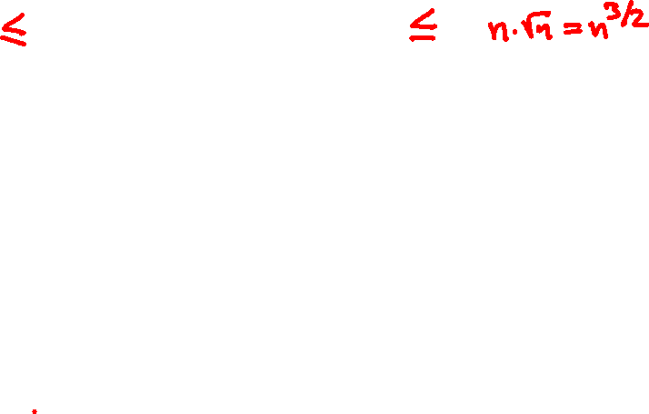



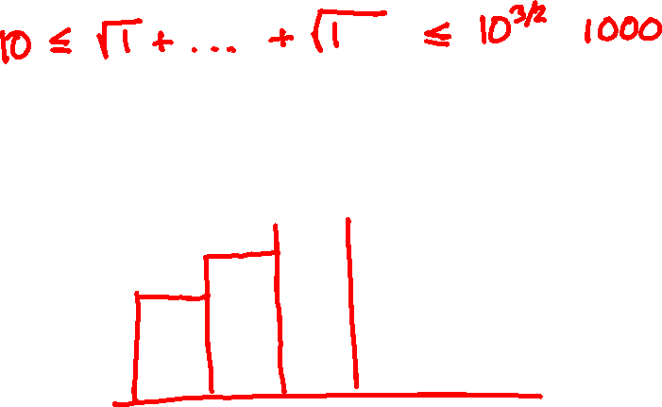




approximating sums
√1 + √2 + … +√n = ?

Slide 9


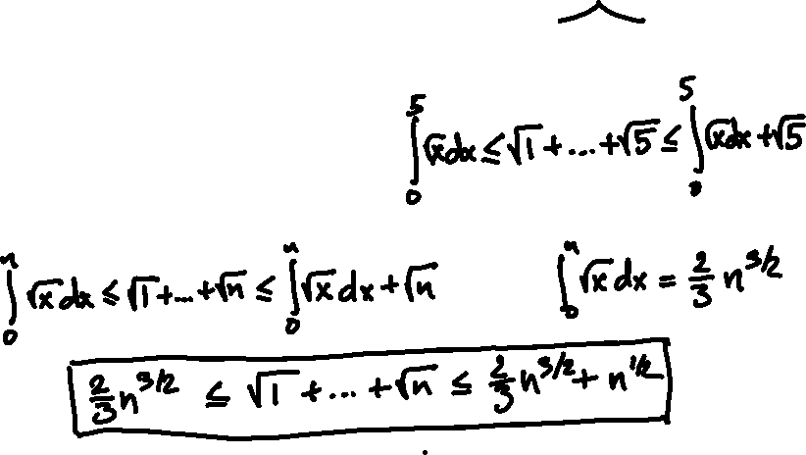
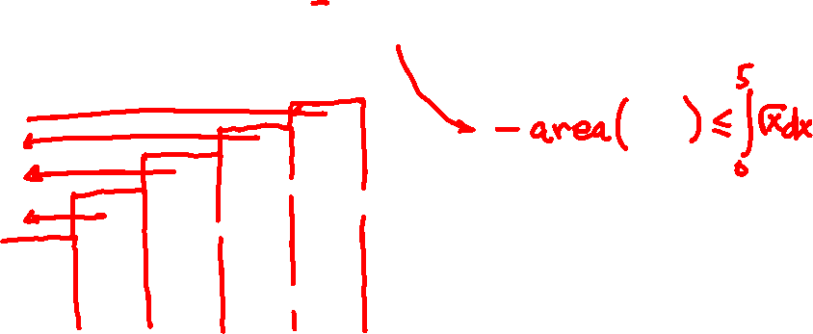
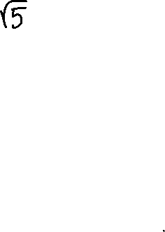
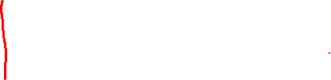

Slide 10

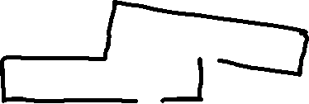
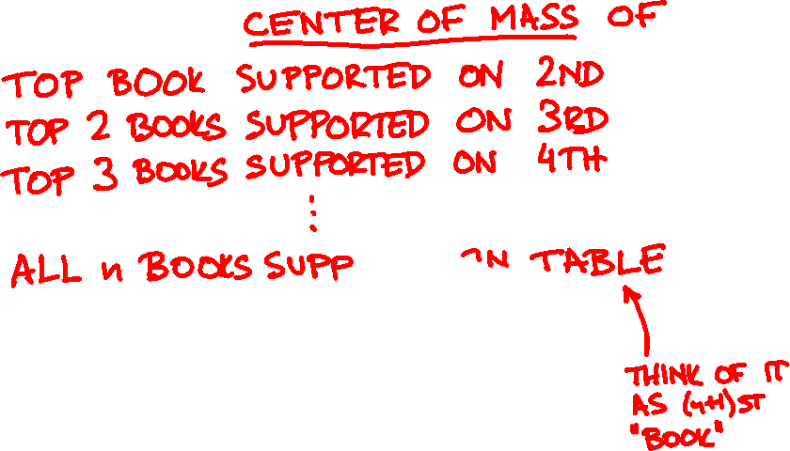
overhang

Slide 11


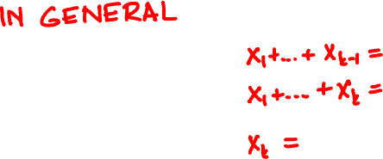
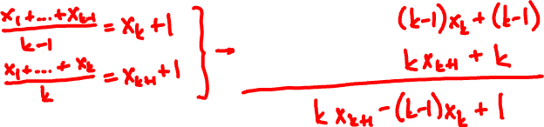
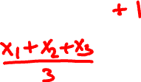
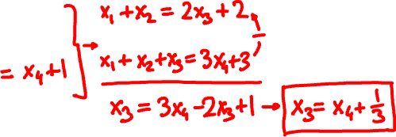

Slide 12


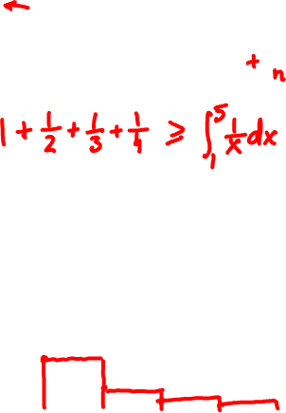
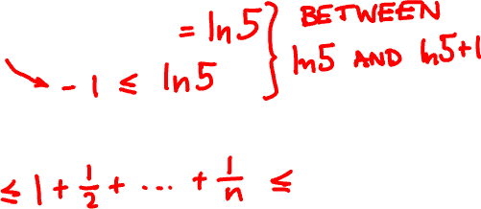



Slide 13
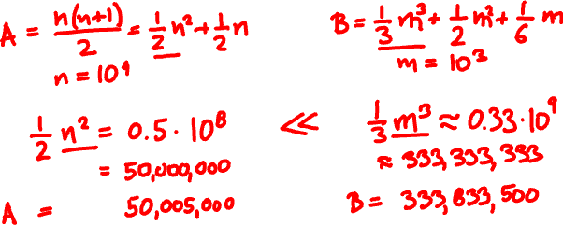
asymptotics
A = 1 + 2 + … + 10000
B = 1² + 2² + … + 1000²

Slide 14
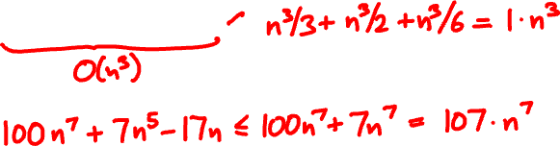
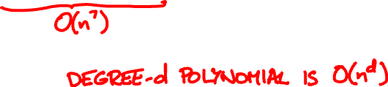
big O
f is O(g) if there is a constant C so that f(n) < C∙g(n) for all sufficiently large n.
n³/3 + n²/2 + n/6 =

Slide 15
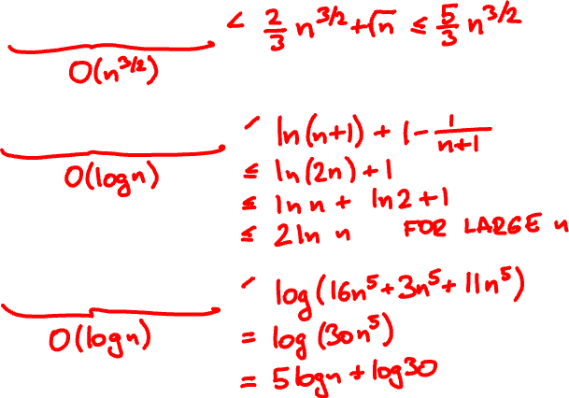

√1 + √2 + … +√n =
1 + 1/2 + … + 1/n =
log(16n⁵ + 3n + 11) =

Slide 16
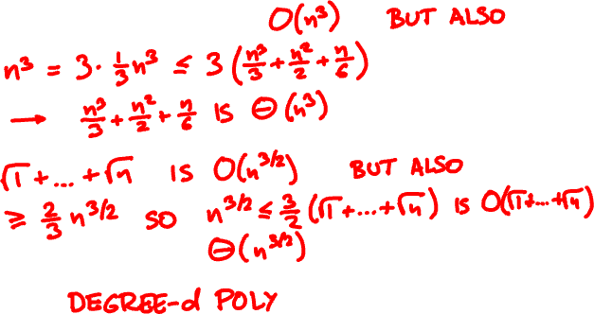

big Theta
f is Θ(g) if f is O(g) and g is O(f)
n³/3 + n²/2 + n/6 =

Slide 17
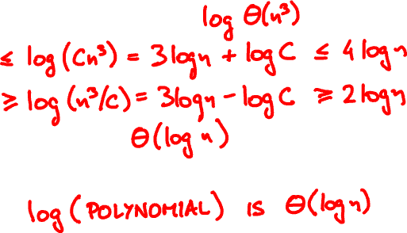
big Theta
f is Θ(g) if for some C and large n
g(n)/C < f(n) < C∙g(n)
log(16n⁵ + 3n + 11) =

Slide 18
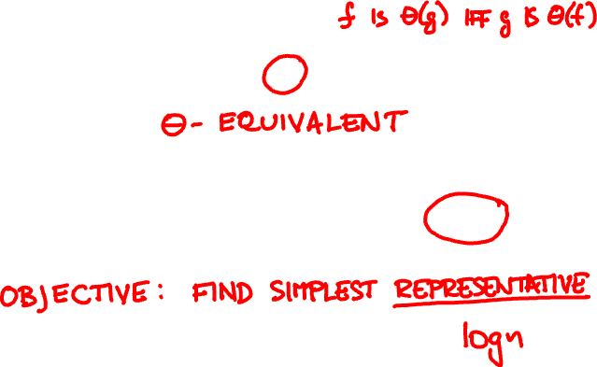

basic functions
n(n+1)/2
n²
0.1n² – 10n
5log(n² + n)
lnn – √lnn
log n

Slide 19
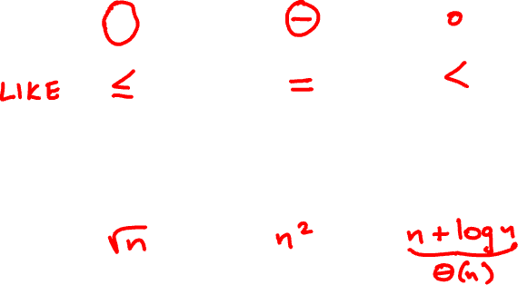


asymptotic order

Slide 20

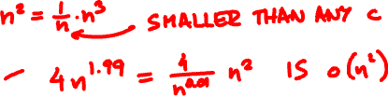
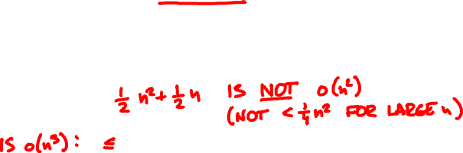
little o
f is o(g) if for every constant c and all sufficiently large n, f(n) < c∙g(n)
n(n+1)/2 =
n^{1.99} + 3n^{1.54} =

Slide 21
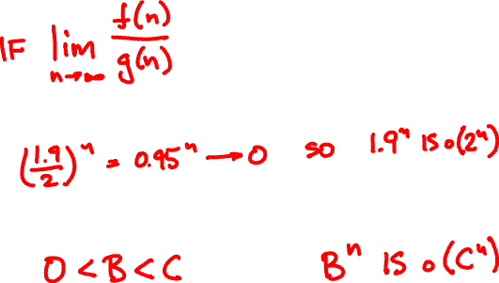
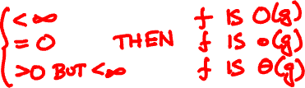
asymptotics from limits
1.9^{n}
2^{n}

Slide 22
exponential growth
(log n)² vs √n?

Slide 23
n² vs 2^{n/2}?

Slide 24
Order these functions asymptotically:
n^{n}
2^{n}
2^{n}
n²
2

