Slide 1
Lab 0 Quick tips on how to write, compile and run a C program
CSI3131 Operating Systems

Slide 2
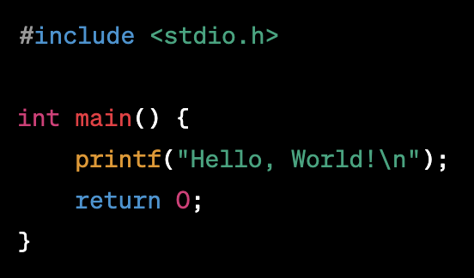
Write “Hello World Code” in C
To write a C program and save it in Linux or macOS, you can follow these steps:
Open a text editor. Linux and macOS come with various text editors pre-installed, such as Nano, Vim, or Emacs. Alternatively, you can use a graphical text editor like Sublime Text, Atom, or Visual Studio Code.
Create a new file in the text editor and enter the C program code. For example, you can write the "Hello, World!" program:

Slide 3
Write “Hello World Code” in C
Save the file with a .c extension. Choose a meaningful filename for your program, such as hello.c Make sure to use the .c extension to indicate that it's a C program.
Choose a directory where you want to save your program. For example, you can save it in your home directory or create a new folder specifically for your C programs.
Open the terminal on your Linux or macOS system.
Navigate to the directory where you saved the C program using the cd command. For example, if you saved the program in your home directory, you can use the ‘cd’ command to navigate there.

Slide 4


Compile and Run the code
Compile the C program using a C compiler. On Linux and macOS, the most common C compiler is gcc. In the terminal, use the following command to compile the program:
This command tells gcc to compile the hello.c file and create an executable file named hello.
After successful compilation, you can run the program by entering the following command in the terminal:
This command executes the compiled program, and you should see the "Hello, World!" message printed in the terminal.

Slide 5

Main structure of C program
Here's an explanation of each line in the "Hello, World!" program written in C:
This line is a preprocessor directive that tells the C compiler to include the stdio.h header file, which stands for "standard input/output." This header file provides functions like printf() that allow you to perform input and output operations.

Slide 6


Main structure of C program
This line declares the main() function, which is the entry point of a C program. It indicates that the program's execution will start from this point. The int before main() specifies that the function returns an integer value.
This line uses the printf() function to print the text "Hello, World!" to the console. The printf() function is part of the stdio.h library and is used for formatted output. The text to be printed is enclosed within double quotes. The \n represents the newline character, which moves the cursor to the next line after printing the message.

Slide 7

Main structure of C program
This line is a return statement. It ends the main() function and returns the value 0 to the operating system. By convention, a return value of 0 typically indicates successful execution of the program.
The program ends after the return 0; statement, and control is handed back to the operating system.

Slide 8
Summary
Using previous slides you must have learned:
How to write a C program
Compile the code to get the executable file
Run the executable file to get the output

