Slide 1

PROFILE
卓越1309班

Slide 2

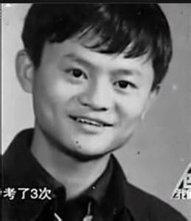
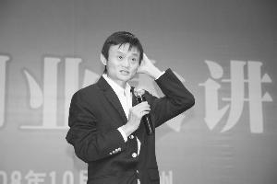
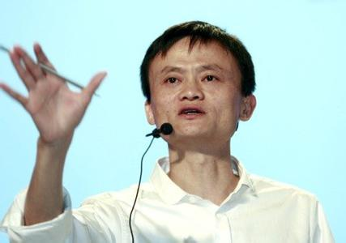
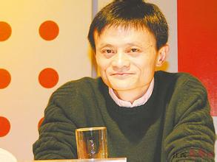
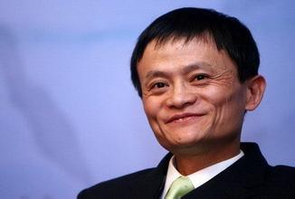
Who is he ?

Slide 3
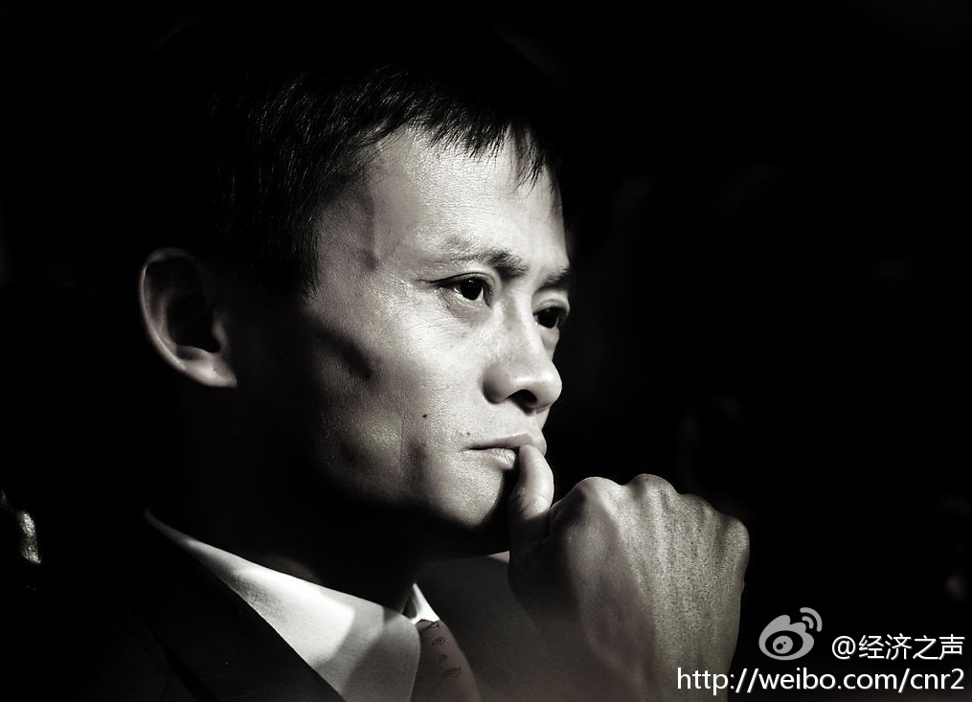
马
云

Slide 4

Primary Coverage
Introduction of Jack ma
Entrepreneurial experience
Way of business
Entrepreneurship sayings

Slide 5

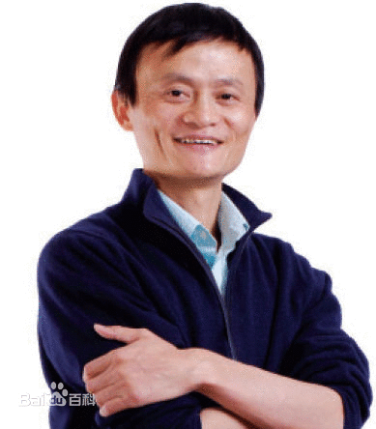
Introduction of Jack ma
Chinese Name：MaYun
English Name：Jack ma
Birth Day：On September 11, 1964
Native Place：Hangzhou city, zhejiang province
Graduate School：Hangzhou normal university

Slide 6
Positions
Alibaba group chairman of the board
Chinese yahoo chairman of the board
Alibaba hangzhou normal university
business school dean
Huayi brothers media group director
Novice network chairman
……

Slide 7
Glory
1) Jack ma is the founder of the world's
largest enterprise e-commerce sites.
2) In 1999, Mr Ma was "PC" as China's most
valuable network, known as the "father" of
the Chinese Internet.
3)In 2000, Jack has become the first 50
years on the international authoritative
caijing magazine Forbes cover Chinese
entrepreneurs.

Slide 8
Glory
4) for the year 2001, the Asian business
association rated ma as "business
leaders", the world economy BBS Ma
Yunxuan as one of the world 100 "future
leader"
5) Ma Yunceng invited many times for the
world famous universities, the Wharton
school of business at the Massachusetts
institute of technology, Harvard University
to give lectures.

Slide 9
Glory
6) British prime minister Tony Blair's visit to
China in 2004, named to see Mr Ma.
7) Ma in 2004 was named person of the
year zheshang and CCTV China
economic annual figure.
8) In 2007, the leading business magazine
businessweek names 24 for the future
business, financial and economic has a
significant influence, 2008.

Slide 10







Entrepreneurial Experience

Slide 11
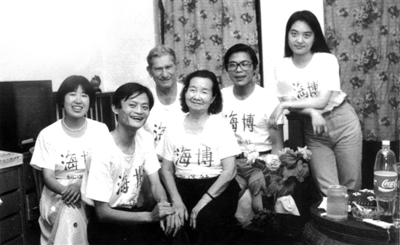
Entrepreneurial Experience
Founded in 1992, the first startup, hai bo translation agency.

Slide 12
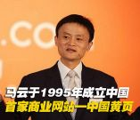
Entrepreneurial Experience
Founded in 1995-1997 China's first Internet business information website "Chinese pages"

Slide 13

Entrepreneurial Experience
Founded in 1999, alibaba web site, developing e-commerce applications.

Slide 14

Entrepreneurial Experience
Founded in 2003, taobao, has now become Asia's largest personal Internet auction site

Slide 15

Entrepreneurial Experience
Founded in 2004, an independent third party electronic payment platform, currently ranked first in the Chinese market.

Slide 16

Entrepreneurial Experience
In 2005, and the world's largest portal yahoo! 's strategic cooperation, merger and acquisition (m&a) in China all of its assets, alibaba so become China's biggest Internet company

Slide 17
Way of Business
Customer
First
客户第一
Team
Work
团队合作
Embrace
Change
拥抱变化
Integrity
诚信
Passion
激情
Commitment
敬业

Slide 18

Entrepreneurship Sayings
The main task of the CEO is not
looking for opportunities but the
chance to say NO. Opportunity is too
much, can only catch one
Network the above sentence, barefoot
forever are not afraid of the shoes
Heard of lobster is rich, have never
heard of whaling rich.

Slide 19
Entrepreneurship sayings
The Internet is 4 by one hundred
meters relay, you again good, can
only run a bar, should give
opportunities to young people.
Since the takeover of yahoo China
that day, I suddenly "ou" by the
China's Internet industry.
We are alibaba, holding a telescope
find opponent.

Slide 20
Entrepreneurship sayings
We can't seek inspiration. Inspiration
to speaking, like broken jade six pulse
excalibur.
Ebay is a shark in the ocean, taobao
is the crocodile in the Yangtze river, a
crocodile to fight with the sharks in
the ocean. It is conceivable,we should
guide the shark to theYangtze river

Slide 21
Thank You !

