Slide 1
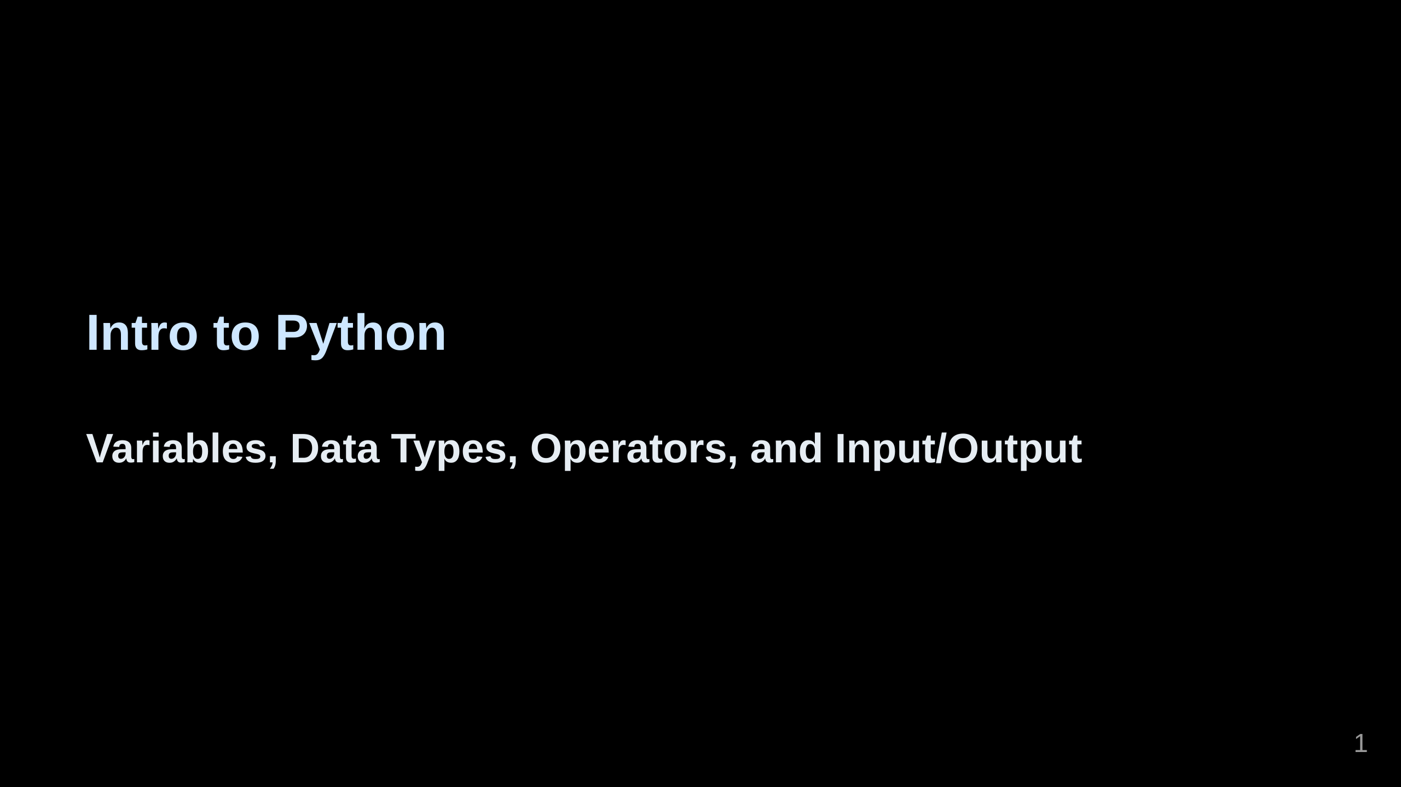

Slide 2
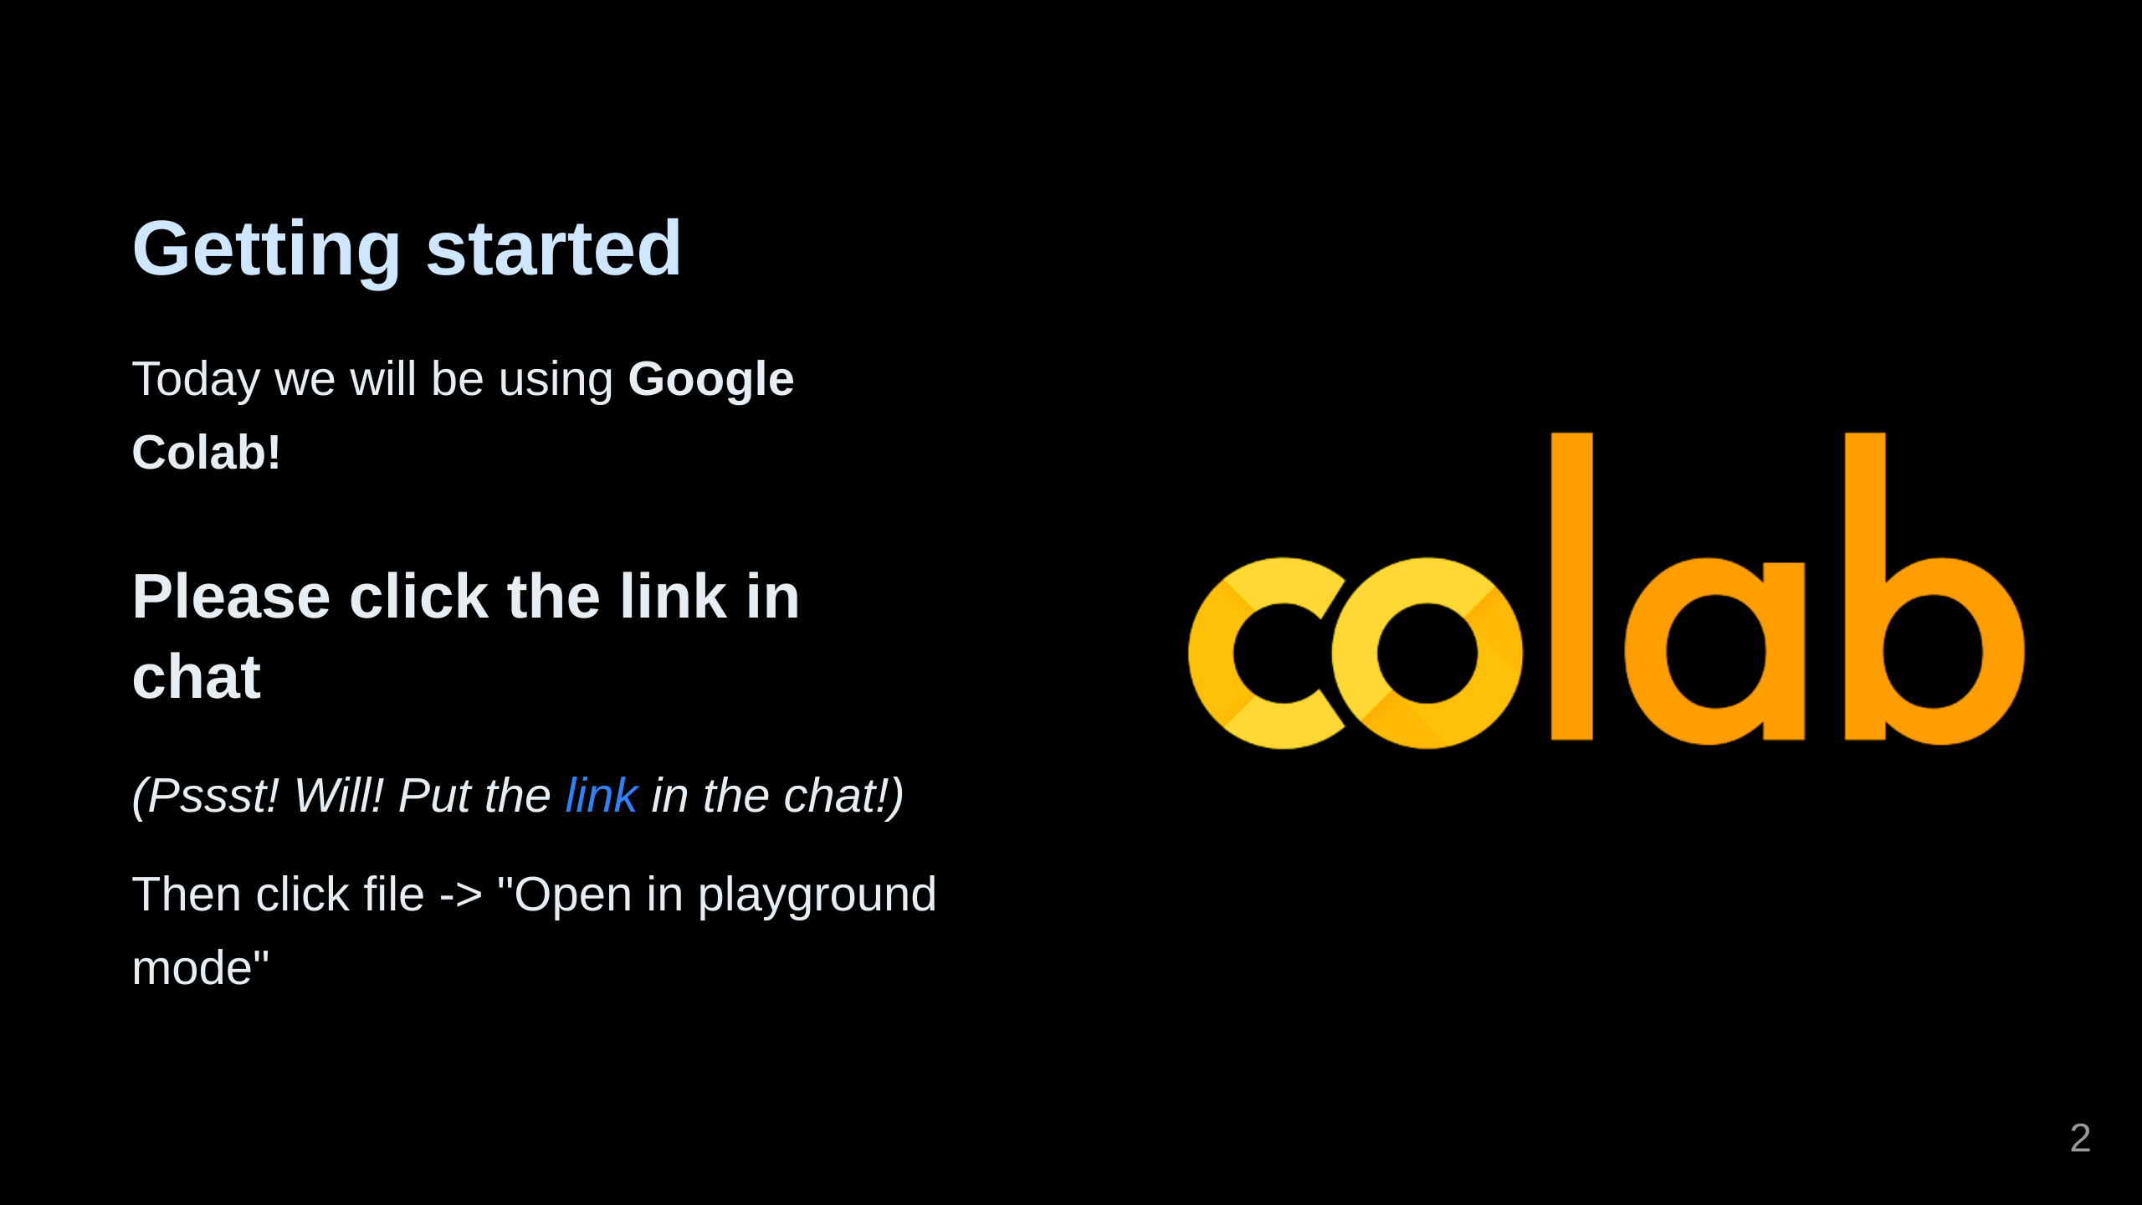
Notes:
Give me a thumbs up when you're ready to move on!

Slide 3
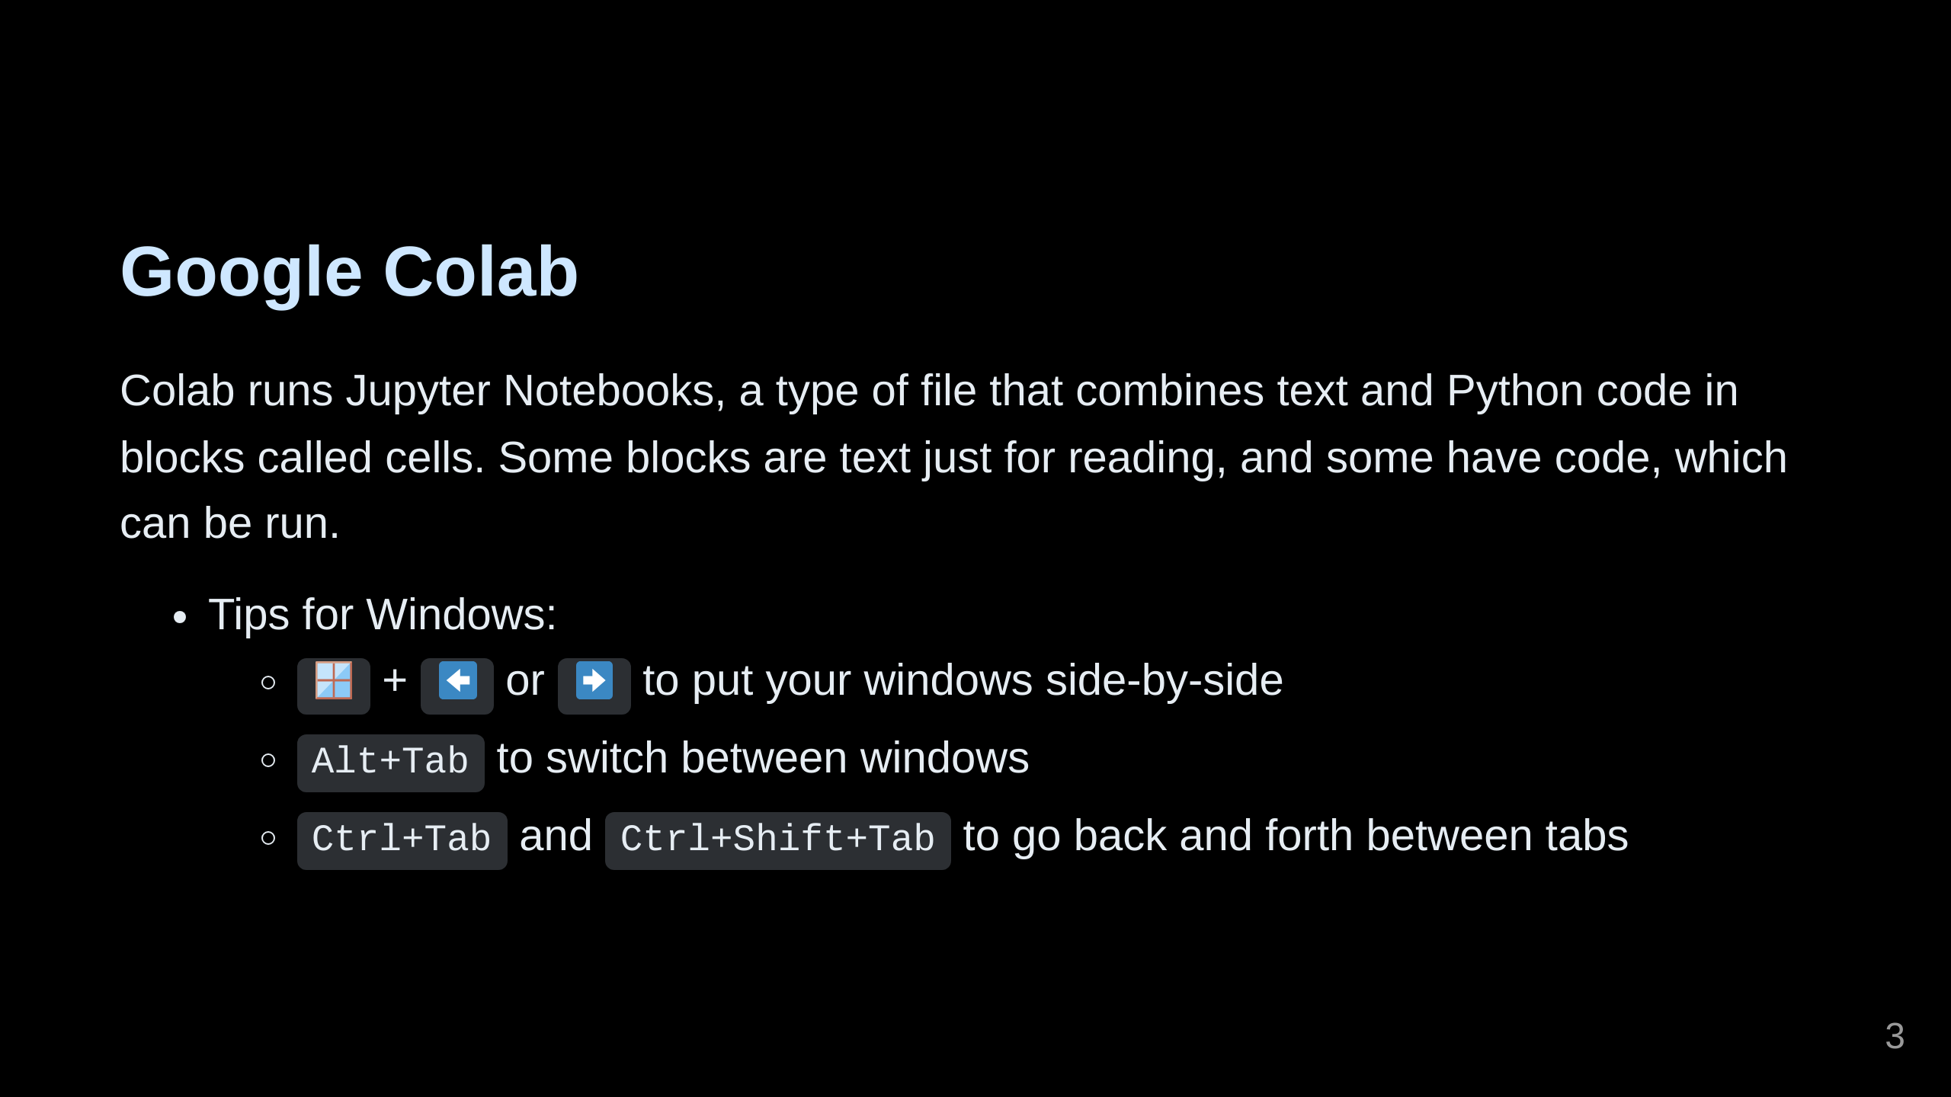
Notes:
You'll need to switch back and forth between Teams and your browser. I've indicated the slide numbers beside each section of the notebook to help you keep track of where we are in the lesson. I also want you to disable AI suggestions by going to settings (gear icon at the top right) and clicking AI Assistance, then uncheck "show AI-powered inline completions" if it's checked.

Slide 4
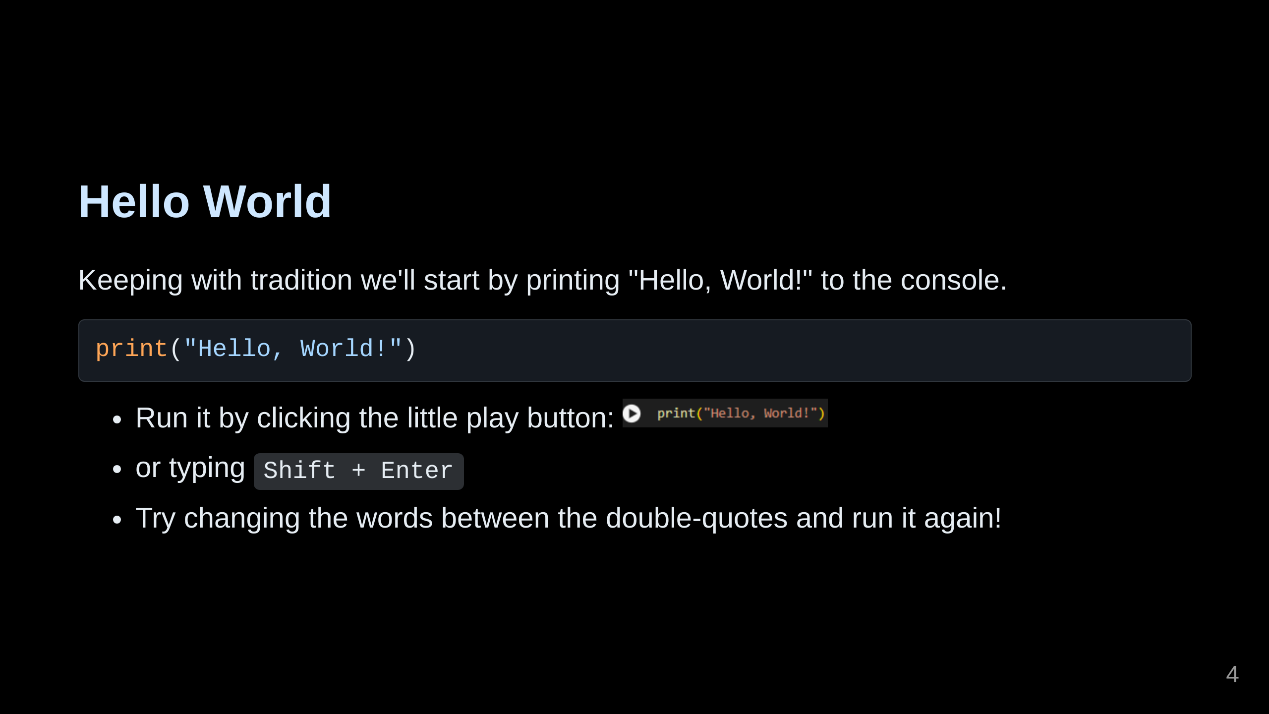
Notes:
Give me a thumbs up when you're ready! Notes: What is this print() thing? This is one of many built-in "functions" available in Python. In describing this line, one would say that we are "calling the print function and passing in the variable 'a'." Don't worry for now if that's too much to remember! A function is kind of a mini-program. Soon you'll be writing your own functions, but we will only be using or "calling" them for now.

Slide 5
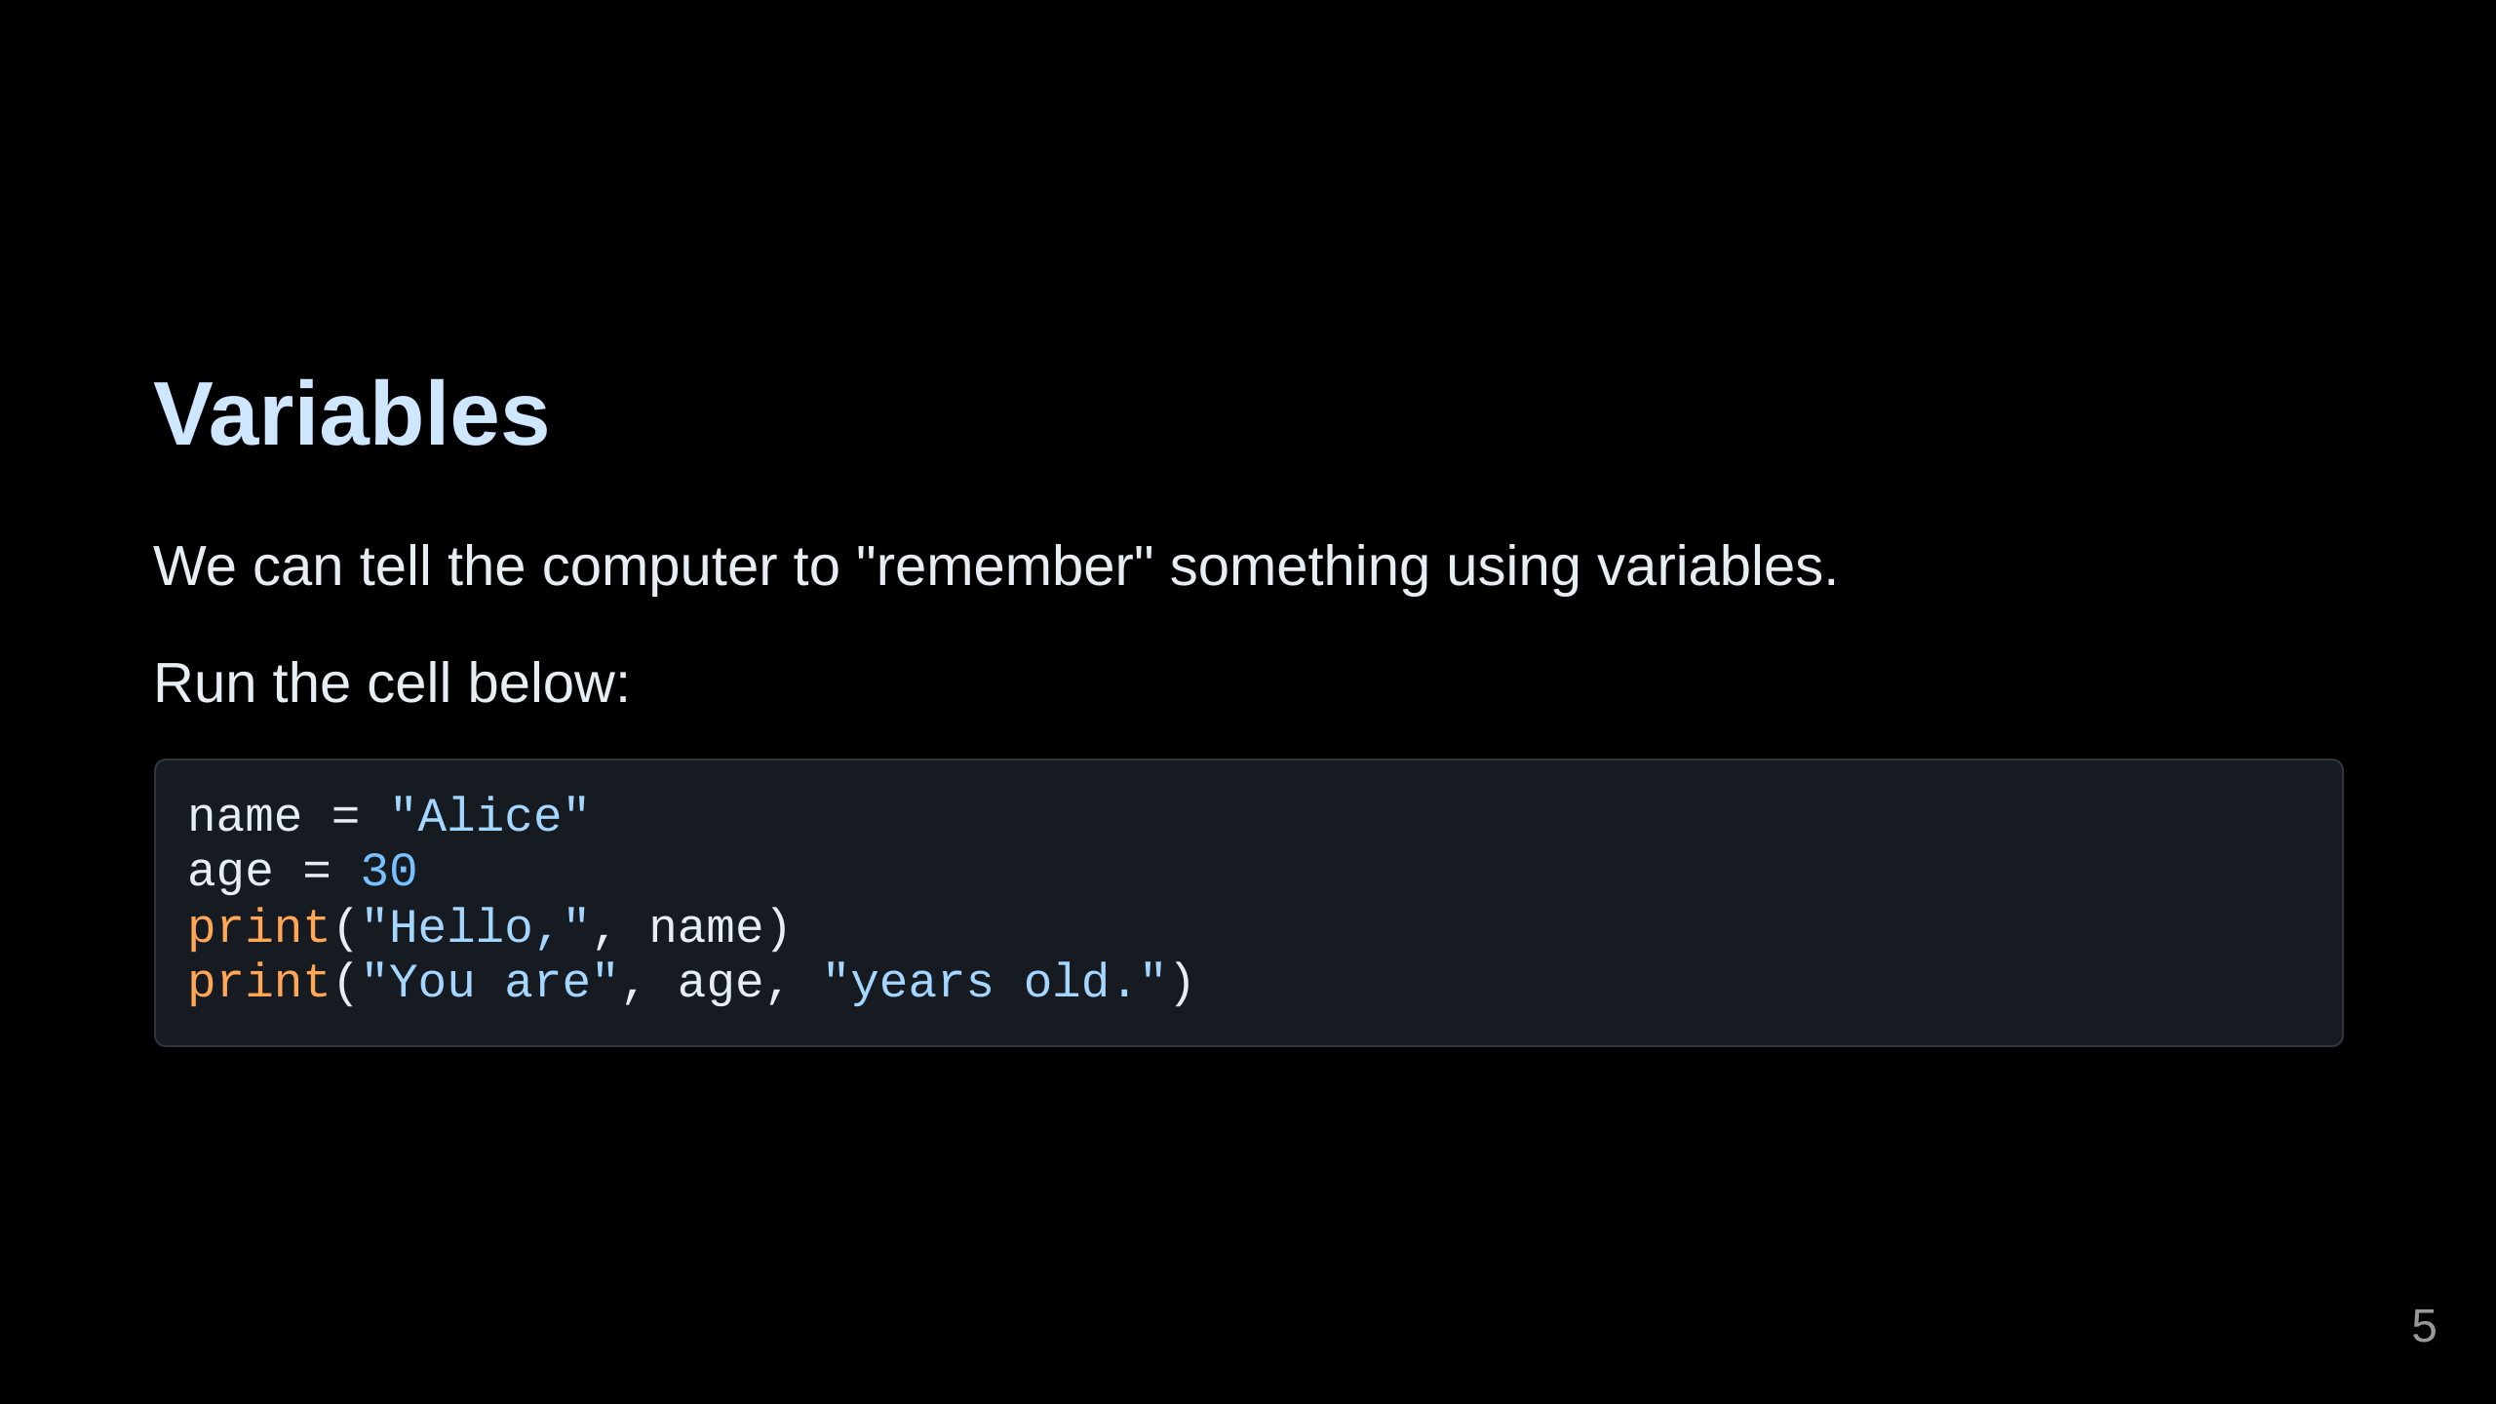

Slide 6
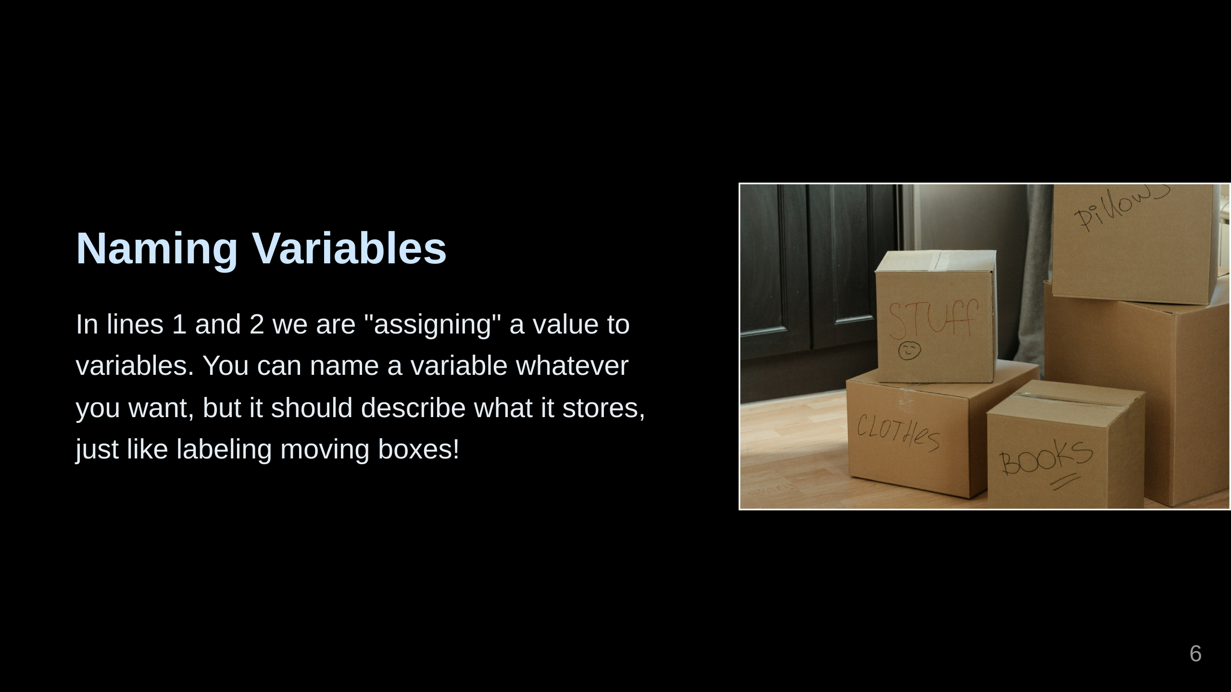

Slide 7
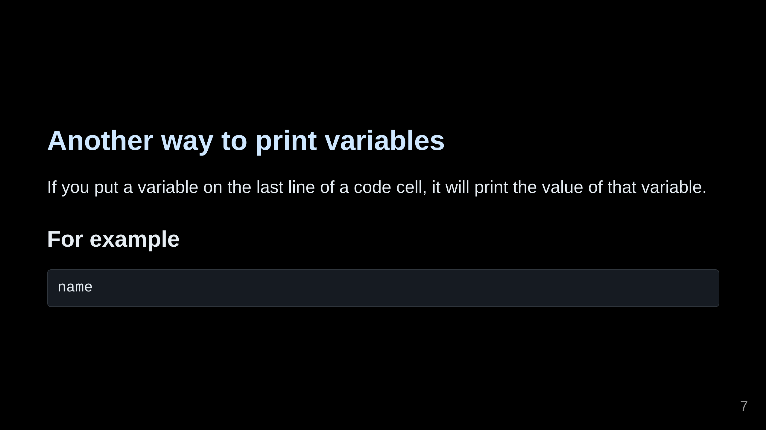
Notes:
run it and tell me what you got!

Slide 8
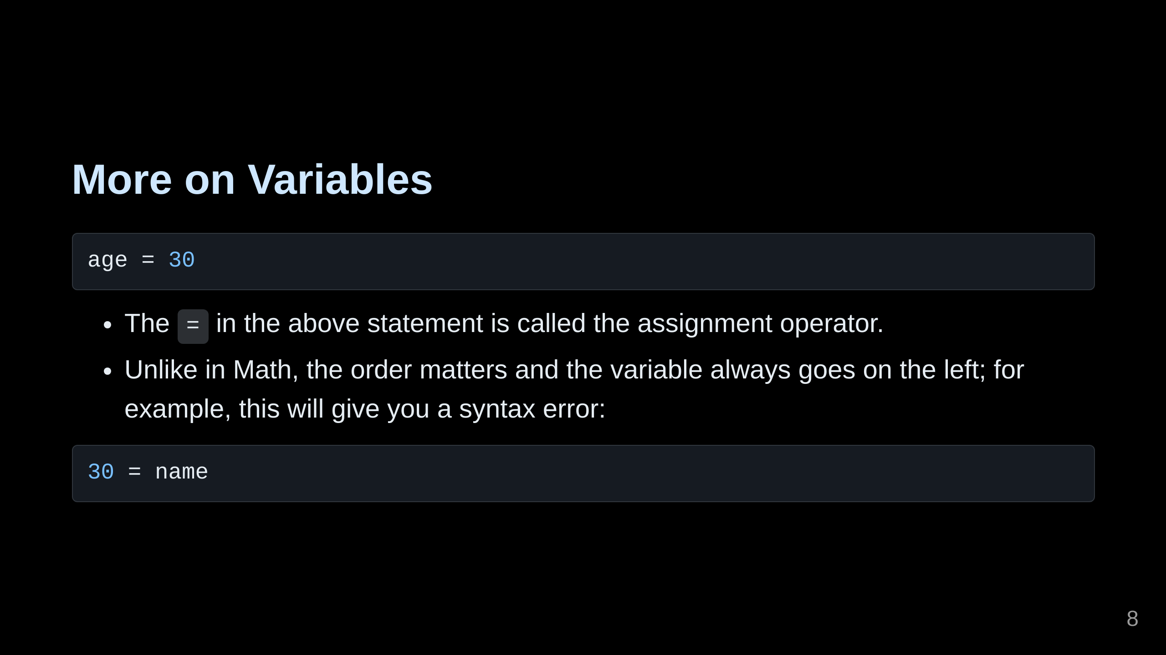
Notes:
Run the code above and give me a thumbs up!

Slide 9
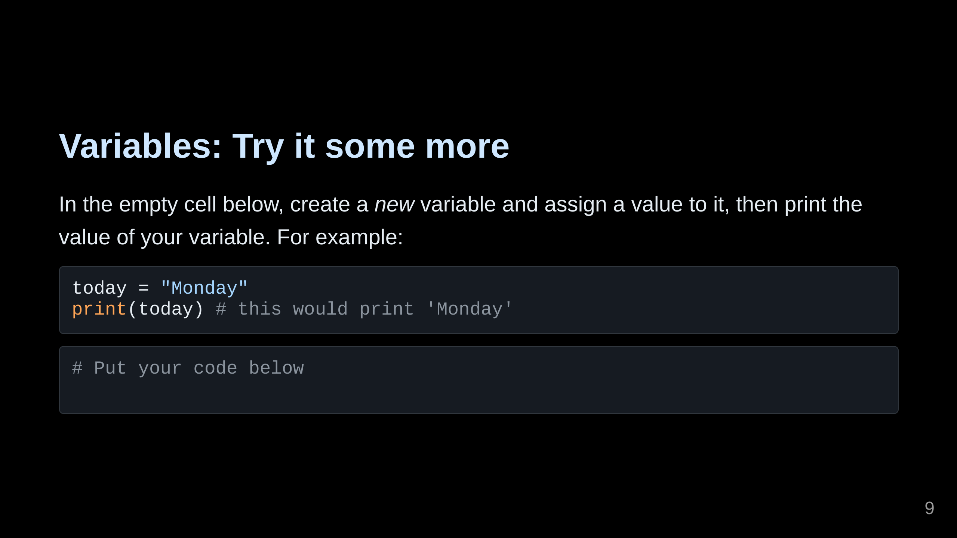
Notes:
Give me a thumbs up when you're ready!

Slide 10
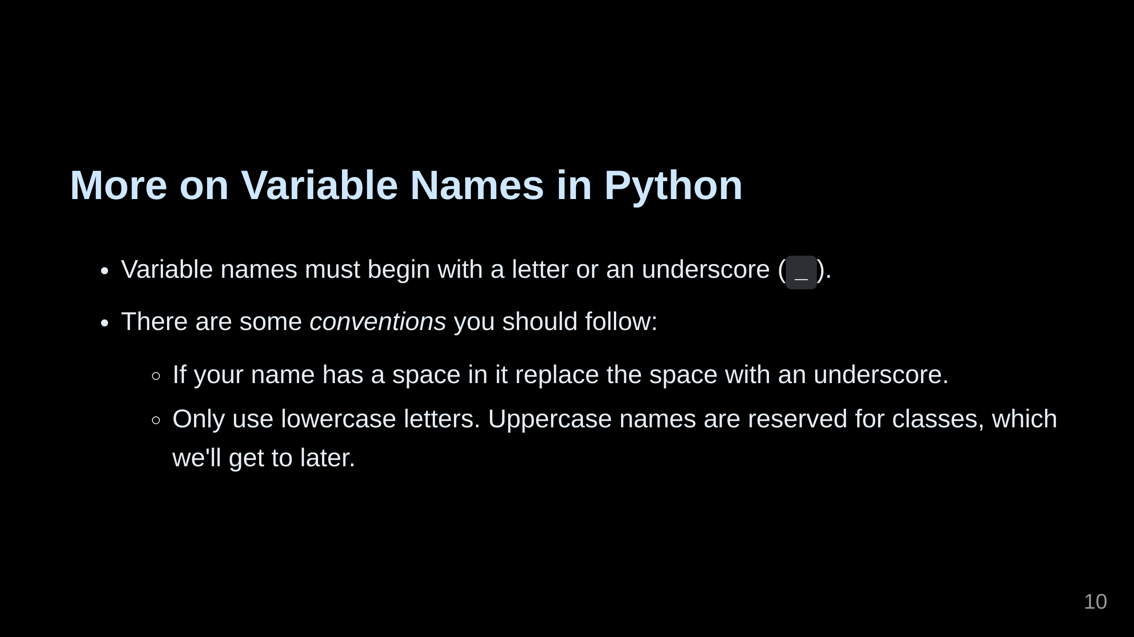

Slide 11
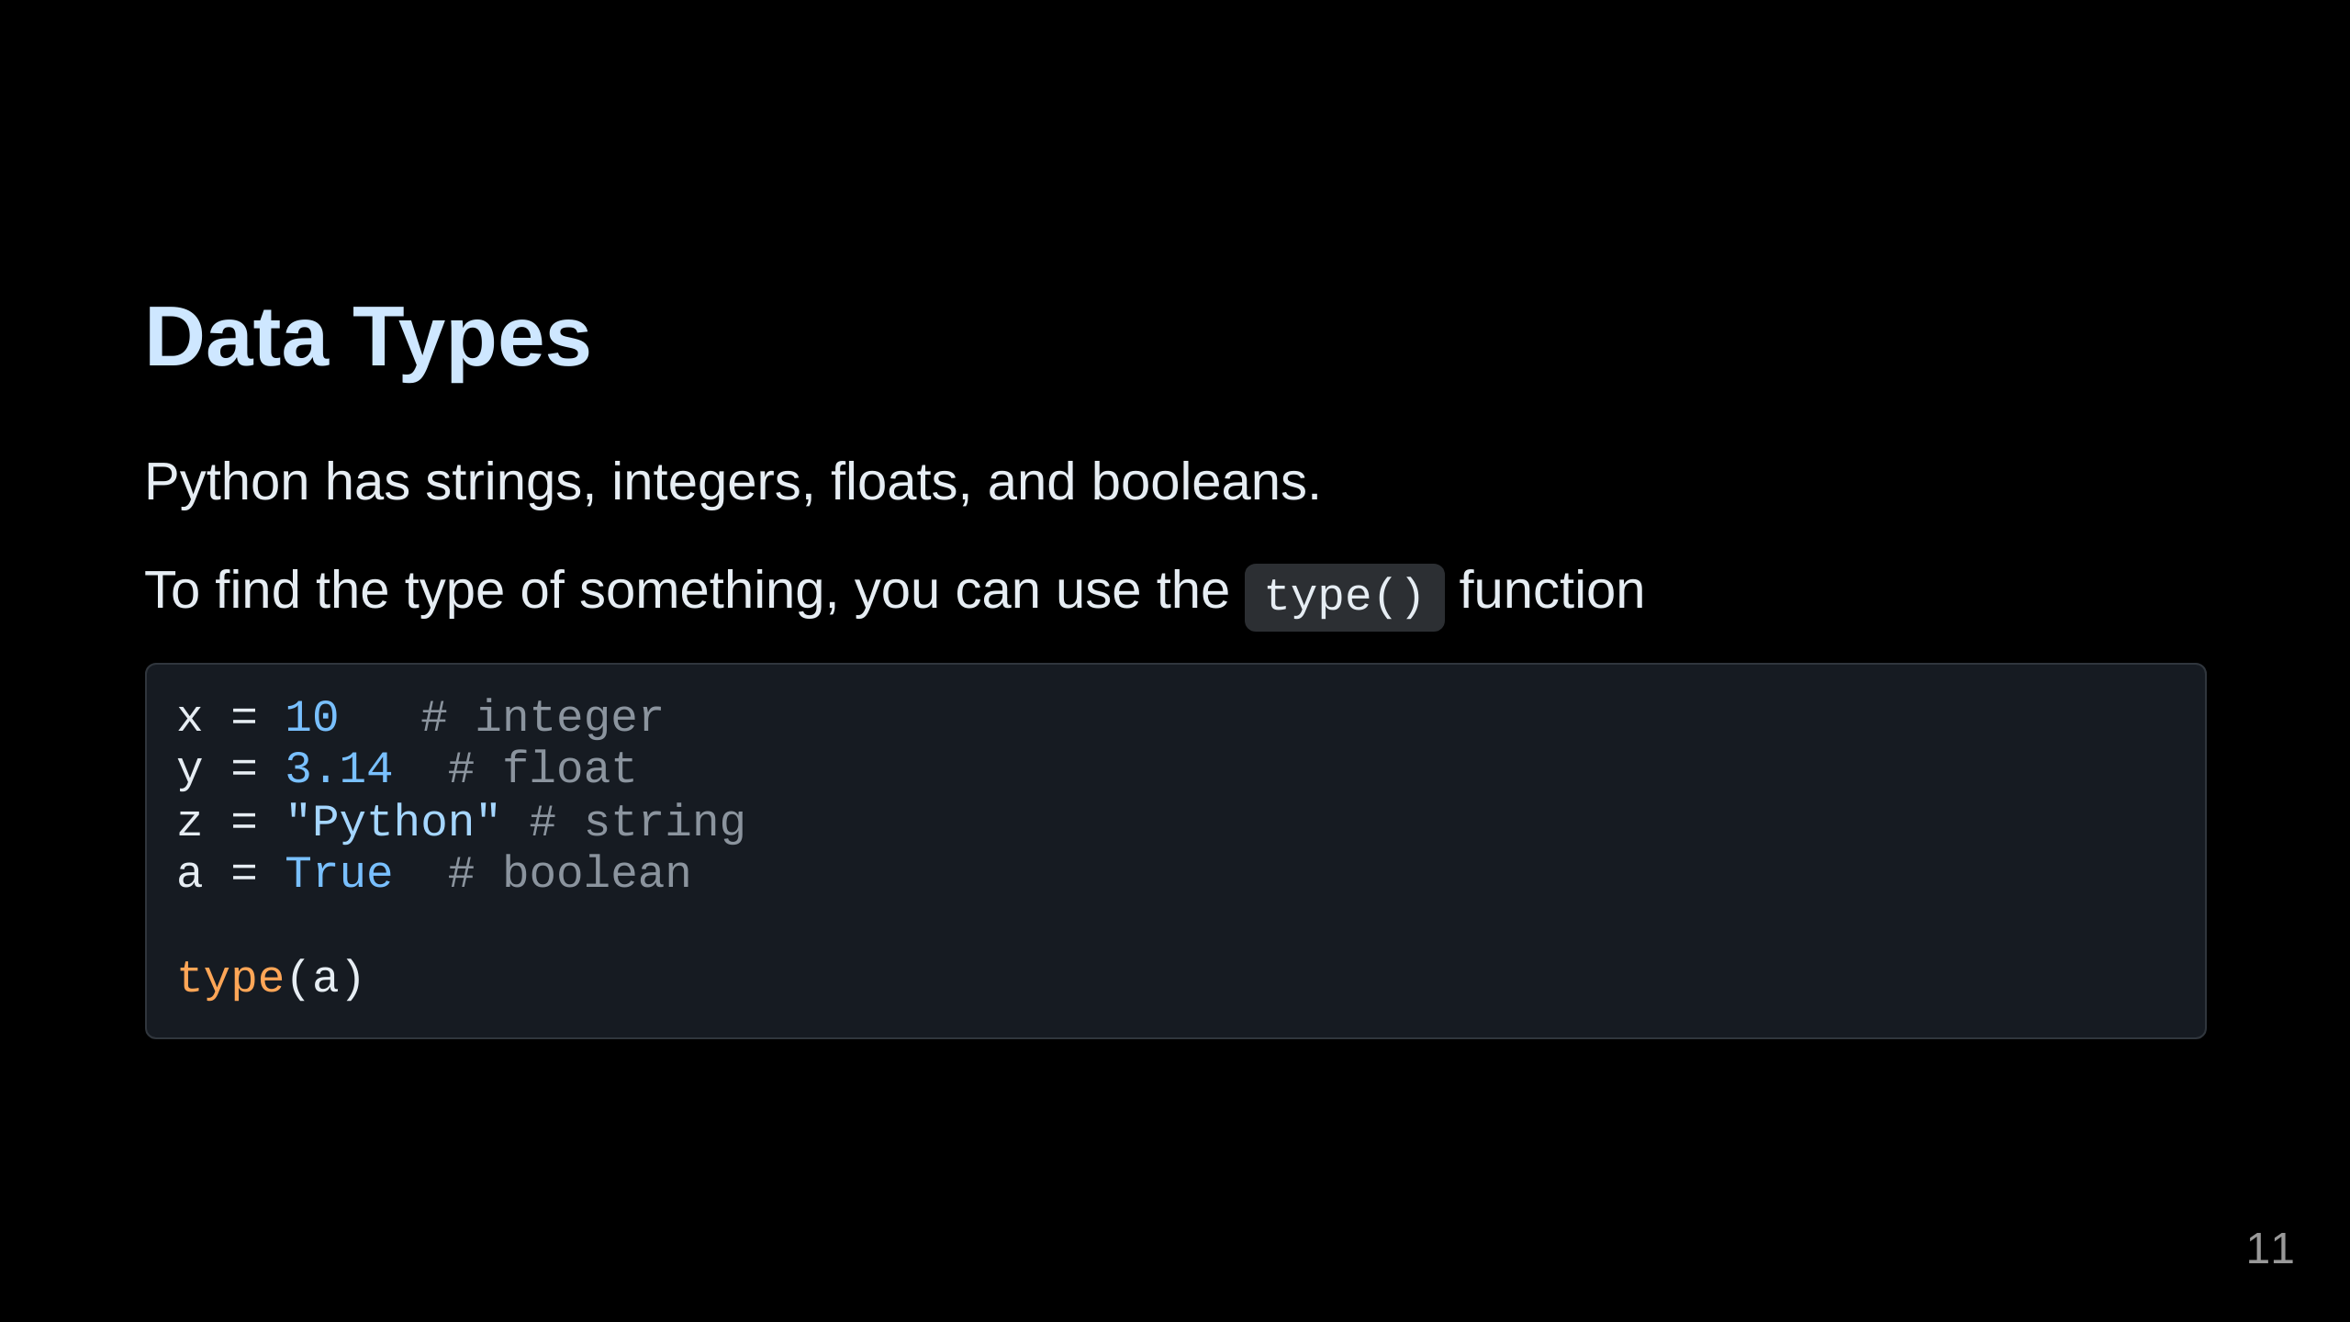
Notes:
Run the code above and tell me what you got!

Slide 12
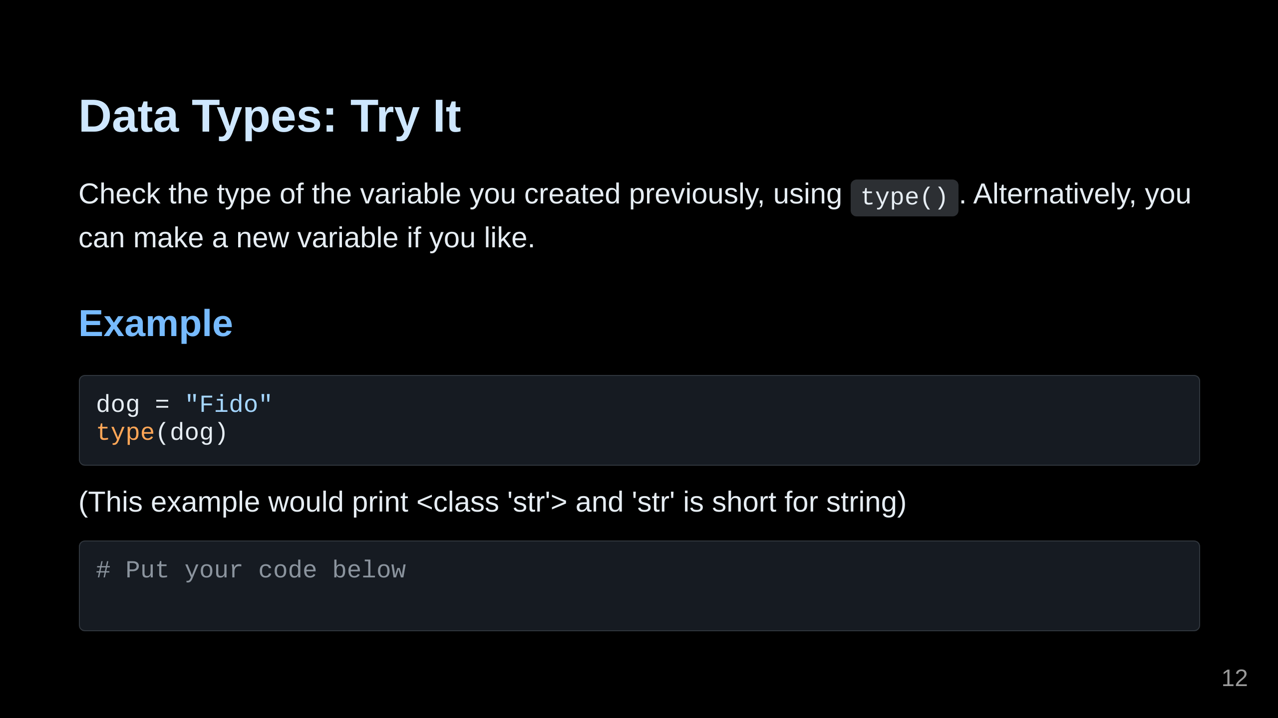
Notes:
Run the code above and give me a thumbs up!

Slide 13
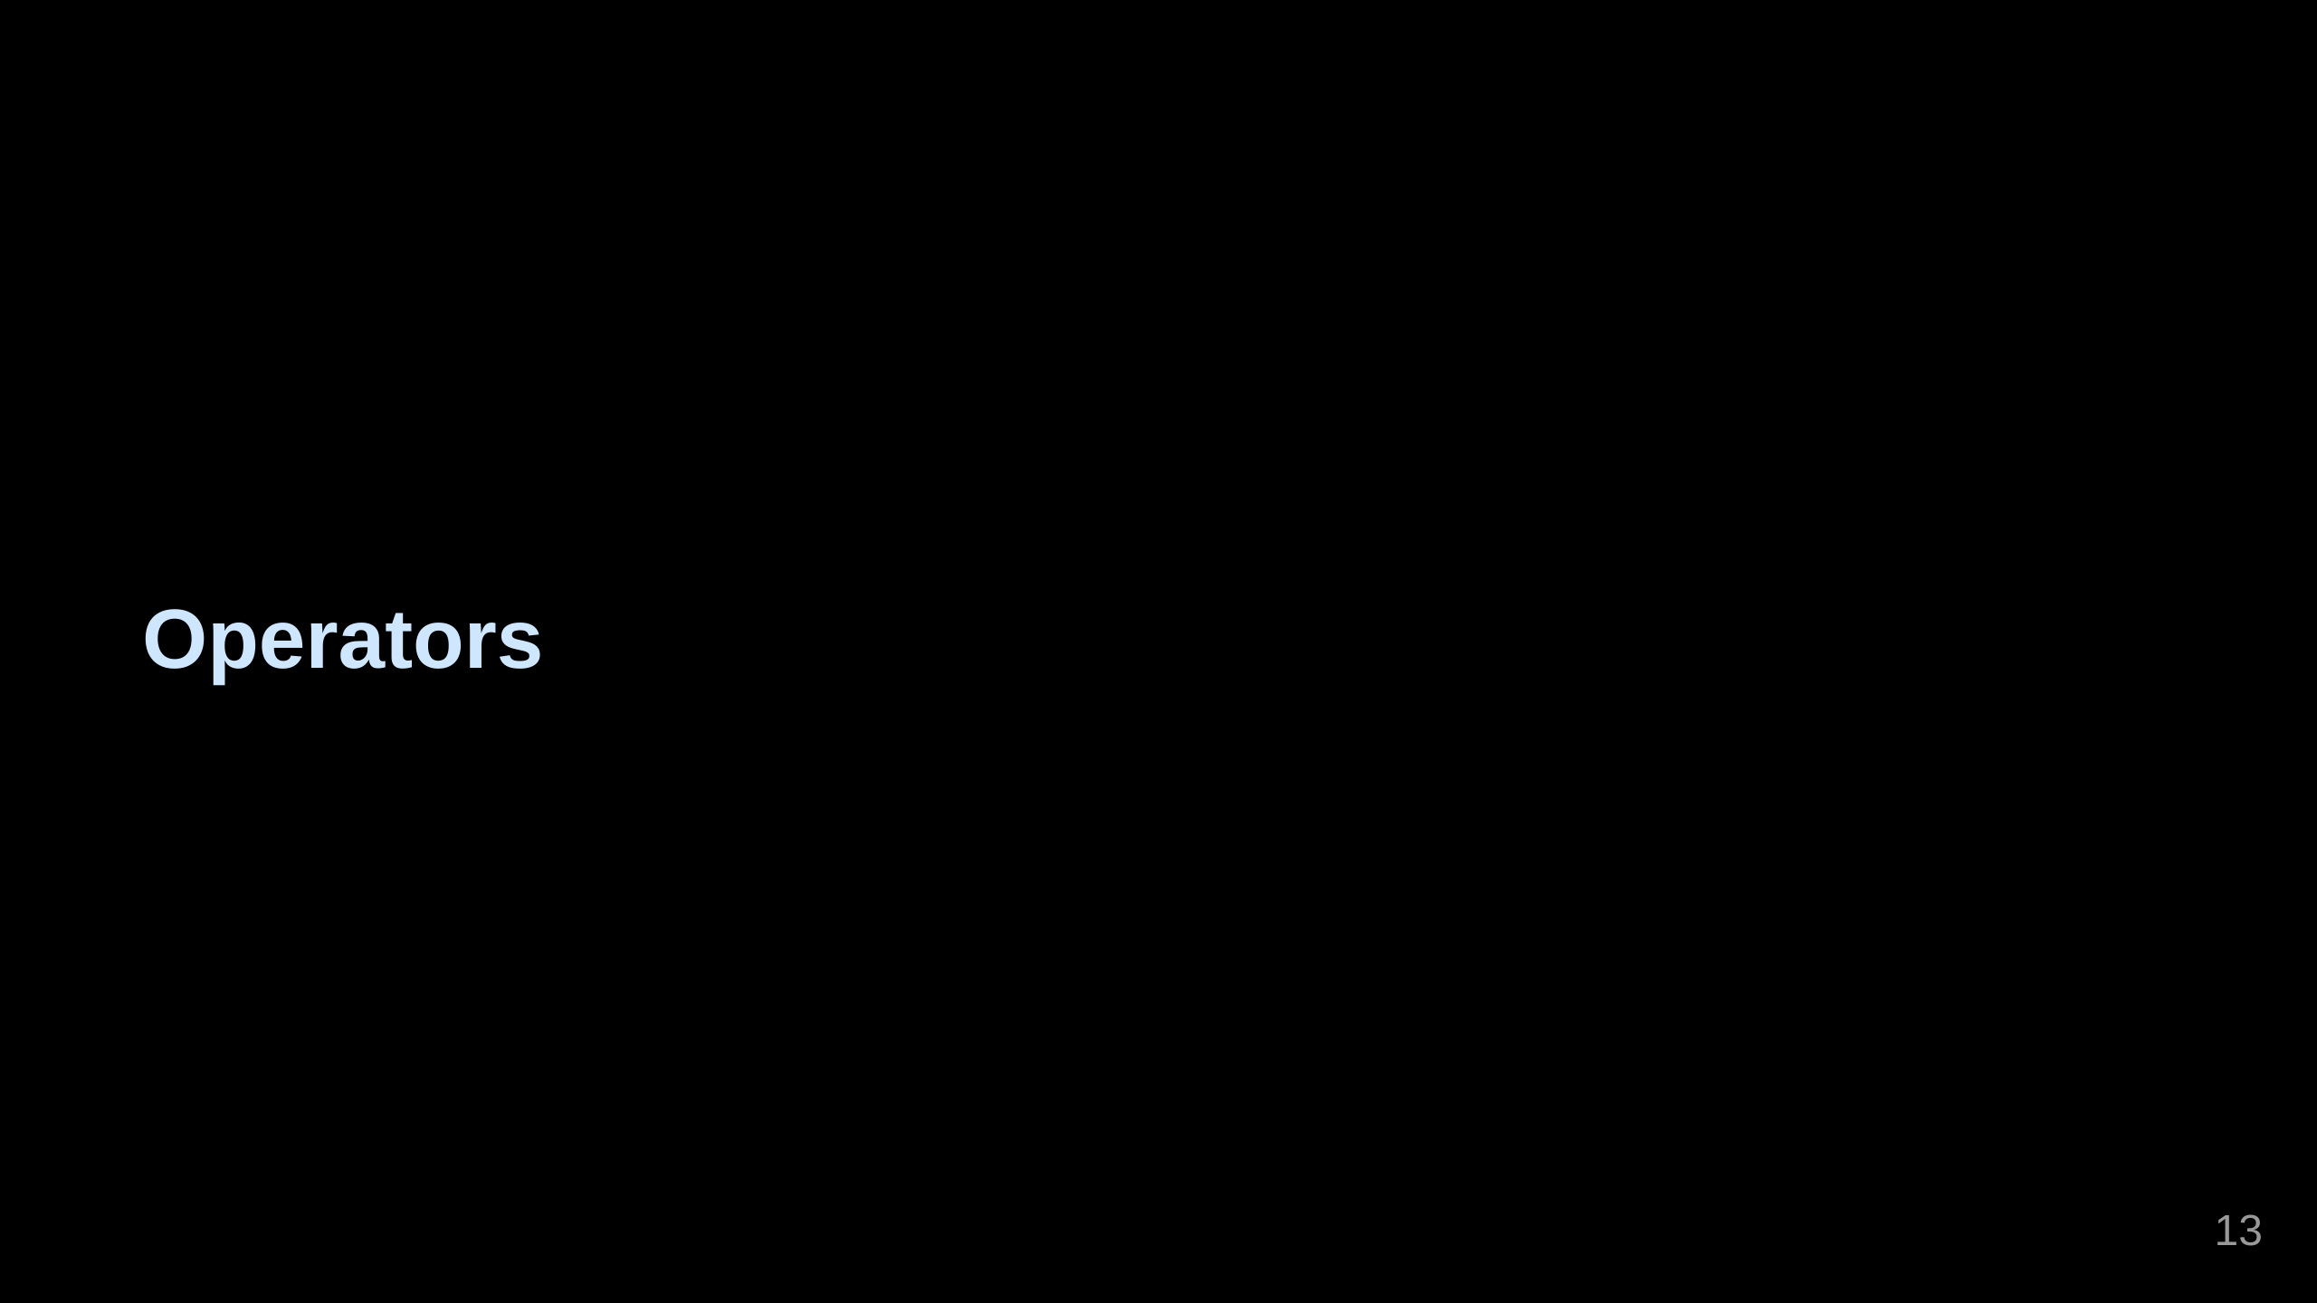

Slide 14
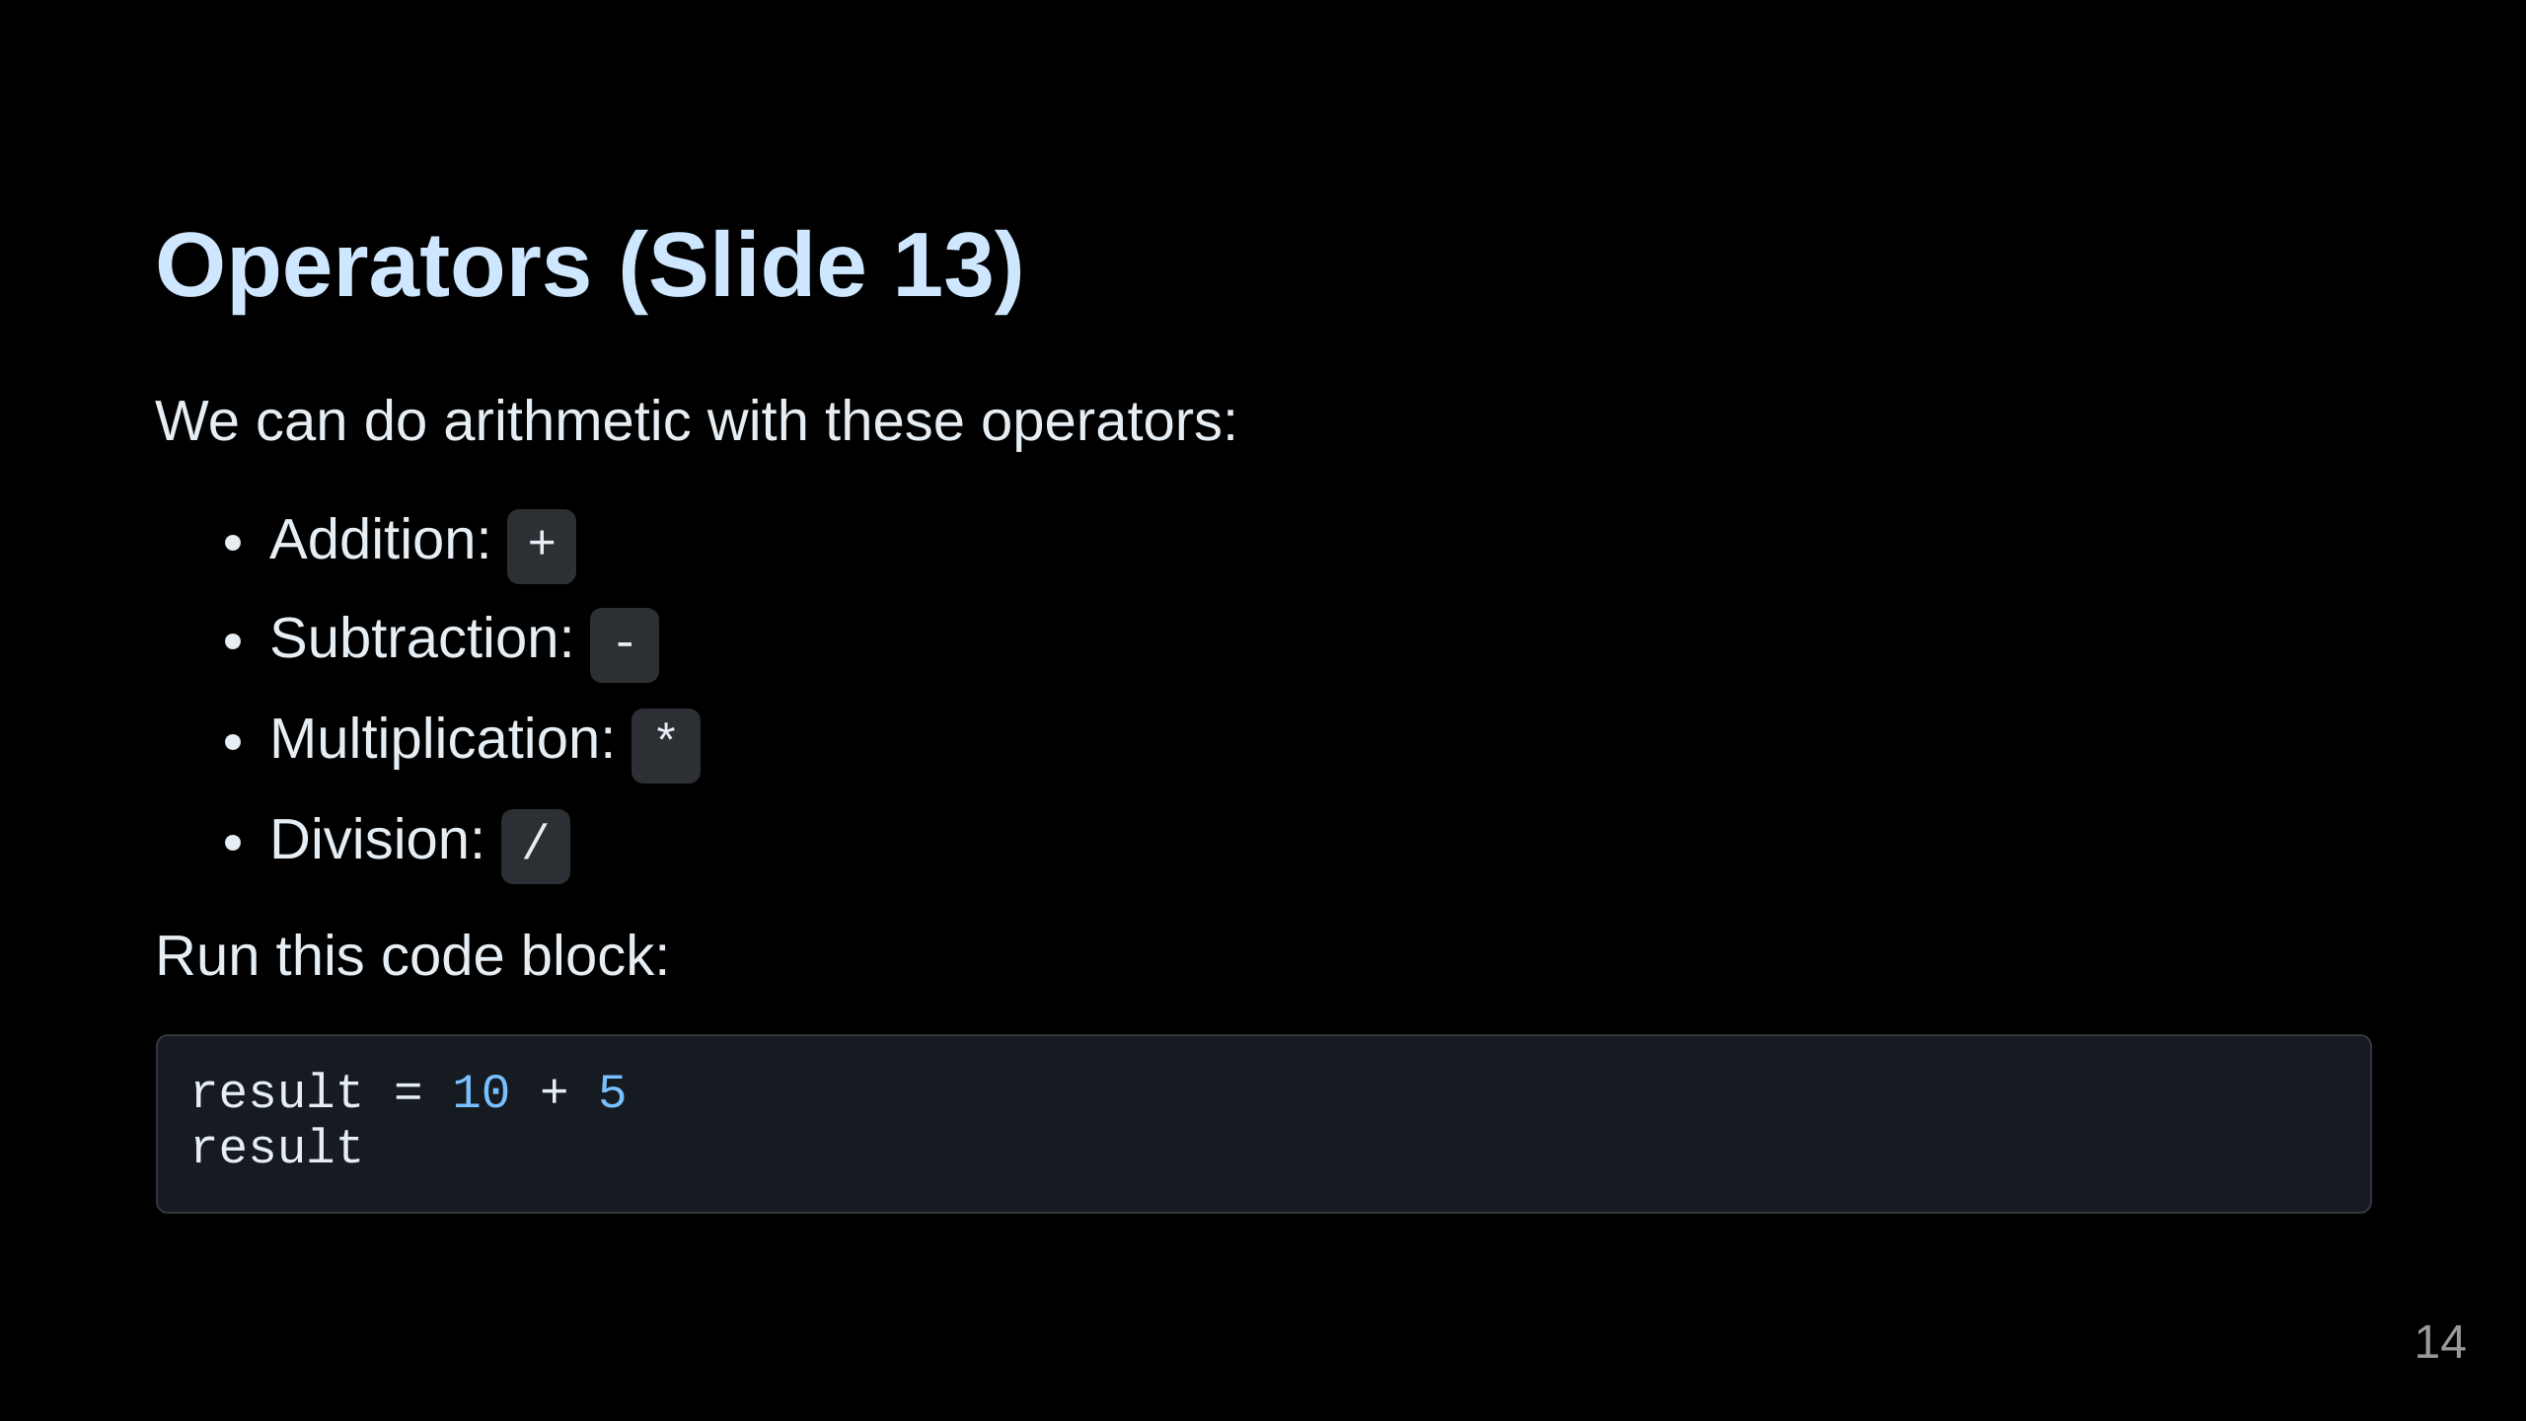
Notes:
Run the code above and give me a thumbs up!

Slide 15
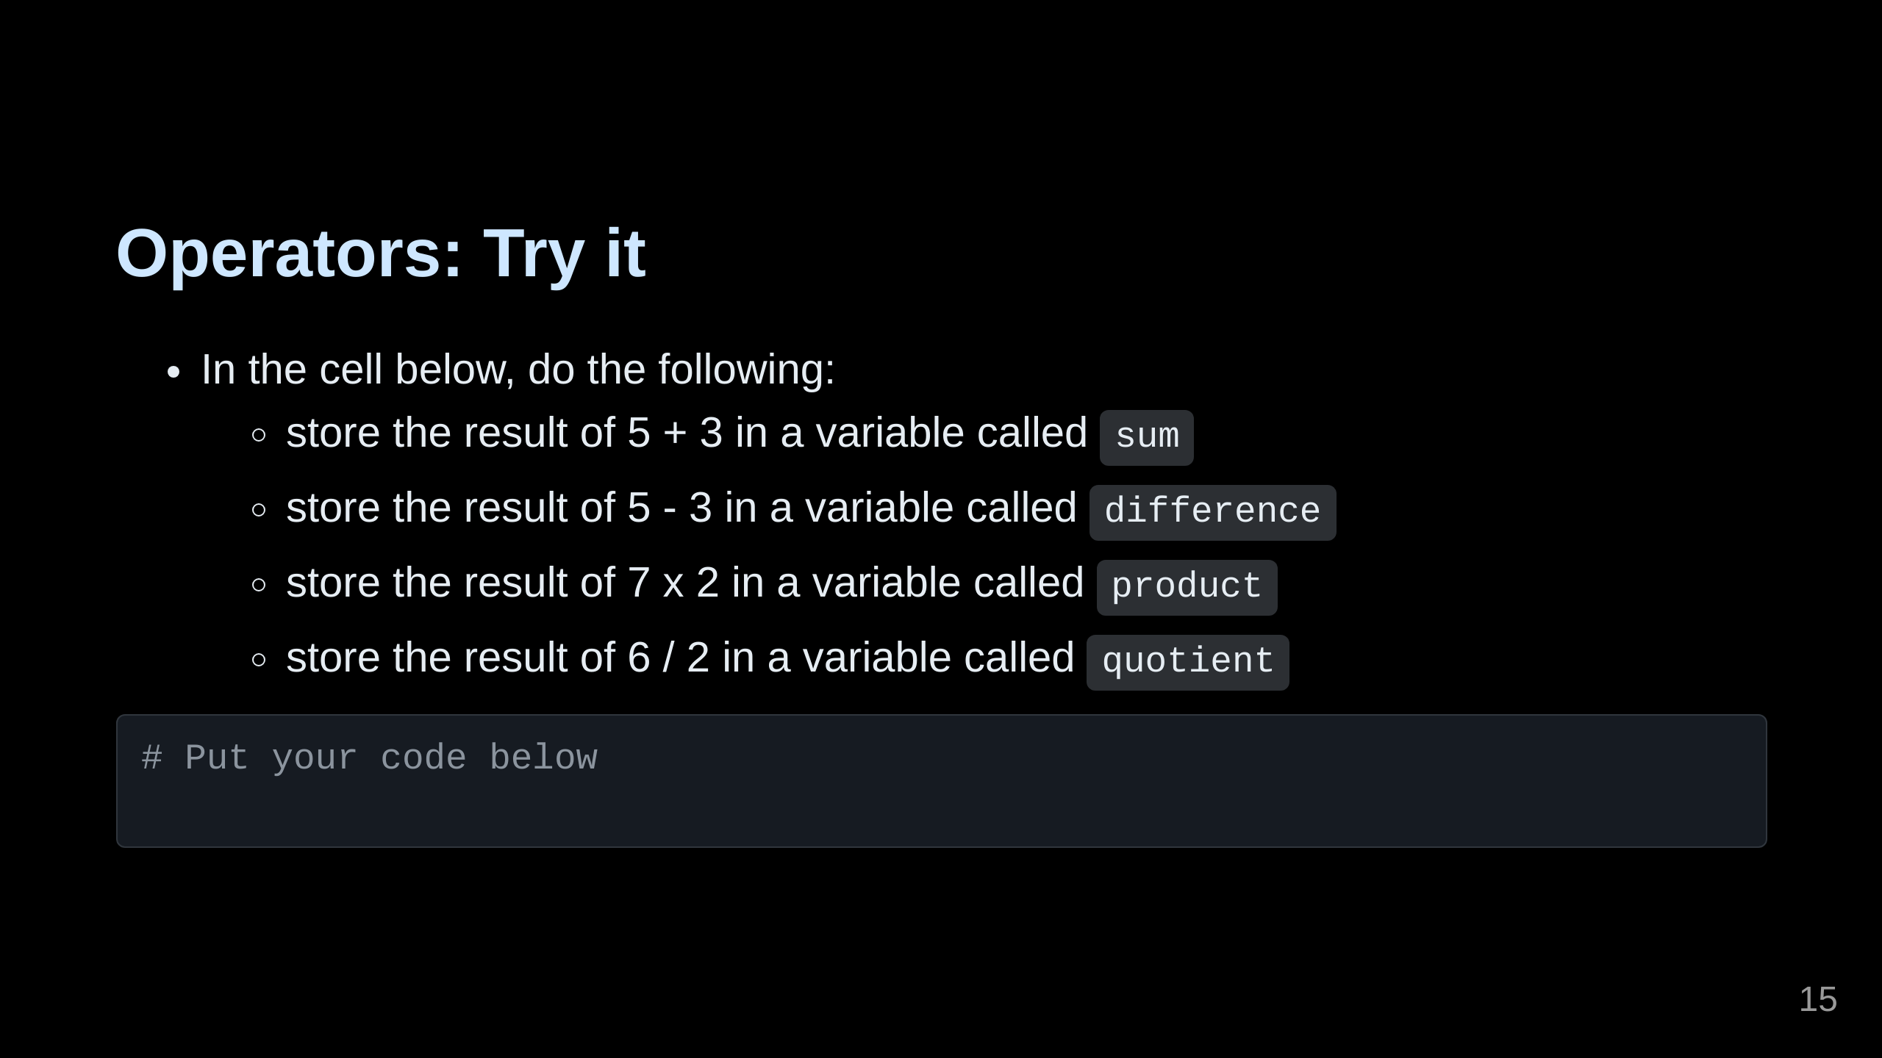

Slide 16
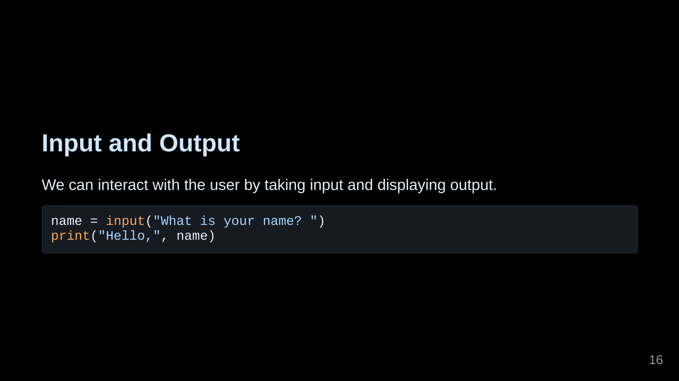
Notes:
Run the code above and give me a thumbs up!

Slide 17
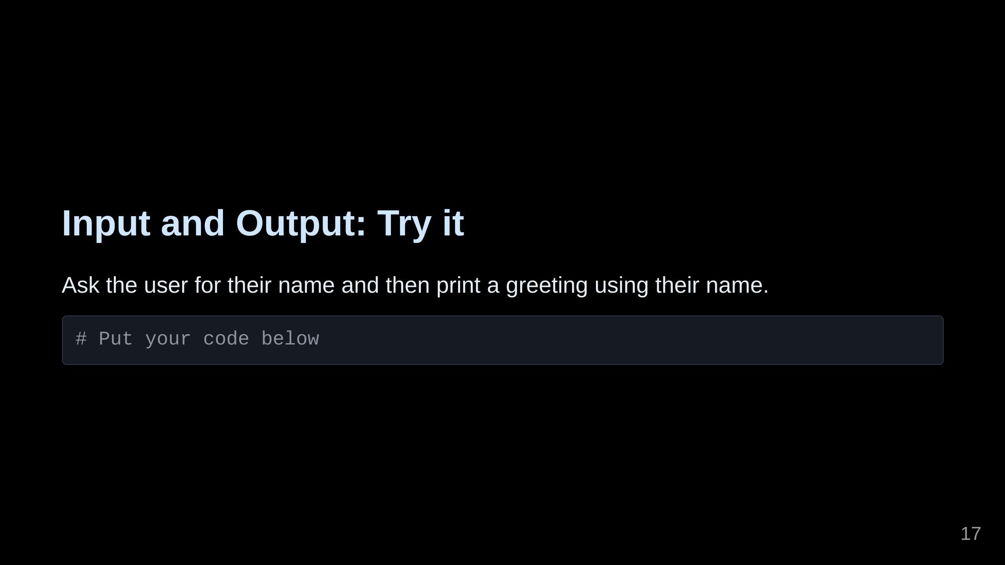

Slide 18
