Slide 1
Project 3(CS472 A1 Computer Architecture)
Pipelined Datapath– Project 3 Review Session
04/04/2024
Yeryoung Kim

Slide 2
Contents
1. Simulation Framework
- Main memory & Simulated Registers
- Read & Write Registers
- Create big loop based on Clock cycle.
- Five stages Methods
2. Output examples of Pipelined Datapath simulation
3. Q&A

Slide 3
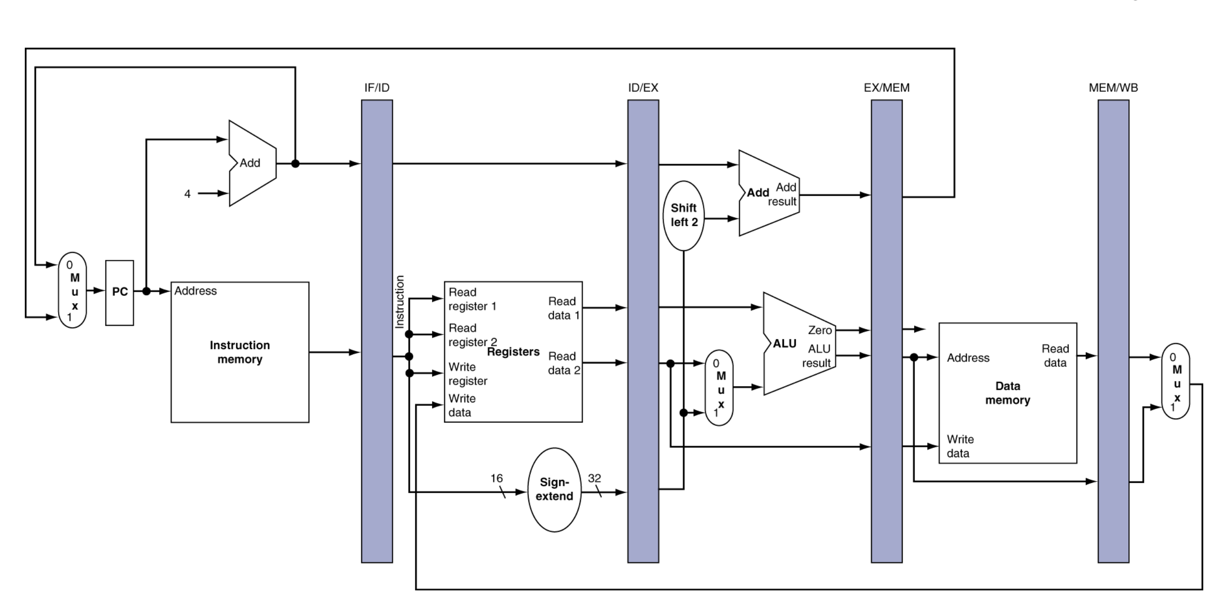
Pipelined Datapath
Notes:
IF stage()
- Instruction Fetch from the Instruction Cach
(input array for your code)
- Write the Fetched instruction to IF/ID Write register.

Slide 4
Main Memory and simulated Registers
Initialization on Main_Mem and simulated Register
Main_Mem[0]=0,Main_Men[1]=1,… Main_Mem[0XFF]=FF
Example of C++: int Regs[32]
Initial value = 0x100 +Register number
$0 = 0,$1=0x101 ,$2=0x102,…$31 =0x11f.

Slide 5
Five stages sequence Methods
IF_stage() : Instruction fetch
ID_stage(): Instuction decode/ register file read
EX_stage(): Execute/ address calculation
MEM_stage(): Memory access
WB_stage(): Write back to Register file
Print_out_everything(): Print the Regs[32] values and both the Read and Write version of all four pipeline registers
Copy_write_to_read(): Copy all information from Write version of pipeline registers to Read version of pipeline registers.

Slide 6
1. Simulation Framework
<Pipeline Datapath>
Implant your `Disassembler` program from Project 1
32-bit instruction and extract the opcode, two source reg #s,
two possible write reg #s, the function code, and the offset.
‘InstructionsCache Array’ to put all 12 instructions
Read and Write versions of 4 pipelined Registers
<Your choice of Big loop>
(1 loop =1 clock cycle)
IF_stage();
ID_stage();
EX_stage();
MEM_stage();
WB_stage();
Print_out_everything();
Copy_write_to_read();

Slide 7
Clock Cycle 1
Four pipeline Registers
Method
<InstructionsCache Array>
0x00a63820 [add, $7, $5, $6]
0x8d0f0004[lw,$15,4,($8)]
0xad09fffc [sw, $9,-4,($8)]
0x00625022[sub,$10,$3,$2]
0x10c8fffb [beq,$6,$8,label]
Write
IF/ID Register
Readx
IF stage()
- Fetched 0x00a63820 [add, $7, $5, $6]
Write
ID/EX Register
Read
ID stage()
-NOPs
Write
EX/MEM Register
Read
EX stage()
-NOPs
Write
MEM/WB Register
Read
MEM stage()
Main Memory(Data Cache)
-NOPs
Registers
WB stage()
-NOPs

Slide 8
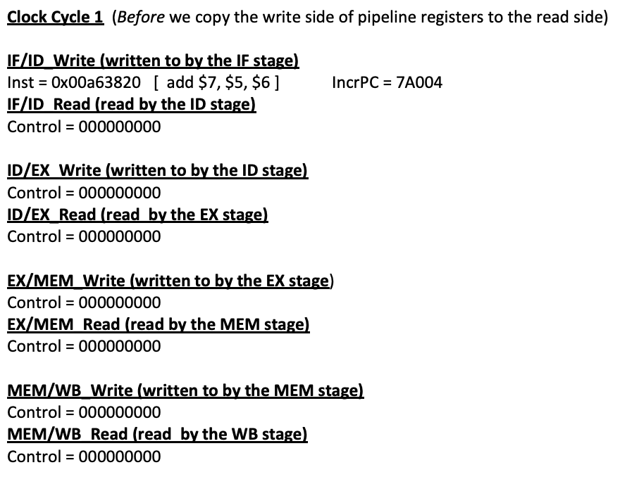
Print out everything()
+ Reg[32] values

Slide 9
Clock Cycle 1
Four pipeline Registers
Method
< InstructionsCache Array >
0x00a63820 [add, $7, $5, $6]
0x8d0f0004 [lw, $15, 4, ($8)]
0xad09fffc [sw, $9,-4,($8)]
0x00625022 [sub, $10, $3 ,$2]
0x10c8fffb [beq, $6, $8 ,label]
Write
IF/ID Register
Read
Write
ID/EX Register
Read
Copy write to read()
- Copy information from the write pipeline registers
to the read pipeline registers
Write
EX/MEM Register
Read
Write
MEM/WB Register
Read

Slide 10
Clock Cycle 2
Four pipeline Registers
Method
< InstructionsCache Array >
0x00a63820 [add, $7, $5, $6]
0x8d0f0004 [lw, $15, 4, ($8)]
0xad09fffc [sw, $9,-4,($8)]
0x00625022 [sub, $10, $3 ,$2]
0x10c8fffb [beq, $6, $8 ,label]
Write
IF/ID Register
Read
IF stage()
- Fetched 0x8d0f0004 [lw, $15, 4, ($8)]
Write
ID/EX Register
Read
ID stage()
(Instruction: 0x00a63820)
- Access IF/ID Read pipeline register
- Decode Fetched instruction
- Read the register files
- Generate the control bits
Write
EX/MEM Register
Read
EX stage()
-NOPs
Write
MEM/WB Register
Read
MEM stage()
Main Memory(Data Cache)
-NOPs
Registers
WB stage()
-NOPs

Slide 11
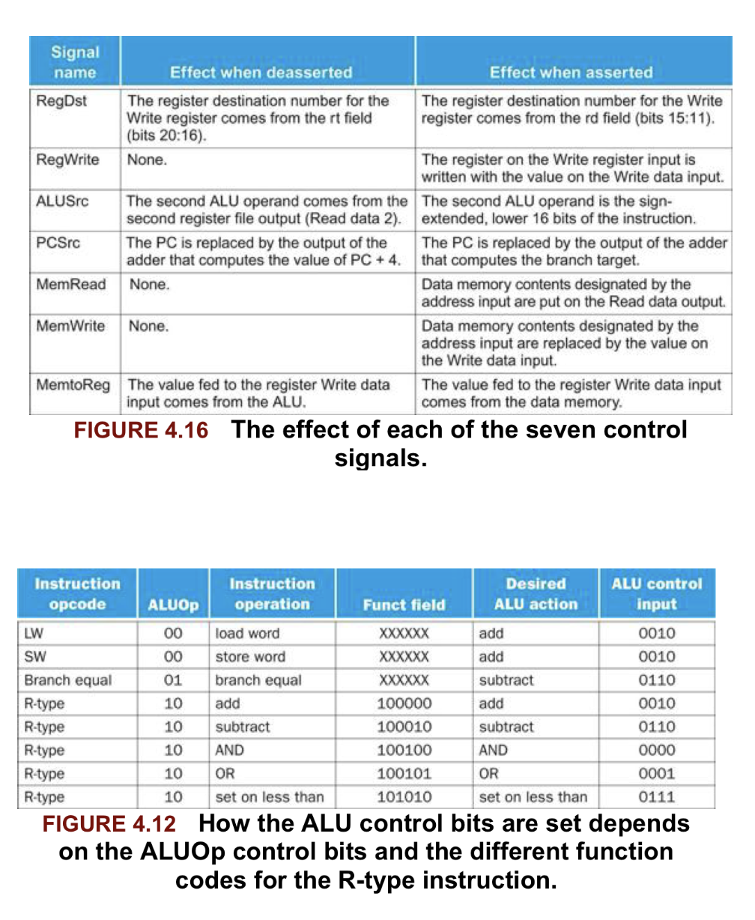
Reference Materials for the control signal

Slide 12
Reference Materials for the control signal
Notes:
You are using ALU action column.

Slide 13
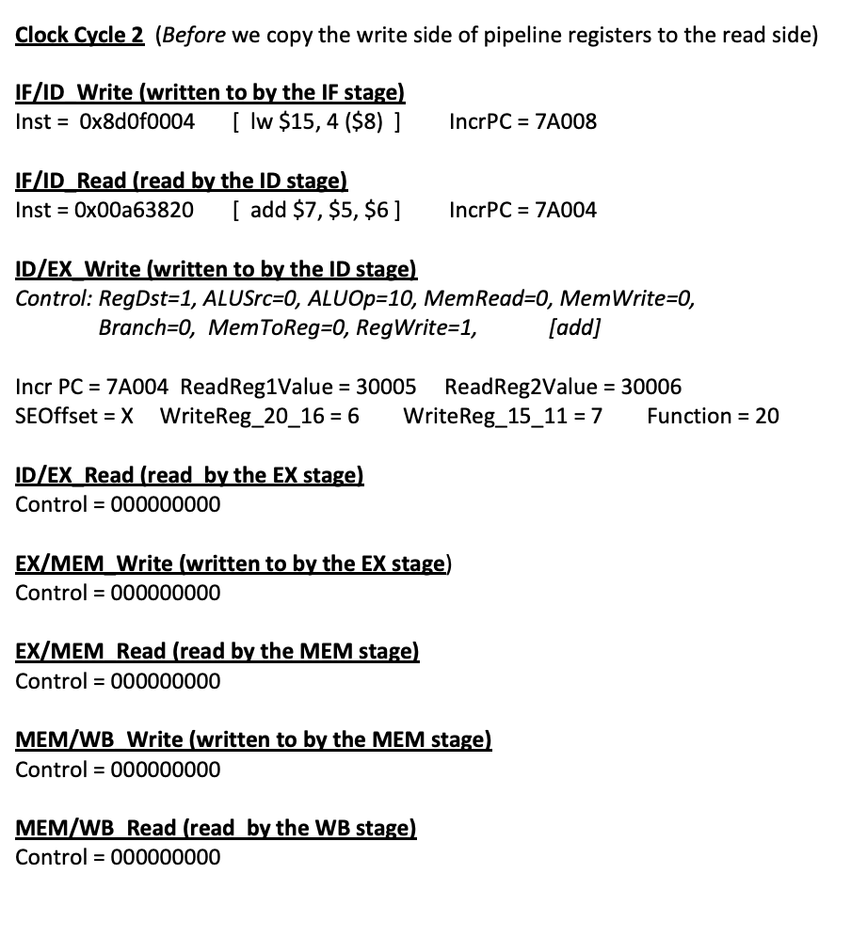
+ Reg[32] values

Slide 14
Clock Cycle 2
Four pipeline Registers
Method
< InstructionsCache Array >
0x00a63820 [add, $7, $5, $6]
0x8d0f0004 [lw, $15, 4, ($8)]
0xad09fffc [sw, $9,-4,($8)]
0x00625022 [sub, $10, $3 ,$2]
0x10c8fffb [beq, $6, $8 ,label]
Write
IF/ID Register
Read
Write
ID/EX Register
Read
Copy write to read()
- Copy information from the write pipeline registers
to the read registers
Write
EX/MEM Register
Read
Write
MEM/WB Register
Read

Slide 15
Clock Cycle 3
Four pipeline Registers
Method
< InstructionsCache Array >
0x00a63820 [add, $7, $5, $6]
0x8d0f0004 [lw, $15, 4, ($8)]
0xad09fffc [sw, $9,-4,($8)]
0x00625022 [sub, $10, $3 ,$2]
0x10c8fffb [beq, $6, $8 ,label]
Write
IF/ID Register
Read
IF stage()
- Fetched 0xad09fffc [sw, $9,-4,($8)]
Write
ID/EX Register
Read
ID stage()
(Instruction: 0x8d0f0004)
- Access IF/ID Read pipeline register
- Decode Fetched instruction
- Read the register files
- Generate the control bits
Write
EX/MEM Register
Read
EX stage()
(Instruction: 0x00a63820)
- Access ID/EX Read Register
- Calculate the address with requested operation
- Write the appropriate value on Write pipeline register
Write
MEM/WB Register
Read
MEM stage()
Main Memory(Data Cache)
-NOPs
Registers
WB stage()
-NOPs

Slide 16
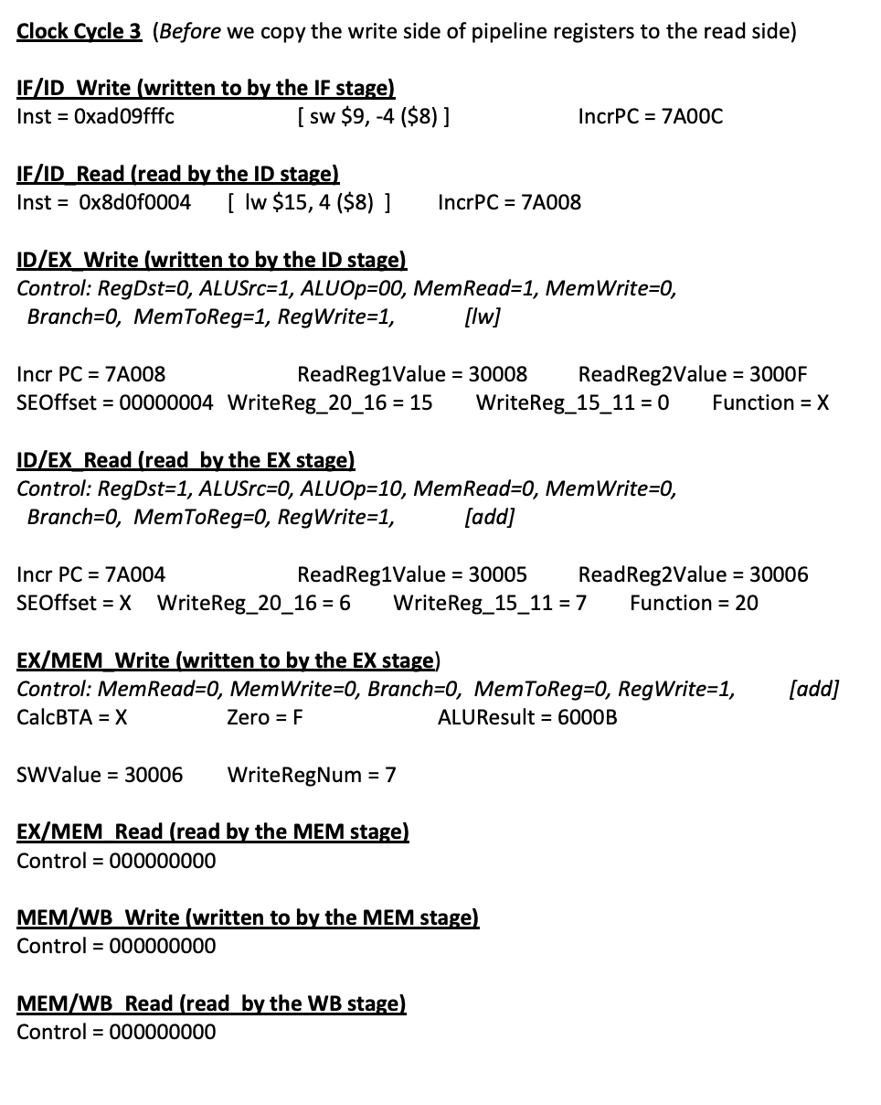
+ Reg[32] values

Slide 17
Clock Cycle 3
Four pipeline Registers
Method
< InstructionsCache Array >
0x00a63820 [add, $7, $5, $6]
0x8d0f0004 [lw, $15, 4, ($8)]
0xad09fffc [sw, $9,-4,($8)]
0x00625022 [sub, $10, $3 ,$2]
0x10c8fffb [beq, $6, $8 ,label]
Write
IF/ID Register
Read
Write
ID/EX Register
Read
Copy write to read()
- Copy information from the write pipeline registers
to the read pipeline registers
Write
EX/MEM Register
Read
Write
MEM/WB Register
Read

Slide 18
Clock Cycle 4
Four pipeline Registers
Method
< InstructionsCache Array >
0x00a63820 [add, $7, $5, $6]
0x8d0f0004 [lw, $15, 4, ($8)]
0xad09fffc [sw, $9,-4,($8)]
0x00625022 [sub, $10, $3 ,$2]
0x10c8fffb [beq, $6, $8 ,label]
Write
IF/ID Register
Read
IF stage()
- Fetched 0x00625022 [sub, $10, $3 ,$2]
Write
ID/EX Register
Read
ID stage()
(Instruction: 0xad09fffc)
- Access IF/ID Read pipeline register
- Decode Fetched instruction
- Read the register files
- Generate the control bits
Write
EX/MEM Register
Read
EX stage()
(Instruction: 0x8d0f0004)
- Access ID/EX Read pipeline Register
- Calculate the address with requested operation
- Write the appropriate value on Write pipeline register
Write
MEM/WB Register
Read
MEM stage()
(Instruction: 0x00a63820)
Main Memory(Data Cache)
- In case of `lb` Instruction ,use ALU result as
an index of Main memory and take the value
from the Main memory
- Otherwise, pass information to MEM_WB Write pipeline register.
Registers
WB stage()
-NOPs

Slide 19
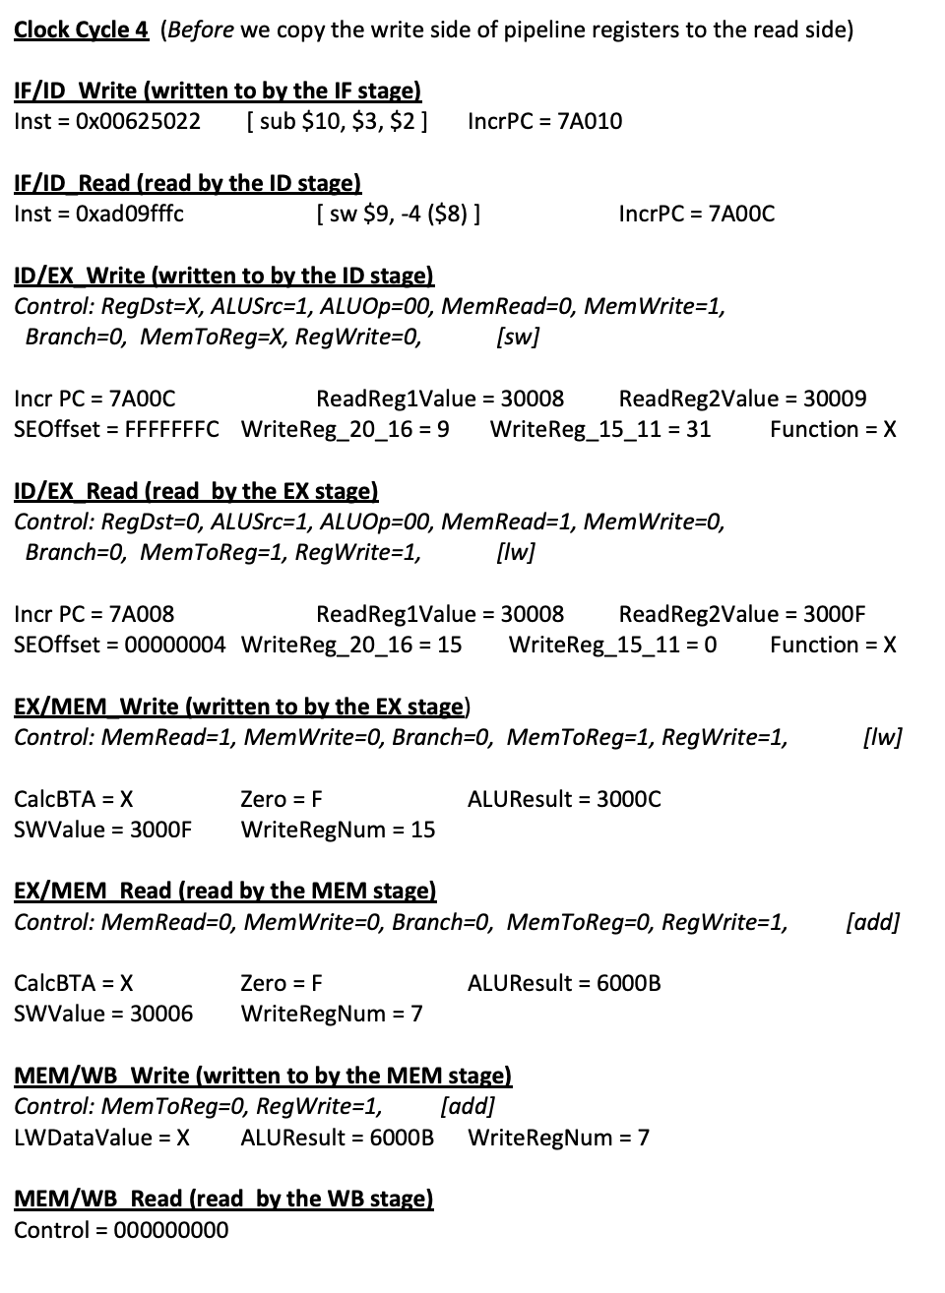
+ Reg[32] values

Slide 20
Clock Cycle 4
Four pipeline Registers
Method
< InstructionsCache Array >
0x00a63820 [add, $7, $5, $6]
0x8d0f0004 [lw, $15, 4, ($8)]
0xad09fffc [sw, $9,-4,($8)]
0x00625022 [sub, $10, $3 ,$2]
0x10c8fffb [beq, $6, $8 ,label]
Write
IF/ID Register
Read
Write
ID/EX Register
Read
Copy write to read()
- Copy information from the write pipeline registers
to the read pipeline registers
Write
EX/MEM Register
Read
Write
MEM/WB Register
Read

Slide 21
Clock Cycle 5
Four pipeline Registers
Method
< InstructionsCache Array >
0x00a63820 [add, $7, $5, $6]
0x8d0f0004 [lw, $15, 4, ($8)]
0xad09fffc [sw, $9,-4,($8)]
0x00625022 [sub, $10, $3 ,$2]
0x10c8fffb [beq, $6, $8 ,label]
Write
IF/ID Register
Read
IF stage()
- Fetched 0x10c8fffb
Write
ID/EX Register
Read
ID stage()
(Instruction: 0x00625022)
- Access IF/ID Read pipeline register
- Decode Fetched instruction
- Read the register files
- Generate the control bits
Write
EX/MEM Register
Read
EX stage()
(Instruction: 0xad09fffc)
- Access ID/EX Read pipeline Register
- Calculate the address with requested operation
- Write the appropriate value on Write pipeline register
Write
MEM/WB Register
Read
MEM stage()
(Instruction: 0x8d0f0004)
Main Memory(Data Cache)
- In case of `lb` Instruction ,use ALU result as
an index of Main memory and take the value
from the Main memory
- Otherwise, pass information to MEM_WB Write pipeline register.
Registers
WB stage()
(Instruction: 0x00a63820)
- Write information based on MEM/WB pipeline Register to register files

Slide 22
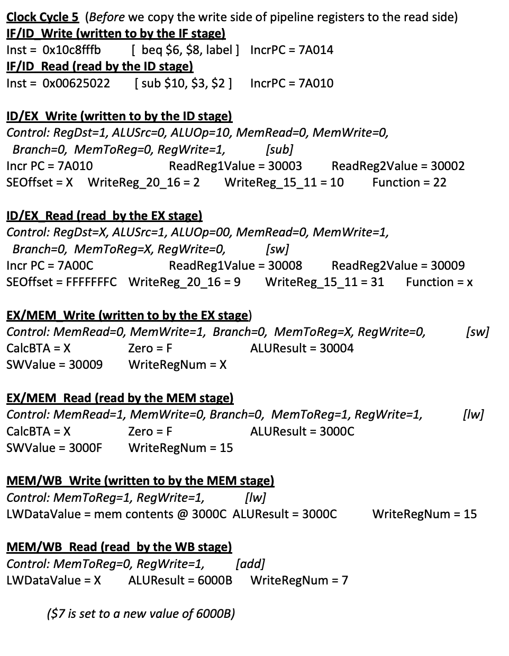
+ Reg[32] values

Slide 23
Clock Cycle 5
Four pipeline Registers
Method
< InstructionsCache Array >
0x00a63820 [add, $7, $5, $6]
0x8d0f0004 [lw, $15, 4, ($8)]
0xad09fffc [sw, $9,-4,($8)]
0x00625022 [sub, $10, $3 ,$2]
0x10c8fffb [beq, $6, $8 ,label]
Write
IF/ID Register
Read
Write
ID/EX Register
Read
Copy write to read()
- Copy information from the write pipeline registers
to the read pipeline registers
Write
EX/MEM Register
Read
Write
MEM/WB Register
Read

Slide 24
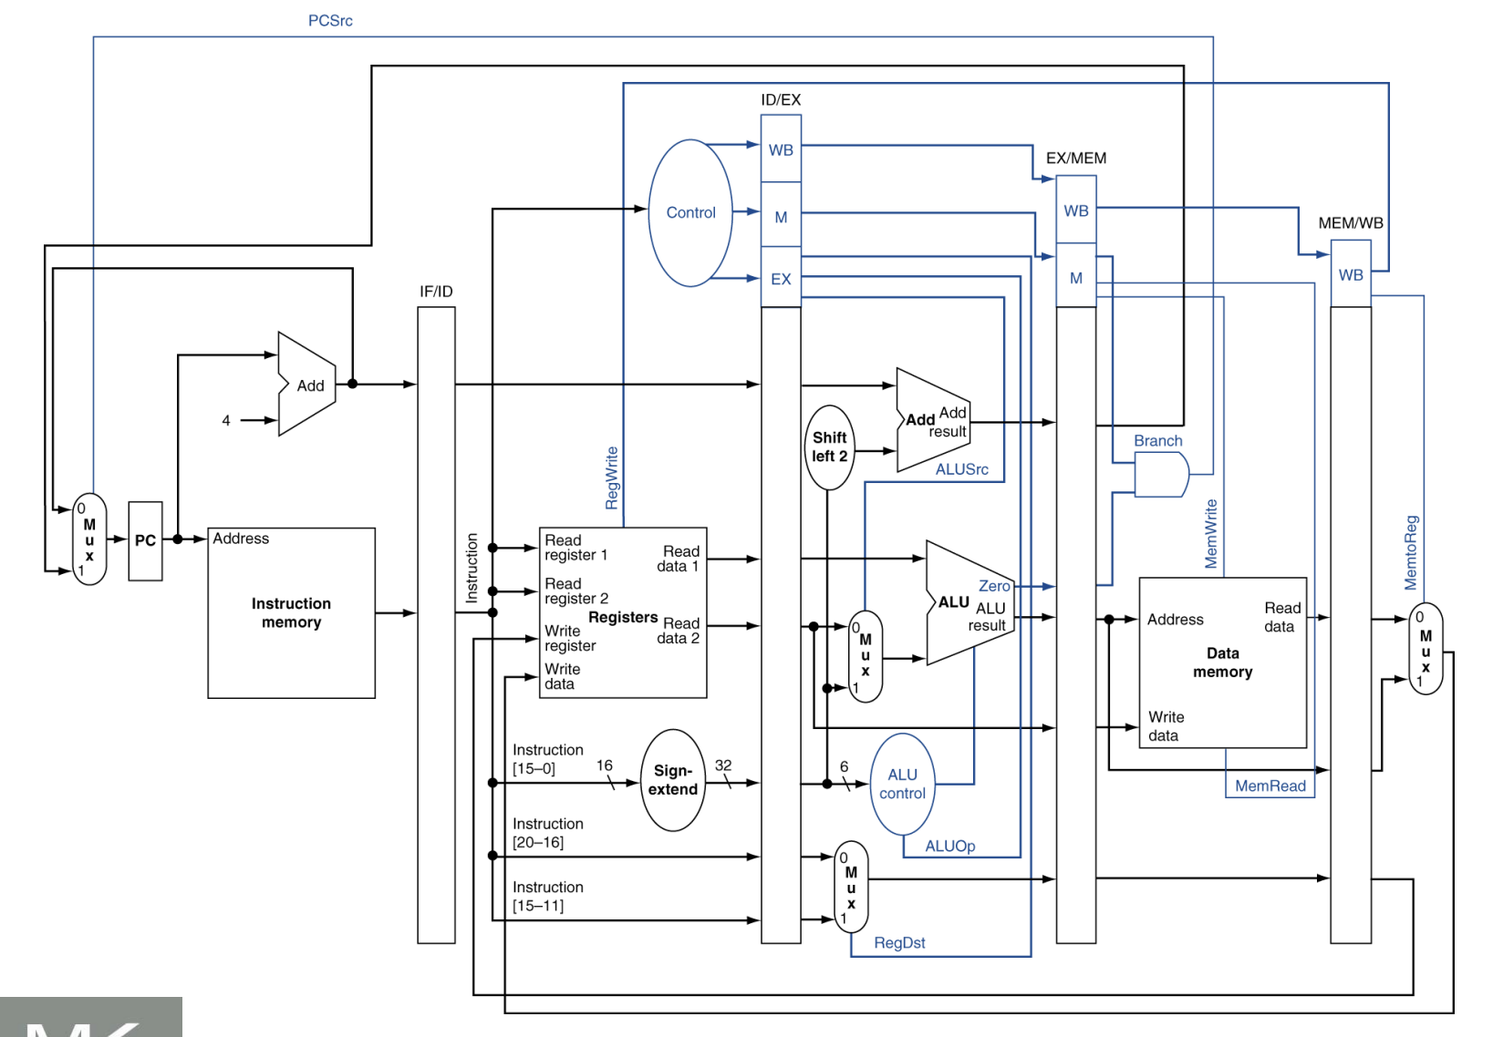
Reference Materials

Slide 25
Q&A

