Slide 1
Constraint Programming for Synthetic Biology
James Williams

Slide 2
What is Constraint Programming?
A form of declarative programming where the user defines relationships between variables and a solver is used to find a feasible solution.
Notes:
* Like linear programming
* Solve problems like knapsack, min cut etc.
* User focuses on problem definition – not concerned with how to solve.

Slide 3
What is Synthetic Biology?
An interdisciplinary science applying theories and practices of computer science and engineering to biological systems.
Specifically, biocompilation aims to combine small ‘parts’ into valid ‘devices’.
Notes:
* Can use a lot of similar terms to CS
* Parts = fragments of DNA, sequences of base atgc, which do specific things, like statements in imperative language
* Device = combination of parts in a defined order, have a specific effect, like functions in imperative

Slide 4
How Are They Combined?
Biological rules can be written as constraints in a constraint satisfaction problem.
Given the data for available parts, a solver can then create a feasible sequence, representing a valid device.
Notes:
* Natural world/biology has rules
* Don’t necessarily know what they are
* Parts have to be combined in a certain order and meet certain constraints
* These can be formally described allowing some automation via the solver

Slide 5
Existing Systems
Notes:
* There are some online tools for biocompilation
* 2 examples seem to have been acquired (and broken?) in the past year

Slide 6

GenoCAD.com
Notes:
* Provides and allows grammars to be defined
* Also allowed simulation

Slide 7
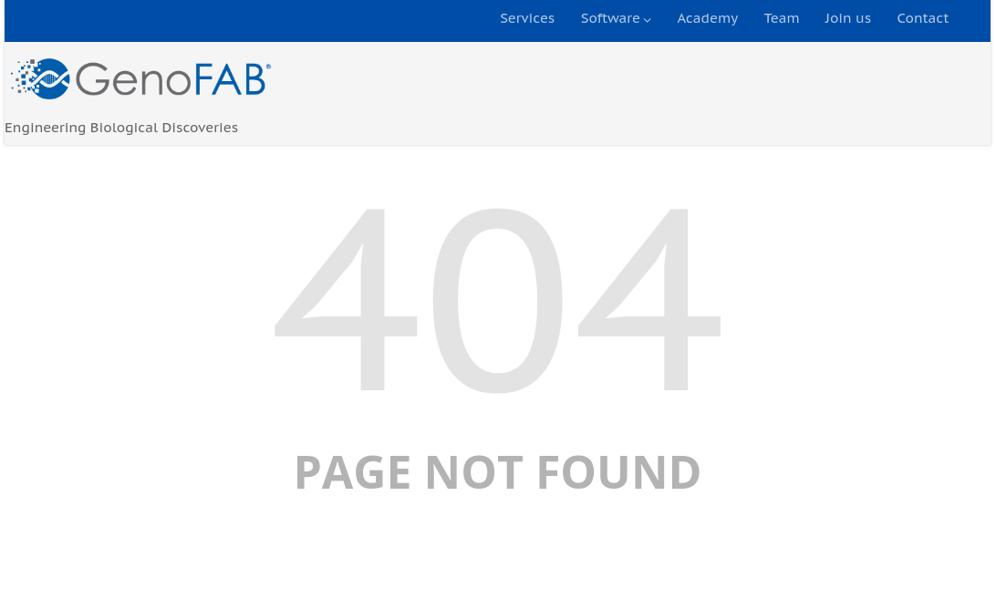
Reactivating Account
Notes:
* Account expired, try to reactivate it, sent to generic help page – doesn’t exist

Slide 8
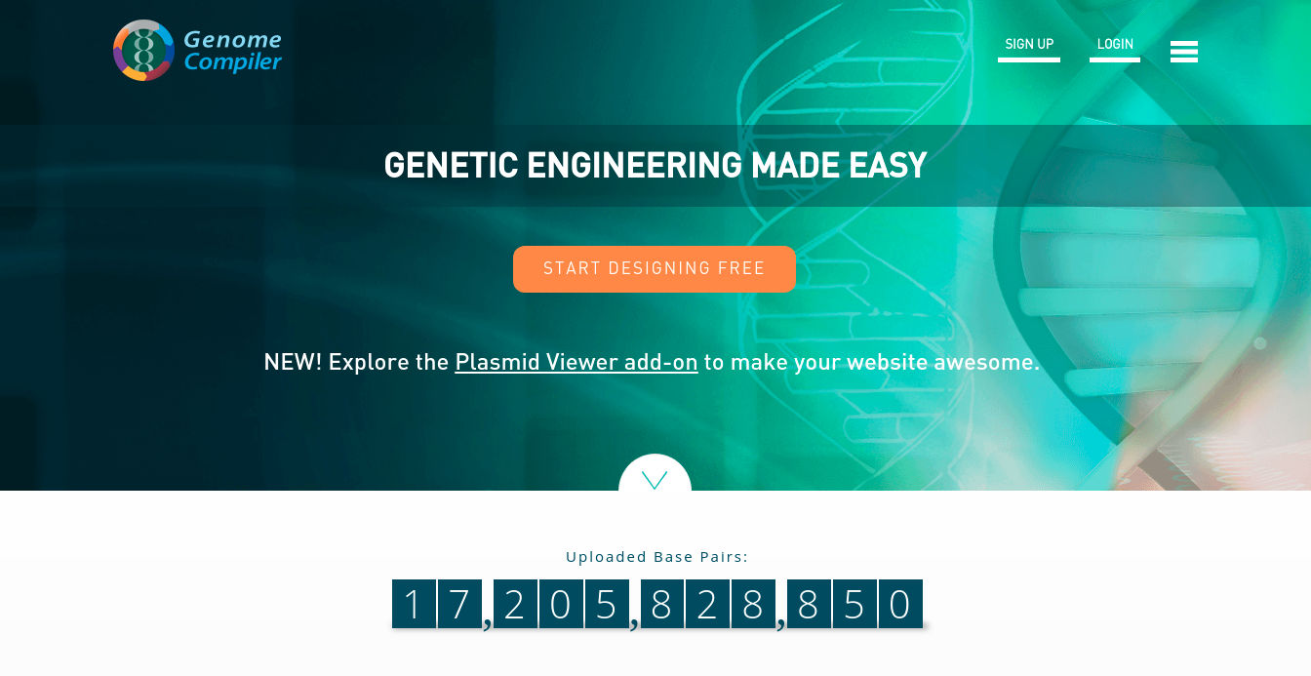
GenomeCompiler.com
Notes:
* Offer desktop version – needs adobe air, windows/mac only
* Linux adobe air discontinued 2011

Slide 9
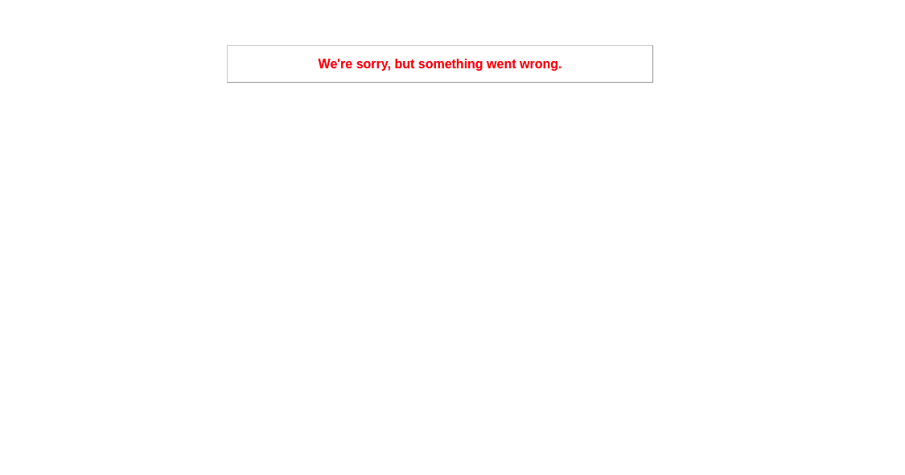
Activating Account
Notes:
Email activation link doesn’t work

Slide 10
Motivation
Produce a cross-platform program to reliably provide some basic tools for synthetic biology.
A desktop program would allow users to access it without the complications of large, broken websites.

Slide 11
Approach

Slide 12

MiniZinc
Open source constraint modelling language.
Provides easy access to multiple solvers.
Syntax replicates familiar mathematical constraint satisfaction language.
www.minizinc.org/
Notes:
* Syntax is fairly friendly and familiar
* General purpose – usually used for knapsack/min cut etc. doesn’t provide all the functions I would have liked
* Somethings don’t work as expected or at all, this presented a challenge

Slide 13
iGem Parts Registry
Database of XML formatted information about available BioBricksTM parts.
BioBricksTM standard means parts are composable, allowing them to be assembled into larger BioBricksTM.
parts.igem.org/Catalog
parts.igem.org/Help:An_Introduction_to_BioBricks
Notes:
* Freely accessible online
* Many biobricks to choose from – biologists research to find, isolate and describe them
* Different types, promotors (conditional statements), ribosome binding sites (indicate coding about to start), coding (‘instructions’), terminators (end)
* All this data can be pulled
* Composable means combining biobricks creates new, larger biobricks (still following standard)

Slide 14
Python
Used for multiple tasks such as extracting data from XML files and writing processed data into MiniZinc files.
Notes:
* General purpose language
* Takes input from files, from user/command line, checks validity
* Some of the MiniZinc files are populated by python
* Call minizinc via inbuilt system command line call

Slide 15
Overview
iGem data
MiniZinc constraint model and data
Python Processing
Constraint solver
User input
Notes:
* Fairly simple
* Data from iGem and user, python processes to generate minizinc files, then calls the solver

Slide 16
Modelling Biological Rules With MiniZinc
Notes:
* The next few slides will go over how the constraint of avoiding restriction sites was implemented
* Several different approaches were tried

Slide 17
Restriction Sites
Restriction enzymes are used during the assembly process to cut the DNA at specific sites.
The sequence for these sites cannot appear within the device.
Notes:
* Devices are often inserted in dna of cells, enzymes are used to cut
* Don’t want to cut device midway – like having an end statement in the middle of a function – won’t work

Slide 18
A Problem
String are a primitive type in MiniZinc
Cannot check for substrings
Notes:
* Need to check within generated sequence, that the restriction site doesn’t appear at any point
* Outside of scope of general constraint solver (usually numbers) so needed thought on how to implement
* Possibility of post processing generated devices in python – defeats point, and python may find generated sequences invalid – leaving no solution

Slide 19
A Solution
String are a primitive type in MiniZinc
Cannot check for substrings
Store sequence strings specifically as array of characters.
Notes:
* Store sequence of each part in an array
* Go through one base at a time checking

Slide 20
A Problem
Would have to be a 2D array to allow access to specific parts sequences.
MiniZinc doesn’t allow variable length arrays.
Padding each sequence to the length of the longest would waste a lot of space.
Notes:
* Could create a massive 2d array – lots of wasted space, extra computation to find actual values

Slide 21
A Solution
Would have to be a 2D array to allow access to specific parts sequences.
MiniZinc doesn’t allow variable length arrays.
Padding each sequence to the length of the longest would waste a lot of space.
Pre process body of strings in python and pass beginnings and ends to MiniZinc to check joins.
Notes:
* If python checks for substring thoughout each part, minizinc only needs to check the size limited joins
* Store substring from start and end of each sequence – only need length 1 shorter than longest restriction site to create overlap
* Storing this in generated files mean array lengths are fixed within the model/at runtime

Slide 22
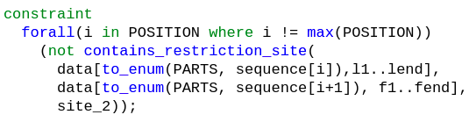
A Problem
Notes:
* Contains restriction site is essentially a function call (we’ll see it later)
* For every adjacent pair of parts, the combination of their base sequences doesn’t contain the specified site
* L1..lend is range of indexes in main data array which contain the last/first substrings
* TAG CAT will return true for site GC
* MiniZinc lacks some features/abilities which would be nice, initial implementation idea didn’t work, part stored at sequence[i] considered variable even with the I value specified

Slide 23
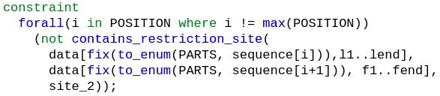
A Solution?
Notes:
* MiniZinc allows for fixing of ‘variables’ at certain points, e.g. in output
* Was hoping due to i being set for each check

Slide 24

No
Notes:
* Apparently not in constraints or predicates

Slide 25
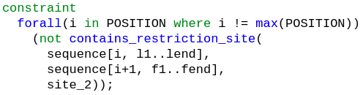
The Solution
Similar, but allowed!
Notes:
* Refactoring to pull all data into sequence array, seems inefficient as more constraints to check (each position must match row in the data table) but can now be accessed using the same data

Slide 26
Finding An Objective Function
Chargaff’s Second Parity Law:
Within each single DNA strand, F(A) ≈ F(T) and F(C) ≈ F(G)
Aim to minimise the differences.
Yamagishi, Michel Eduardo Beleza. Mathematical Grammar of Biology. Springer, 2017.
Notes:
* Constraint model needs an objective function.
* This is usually obvious in linear programming problems, bit more abstract in this project.
* Edwin Chargaff believed biology/DNA follows a grammar, or rules, even if we don’t know or understand what.
* Nature has been selecting DNA that abides by these rules.
* Generated sequences should try to follow these rules to be ‘realistic’
* Current objective function adds the absolute differences of at and gc – would be trivial to change/experiment – possibly square values

Slide 27
Project Management
MiniZinc was unfamiliar, development needed flexible.
Features were added incrementally.
Git was used for version control.

Slide 28
Summary
Some rules implemented
Basic interactivity provided
Designed to be extensible
Aim to provide a graphical user interface
Add data for parts
More rules could be added

Slide 29
Demo
Notes:
Talk through MiniZinc syntax
Show python processing
Run Model – see output
Questions?

Slide 30
