Slide 1
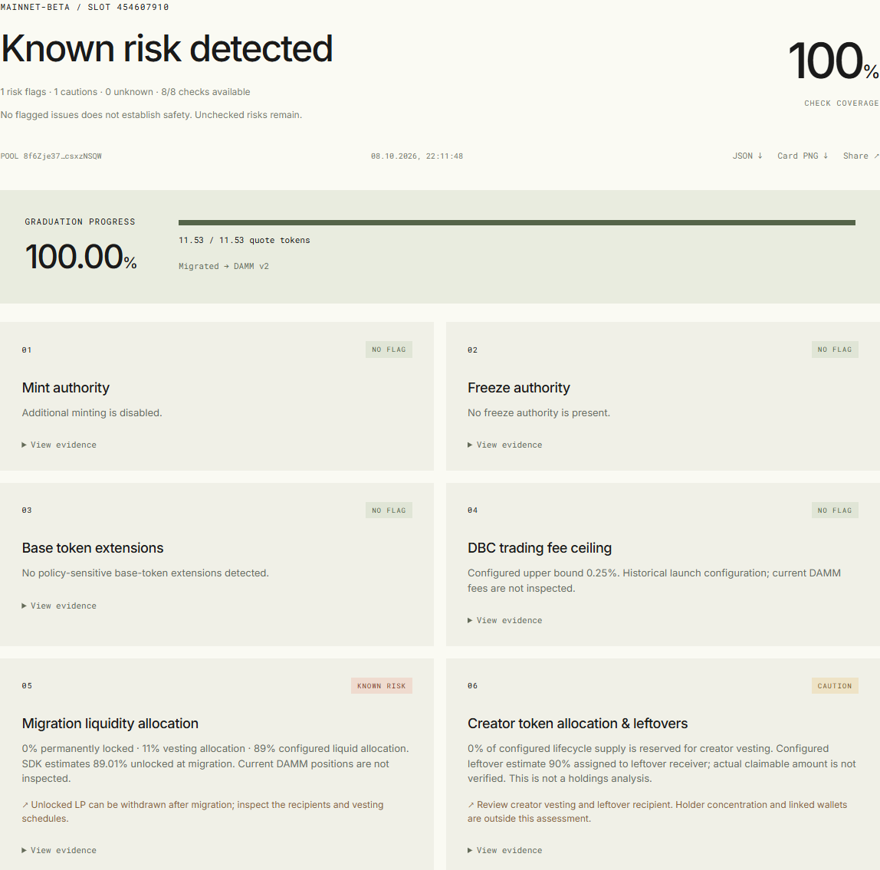
01 / DBC GUARD
DBC / GUARD
Understand a
Meteora launch
before you trade.
Turn a token or pool address into a clear review of fees, token controls and liquidity.
Live at dbc.whoim.space
DBC GUARD
01 / 09
Notes:
DBC Guard helps people understand a Meteora token launch before their first trade. Give it a token or pool address, and it brings fees, token controls and liquidity arrangements into one clear review.

Slide 2
02 / THE PROBLEM
You found the token.
Now understand the launch.
Before their first trade, people want answers.
01 / CONTROL
02 / COSTS
03 / LIQUIDITY
Who controls
the token?
What fees
apply?
What happens
to liquidity?
DBC GUARD
02 / 09
Notes:
Finding a token is only the beginning. People also want to know who controls it, which fees apply and what happens to liquidity. Those are the questions DBC Guard is built to answer.

Slide 3
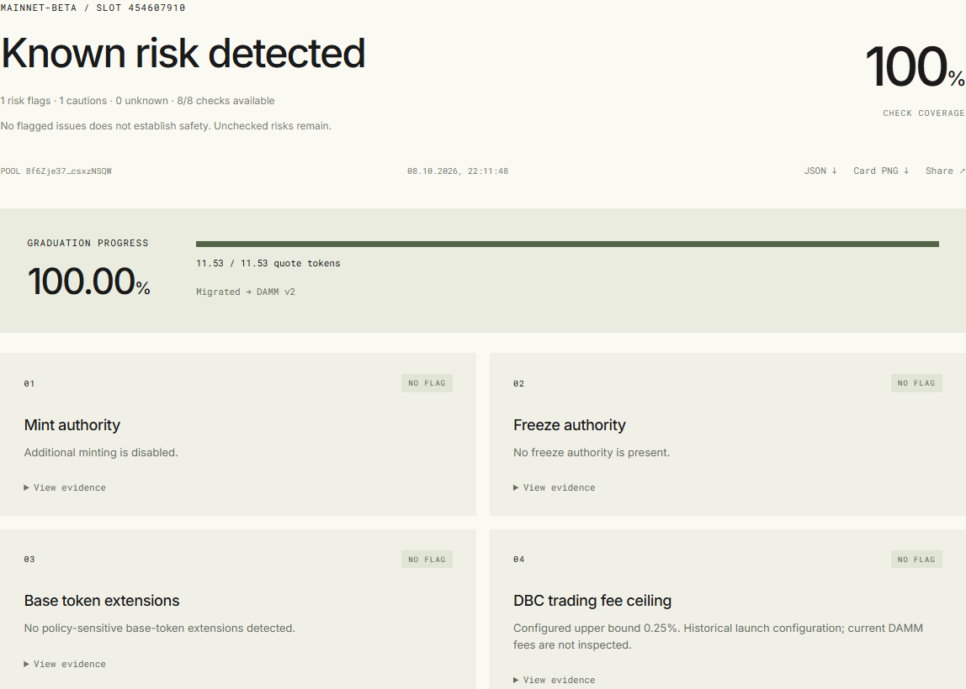
03 / THE PRODUCT
One address.
A clearer
picture.
01
Paste a token or pool address.
02
Get eight clear checks in one report.
03
Explore the findings that matter to you.
DBC GUARD
03 / 09
Notes:
This is the working product. Paste an address, open the report and explore eight checks. The findings stay close to their evidence, so people can understand what they are looking at and share the report with others.

Slide 4
04 / THE VALUE
Understand what shapes the launch.
The important choices, brought together in a readable review.
01
Token controls
04
Liquidity commitments
Understand who can change the token.
Review the launch’s liquidity allocations.
02
Trading fees
See the costs set for the launch.
05
Launch progress
Creator allocations
See where the launch stands and what comes next.
03
Explore the creator’s share and release schedule.
DBC GUARD
04 / 09
Notes:
The review brings together token controls, trading fees, creator allocations, liquidity commitments and launch progress. People get a readable starting point for their research.

Slide 5
05 / WHY METEORA
Flexible launches
deserve clear
explanations.
Meteora gives creators flexibility in how they launch tokens.
DBC Guard helps people understand those choices before participating.
DBC GUARD
05 / 09
Notes:
Meteora gives creators flexibility in how they launch tokens. DBC Guard makes those choices more accessible to people exploring the Meteora ecosystem.

Slide 6
06 / THE LANDSCAPE
A focused view of the launch.
PRODUCT
PRIMARY FOCUS
Rugcheck
Token risk
DEX Screener
Market activity and charts
Solscan
Blockchain records
DBC Guard
Meteora launch settings and their implications
Add launch context to your research.
DBC GUARD
06 / 09
Notes:
People already use tools for token risk, market charts and blockchain records. DBC Guard adds a focused view of Meteora launch settings and what those choices mean. It fits alongside existing research tools.

Slide 7
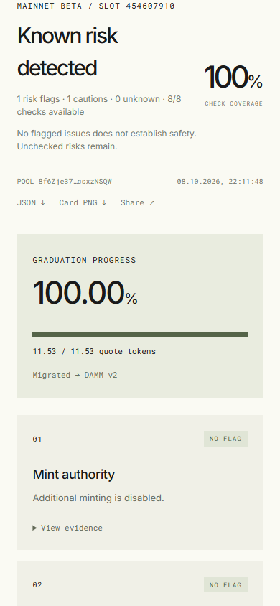
07 / WORKING TODAY
Live. Tested.
Ready to explore.
100
Real Meteora DBC pools
used to validate the product.
Desktop and mobile.
No account or wallet required.
DBC GUARD
07 / 09
Notes:
DBC Guard is available today on desktop and mobile without an account or connected wallet. It has been validated across 100 real Meteora DBC pools. This is product-validation evidence, not a count of customers.

Slide 8
08 / THE FOUNDER
Daniyar
Gabdullin
PRODUCTS
Creator of Seeker Vault
and X-Booster
Product Builder / Blockchain & AI
EDUCATION
Information Security
Kazakh National Technical University
Building in crypto since 2019.
Practical products for people using Solana.
LEADERSHIP
Former Technical Director, SIA Amakids
Former Board Member, SIA GASD
portfolio.whoim.space
Meet Daniyar on LinkedIn
08 / 09
Notes:
I am Daniyar Gabdullin, a product builder working across blockchain and AI. I have been building in crypto since 2019 and created Seeker Vault and X-Booster. My background combines information-security education with technical leadership experience.

Slide 9
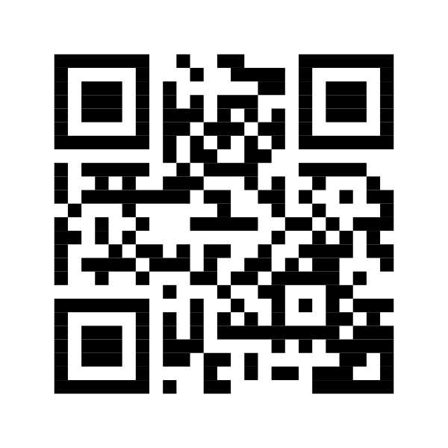
09 / TRY DBC GUARD
Know the launch.
Share the findings.
Paste a token. Review the launch. Share the report.
dbc.whoim.space
github.com/who1900/dbc-guard
TRY DBC GUARD
DBC GUARD
09 / 09
Notes:
Try DBC Guard at dbc.whoim.space. Paste a token, review the launch and share the findings. The product is live and the project is open on GitHub.

