Slide 1

SEEKER: TD
Build a maze.
Survive the waves.
Tower defense for Solana Seeker
CLOCK IN 2026
Local prototype on Seeker
Notes:
SEEKER: TD, also referred to as SeekDef, is a local tower-defense prototype aimed at Solana Seeker players. The objective is simple: build a route that buys enough time for your towers to stop the waves. This deck presents current gameplay and current integration boundaries.
Sources and status, checked 2026-10-05:
C:/Users/User/Documents/work/Claude/seekdef-app/src/game/engine.ts:222-295,323-355,672-688,837-844; src/game/waveManager.ts:86-92
https://solanamobile.com/blog/clock-in-the-solana-mobile-hackathon
C:/Users/User/Documents/work/Claude/seekdef-app/public/paper-assets/runtime/branding/app_icon.png
All game artwork comes from the existing local project. Asset redistribution rights remain a publication gate. Physical Seeker smoke checks cover ordinary Practice play, placement, Enhance, the first three cleared waves, pause/resume, speed controls and short Home-to-app resume. MWA, audio, offline behavior and cold relaunch remain unverified. No financial operations were tested.

Slide 2
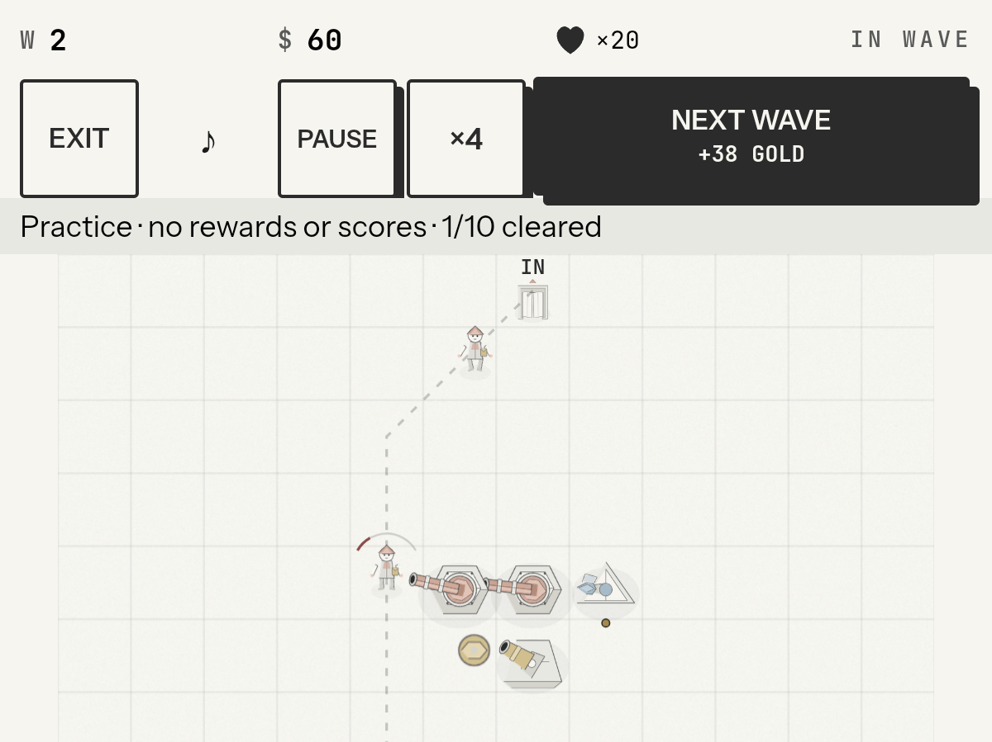
A maze built by the player
Tower placement can
reshape the route.
Keep the exit reachable.
Make enemies spend more
time in tower range.
Seeker device capture, enlarged detail
Notes:
Place a base tower on the grid. Each valid placement can change the route enemies take from entrance to exit. The placement check rejects a fully blocked route. Longer routes buy firing time, so the player weighs path length against useful tower coverage. This screenshot shows actual Seeker gameplay, with a native crop of the app-only image.
Sources and status, checked 2026-10-05:
C:/Users/User/Documents/work/Claude/seekdef-app/src/game/engine.ts:222-295,323-355,672-688,837-844; src/game/waveManager.ts:86-92
../demo/device/SEEKER_TD_CLOCK_IN_Seeker_raw.mp4; 05-record-mode-full.png; 07-inspector-app.png; 10-wave2-app.png; 11-wave3-app.png; 12-resume-full.png. Actual authorized Seeker, Android 16, 2026-10-05. Debug APK SHA256 66196a2b868595048ba4fc10af645ae32b7f8d2ceb366a9a1e4a7cb35a650c35.
All game artwork comes from the existing local project. Asset redistribution rights remain a publication gate. Physical Seeker smoke checks cover ordinary Practice play, placement, Enhance, the first three cleared waves, pause/resume, speed controls and short Home-to-app resume. MWA, audio, offline behavior and cold relaunch remain unverified. No financial operations were tested.

Slide 3
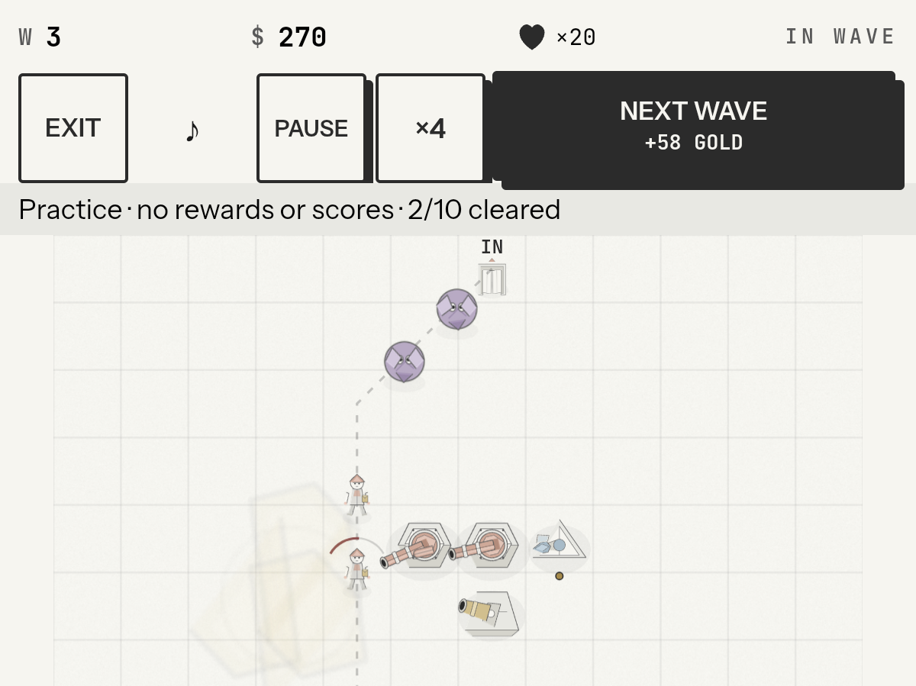
The combat loop
Build the route
Start a wave
Earn gold in combat
Enhance and adapt
Leaks cost lives.
Seeker device capture, enlarged detail
Notes:
Start a wave after arranging your defense. Towers fire automatically. Enemy kills and cleared waves add in-game gold. Enemies that reach the exit cost lives. Use gold to Enhance a tower's statistics, or Upgrade it to the next model when the budget permits. Then adapt the maze and start another wave. The screenshot shows an ordinary Practice run on a real Seeker. Device checks cleared the first three waves with 20 lives. Later play reached four of ten cleared waves and defeat in wave six, followed by a restart to wave zero, 500 gold and 20 lives. The initial raw recording ends after the first wave. Additional device screenshots and a subsequent recording cover later play.
Sources and status, checked 2026-10-05:
C:/Users/User/Documents/work/Claude/seekdef-app/src/game/engine.ts:222-295,323-355,672-688,837-844; src/game/waveManager.ts:86-92
C:/Users/User/Documents/work/Claude/seekdef-app/src/game/Game.tsx:648-677,760-808,2290-2293
../demo/device/SEEKER_TD_CLOCK_IN_Seeker_raw.mp4; 05-record-mode-full.png; 07-inspector-app.png; 10-wave2-app.png; 11-wave3-app.png; 12-resume-full.png. Actual authorized Seeker, Android 16, 2026-10-05. Debug APK SHA256 66196a2b868595048ba4fc10af645ae32b7f8d2ceb366a9a1e4a7cb35a650c35.
All game artwork comes from the existing local project. Asset redistribution rights remain a publication gate. Physical Seeker smoke checks cover ordinary Practice play, placement, Enhance, the first three cleared waves, pause/resume, speed controls and short Home-to-app resume. MWA, audio, offline behavior and cold relaunch remain unverified. No financial operations were tested.

Slide 4
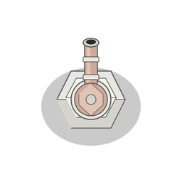
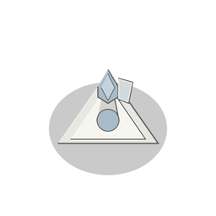
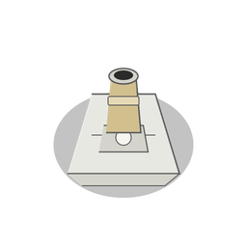
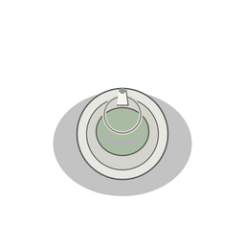
Four tower families
12 models across four upgrade trees
Bullet
Laser
Explosive
Control
Canon
Dual Canon
Machine Gun
Simple Laser
Bouncing Laser
Straight Laser
Mortar
Mine Layer
Rocket Launcher
Glue Tower
Glue Gun
Teleporter
Notes:
The shop offers four base towers. Their upgrade trees contain twelve models in total. The source roster defines eleven enemy types, including a boss. More types appear as waves progress. These are source capabilities, not a claim that every model or late-game enemy appears in the short demo.
Sources and status, checked 2026-10-05:
C:/Users/User/Documents/work/Claude/seekdef-app/src/game/data.ts:110-181; src/game/types.ts:11-12
All game artwork comes from the existing local project. Asset redistribution rights remain a publication gate. Physical Seeker smoke checks cover ordinary Practice play, placement, Enhance, the first three cleared waves, pause/resume, speed controls and short Home-to-app resume. MWA, audio, offline behavior and cold relaunch remain unverified. No financial operations were tested.

Slide 5
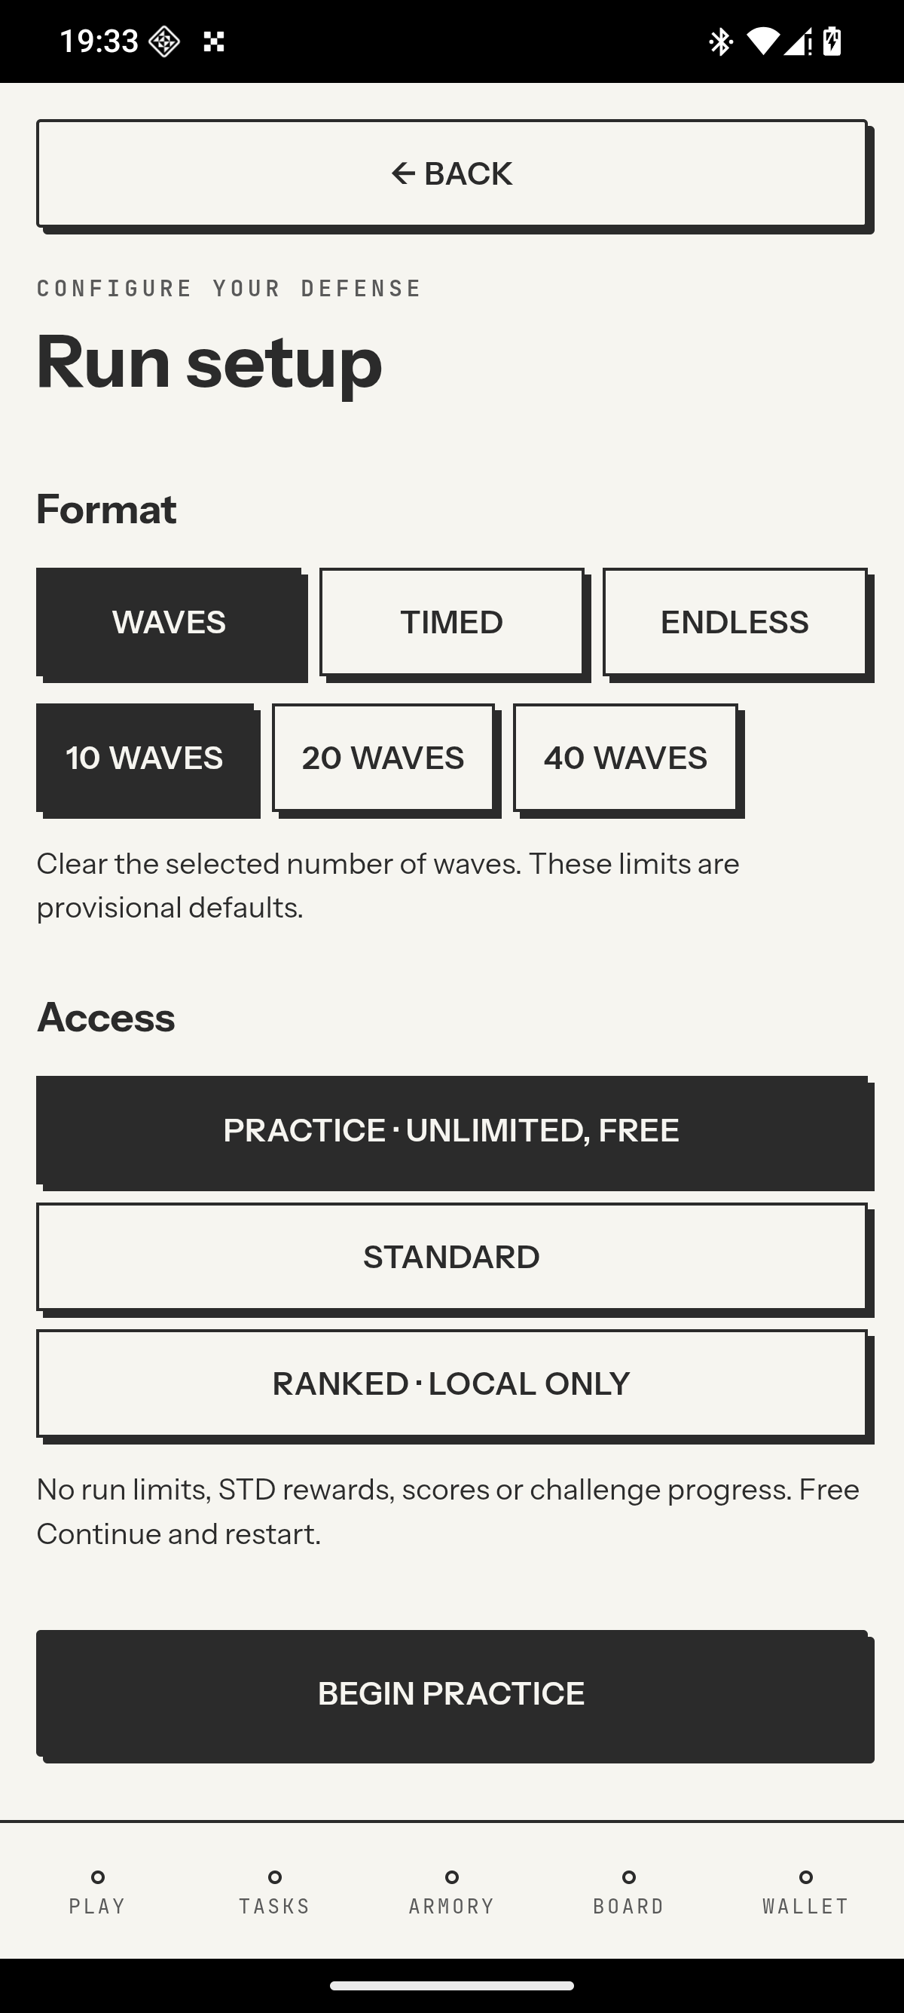
Practice and run modes
Free, unlimited practice
Waves
Timed
Endless
Ranked results remain local.
They do not qualify for prizes.
Seeker device capture
Notes:
Practice is free and unlimited. It supports Waves, Timed and Endless configurations. The screenshot shows actual Waves Practice setup on Seeker. The existing Ranked experience stores local results. It does not establish authenticated competition, prize eligibility or submitted cloud scores.
Sources and status, checked 2026-10-05:
C:/Users/User/Documents/work/Claude/seekdef-app/src/screens/RunSetupScreen.tsx:27-34
C:/Users/User/Documents/work/Claude/seekdef-app/src/state/runs.ts
../demo/device/SEEKER_TD_CLOCK_IN_Seeker_raw.mp4; 05-record-mode-full.png; 07-inspector-app.png; 10-wave2-app.png; 11-wave3-app.png; 12-resume-full.png. Actual authorized Seeker, Android 16, 2026-10-05. Debug APK SHA256 66196a2b868595048ba4fc10af645ae32b7f8d2ceb366a9a1e4a7cb35a650c35.
All game artwork comes from the existing local project. Asset redistribution rights remain a publication gate. Physical Seeker smoke checks cover ordinary Practice play, placement, Enhance, the first three cleared waves, pause/resume, speed controls and short Home-to-app resume. MWA, audio, offline behavior and cold relaunch remain unverified. No financial operations were tested.

Slide 6
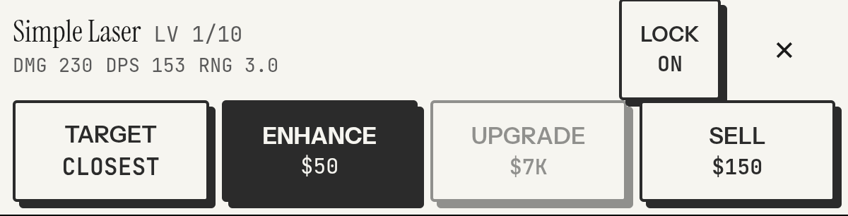
Mobile controls
Tap to inspect. Enhance, upgrade or sell.
Placement, Enhance, pause and speed controls checked on Seeker.
Seeker device capture, enlarged tower controls
Notes:
The interface provides tower selection, inspection and enhancement, wave control, pause and simulation speed controls. The Android project wraps the web client with Capacitor. An actual Seeker running Android 16 passed ordinary Practice placement, Enhance, pause/resume, speed controls at two and four times, and a short Home-to-app return to the same paused state. This inspector screenshot precedes the Enhance action and shows level one. Tier Upgrade and Sell are visible controls, not assertions that these actions passed physical acceptance. Audio, MWA, offline behavior, cold relaunch and long-session thermal performance remain unverified.
Sources and status, checked 2026-10-05:
C:/Users/User/Documents/work/Claude/seekdef-app/src/game/Game.tsx:648-677,760-808,2290-2293
C:/Users/User/Documents/work/Claude/seekdef-app/package.json; capacitor.config.ts; src/state/store.ts:183-191
../demo/device/SEEKER_TD_CLOCK_IN_Seeker_raw.mp4; 05-record-mode-full.png; 07-inspector-app.png; 10-wave2-app.png; 11-wave3-app.png; 12-resume-full.png. Actual authorized Seeker, Android 16, 2026-10-05. Debug APK SHA256 66196a2b868595048ba4fc10af645ae32b7f8d2ceb366a9a1e4a7cb35a650c35.
All game artwork comes from the existing local project. Asset redistribution rights remain a publication gate. Physical Seeker smoke checks cover ordinary Practice play, placement, Enhance, the first three cleared waves, pause/resume, speed controls and short Home-to-app resume. MWA, audio, offline behavior and cold relaunch remain unverified. No financial operations were tested.

Slide 7
Architecture
React + TypeScript
Canvas simulation
Screens, touch controls
and local player state
Pathfinding, waves
and automatic tower combat
Capacitor Android
Mobile Wallet Adapter
Vite build packaged as an APK
Separate wallet authorization path
Notes:
React and TypeScript own the screens and controls. Canvas renders a local simulation with pathfinding, waves and combat. Local storage persists player state. Capacitor packages the Vite dist directory into the Android app. Mobile Wallet Adapter handles a separate wallet authorization path. The local server admission and replay experiments are not connected to a deployed authoritative scoring service.
Sources and status, checked 2026-10-05:
C:/Users/User/Documents/work/Claude/seekdef-app/package.json; capacitor.config.ts; src/state/store.ts:183-191
C:/Users/User/Documents/work/Claude/seekdef-app/src/wallet.ts:71-89
C:/Users/User/Documents/work/Claude/seekdef-app/server/
C:/Users/User/Documents/work/Claude/seekdef-app/src/game/
All game artwork comes from the existing local project. Asset redistribution rights remain a publication gate. Physical Seeker smoke checks cover ordinary Practice play, placement, Enhance, the first three cleared waves, pause/resume, speed controls and short Home-to-app resume. MWA, audio, offline behavior and cold relaunch remain unverified. No financial operations were tested.

Slide 8
Solana integration today
Implemented in source
Validation still needed
Android MWA authorization
Desktop wallet fallback
Wallet handoff on Seeker
A demonstrated Solana flow
Local combat stays independent of wallet transactions.
Notes:
The client implements the Android Mobile Wallet Adapter authorize path and a desktop Solana/Solflare provider fallback. The intended audience is Solana Seeker users. Combat remains local. Physical wallet acceptance and a meaningful demonstrated Solana product flow are outstanding. This presentation does not claim a completed onchain gameplay loop or CLOCK IN eligibility.
Sources and status, checked 2026-10-05:
C:/Users/User/Documents/work/Claude/seekdef-app/src/wallet.ts:71-89
C:/Users/User/Documents/work/Claude/seekdef-app/src/services/payments.ts:37-50
https://solanamobile.com/blog/clock-in-the-solana-mobile-hackathon
All game artwork comes from the existing local project. Asset redistribution rights remain a publication gate. Physical Seeker smoke checks cover ordinary Practice play, placement, Enhance, the first three cleared waves, pause/resume, speed controls and short Home-to-app resume. MWA, audio, offline behavior and cold relaunch remain unverified. No financial operations were tested.

Slide 9
Current product scope
Played on Seeker
Planned or unfinished
Maze placement
Wave combat
Gold, lives and enhancement
Verified online scores
Payments and payouts
Prize pool and store release
Payments are disabled. No token or cash-out promise.
Notes:
Working local gameplay includes maze placement, waves, tower combat, gold, lives and enhancement. The source also contains prototypes for admission and replay. Payments and payouts remain disabled, and there is no funded prize pool claim. Authoritative scores, prizes and dApp Store publication remain future work. STD is a closed in-game balance, not an issued onchain token.
Sources and status, checked 2026-10-05:
C:/Users/User/Documents/work/Claude/seekdef-app/src/game/engine.ts:222-295,323-355,672-688,837-844; src/game/waveManager.ts:86-92
C:/Users/User/Documents/work/Claude/seekdef-app/src/services/payments.ts:37-50
C:/Users/User/Documents/work/Claude/seekdef-app/README.md
C:/Users/User/Documents/work/Claude/seekdef-app/server/
All game artwork comes from the existing local project. Asset redistribution rights remain a publication gate. Physical Seeker smoke checks cover ordinary Practice play, placement, Enhance, the first three cleared waves, pause/resume, speed controls and short Home-to-app resume. MWA, audio, offline behavior and cold relaunch remain unverified. No financial operations were tested.

Slide 10
The next milestone
A demonstrated Solana flow
and release acceptance
Public source and asset rights review
Daniyar Gabdullin
Solo Founder & Engineer
portfolio.whoim.space
Notes:
Daniyar Gabdullin is the solo founder and engineer. Prior shipping of Seeker Vault and X-Booster is founder-reported in the existing local materials. Basic Seeker gameplay checks now pass. The next milestone is a demonstrated Solana wallet flow, remaining release acceptance, and source/asset rights clearance before public distribution. Physical wallet handoff, audio, offline behavior and cold relaunch remain unverified. The official CLOCK IN blog requires APK, source GitHub, a video of the app in use and a short pitch by October 8, 2026. It does not confirm an exact closing hour.
Sources and status, checked 2026-10-05:
https://solanamobile.com/blog/clock-in-the-solana-mobile-hackathon
../demo/device/SEEKER_TD_CLOCK_IN_Seeker_raw.mp4; 05-record-mode-full.png; 07-inspector-app.png; 10-wave2-app.png; 11-wave3-app.png; 12-resume-full.png. Actual authorized Seeker, Android 16, 2026-10-05. Debug APK SHA256 66196a2b868595048ba4fc10af645ae32b7f8d2ceb366a9a1e4a7cb35a650c35.
C:/Users/User/Documents/work/Claude/seekdef-app/README.md:Founder
https://portfolio.whoim.space
All game artwork comes from the existing local project. Asset redistribution rights remain a publication gate. Physical Seeker smoke checks cover ordinary Practice play, placement, Enhance, the first three cleared waves, pause/resume, speed controls and short Home-to-app resume. MWA, audio, offline behavior and cold relaunch remain unverified. No financial operations were tested.

