Slide 1
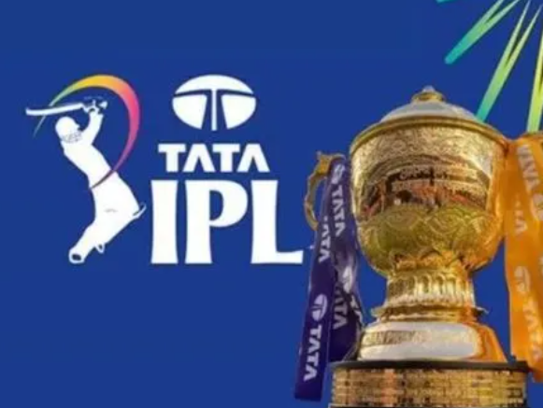
IPL Data Analysis & Strategic Insights for RCB
Performance Analysis, Player Evaluation,
and Team Strategy Recommendations
Tools: MySQL Workbench, Google Sheets
Objective: Analyze IPL data to identify performance trends and auction strategies
Presented By: Adil Saifi

Slide 2



Business Objective
This project analyzes historical IPL data to identify key factors affecting team and player performance. The analysis focuses on Royal Challengers Bangalore (RCB), evaluating performance trends, venue and toss impact, player contributions, and strategic insights to support data-driven decision-making for team selection and future auction planning.
Performance Trends
Player Evaluation
Team Strategy
Top run-scorers, all-rounders, and players who lift team results
Bowling weaknesses and auction priorities backed by real query results
Season-wise win rates, toss impact, and home-ground advantage

Slide 3
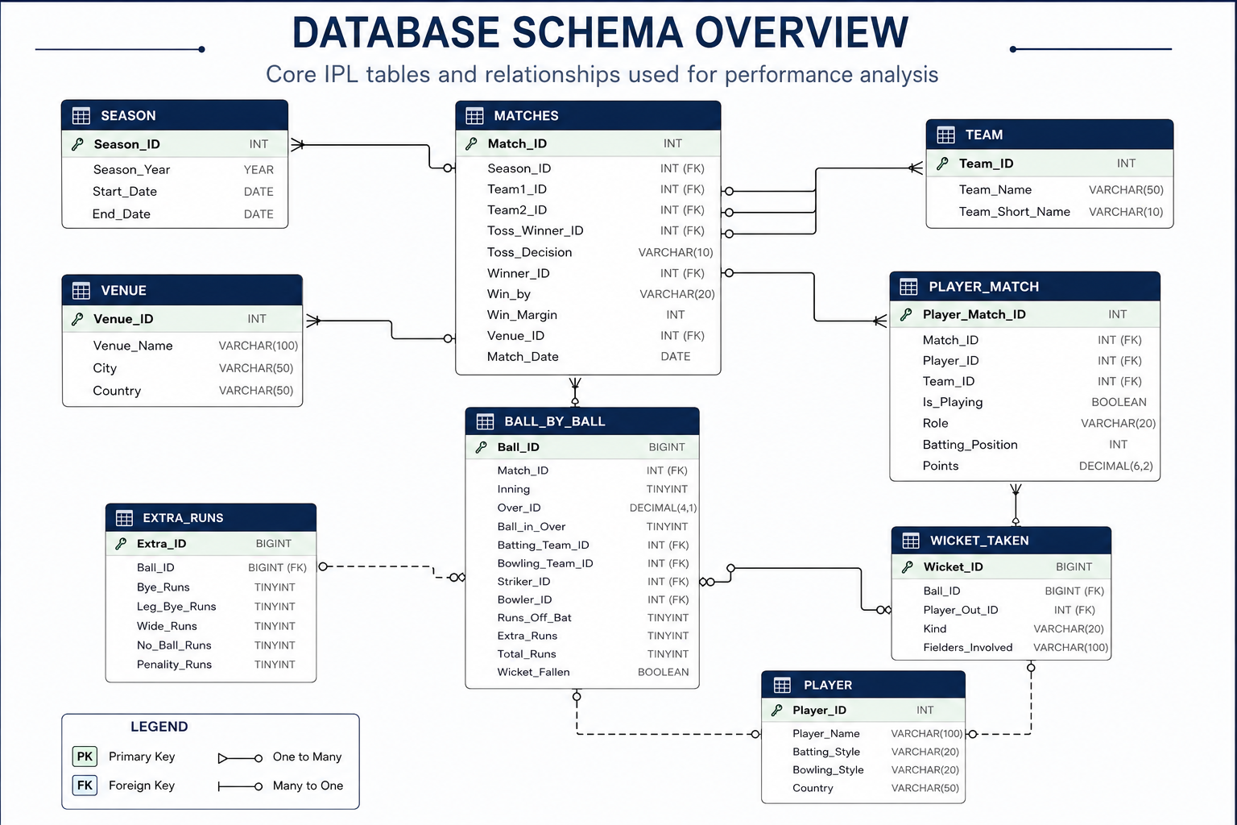

Slide 4
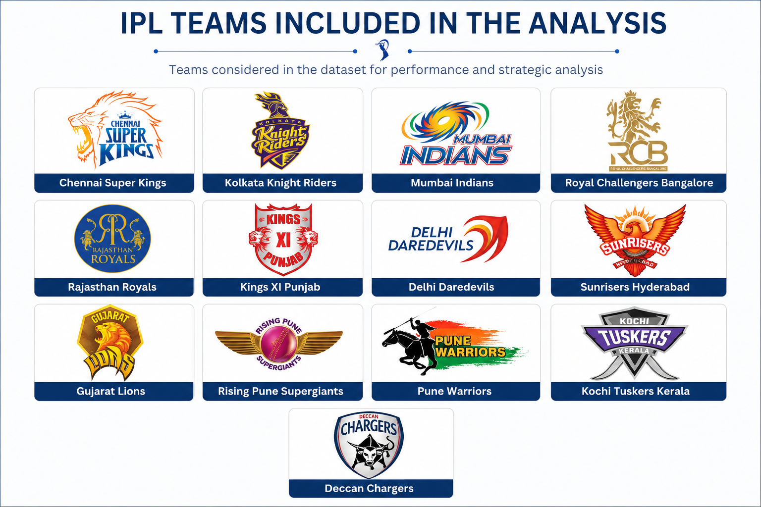
Participating Teams Overview

Slide 5
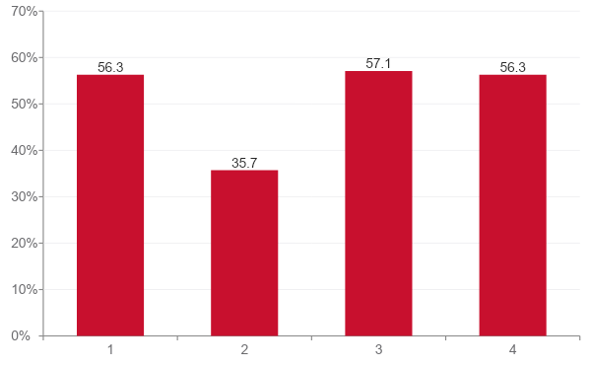
RCB's Season-wise Performance
3 OF 4 SEASONS
RCB won more than half their matches — a genuinely competitive league-stage record.
RCB won more than half their matches — a genuinely competitive league-stage record.
A 35.7% win rate that season pulled down that auction cycle's overall trophy push.

Slide 6
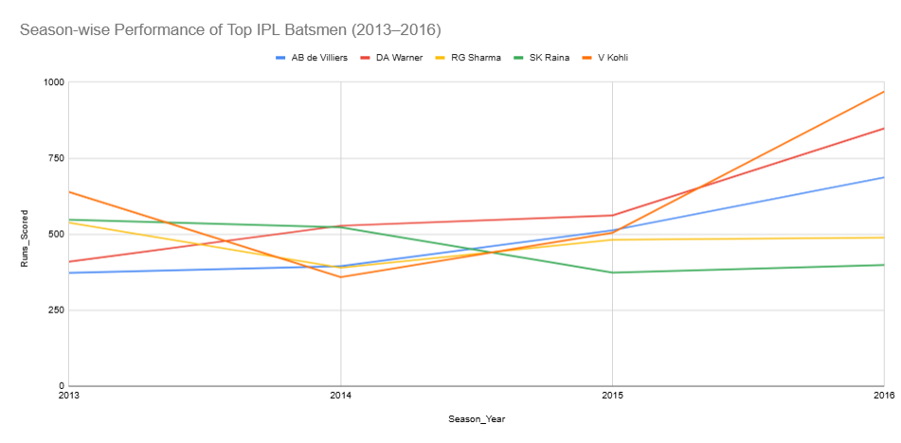
Consistent Player Performance Across IPL Seasons
(2013–2016)
Kohli and Warner showed consistent run growth across all four seasons.
Kohli posted the highest seasonal score: 969 runs (2016).
Sharma and Raina stayed relatively stable throughout.
Kohli was the most consistent performer, peaking at 969 runs in 2016.

Slide 7
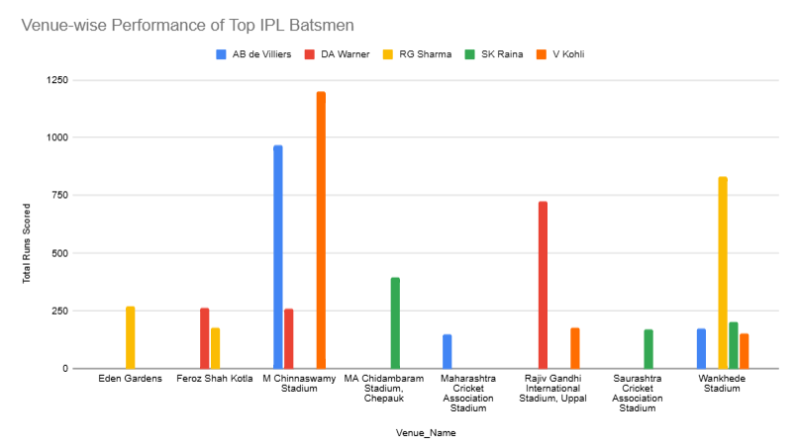
Venue-wise Performance of Top IPL Batsmen
Kohli's top venue: M Chinnaswamy Stadium (1,200 runs) — strong home-ground advantage.
De Villiers also peaked at Chinnaswamy (967 runs).
Warner's best: Rajiv Gandhi International Stadium (724 runs).
Sharma's best: Wankhede Stadium (832 runs).

Slide 8
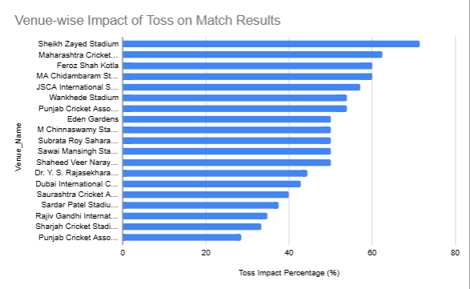
Impact of Toss Decision on Match Outcomes
Bat-first teams won 54.84% of matches vs. 43.00% for field-first — a clear edge.
Toss impact varies sharply by venue, pointing to pitch-specific effects.
Highest dependency: Sheikh Zayed Stadium (71.43%), Maharashtra CSA (62.50%).
Lowest dependency: Punjab CSA Bindra (28.57%), Sharjah (33.33%)
Toss impact varies by venue — teams should use venue-specific strategies, not generic toss logic

Slide 9
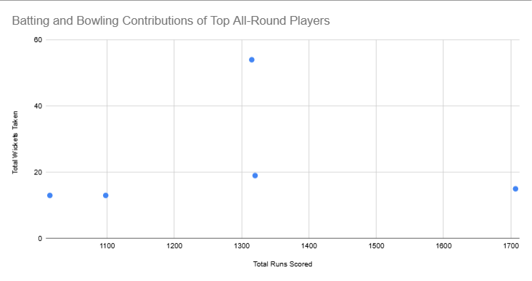
Top All-Rounders – Batting and Bowling Contributions
Watson: most impactful all-rounder — 1,315 runs and 54 wickets.
Smith: highest run tally among all-rounders — 1,707 runs, 15 wickets.
Pollard: balanced batting and useful bowling contributions.
Yuvraj and Duminy: added flexibility across both departments
Strong bat-and-ball contributors offer greater tactical flexibility — valuable for team selection and auctions.

Slide 10
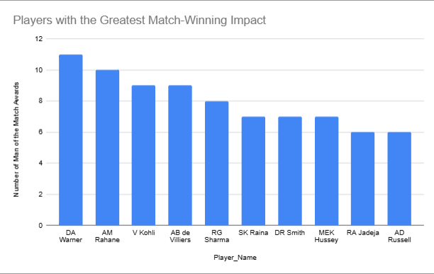
Players with the Greatest Match-Winning Impact
Warner led all players with 11 Man of the Match awards.
Rahane: 10 awards — consistent match impact.
Kohli and de Villiers: 9 awards each.
Sharma: 8 awards
Frequent MOTM winners consistently influence outcomes — key assets when building a squad .

Slide 11
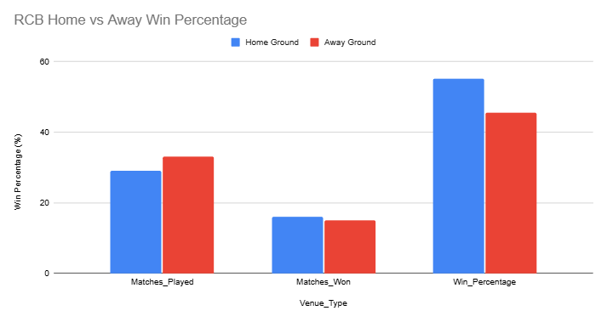
Impact of Home-Ground Advantage on RCB Performance
RCB's home win rate: 55.17% vs. 45.45% away.
Won 16 of 29 home matches.
Home advantage likely from pitch familiarity and conditions
RCB performs better at home — venue familiarity boosts performance.

Slide 12
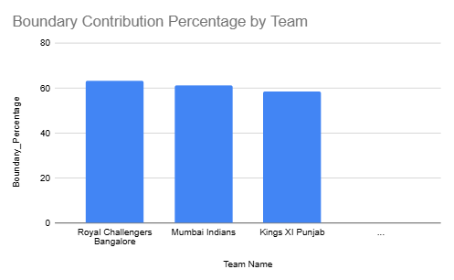
RCB's Batting Strength and Scoring Patterns
RCB recorded the highest average team score in the IPL (153.24 runs).
RCB also led in boundary contribution (63.47%), well ahead of MI and KXIP — showing a power-hitting approach over strike rotation.
This aggressive style let RCB consistently post competitive totals across seasons.
Their batting strategy leaned heavily on power hitters and boundary-scoring chances
RCB's success was driven by aggressive batting and boundary scoring — one of the IPL's most explosive lineups

Slide 13
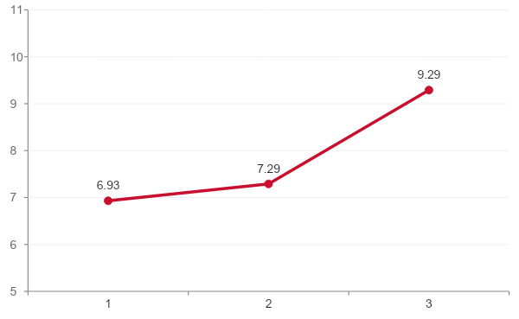
RCB's Bowling Weak Spot: The Death Overs
9.29 at the death
RCB's economy climbs sharply in the last 5 overs — among the worst death-overs figures in the league, behind only a handful of teams.
This is the single clearest weakness in the bowling data, and the most actionable target for the next auction.

Slide 14
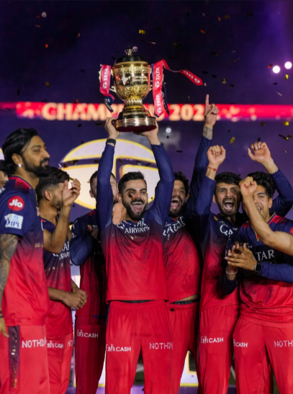
Key Challenges Limiting RCB's Championship Success
Star Dependence
Heavy reliance on Kohli and de Villiers.
Boundary-Heavy Batting
63.47% of runs from boundaries — risky over-reliance on power hitting.
Inconsistent Away Form
45.45% away win rate vs. 55.17% at home.
Imbalanced Squad
Success leaned on a few key performers, not depth

Slide 15

Data-Driven Recommendations for Future Success
Strengthen bowling with wicket-taking options.
Invest in quality all-rounders.
Build a stronger middle order to reduce star dependence.
Improve away-match adaptability.
Prioritize players with proven match-winning ability.
Keep leveraging home advantage at Chinnaswamy Stadium.

Slide 16

Conclusion
Analyzed historical IPL data using SQL and visualization.
RCB showed strong batting and home-ground advantage.
Toss and venue conditions influenced outcomes.
Some players consistently delivered match-winning, venue-specific success
Insights can guide player selection, auctions, and strategy

Slide 17


