Slide 1

Columbia Asia Hospital
Healthcare Analytics
PRESENTED BY
ADIL SAIFI

Slide 2
AGENDA
How I cleaned and modeled the data
Dashboard walkthrough
Key insights I found
Recommendations for the hospital

Slide 3
Data Cleaning
Found missing values in referral, race, wait time, satisfaction
Filled text fields with "Unspecified"
Filled number fields with department median
Fixed inconsistent date formats
Cleaned currency symbols from fee columns

Slide 4
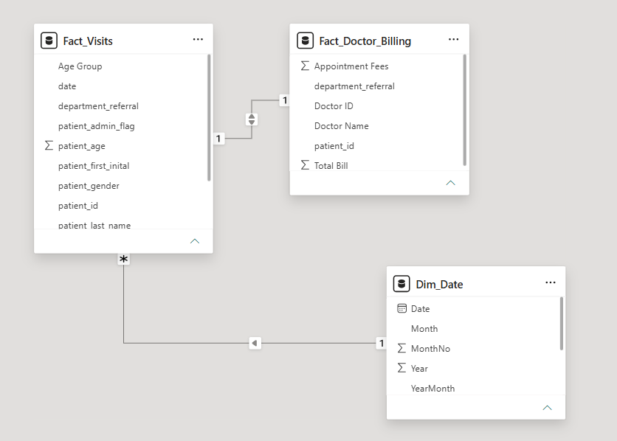
DATA MODELLING

Slide 5
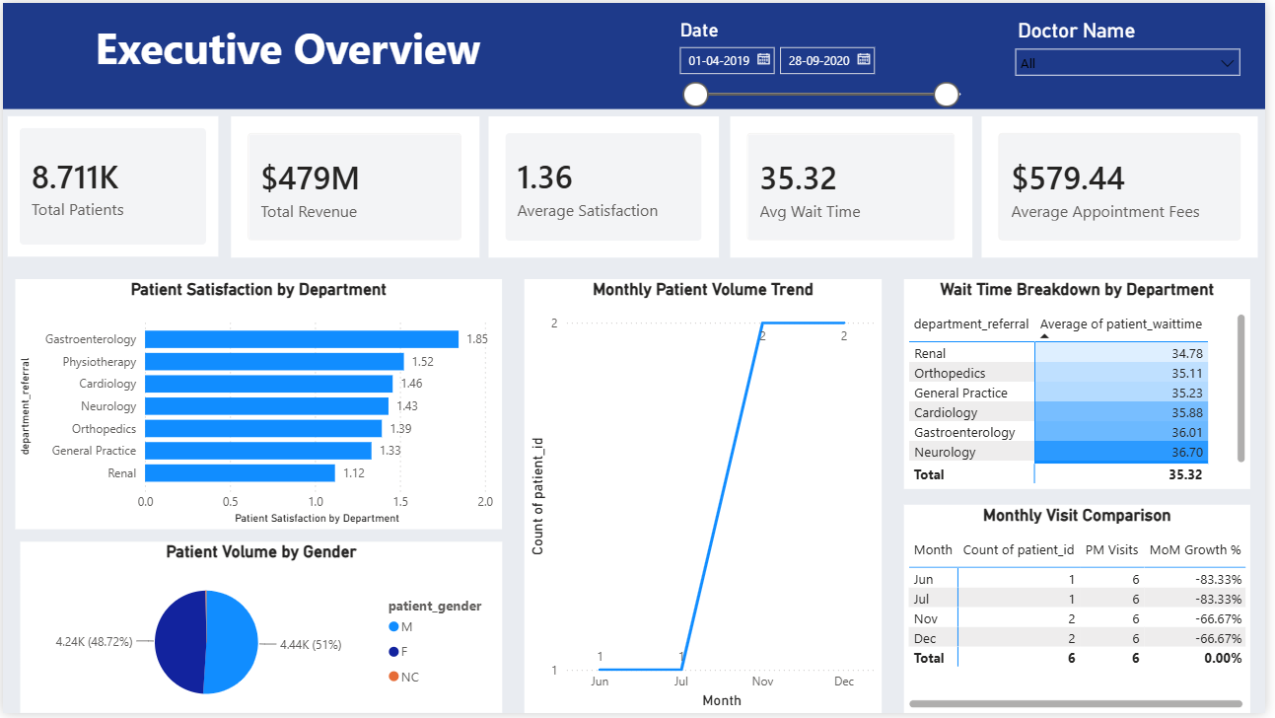

Slide 6
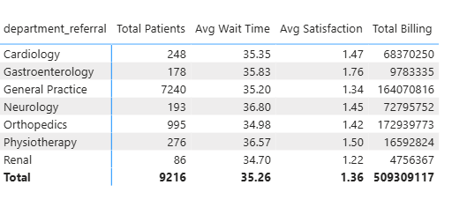
REVENUE BY DEPARTMENT
Orthopedics: ₹173M (34%)
General Practice: ₹164M (32%)
Neurology: ₹73M (14%)
Cardiology: ₹68M (13%

Slide 7
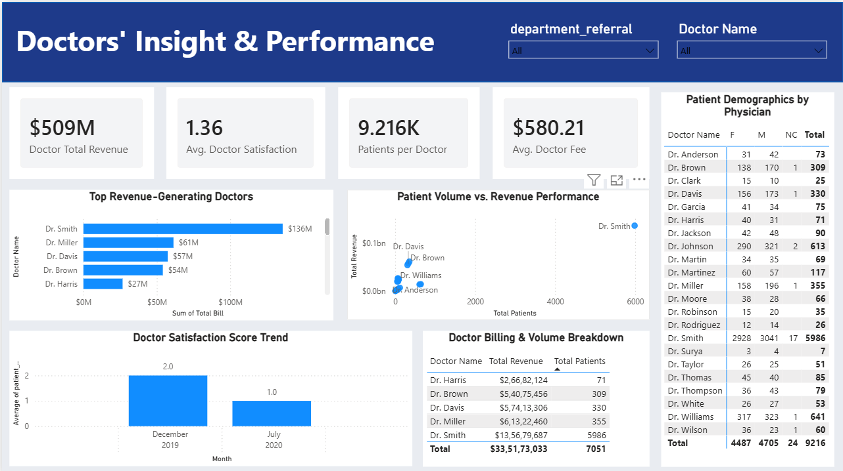

Slide 8
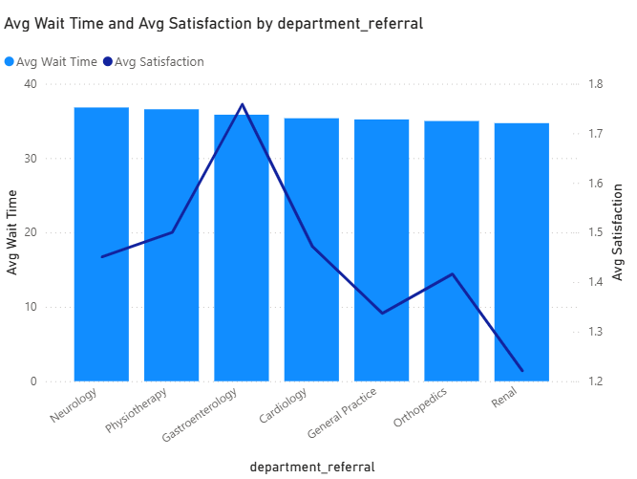
AVG WAIT TIME AND AVG SATISFACTION
Under 20 min wait satisfaction stays high
Over 45 min wait satisfaction drops sharply

Slide 9
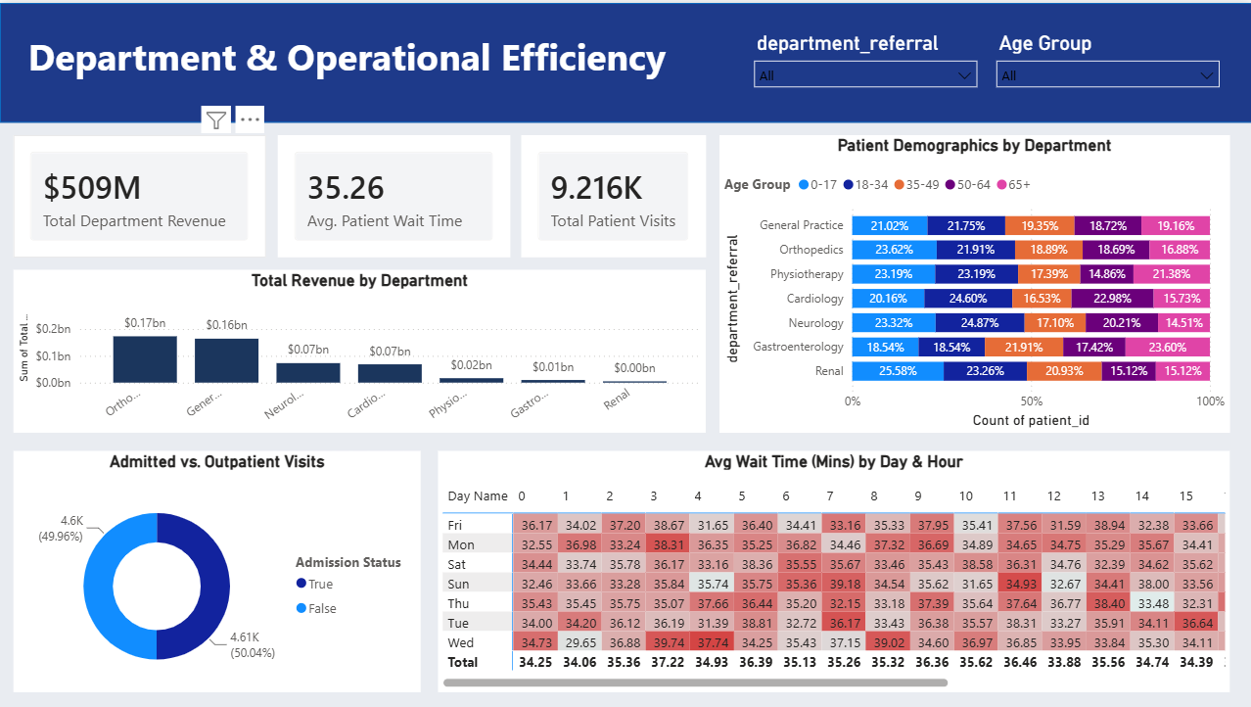

Slide 10
OVERALL INSIGHTS
Two departments drive the hospital — Orthopedics and General Practice together make up two-thirds of all revenue (₹337M of ₹509M).
Wait time has a breaking point — satisfaction stays fine under 20 minutes but drops sharply past 45 minutes; it's not a slow decline, it's a cliff.
One doctor carries the load — Dr. Smith alone treats 65% of all patients (5,986 of 9,216), which is a staffing risk, not just a stat.
Older patients are least satisfied — 65+ patients face longer waits and more multi-department visits, pulling their satisfaction scores down.
Demand isn't steady year-round — visits spike in Q1 and Q4 (flu season), meaning fixed staffing levels leave the hospital understaffed exactly when it matters most.

Slide 11
RECOMMENDATIONS
Hire 2-3 doctors for General Practice & Emergency
Split GP doctors into 2 shifts (7am-3pm / 2pm-10pm)
Offer off-peak discounts and preventive care bundles

Slide 12


