Slide 1


THE 11th INTERNATIONAL CONFERENCE ON COMPUTING, COMMUNICATION AND NETWORKING TECHNOLOGIES (ICCCNT)
JULY 1-3,IIT Kharagpur, West Bengal, India

Slide 2
A Deep Learning Based Assistive System to Classify COVID-19 Face Mask for Human Safety with YOLOv3
Paper id - 655
Presenter- Md. Rafiuzzaman Bhuiyan
Present from Bangladesh
Member of DIU NLP & Machine Learning Research Lab
rafiuzzaman15-9655@diu.edu.bd
github.com/whoafridi

Slide 3
Authors
Md. Rafiuzzaman Bhuiyan
Sharun Akter Khushbu
Md. Sanzidul Islam
A Deep Learning Based Assistive System to Classify COVID-19 Face Mask for Human Safety with YOLOv3

Slide 4
The subject of discussion
Introduction
Methodology
Experiment output
Future Work

Slide 5
Related Works
“Convolutional neural network for person and car detection using YOLO framework”, M.H. Putra, Z.M. Yussof, K.C. Lim, S.I. Salim.
“A Robust Real-Time Automatic License Plate Recognition Based on the YOLO Detector”, Rayson Laroca, E. S.
“YOLO based Human Action Recognition and Localization”, Shubham Shinde, A. K.

Slide 6
Introduction(Problem Discussion)
Object detection
One stage
Two stage

Slide 7
Introduction(Problem Discussion)
Detector
Mask
No mask

Slide 8
Why Mask detector?
Face mask is an effective tool during this pandemic
Survilence because it’s really need
Distinguish a person is wearing mask or not

Slide 9
Introduction (Our Contribution)
Data annotation.
Reduce train loss.
Proposed a method for object detector.

Slide 10
Proposed Method(works flow)
Dataset
Data pre processing
Data Annotation
Setup YOLOv3
Train YOLOv3
Prediction

Slide 11



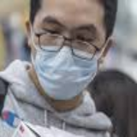

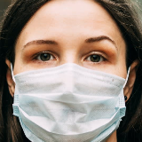
Dataset
600 data
( 280 mask,
320 without
Mask)

Slide 12
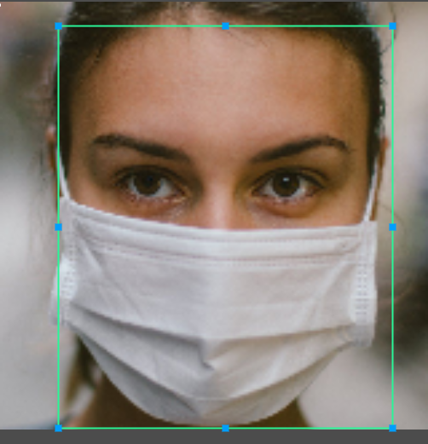
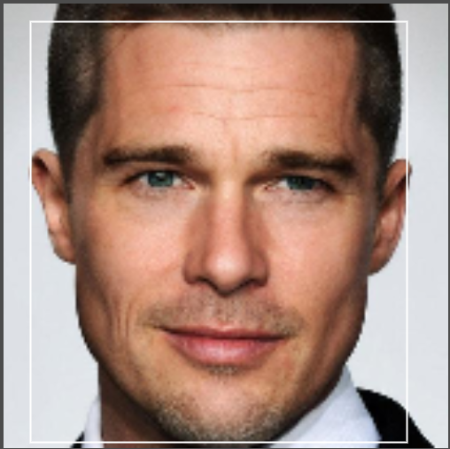
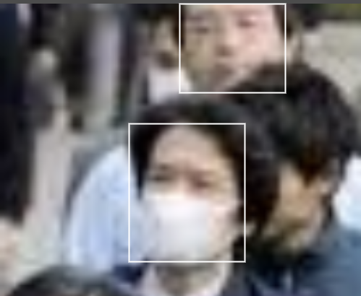
Data Annotation

Slide 13
Configuration
Creating “obj.names”
Creating “obj.data”
Custom YOLOv3 cfg
YOLOv3 cfg
Set classes = 2
Set filters = 21

Slide 14
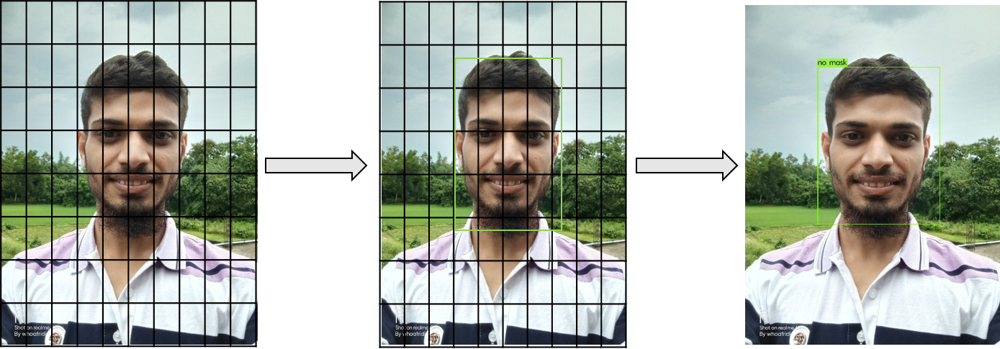
Applied YOLOv3

Slide 15
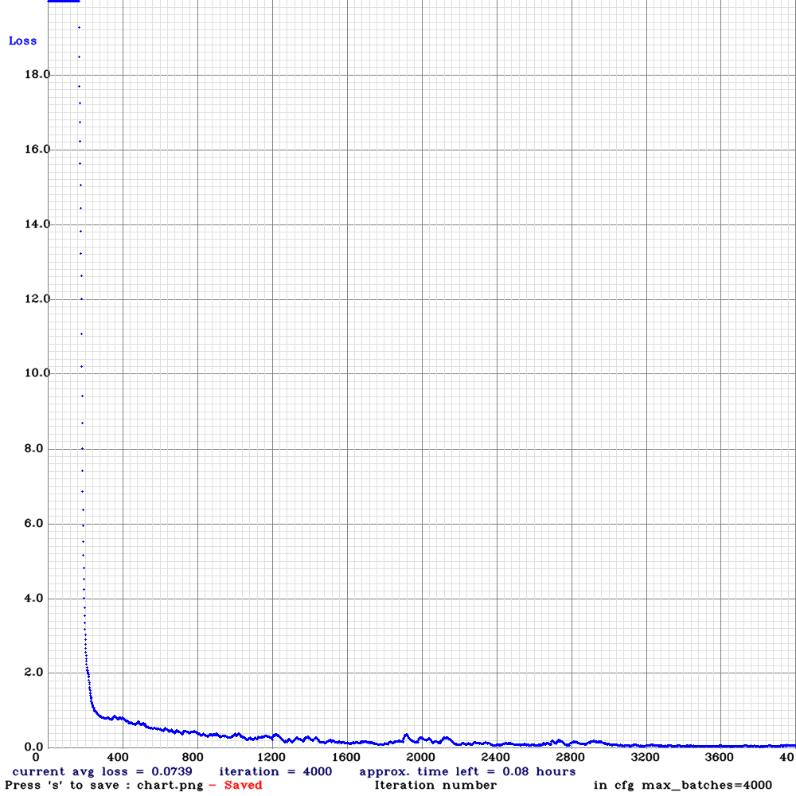
Experimental Result

Slide 16
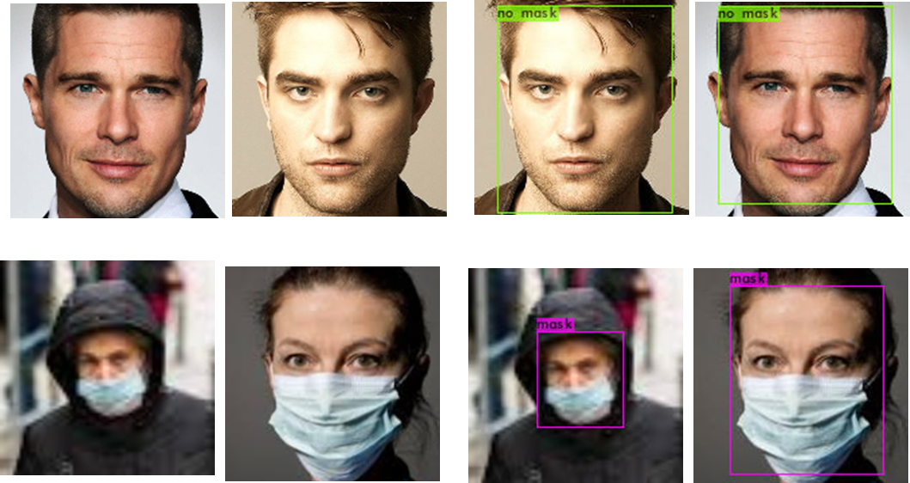
Experimental Result (cont.)

Slide 17
Future Work
Make dataset bigger & diverse
Apply state of art new YOLOv4 & v5
Apply Faster-RCNN with the same dataset

Slide 18
Conclusion
Detecting a person is wearing a mask or not
Applied this model into a real-time video.

Slide 19
REFERENCES
[1] Hongzhou Lu, Charles W. Stratton, and Yi-Wei Tang. Outbreak of pneumonia of unknown etiology in Wuhan, china: The mystery and the miracle. Journal of Medical Virology, 92(4):401–402, 2020.
[2] Chih-Cheng Lai, Tzu-Ping Shih, Wen-Chien Ko, HungJen Tang, and PoRen Hsueh. Severe acute respiratory syndrome coronavirus 2 (SARSCoV-2) and coronavirus disease-2019 (COVID-19): The epidemic and the challenges. International Journal of Antimicrobial Agents, 55(3):105924, March 2020.
[3] Hussin A. Rothan and Siddappa N. Byrareddy. The epidemiology and pathogenesis of coronavirus disease (COVID-19) outbreak. Journal of Autoimmunity, page 102433, February 2020.
[4] R. Girshick, J. Donahue, T. Darrell, and J. Malik, “Rich feature hierarchies for accurate object detection and semantic segmentation,” In Conference on Computer Vision and Pattern Recognition, 2014.
[5] Reinhard Klette, “Concise Computer Vision”. Springer, 2014.
[6] Tulin Ozturk, Muhammed Talo, Eylul Azra Yildirim, Ulas Baran Baloglud, Ozal Yildirim, U. Rajendra Acharya”, “Automated detection of COVID-19 cases using deep neural networks with X-ray images”, 2020.
[7] Joao Carlos Virgolino Soares, Marcelo Gattass, Marco Antonio Meggiolaro, “Visual SLAM in Human Populated Environments: Exploring the Trade-off between Accuracy and Speed of YOLO and Mask R-CNN”, 19th International Conference on Advanced Robotics (ICAR), 2019.
[8] L. Hensley, “Social distancing is out, physical distancing is inheres how to do it,” Global News–Canada (27 March 2020), 2020.
[9] S. Wan, Y. Liang, Y. Zhang, “Deep convolutional neural networks for diabetic retinopathy detection by image classification”, Comput. Electr. Eng. 72 (2018) 274–282.
[10] A. Koubaa, B. Qureshi, M. Sriti, Y. Javed, and E. Tovar, “A service oriented cloud-based management system for the internet-of-drones”,2017 IEEE International Conference on Autonomous Robot Systems and
Competitions, ICARSC 2017, April 26-28, 2017, pp. 329–335, 2017.

Slide 20
REFERENCES (cont.)
[11] S. Ren, K. He, R.B. Girshick, J. Sun, “Faster R-CNN: Towards Real-Time Object Detection with Region Proposal Networks”, CoRR abs/1506.01497, 2015.
[12] E. Dong, Y. Zhu, Y. Ji, S. Du, An improved convolution neural network for object detection using YOLOv2, 2018 IEEE International Conference on Mechatronics and Automation (ICMA), pp. 1184–1188, 2018.
[13] M.H. Putra, Z.M. Yussof, K.C. Lim, S.I. Salim, “Convolutional neural network for person and car detection using YOLO framework”, 67–713, 2018.
[14] Bin Wang, S. T.-B.-F.-D., “Detection and tracking based tubelet generation for video object detection. Journal of Visual Communication and Image Representation”, 102-111, 2019.
[15] Dongqing Shen, X. C., “Flame detection Using deep learning”, 2018 4th International Conference Control, Automation and Robotics, IEEE, 2018.
[16] First A. Jiangyun Li, S. B., “Real-time Detection of Steel Strip Surface Defects Based on Improved YOLO Detection Network”, IFACPapersOnLine, (pp. 76-81), 2018.
[17] Jiajun Lu, H. S., “No Need to Worry about Adversarial Examples in Object Detection in Autonomous Vehicles”, Computer Vision and Pattern Recognition (cs.CV), 2017.
[18] Joseph Redmon, A. F., “YOLO9000 :Better, Faster, Stronger.”, arXiv:1612.0824v1 [cs.CV], Washington: IEEE, 2016.
[19] Joseph Redmon, S. D., “You Only Look Once: Unified, Real Time Object Detection” IEEE, 2016.
[20] Mennatullah Siam, H. M., “MODNet: Motion and appearance based Moving Object Detection Network for autonomous Driving”, Computer Vision and Pattern Recognition (cs.CV), IEEE, 2017.
[21] Rayson Laroca, E. S., “A Robust Real-Time Automatic License Plate Recognition Based on the YOLO Detector”, 2018 International Joint Conference on Neural Networks (IJCNN), 2018.
[22] Shubham Shinde, A. K., “YOLO based Human Action Recognition and Localization”, International Conference on Robotics and Smart Manufacturing, pp. 831-838, 2018.
[23] ”tzutalin/labelImg”, GitHub. https://github.com/tzutalin/labelImg. [Accessed: 09- Jun- 2020].

