Slide 1
Huffman Encoding
Team 3: 林承德, 張俊堉, 蔡孟桓
Advisor: Prof. 簡韶逸, Prof. Jiin

Slide 2
Huffman Encoding
我想耍廢不想做這頁XD

Slide 3
Software Simulation
Csim failed just after downloading.
Miss the Initialization the array.
Different line endings: CRLF(\r\n) v.s. LF(\n)

Slide 4
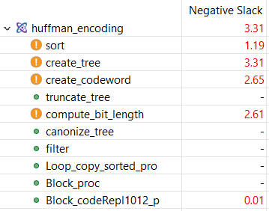
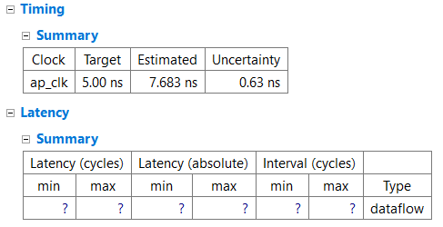
Timing Violation

Slide 5
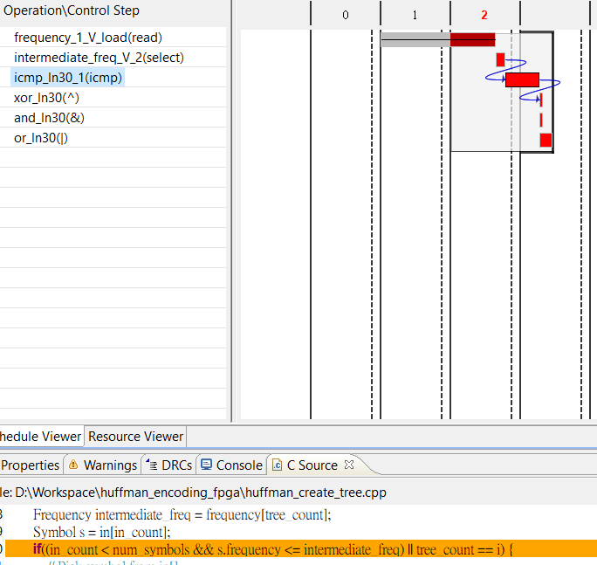
Analyze the Violation
In Vivado HLS, the schedule viewer shows the path that violate the timing and corresponding source code.

Slide 6
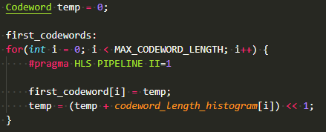
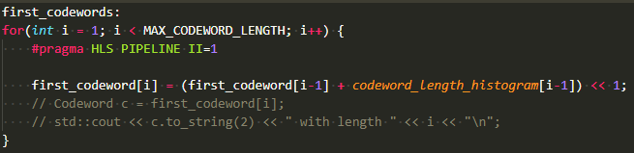
Remove read process
Use additional register to remove the read process.
“#pragma HLS dependence variable=first_codeword intra WAR” might have the same effort.

Slide 7
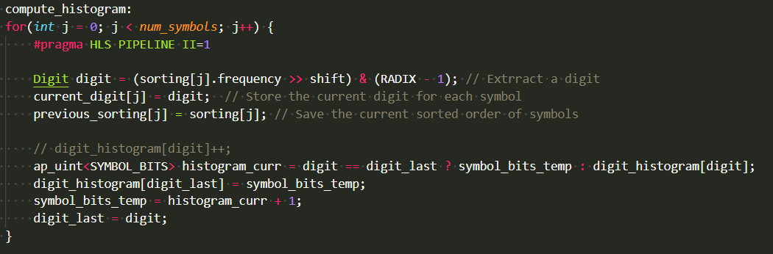
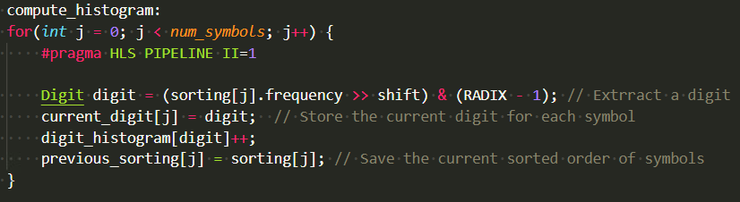
Pipeline with Data Forwarding
Read from ram, plus 1, and write back to ram cost too much time, yet it must finish in 1 cycle with II = 1.
Data Forwarding allows it to pipeline to 2 cycles.
應該要畫個電路圖但我不會用電腦畫圖XD

Slide 8
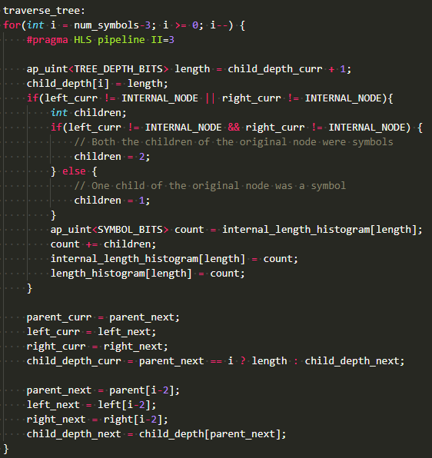
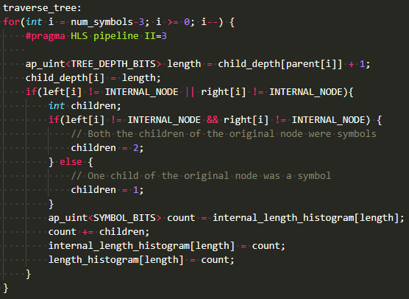
Prefetch
Use additional registers to store prefetched data to reduce the critical path.

Slide 9
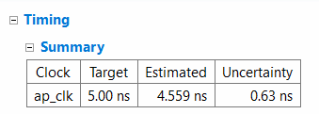
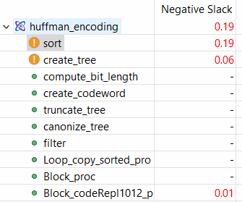
Result

Slide 10
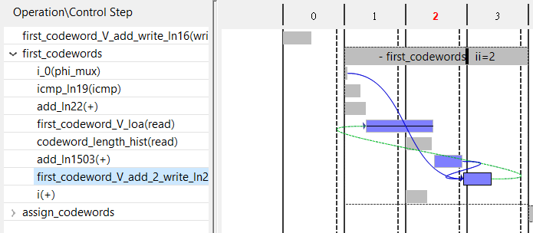
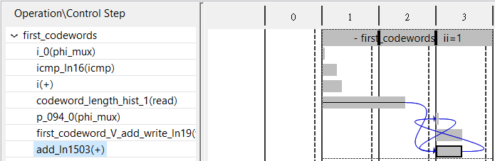

Slide 11
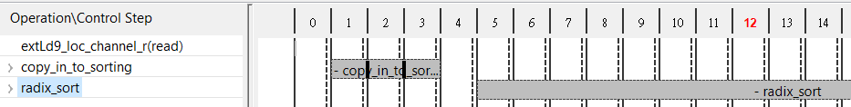
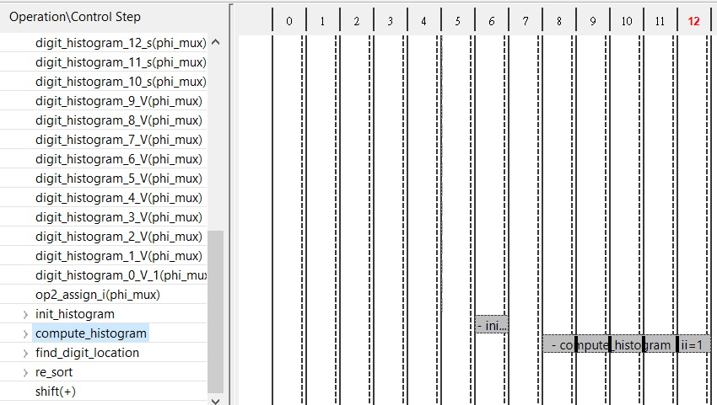
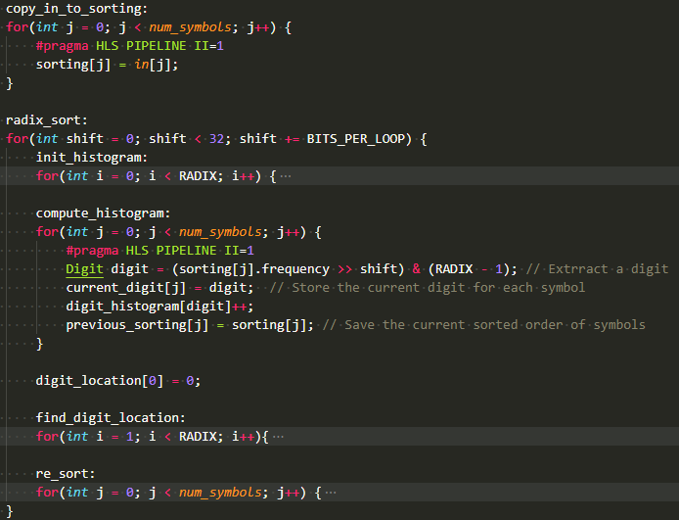

Slide 12
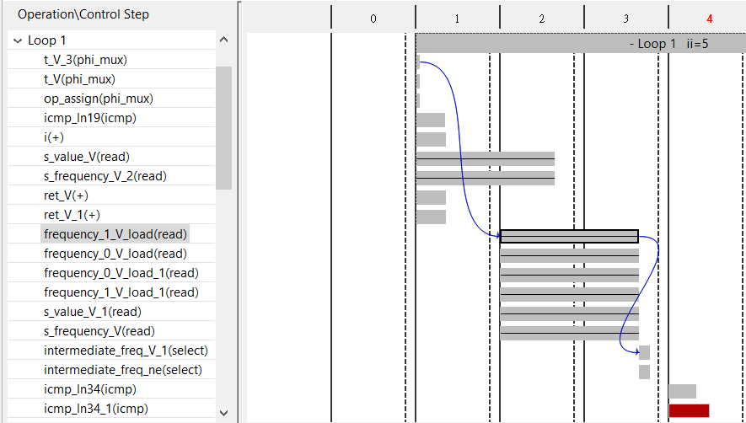

Slide 13
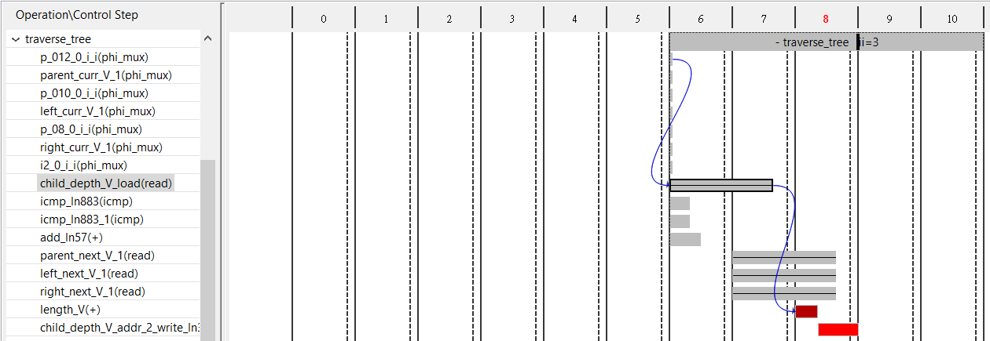
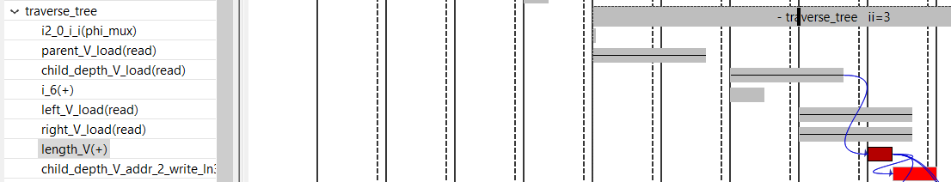
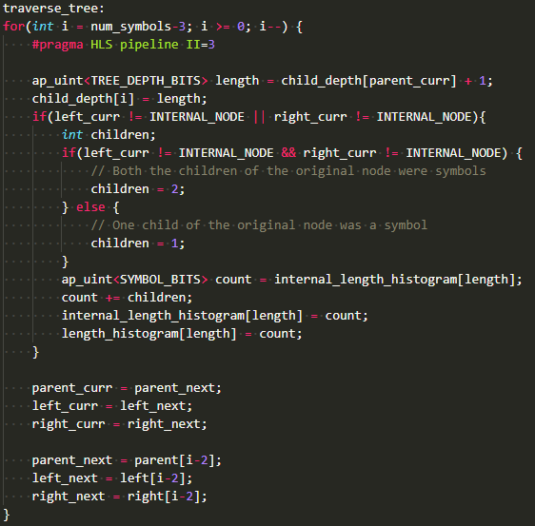

Slide 14
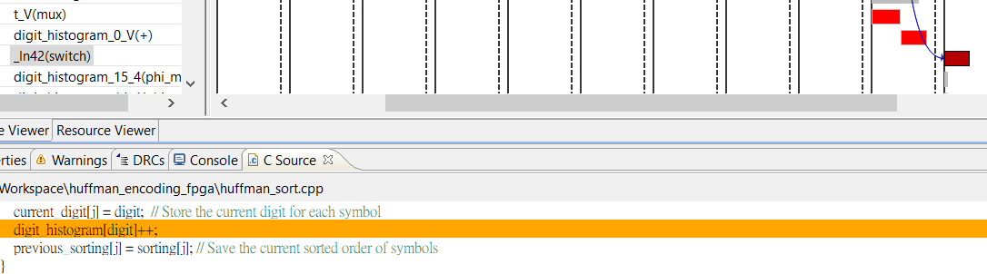
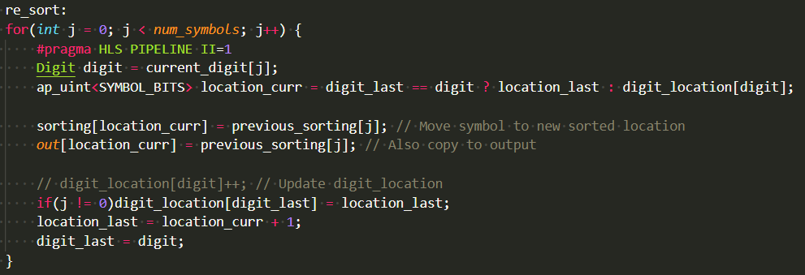
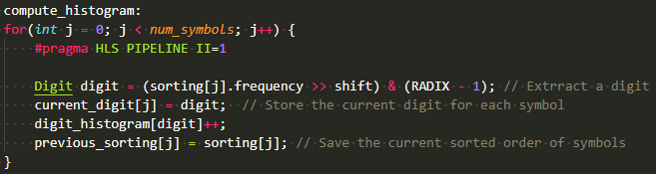

Slide 15
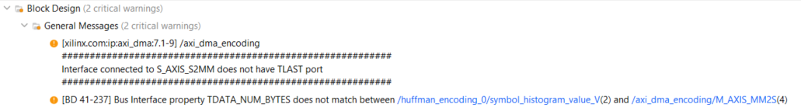

Slide 16
