Slide 1
Android-Based College Planner
Donne Lorenzo C. Ros

Slide 2
Introduction
College Planner is an android application that will be used by college students to organize and manage their schedule effectively.
Although there are several planner applications available in the market, College Planner is different in that it will integrate different organizational apps relevant to the planner into one single app.

Slide 3
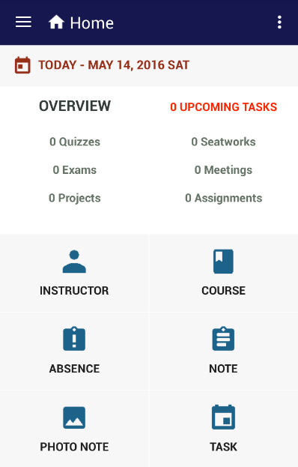
FEATURES

Slide 4
INSTRUCTOR
The student can create a list of instructors by supplying their details.
The student can also create a timetable of schedule (consultation hours) for every instructor.

Slide 5
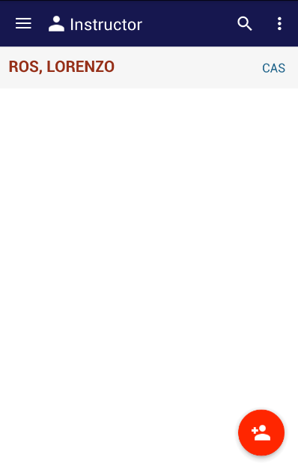
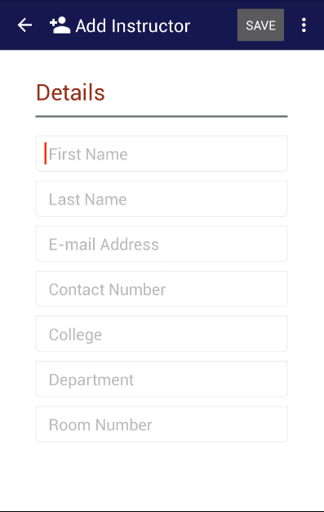
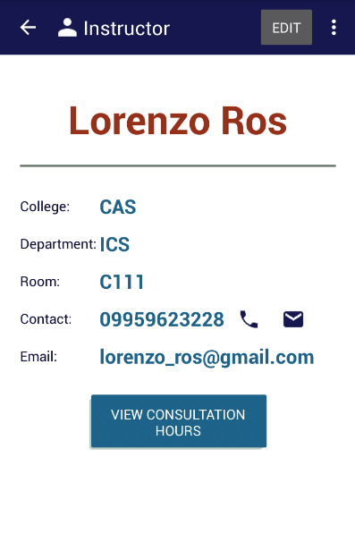

Slide 6
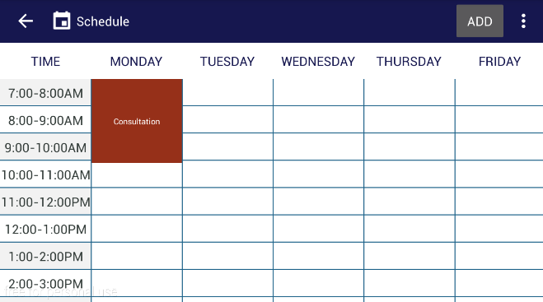

Slide 7
Course
The student can create a list of courses that the student’s currently taking.
The courses created will be used for the other features of the application.

Slide 8
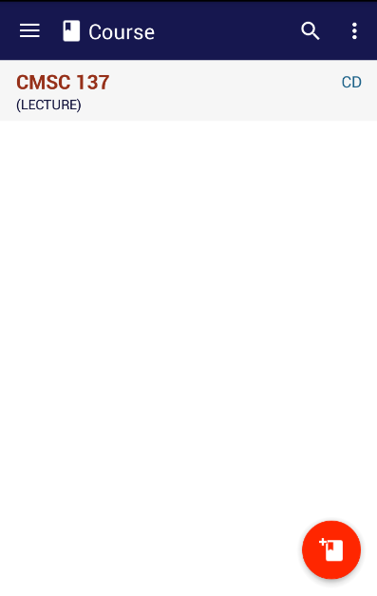
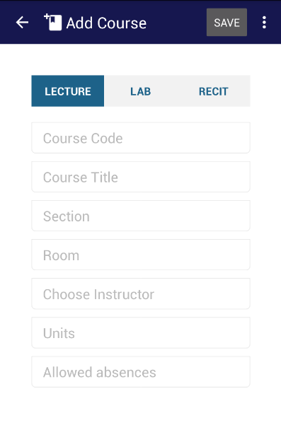
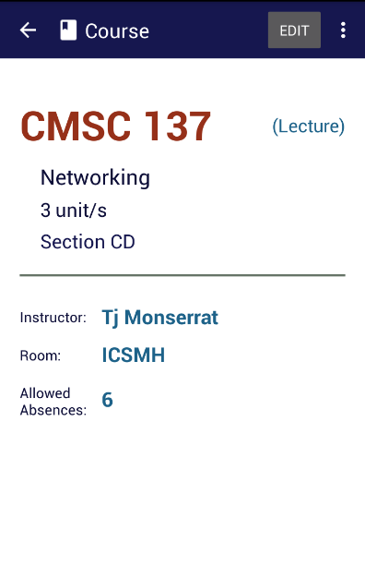

Slide 9
Absence
The student will have a list of courses based from the course feature.
In the list, the course code, course type (lecture, recitation, laboratory) and the student’s current number of absences in a particular course would be displayed.
The student can add an absent by selecting the date of absence. Clicking a course from the list would take the student to another interface wherein the list of date of absences is displayed.

Slide 10
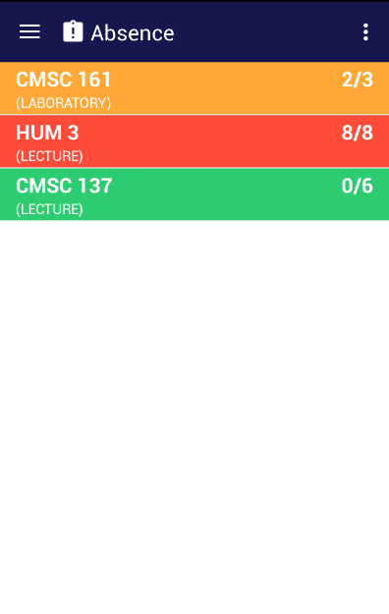
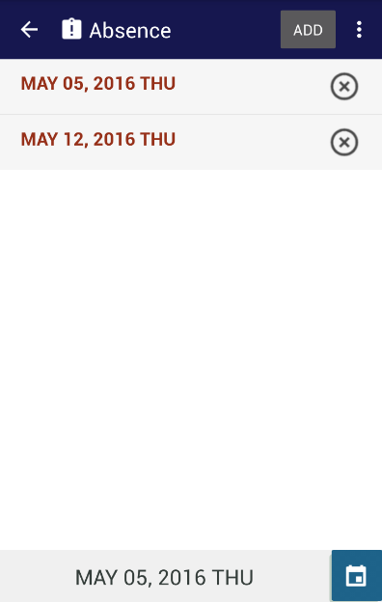

Slide 11
Note
The student can take notes for every course created.
Hence, the student can also arrange the notes according to course

Slide 12
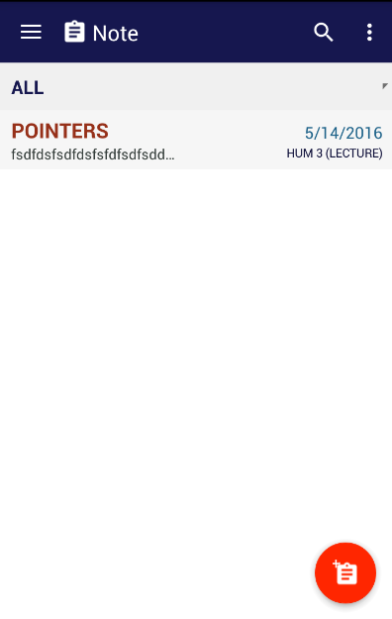
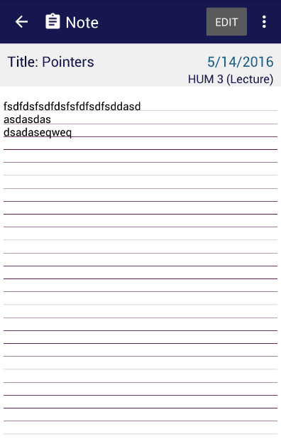

Slide 13
Photo Note
The student can create a photo note for every course by selecting an image from the phone’s gallery or directly from the camera.
The student can also arrange the photo notes according to course.

Slide 14
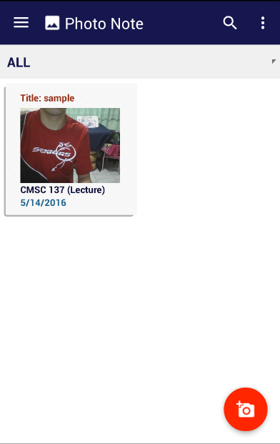
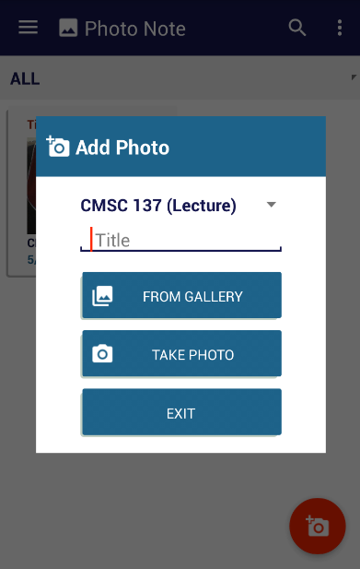

Slide 15
Task
This would be the main feature of the application.
The student can create a task for every course from the course feature. There would a three lists of tasks, upcoming, late and completed tasks.
The student can filter the tasks by course, due date, weight (assignment, exam, quiz, group meeting, etc.) or priority.
When an upcoming task is completed, the student must mark it as done. The task would be automatically moved to the completed tasks list. If a task was not marked as done before the due date, the task would be moved from the late tasks list.
The student can also create a status bar notification for a specified date for each upcoming task.
And lastly, the student can display a widget of the upcoming task list in home screen.

Slide 16
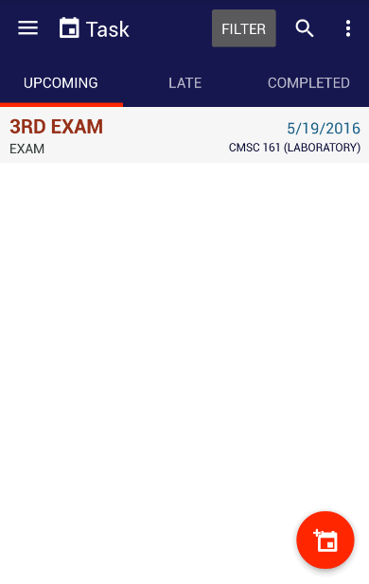
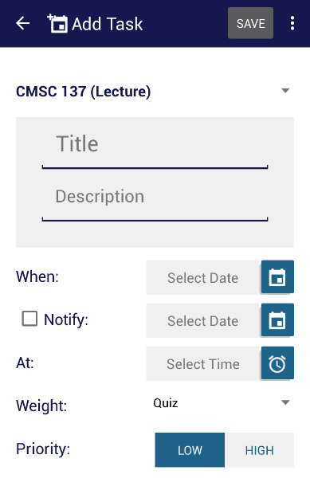
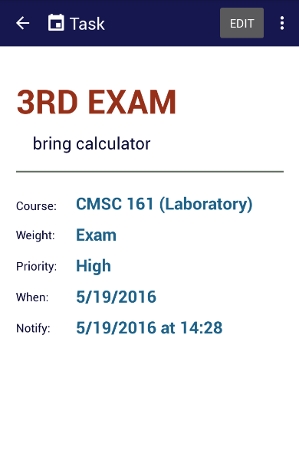

Slide 17
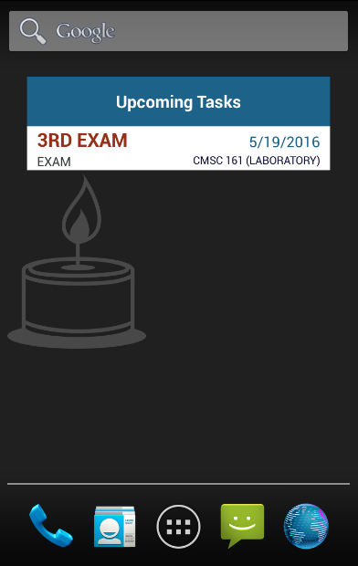

Slide 18
Results and Discussion
To determine its effectiveness, thirty-two UPLB students were asked to test and evaluate the overall ease of use, user interface design, satisfaction and usefulness of the application

Slide 19
Table 1. Frequency distribution of feedback from 32 UPLB students towards ease of use
Ease of use | Strongly Agree (5) | Agree (4) | Neutral (3) | Disagree (2) | Strongly Disagree (1) | TOTAL
I found this app easy to use. | 15 | 16 | 1 | 0 | 0 | 32
I can use it without written instructions. | 10 | 15 | 7 | 0 | 0 | 32
I can navigate through the app easily. | 15 | 16 | 1 | 0 | 0 | 32
I can accomplish task quickly. | 20 | 10 | 2 | 0 | 0 | 32
The language used in the app is easily understood. | 17 | 14 | 1 | 0 | 0 | 32
I felt very confident using the app. | 12 | 18 | 2 | 0 | 0 | 32

Slide 20
Table 2. Frequency distribution of feedback from 32 UPLB students towards user interface design
UI Design | Strongly Agree (5) | Agree (4) | Neutral (3) | Disagree (2) | Strongly Disagree (1) | TOTAL
The app has clearly marked way-finding buttons | 13 | 12 | 7 | 0 | 0 | 32
The UI is consistent (font, color, layout). | 22 | 7 | 3 | 0 | 0 | 32
The UI design is engaging and attractive. | 22 | 6 | 4 | 0 | 0 | 32
The prompts for inputs are clear. | 13 | 11 | 8 | 0 | 0 | 32

Slide 21
Table 3. Frequency distribution of feedback from 32 UPLB students towards satisfaction
Satisfaction | Strongly Agree (5) | Agree (4) | Neutral (3) | Disagree (2) | Strongly Disagree (1) | TOTAL
The app does everything I would expect it to. | 16 | 13 | 3 | 0 | 0 | 32
The app works the way I would want it to work. | 15 | 13 | 4 | 0 | 0 | 32
The app is well-designed for college students | 20 | 9 | 3 | 0 | 0 | 32
I found the various functions/features in the app were well integrated. | 23 | 9 | 0 | 0 | 0 | 32
Using the app was an enjoyable experience. | 16 | 14 | 2 | 0 | 0 | 32
I think that I would use this app frequently. | 12 | 17 | 3 | 0 | 0 | 32

Slide 22
Table 4. Frequency distribution of feedback from 32 UPLB students towards usefulness
Usefulness | Strongly Agree (5) | Agree (4) | Neutral (3) | Disagree (2) | Strongly Disagree (1) | TOTAL
Using the application would enable me to accomplish tasks more quickly | 13 | 14 | 5 | 0 | 0 | 32
Using the application would improve my scholastic performance | 11 | 14 | 7 | 0 | 0 | 32
Using the application would increase my productivity in college | 14 | 11 | 7 | 0 | 0 | 32
Using the application would enhance my effectiveness in college | 12 | 11 | 9 | 0 | 0 | 32
Using the application would make it easier to do my studies | 18 | 11 | 3 | 0 | 0 | 32

Slide 23
Figure 1. Mean percentage score of 32 UPLB students who evaluated the application
Based from the results (as shown in Figure 1), the application was able to score significantly high in every metric. Thus, it can be concluded that the application was effective.

Slide 24
Future Work
To further enhance the application, a login feature will be considered where students can automatically sync data to other devices online.
The application will also be improved by integrating Google calendar API to the task feature so that the students can have a clear view of their upcoming tasks or activities.
And lastly, since the application is only available for android devices, future developers may create an iOS version of the application.

