Slide 1
Preface
The following slides are not final and are produced solely for the purposes of informing operations. All information in this slide deck should be treated as confidential and provisional, and should not be shared or used for any outward facing products.
Caution must be taken when interpreting all data presented. Differences between information products published by WHO, national public health authorities, and other sources using different inclusion criteria and different data cut-off times are to be expected. While steps are taken to ensure accuracy and reliability, all data are subject to continuous verification and change. Counts are subject to variations in case detection, definitions, laboratory testing, and reporting strategies and capacities between countries, states and territories.​
The signals/events presented here may not be recorded in EMS or on the emergency dashboard.

Slide 2
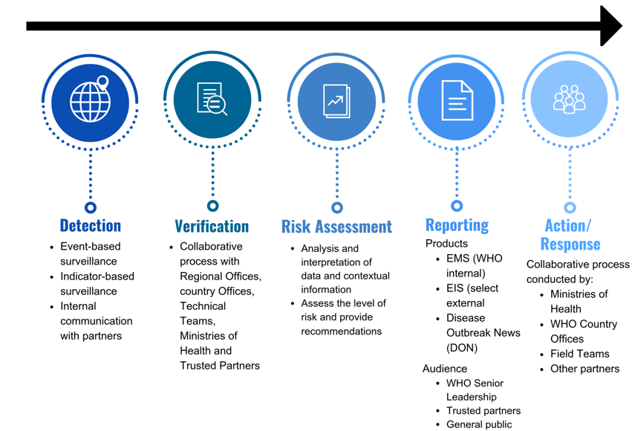
Detection, verification, risk assessment, communication and response process

Slide 3
Detection and Verification Process
Detection and verification occur through three different pathways simultaneously:
  Epidemic Intelligence from Open Source (EIOS) monitoring: to detect signals through event-based surveillance, this includes signals on human health, animal health (zoonosis or unknown disease with potential threat to human health), food security & food safety, travel and trade restrictions, environmental and chemical hazards.
  Outbreak email monitoring: to detect and verify signals, "Outbreak" receives information about signals and event from formal, informal sources, indicator-based surveillance and official notifications.
  EMS monitoring and event follow-up: to determine if any identified signal is already classified as an event and to follow-up on existing events.
Signals are defined as incidents needing further inquiry using a set of criteria including (list not exhaustive):
  higher than expected mortality or morbidity in human
  an unusual/unexpected/unexplained cluster of cases or deaths in the community with similar symptoms
  potential to cause an outbreak with a high potential for spread
  possible consequences for international trade or travel
  morbidity and/or mortality due to an undiagnosed or unknown disease in a community
  mortality or morbidity among specific population groups (i.e. refugees, health care workers or marginalized populations)
To verify signals, information is cross-checked against several reference sources and sent to the appropriate WHO regional office and/or partners to confirm the veracity of the information and determine if it should be classified as an event.

