Slide 1
Preface
The following slides are not final and are produced solely for the purposes of informing operations. All information in this slide deck should be treated as confidential and provisional, and should not be shared or used for any outward facing products.
Caution must be taken when interpreting all data presented. Differences between information products published by WHO, national public health authorities, and other sources using different inclusion criteria and different data cut-off times are to be expected. While steps are taken to ensure accuracy and reliability, all data are subject to continuous verification and change. Counts are subject to variations in case detection, definitions, laboratory testing, and reporting strategies and capacities between countries, states and territories.​
The signals and/or events presented here may not be recorded in EMS or on the emergency dashboard.

Slide 2
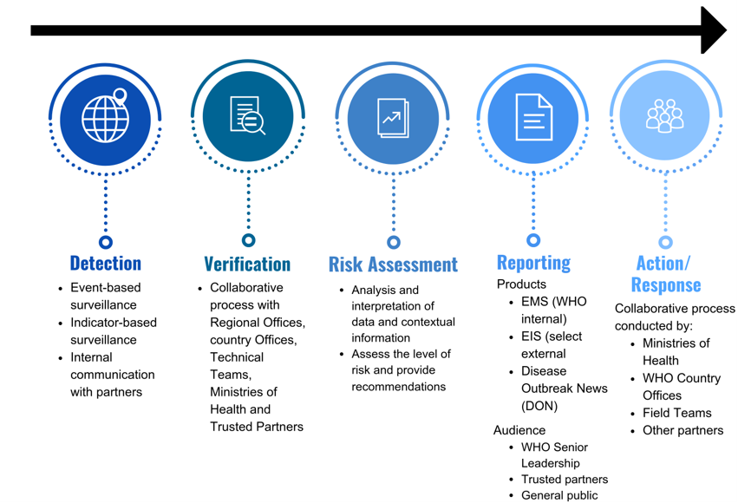
Detection, verification, risk assessment, communication and response process

Slide 3
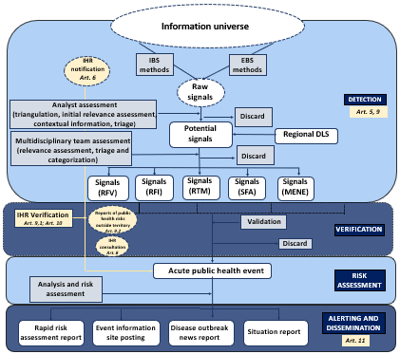
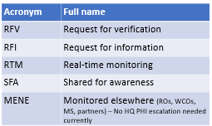
WHO-HQ PHI information flow

Slide 4
Detection and Verification Process
Detection and verification occur through three different pathways simultaneously:
Epidemic Intelligence from Open Source (EIOS) monitoring: to detect signals through event-based surveillance, this includes signals on human health, animal health (zoonosis), undiagnosed disease with potential threat to human health), food security & food safety, travel and trade restrictions, environmental and chemical hazards.
Outbreak email monitoring: to detect and verify signals, "Outbreak" receives information about signals from formal, informal sources, and indicator-based surveillance; official IHR notifications for events and updates on events are also received through “Outbreak”.
EMS monitoring and event follow-up: to determine if any identified signal is already classified as an event and to follow-up on existing events.
From signal to event
To assess and verify signals, information is cross-checked against several reference sources and sent to the appropriate WHO regional office and/or partners to confirm the veracity of the information and determine if it should be classified as an event.​
​
Signals/events referred to in the following slides include those identified during event-based surveillance using EIOS, received in 'Outbreak' email inbox, or published in EMS.

Slide 5
Signal nomenclature
Raw signal: any information, data or communication collected, obtained, received, or acquired through an initial filtering of sources used for surveillance activities for the purpose of detecting potential acute risks to human health
Potential signal: raw signals that are triangulated with other contemporaneous reports, reviewed against previous trends/occurrences, considered in the context of the situation and dynamically assessed by the PHI analyst in order to retain only those pertinent to early detection purposes. Potential signals are then triaged and either discarded or categorized if they meet predefined criteria.
Signal: is data and/or information detected that has been triangulated, assessed, triaged, and categorized using a multidisciplinary and PHI-specific lens, and determined to represent a potential acute risk to human health, encompassing all-hazard considerations. Signals may consist of reports of cases or deaths (individual or aggregated), potential exposure of human beings to biological, chemical or radiological and nuclear hazards, or the occurrence of natural or human-made disasters. Signals can be detected from a variety of sources and through a range of approaches.

Slide 6
Categorization definitions
Verification: a signal triaged for verification requires additional information for the purpose of verification from the IHR NFP via the respective RO.
Request for information (RFI): a signal triaged for RFI requires additional information for risk assessment. This information may be required from the respective RO, TT or relevant partners (e.g., GLEWS+, UNICEF, GOARN).
Real-time monitoring (RTM): a potential-signal triaged for RTM is shared with the hazard focal points within PHI unit and the hazard focal points will reassess status at least weekly based on targeted search.
Shared for awareness (SFA): a signal triaged for SFA is shared with TT, RO, and/or relevant partners and requires no further action for HQ PHI – examples include the sharing of information about substandard or falsified medicines with the rapid alert team or sharing of information about a signal affecting children with UNICEF. This may also include an IHR notification received via the RO that is then shared onward for TT awareness.
Monitored elsewhere (ROs, WCOs, MS, partners) – No HQ PHI escalation needed currently (MENE): a signal triaged for MENE is one that does not require any monitoring or escalation by HQ PHI, at the time of detection, as the signal is already being monitored closely by the RO, WCO, Member State, partners, HQ technical team, or an IMST.
Discard for HQ PHI (DHQP): Signals that are already known through official channels, related to animal health only, clearly irrelevant, erroneous, outdated or negative test results (e.g., translation errors, duplicate reports, old articles) should be discarded. Importantly, discarding a signal related to an ongoing event does not imply that the event itself is discarded—only that the specific signal is not considered pertinent at the time of assessment.

