Slide 1
BGI HACKATHON 2026
IDEA SUBMISSION
Theme : Robotics, Drones & Industry 5.0
Problem Statement ID : IT2P2
Problem Statement Title : Autonomous Drone-Based Infrastructure Inspection System
Problem Statement Category : Software and Hardware
Team ID : 2449
Team Name (Registered on portal) : YellowDuck

Slide 2
PROJECT STRIDE: Smart Technology for Real-Time Infra Detection & Evolution
Solution Overview :
Description: STRIDE is an end-to-end ROS 2 and autonomous UAV system featuring edge-compatible fine-tuned YOLOv8 defect detection, live telemetry, and automated PDF reporting.
Resolving the Problem: Replaces hazardous manual inspections with an automated, state-machine-driven flight stack. It processes visual data in real-time to detect structural anomalies, minimizing operational delays and human risk.
Key Novel Elements:
Sim-to-Real Pipeline: Dockerized architecture designed for immediate transition to edge compute hardware.
Infrastructure Evolution Tracking: Tracks and plots defect severity scores across multiple missions over time via the web dashboard.
Pluggable Multi-Sensor Architecture: ROS 2 topic interface allows seamless swapping between RGB, Thermal, and LiDAR data streams.

Slide 3
SOLUTION APPROACH
Technologies to be used:
Simulation & Navigation: ROS 2 Humble (LTS), PX4 SITL, Gazebo (Dockerized for Windows)
Computer Vision: YOLOv8 (Ultralytics) fine-tuned for structural defects
Backend & Edge: FastAPI (Python), WebSockets, rclpy
Frontend: Next.js, TailwindCSS, shadcn/ui
Methodology and Implementation Process: (Note: Add your system architecture flowchart here alongside these points)
Mission Planning: Waypoints are sent from the Next.js dashboard to the custom ROS 2 navigation node via FastAPI.
Autonomous Flight: A rigid state machine executes transit, obstacle avoidance (via depth/scan thresholds), and strictly enforced geo-fencing.
Vision Pipeline: The simulated camera feed is ingested by the YOLOv8 node, which extracts defect metadata and compresses annotated frames to MJPEG to optimize bandwidth.
Data Aggregation: Telemetry, alerts, and video feeds are streamed to the web dashboard, concluding with an automated Python (ReportLab) PDF summary.

Slide 4
FEASIBILITY AND VIABILITY
Feasibility Analysis:
Highly viable due to the containerized Docker setup, which abstracts complex Gazebo dependencies and ensures cross-platform stability.
The modular ROS 2 architecture ensures the vision node is hardware-agnostic, allowing the YOLOv8 pipeline to be seamlessly deployed directly onto edge devices for real-world scaling.
Challenges and Risks:
High latency or frame drops during video streaming from the simulation to the frontend.
Communication loss during active flight operations.
False positives in defect detection due to diverse lighting or background noise.
Mitigation Strategies:
Implemented on-node frame compression (JPEG) before publishing to the WebSocket server.
Integrated a robust failsafe state machine (FAILSAFE -> RETURN_TO_LAUNCH / EMERGENCY_LAND) triggered by communication timeouts or geo-fence breaches.
Fine-tuning YOLOv8 on specialized, high-variance datasets (CODEBRIM/RDD2022) to maintain high mAP@50 accuracy.

Slide 5
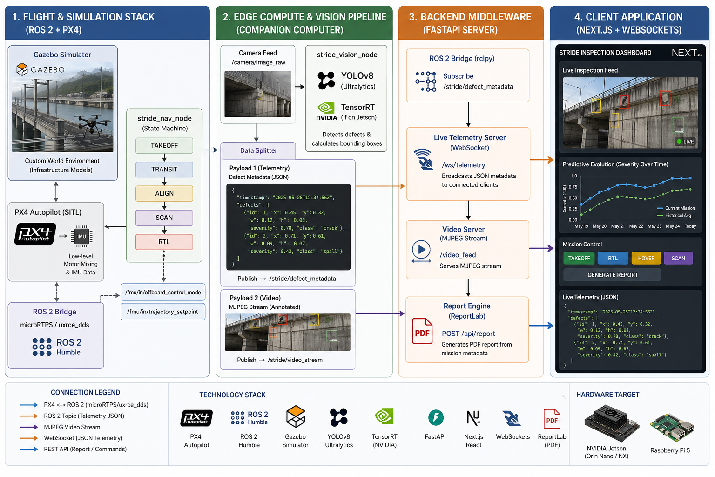
IMPACT AND BENEFITS
Potential Impact on Target Audience:
Provides civil engineering firms, power grid authorities, and infrastructure operators with actionable, real-time data, shifting maintenance strategies from reactive to predictive.
Benefits of the Solution:
Economic: Drastically reduces the high costs associated with scaffolding, rope-access teams, and prolonged facility downtime.
Social & Safety: Completely removes human operators from hazardous, hard-to-reach, or structurally compromised environments.
Operational: Delivers consistent, unbiased AI analysis. The centralized dashboard and automated reporting streamline compliance logging and decision-making.

Slide 6
RESEARCH AND REFERENCES
Research Focus:
Optimization of YOLOv8 inference for edge-device deployment.
State-machine architectures for autonomous UAV flight systems.
References:
CODEBRIM Dataset: Concrete Defect Bridge Image Dataset for training structural anomaly detection.
RDD2022: Road Damage Detection Dataset for varied environmental defect training.
ROS 2 Humble Documentation: Implementation of rclpy and custom node orchestration.
PX4 Autopilot SITL: Offboard control and Gazebo simulation integration.

