Slide 1

GraphViz
Ditching Visio for Coded Diagrams in Source Control

Slide 2

Kevin Rich
Engineering Supervisor
OSU Alum
DotNet Fan
Dynamic Speaker

Slide 3
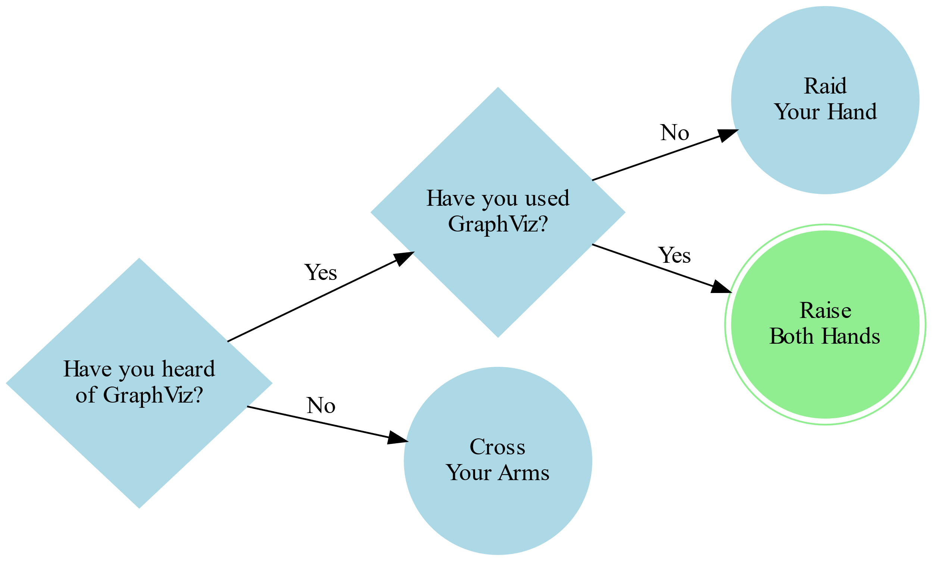
Audience Gauge

Slide 4
Demonstration

Slide 5
Who Should Use GraphViz?
People who suck at drawing
People who like source control
Nerds
People that prefer open-source tools (Common Public License Version 1.0)
People interested in a graphing/charting solution that integrates well with LaTeX
People who don’t like Visio

Slide 6
Resources
GraphViz.org the base site from the creators
GraphViz Pocket Reference – (graphs.grevian.org) by Josh Hayes-Sheen
WebGraphViz.com a web-based tool
GraphViz Preview – Visual Studio Code Plugin (https://marketplace.visualstudio.com/items?itemName=EFanZh.graphviz-preview)

Slide 7

Presentation Resources
https://github.com/whoiskevinrich/GraphViz-LightningTalk

