Slide 1

GraphViz
Ditching Visio for Coded Diagrams in Source Control

Slide 2

Kevin Rich
Engineering Supervisor
OSU Alum
DotNet Fan
Dynamic Speaker

Slide 3
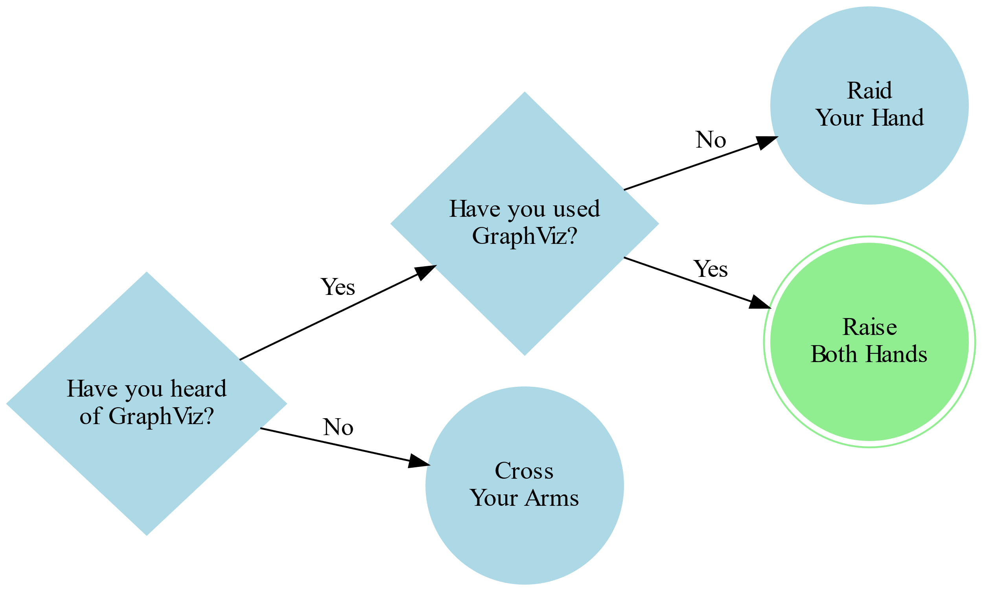
Audience Gauge

Slide 4
Samples

Slide 5
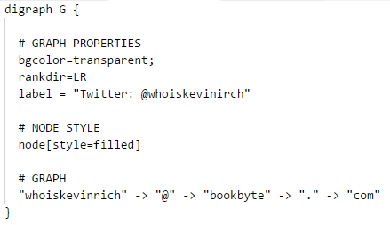


Slide 6
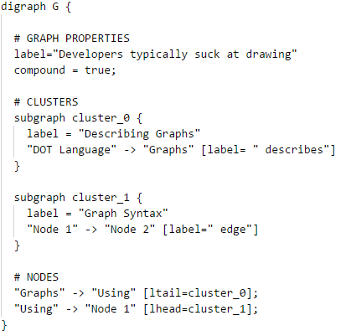
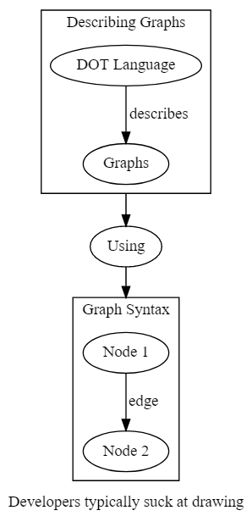

Slide 7
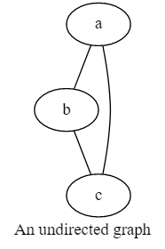
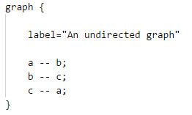

Slide 8
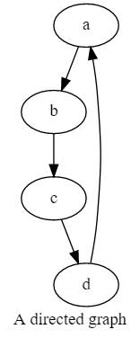
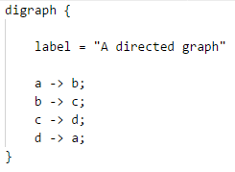

Slide 9
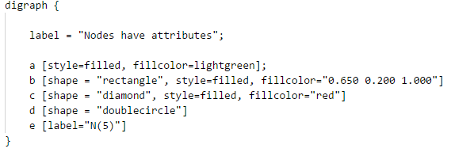


Slide 10
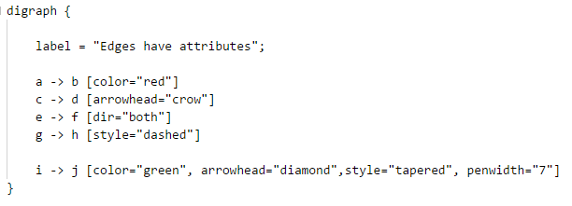
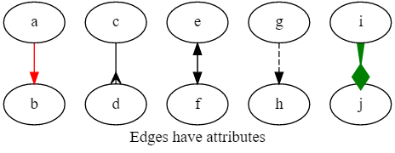

Slide 11
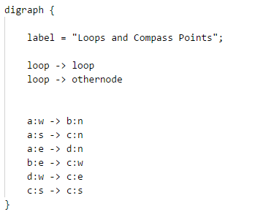
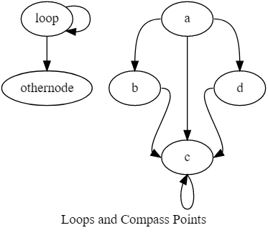

Slide 12
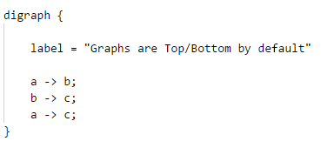
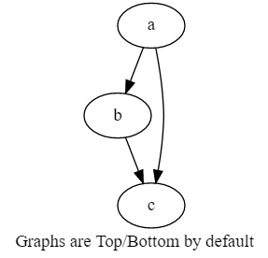
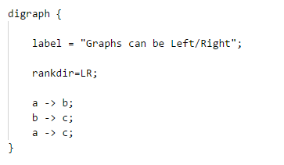
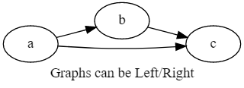

Slide 13
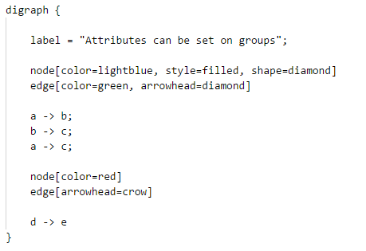
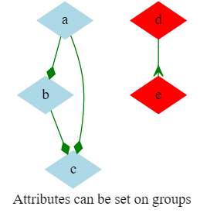

Slide 14
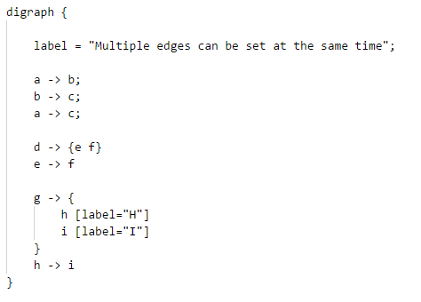
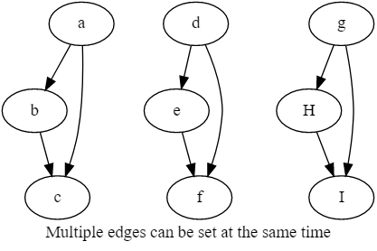

Slide 15
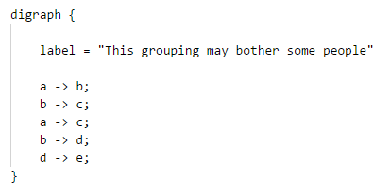
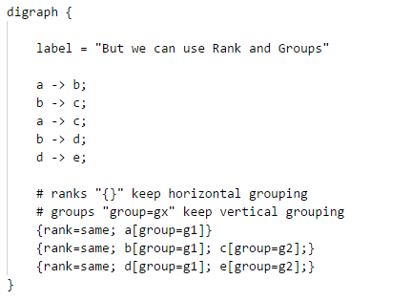
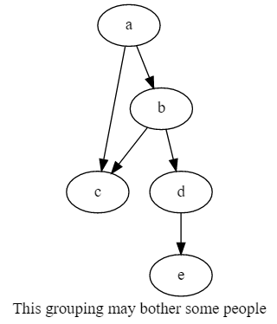
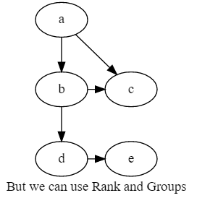

Slide 16
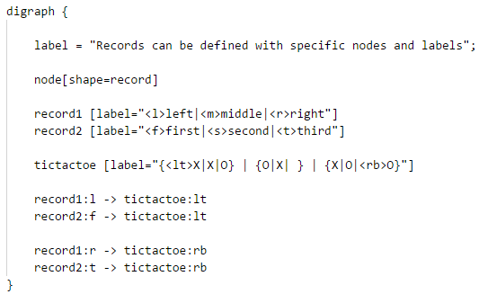
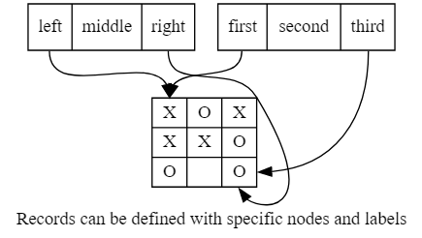

Slide 17
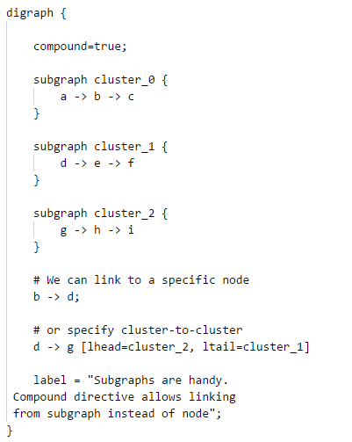
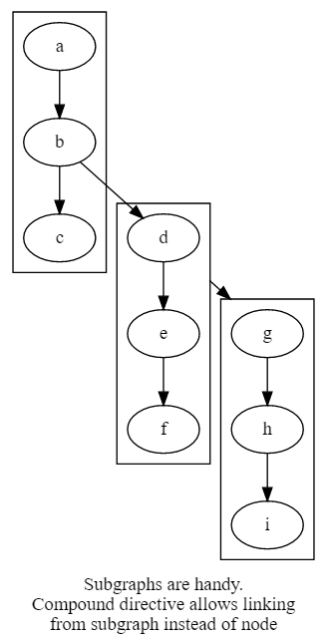

Slide 18
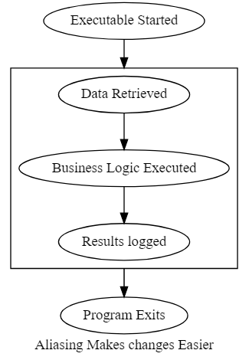
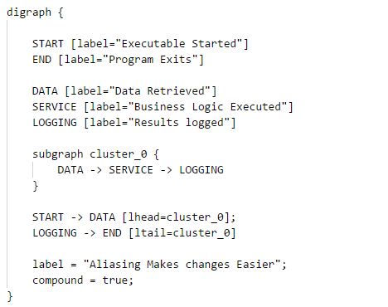

Slide 19
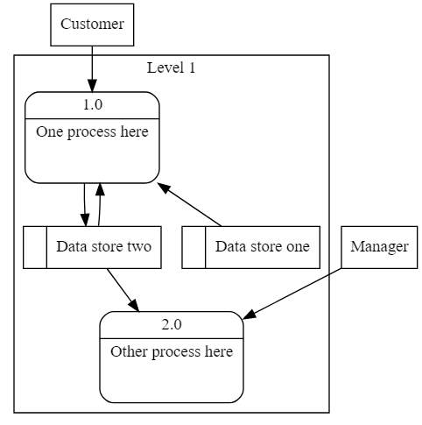
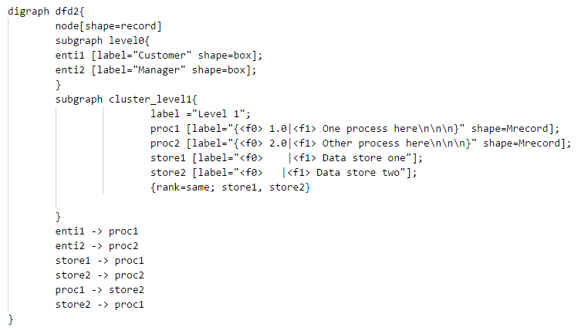

Slide 20
VS Code Demonstration

Slide 21
Who Should Use GraphViz?
People who suck at drawing
People who like source control
Nerds
People that prefer open-source tools (Common Public License Version 1.0)
People interested in a graphing/charting solution that integrates well with LaTeX
People who don’t like Visio
People who still spell Microsoft with a “$” in it

Slide 22
Resources
GraphViz.org the base site from the creators
GraphViz Pocket Reference – (graphs.grevian.org) by Josh Hayes-Sheen
WebGraphViz.com a web-based tool
GraphViz Preview – Visual Studio Code Plugin (https://marketplace.visualstudio.com/items?itemName=EFanZh.graphviz-preview)

Slide 23

Presentation Resources
https://github.com/whoiskevinrich/GraphViz-LightningTalk

