Slide 1
OptMCTS
Replication of SolverLLM for Mathematical Optimization
with MCTS-Guided LLM Formulation
Model: GPT-4o-mini | Paper: SolverLLM (NeurIPS 2025) | Datasets: 9 benchmarks, 2,634 problems Reference： https://neurips.cc/virtual/2025/loc/san-diego/poster/116215
Technical Report • 2026

Slide 2
PROBLEM & MOTIVATION
Slide 02
Solving optimization problems with LLMs is hard.
Traditional Sequential Pipeline
Key Idea from SolverLLM
Interpret → Formulate Math → Write Solver Code
Use Monte Carlo Tree Search to explore multiple formulations and pick the best one
Sequential pipeline (Chain-of-Experts) commits to one formulation early
If the formulation is wrong, the final answer is wrong — no chance to recover
No exploration of alternative formulation strategies
Decomposes formulation into 6 searchable layers
Explores multiple alternative choices per layer
Exploits feedback to refine promising paths
Can revise earlier decisions when errors are detected

Slide 3
PROJECT OVERVIEW
Slide 03
2
Implementation Parts
9
Benchmark Datasets
2,634
Problems Total
Part 1 — CoE Baseline
Sequential 3-stage LLM pipeline
Interpret → Formulate → Code → Execute
Each stage is a single LLM call (GPT-4o-mini)
Code generation uses scipy/PuLP
Up to 3 retries if code fails to execute
Part 2 — OptMCTS
Full MCTS over the formulation space
Three key innovations from the paper
Dynamic expansion, prompt backpropagation, uncertainty weighting
20 MCTS iterations per problem
Implementation: ~1,300 lines of Python, modular architecture | Resume-safe SQLite storage | CoE and MCTS results stored in separate tables

Slide 4
CHAIN-OF-EXPERTS BASELINE
Slide 04
Simple sequential pipeline — serves as our baseline for comparison
Problem Text
Interpretation
Formulation
Code Generation
Execute
LLM Model
GPT-4o-mini for all 3 stages (interpret, formulate, code)
Code Generation
Uses scipy/PuLP for solver code generation
Error Handling
Up to 3 retries if code fails to execute (auto-debug loop)
Limitation
One-shot formulation — no exploration of alternatives. Wrong early decision = wrong answer
CoE uses only 4–7 LLM calls per problem vs. 50–100+ for MCTS. Serves as the efficiency baseline for measuring MCTS accuracy gains.

Slide 5
SYSTEM ARCHITECTURE
Slide 02
Module Structure
Technology Stack
main.py
Language
Python 3.x
Orchestrator · CLI · DB I/O · Problem Loop
core/llm.py
LLM
OpenAI API Wrapper · 4 call variants · Retry logic
GPT-4o-mini (OpenAI)
core/executor.py
Sandboxed subprocess · 120s timeout · Numeric validation
Solver
SciPy optimize
pipeline/experts.py
Chain-of-Experts 3-stage pipeline (Part 1 Baseline)
Database
SQLite (3 tables)
mcts/node.py
MCTSNode · UCB1 formula · Tree structure
API Client
OpenAI Python SDK
mcts/search.py
Select · Expand · Simulate · Backpropagate
Config
python-dotenv
mcts/evaluator.py
LLM scoring · Reasoning signals · Uncertainty est.
evaluation/evaluator.py
SQLite Database: 3 Tables
Answer extraction · Correctness check (10% tol.)
problems (2,634 rows) results (CoE) mcts_results

Slide 6
PIPELINE DESIGN & MCTS TREE STRUCTURE
Slide 03
Part 1 · Chain-of-Experts (CoE) Pipeline
Part 2 · MCTS Tree (6 Layers)
Natural Language Problem
ROOT (Problem Statement)
① Interpretation
Layer 1 · Type (LP/MILP/NLP…)
② Formulation
Layer 2 · Sets
③ Code Generation
Layer 3 · Parameters
④ Execution (≤3 retries)
Retry
on fail
Layer 4 · Variables
Numeric Answer
Layer 5 · Objective
Layer 6 · Constraints ← Complete

Slide 7
MCTS ALGORITHM: 4-STEP SEARCH LOOP
🔴 Visited Node 🩶 Leaf Node 🔵 Expanded Child 🟣 Rollout Node 🟢 Terminal State
1
2
3
4
STEP 1:
STEP 2:
STEP 3:
STEP 4:
SELECTION
EXPANSION
SIMULATION
BACKPROPAGATION
From the root, walk the tree using UCB1 to choose which existing child to visit next. Unvisited nodes return ∞ and are always explored first.
Generate new child nodes (formulation elements) for the selected node using the LLM. Up to 5 children per node; similar candidates (>0.8) are pruned.
Complete the remaining formulation layers greedily, generate & execute Python/SciPy code (up to 12 retries), and evaluate the result with the LLM scorer.
Update N and Q for every node on the path. Uses confidence-weighted update: Q ← Q + ρ·(R−Q)/N, where ρ=exp(−U_global) dampens noisy evaluations.
Follow UCB1 Policy
Unvisited node → ∞
UCB1 = Q + C · √( 2·ln(N_parent) / N )
Expand Leaf Node
LLM generates ≤5 alternatives
★
★
Greedy Rollout → Execute
Layers 2–6 + SciPy code → Answer
Update N, Q along path
Q ← Q + ρ·(R−Q)/N
Loop runs for T=20 iterations per problem · Early stop when R=1.0 (predicted answer matches ground truth ±10%) · Exploration constant C=2.0 · Uncertainty threshold η=0.3

Slide 8
FROM NATURAL LANGUAGE TO ANSWER: THE FULL PIPELINE
Slide 05
End-to-End Problem Solving Pipeline
Natural
Language
Problem
Problem
Interpret-
ation
Mathematical
Formulation
Code
Generation
Execution
& Answer
"A factory
produces…"
Identify
entities,
relations, goals
Type, Sets, Params
Vars, Objective
Constraints
Translate math
into executable
solver code
Run code,
extract
optimal value
Text
Logic
Math
Code
Answer
MCTS operates here
Why Replace Single-Pass Formulation with MCTS?
CoE Baseline — Single Pass
MCTS — Iterative Search
✗ Generates the entire formulation in one LLM call.
✓ Decomposes formulation into 6 searchable layers.
✗ A wrong early decision (e.g. LP instead of MILP)
VS
✓ Explores multiple alternative choices per layer.
✗ propagates through the full pipeline — no recovery.
✓ Exploits feedback to refine promising paths.
✗ No exploration of alternative formulation strategies.
✓ Can revise earlier decisions when errors are detected.

Slide 9
THREE KEY INNOVATIONS OF MCTS
Slide 06
01
02
03
Dynamic Expansion
Prompt Backpropagation
Uncertainty Backpropagation
Standard MCTS expands only leaf nodes.
After each simulation the LLM evaluates all 6 layers
Raw reward is replaced by a confidence-weighted update.
SolverLLM expands any node where trigger=True
and emits a (trigger, explanation, guidance) triplet.
K=3 LLM evaluations at temp=0.5 estimate U_global.
AND local_uncertainty > η (η = 0.3).
Guidance strings accumulate in a per-layer knowledge
Confidence factor ρ = exp(−U_global) dampens noisy
Enables early layer revision (e.g. problem type)
base (capped at 20 entries). During expansion, the 3
updates when the evaluator is inconsistent.
when the evaluator flags a specific layer as flawed.
most recent entries are injected into the prompt,
High agreement → ρ ≈ 1 (full update).
Max children per node: 5 · Similarity pruning: 0.8
steering the LLM toward known improvements.
High variance → ρ ≈ 0 (dampened update).
trigger=True AND U_local > 0.3
G_l ← G_l + {guidance} (|G_l| ≤ 10)
Q ← Q + ρ · (R − Q) / N
Reward: R = 0.1 · feasible + 0.8 · score − 0.1 · error | Override to R=1.0 when predicted answer matches ground truth (±10%)

Slide 10
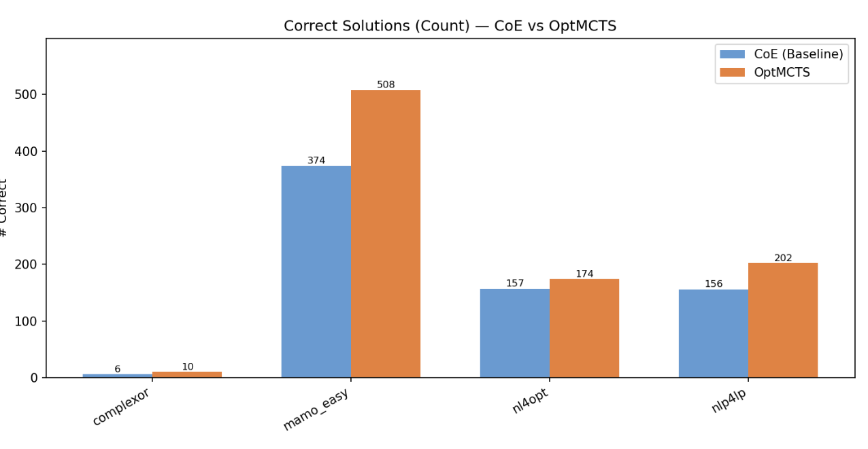
EXPERIMENTAL COMPARISION
Result： OptMCTS outperforms the CoE baseline on all four datasets:
- complexor：33.3% → 55.6%（ The biggest improvement is in the difficulty. ）
- mamo_easy：57.4% → 77.9%
- nl4opt：68.3% → 75.7%
- nlp4lp：64.5% → 83.5%

Slide 11
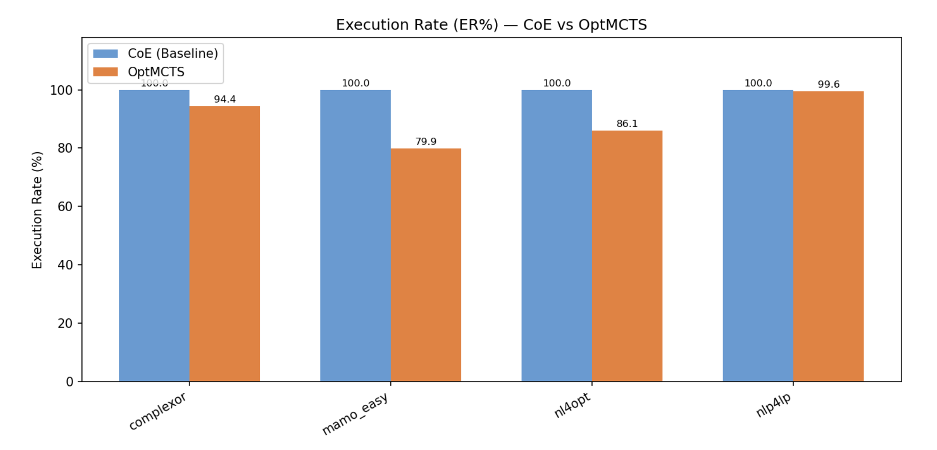
EXPERIMENTAL COMPARISION
The CoE baseline has an ER% of 100% (because it has more rounds of fixes)
OptMCTS has a slightly lower ER% (79.9%~99.6%).
This indicates that the code generation quality of some branches during the MCTS search process is slightly worse, but although fewer branches run successfully, more branches run correctly
This is precisely the value of MCTS search: it is willing to abandon some paths to focus on finding better modeling solutions.

Slide 12
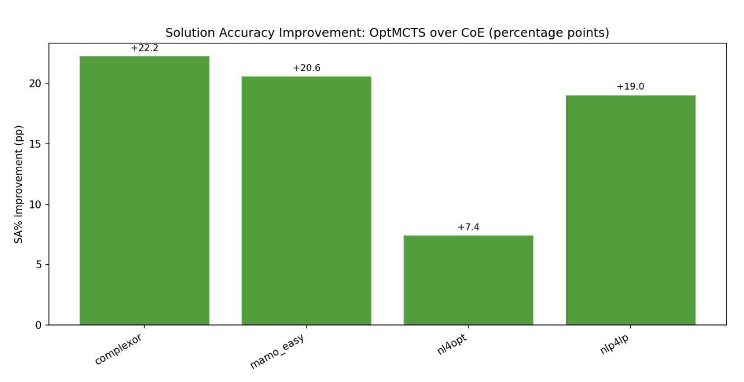
EXPERIMENTAL COMPARISION
Meaning: Essentially the same as SA% but uses absolute numbers to visually show how many more questions were answered correctly for each dataset.
Per-dataset SA% improvement of OptMCTS over CoE, in percentage points (pp)
All four datasets show positive gains
Ranges from +7.4 pp (nl4opt) to +22.2 pp (complexor)
Demonstrates consistent benefit of MCTS-guided formulation search

Slide 13
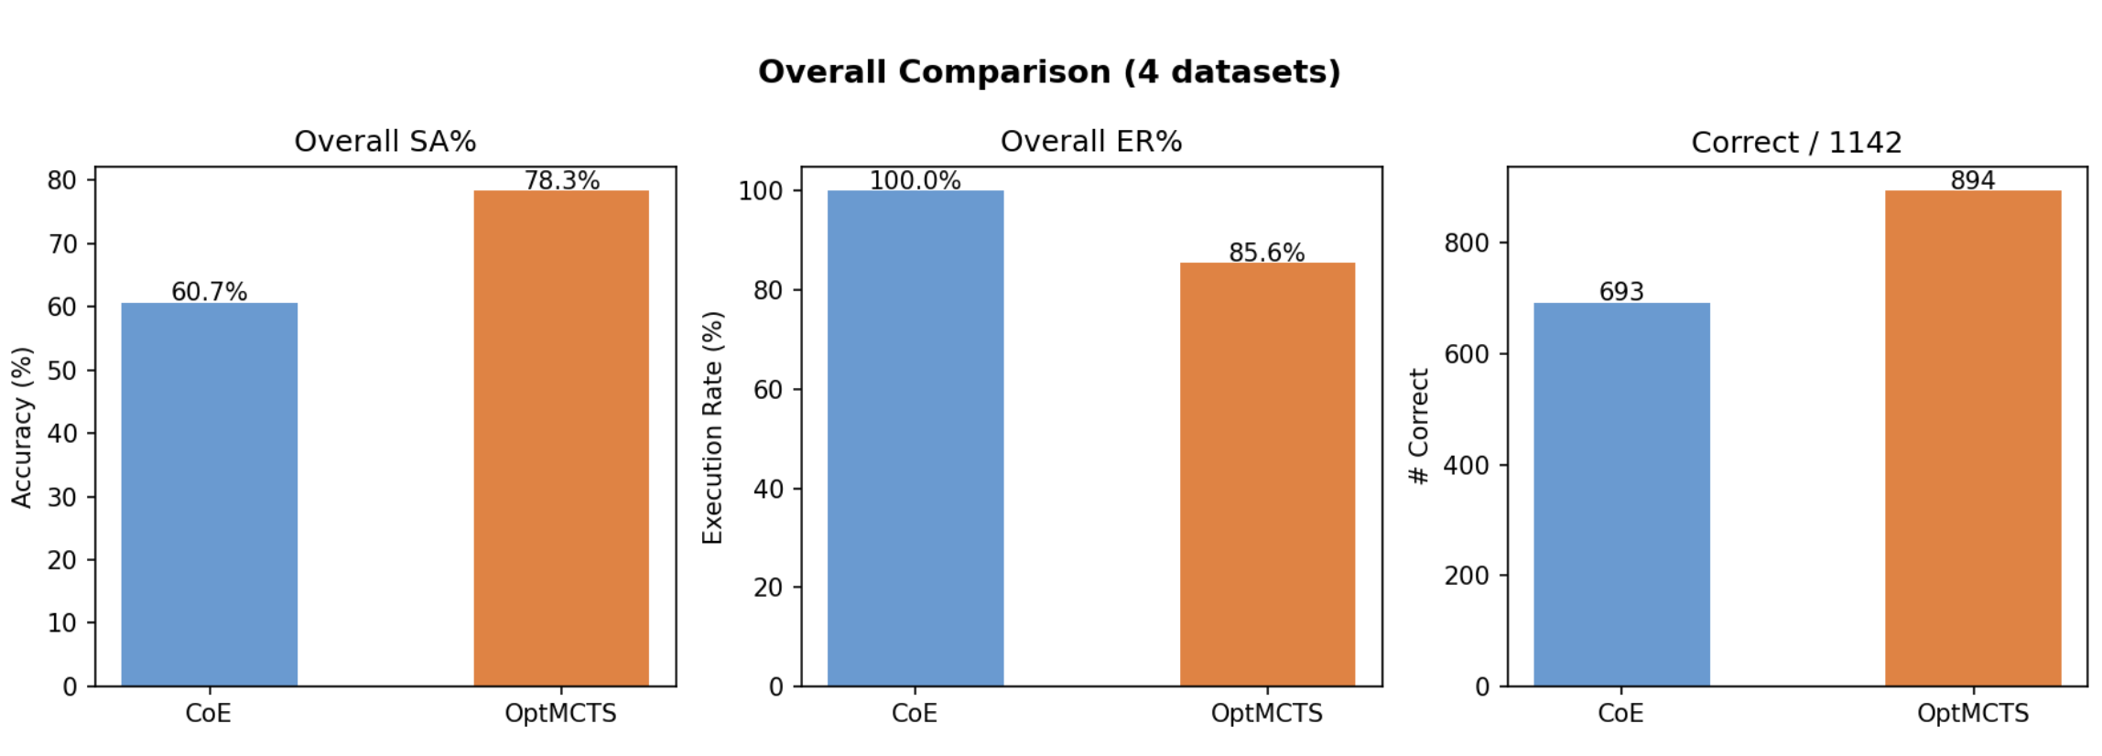
EXPERIMENTAL COMPARISION
Overall SA%: 60.7% (CoE) → 78.3% (OptMCTS), +17.6 pp gain
Overall ER%: 100.0% → 85.6%, as MCTS explores diverse formulation paths
Total correct: 693 → 894 out of 1142 problems

Slide 14
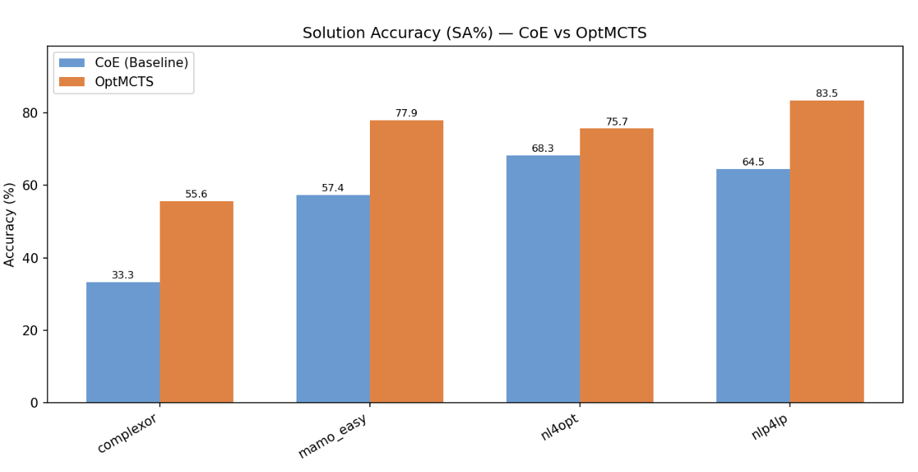
EXPERIMENTAL COMPARISION
SA% measures the percentage of problems whose final answer matches the ground truth (within 10% relative error)
OptMCTS consistently outperforms CoE baseline across all four datasets
Largest gain on complexor (+22.2 pp) and nlp4lp (+19.0 pp)

Slide 15
EXPERIMENTAL RESULTS & CONCLUSIONS
Slide 07
60.7%
78.3%
+22.3%
~10×
CoE Baseline SA%
(1,142 problems)
MCTS SA%
(1,142 problems)
Best MCTS Gain
(ComplexOR dataset)
Cost Reduction
vs GPT-4
CoE → MCTS Improvement (SA%)
vs Paper (GPT-4) — MCTS SA%
Dataset | CoE SA% | MCTS SA% | Gain
NL4Opt | 68.3% | 75.7% | +7.4%
NLP4LP | 64.5% | 83.5% | +19.0%
ComplexOR | 33.3% | 55.6% | +22.3%
MamoEasy | 57.4% | 77.9% | +20.5%
Dataset | Paper GPT-4 | Ours 4o-mini
NL4Opt | 97.0% | 75.7%
NLP4LP | 87.0% | 83.5%
ComplexOR | 77.8% | 55.6%
MamoEasy | 96.0% | 77.9%
Key Conclusions
✓
CoE baseline with gpt-4o-mini matches or exceeds GPT-4 on 2/3 comparable datasets
✓
MCTS improves SA% by +7 to +22 pp on all 4 evaluated datasets, confirming core paper finding
✓
Gap vs paper (GPT-4) explained by MCTS needing accurate LLM evaluation, not just generation
✓
SQLite resume-safe design enables large-scale benchmarking at ~10× lower cost than GPT-4

Slide 16
KEY TAKEAWAYS
+17.6 pp
MCTS Over Formulation Space
Exploring multiple mathematical formulations instead of committing to one
3 Innovations
All Contribute to Better Search
Dynamic expansion, prompt backpropagation, and uncertainty weighting
50–100+ calls
Trade-off: Accuracy vs. Cost
MCTS uses 50–100+ LLM calls per problem vs. 4–7 for CoE, but accuracy gains justify the cost
200x Cheaper
Scales to Weaker Models
Even GPT-4o-mini benefits significantly from tree search vs. GPT-4 at 200x lower API cost
OptMCTS: MCTS-guided formulation search benefits even weaker models significantly

