Slide 1








Vanilla Policy Gradient
Home
Content
Contact
Introduction to
MONTE CARLO POLICY GRADIENT OPTIMIZATION
APPLIED TO INVERTED PENDULUM
CARTPOLE
Presented by Qi Chen

Slide 2


Reinforcement Learning
Why
What
How
1.Introduction to Reinforcement Learning
2.Inverted Pendulum: Background and Applications
3.Monte Carlo Policy Gradient (REINFORCE) Algorithm
4.Implementation and Results
5.Conclusion and Future Directions
AGENDA

Slide 3

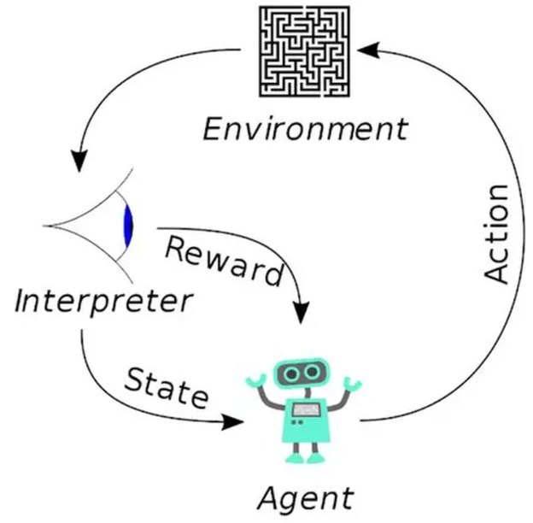
Reinforcement Learning
What is Reinforcement Learning (RL)
The Third Paradigm: RL is one of the three basic machine learning paradigms, alongside supervised and unsupervised learning.
Learning through Interaction: Unlike learning from static labels, RL trains an intelligent agent to take actions in a dynamic environment to maximize a reward signal.
The Exploration-Exploitation Dilemma
Exploration: Trying new actions to discover more about the environment.
Exploitation: Using current knowledge to take the best-known action.
Finding the optimal balance between these two is the key to success.
The Framework (MDP): The environment is typically modeled as a Markov Decision Process (MDP).
Why use RL: It excels in large-scale problems where we do not have an exact mathematical model of the world (like our complex Inverted Pendulum physics).

Slide 4
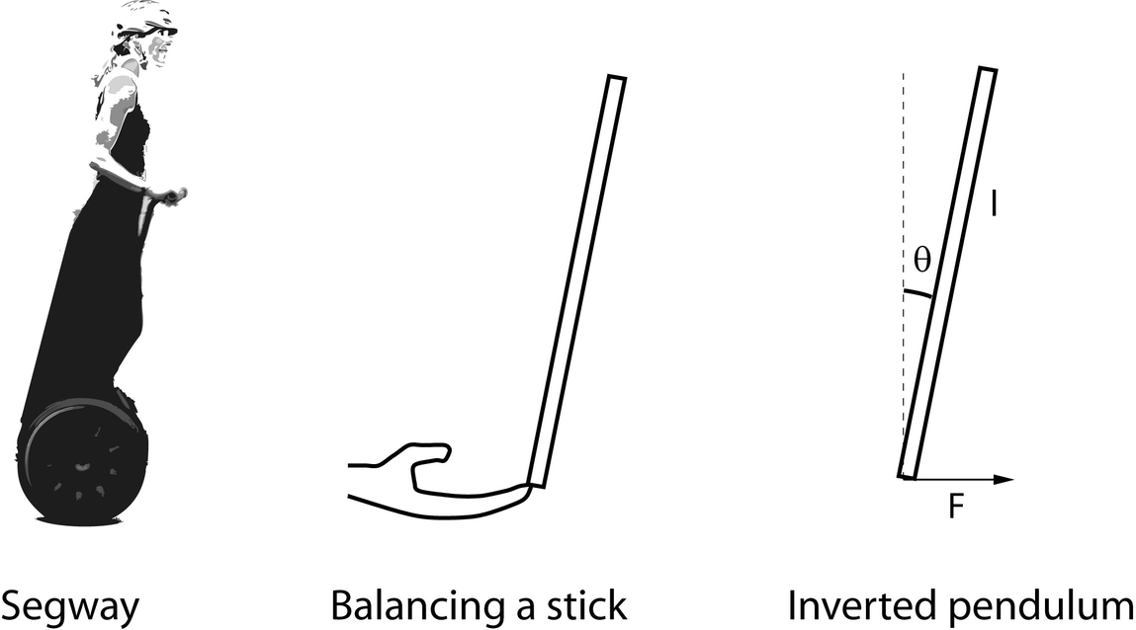
Introduction of Inverted Pendulum
INVERTED PENDULUM-V1
Concept：
An inverted pendulum is a pendulum with its center of mass above its pivot point. It is inherently unstable and requires an active control system to maintain an upright position.
Key Features:
Active Balancing
Cart and Pole Configuration
Inherent Instability
Nonlinear Dynamics
Underactuated System

Slide 5
How does ML connect with Inverted Pendulum
Home
Content
Contact
INVERTED PENDULUM & RL
The Limitation of Classical Control: Traditional physics formulas often fail when real-world conditions like friction or wind change unexpectedly.
The RL Solution (Learning Without Knowing): The agent develops a "balancing reflex" through trial and error without ever needing to understand the laws of gravity.
The MDP Bridge (The Translator): This framework translates complex physical motions into four simple numbers—position, velocity, angle, and speed—that the computer can process.
Problem Solved: We have successfully automated "intuition," allowing a machine to balance a pole just as a human balances a stick on their finger.

Slide 6

Mathematical Foundations
The Goal: Maximize Total Reward
Starting point: Random starting point
s₀ ~ μ(s₀):The initial state s₀ is randomly sampled from the probability distribution μ(s₀).
Step 1: First Action & Feedback
a₀ ~ π(a₀ | s₀): The agent chooses how to move based on its strategy π.
s₁, r₀ ~ P(s₁, r₀ | s₀, a₀): The physical world (Dynamics P) responds with a new state and a reward.
Step 2: Second Action & Feedback
a₁ ~ π(a₁ | s₁): The agent makes its next move based on the new observation.
s₂, r₁ ~ P(s₂, r₁ | s₁, a₁): The world reacts again. s₂ and the reward r₁ are randomly
sampled from the transition distribution
Step 3: The Process Repeats
This alternating cycle continues until a terminal state s_T is reached.
Final Step: Termination
s_T, r_{T-1} ~ P(s_T, r_{T-1} | s_{T-1}, a_{T-1}):The game ends, and we collect the final reward.
Goal: Maximize Total Reward
Find the best policy π that maximizes the expected cumulative reward across trajectories.Maximize E_τ[R|π], R = r₀ + r₁ + ... + r_{T-1}

Slide 7

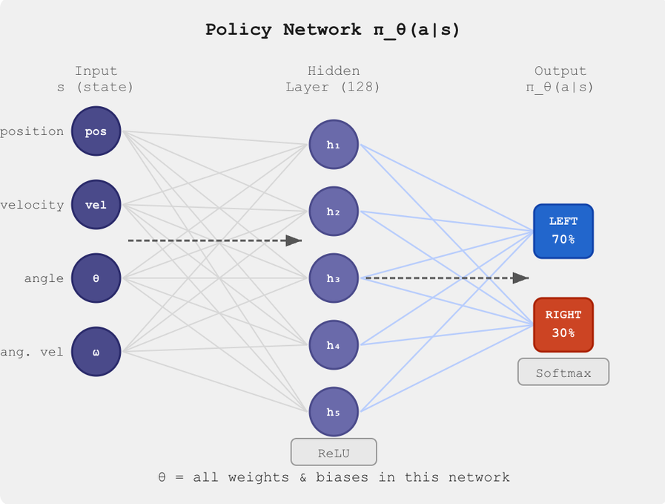
Mathematical Foundations
What is a Policy? π_θ(a|s)
WHAT IS Θ?
θ is every single number inside our neural network.
Changing θ = changing the strategy = changing the score
What is π_θ(a|s)?
π_θ(a|s) = "given state s, probability of taking action a"
CartPole Example:
Input s = [position, velocity, angle, speed] = [0.1, 0.5, -0.2, 0.3]
Output = [70%, 30%] = push left 70%, push right 30%
Question: How do we find the best θ
Answer: Gradient Ascent θ ← θ + α · ∇J(θ)

Slide 8

Mathematical Foundations
The Problem: How do we calculate ∇J(θ)
We need to compute ∇J(θ):
∇J(θ) = ∇∫ p(τ|θ)·R(τ) dτ
Problems:
p(τ|θ) changes with θ
and
infinite trajectories
❌ Cannot compute directly!
Need: Log Derivative Trick
Symbol Guide:
θ = all weights & biases in the neural network changing θ
= changing strategy = changing score
α = learning rate (size of each update step)
J(θ) = average score under policy θ
∇ = gradient = which direction makes J(θ) bigger?
τ(tau) = one complete game recording (trajectory)
= (s₀,a₀,r₀, s₁,a₁,r₁, s₂,a₂,r₂, ... , s_T)
R(τ) = total score of trajectory τ = r₀ + r₁ + r₂ + ... + r_{T-1}
p(τ|θ) = probability of trajectory τ under policy θ
E = Expectation = average value
E_τ[R(τ)] = average total score across all possible trajectories
∫ = sum over infinite possibilities
dτ = with respect to τ (what variable we sum over)
Σᵢ = sum over N games
Σₜ = sum over each step
(1/N) = take average
∫ dτ = take every possible trajectory τ, multiply probability × score, add all results together
We want to do Gradient Ascent:
θ ← θ + α · ∇J(θ)
J(θ) = E_τ[R(τ)] = ∫ p(τ|θ) · R(τ) dτ
average score = for every possible trajectory τ, multiply its probability × its score, add everything together

Slide 9

Mathematical Foundations
How does Log Derivative Trick solve it
Log Derivative Trick:
Log property
log(A · B · C) = log(A) + log(B) + log(C)
Expand p(τ|θ) using log
log turns multiplication into addition!
log p(τ|θ) = log p(s₀)
+ log π_θ(a₀|s₀)
+ log p(s₁|s₀,a₀)
+ log π_θ(a₁|s₁)
+ log p(s₂|s₁,a₁) + ...
3. Take gradient ∇_θ of each term
∇_θ log p(τ|θ) = ∇_θ log p(s₀)
+ ∇_θ log π_θ(a₀|s₀)
+ ∇_θ log p(s₁|s₀,a₀)
+ ∇_θ log π_θ(a₁|s₁) + ...
Environment terms have no θ inside
their gradient = 0 → disappear!
∇_θ log p(τ|θ) = ∇_θ log π_θ(a₀|s₀)
+ ∇_θ log π_θ(a₁|s₁)
+ ∇_θ log π_θ(a₂|s₂)
+ ... = Σₜ ∇_θ log π_θ(aₜ|sₜ)
Problems:
1. p(τ|θ) = p(s₀)·π_θ(a₀|s₀)·p(s₁|s₀,a₀)·π_θ(a₁|s₁)...
∇p(τ|θ) requires chain rule over this product
∫ dτ = sum over ALL possible trajectories
infinite trajectories, impossible to enumerate!
Goal-compute ∇J(θ):
∇J(θ) = ∇∫ p(τ|θ)·R(τ) dτ
= ∫ R(τ)·∇p(τ|θ) dτ
ps: 1. R(τ) has no θ, so ∇ only acts on p(τ|θ)
2. ∇ and ∫ can swap order

Slide 10

Mathematical Foundations
The Final Policy Gradient Formula
Putting it all together:
Step 1: Start with objective
J(θ) = E_τ[ R(τ) ] = ∫ p(τ|θ) · R(τ) dτ
Step 2: Log Derivative Trick
∇J(θ) = E_τ[ R(τ) · ∇log p(τ|θ) ]
Step 3: Expand log p(τ|θ)
∇log p(τ|θ) = Σₜ ∇log π_θ(aₜ|sₜ)
(environment terms cancelled out!)
Step 4: Final Formula(step2+step3)
∇J(θ) = E_τ[ Σₜ ∇log π_θ(aₜ|sₜ) · R(τ) ]
Step 5: Monte Carlo Estimate
∇J(θ) ≈ (1/N) Σᵢ Σₜ ∇log π_θ(aₜ|sₜ) · R(τᵢ)
In summary:Run N games, for each game, for each step: compute gradient × score, add everything up, divide by N.
In practice, replace R(τ) with Gₜ:
R(τ) = total reward of whole game
= r₀ + r₁ + r₂ + ... + r_{T-1}
Gₜ = reward from step t onwards
= rₜ + γ·rₜ₊₁ + γ²·rₜ₊₂ + ...
Why Gₜ instead of R(τ)?
Action at step t should only be credited for
rewards AFTER step t not for rewards that
already happened
Gₜ tells θ which actions are worth learning,
knowing each step's impact matters!
Final REINFORCE Formula:
∇J(θ) ≈ (1/N) Σᵢ Σₜ ∇log π_θ(aₜ|sₜ) · Gₜ

Slide 11
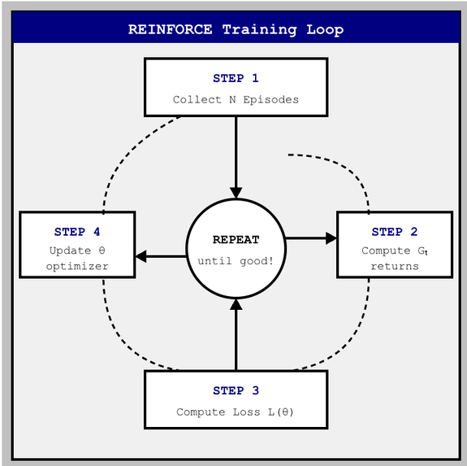
REINFORCE Algorithm
The Algorithm: Step by Step
STEP 1: Collect Episodes
Run N games using current policy π_θ
Record everything:
τ₁ = (s₀,a₀,r₀, s₁,a₁,r₁, ...)
τ₂ = (s₀,a₀,r₀, s₁,a₁,r₁, ...)
...
τ_N = (...)
STEP 2: Compute Returns Gₜ
For each trajectory, work backwards:
G_T = 0
G_t = r_t + γ · G_{t+1}
γ = 0.98 (discount factor)
Gₜ = how much reward from step t onward
STEP 3: Compute Loss
L(θ) = -1/N Σᵢ Σₜ log π_θ(aₜ|sₜ) · Gₜ
Why negative?
PyTorch does gradient DESCENT
we want gradient ASCENT
flip the sign!
STEP 4: Update θ
optimizer.zero_grad()
loss.backward()
optimizer.step()
θ ← θ + α · ∇J(θ)
Repeat from Step 1!

Slide 12
REINFORCE Algorithm
Why Negative Loss
Recall our goal:
MAXIMIZE J(θ) = average score
Gradient Ascent:
θ ← θ + α · ∇J(θ)
But PyTorch only does MINIMIZE:
θ ← θ - α · ∇L(θ) (Gradient Descent)
Solution: flip the sign!
L(θ) = -J(θ)
Then:
θ ← θ - α · ∇(-J(θ))
= θ + α · ∇J(θ)
Think of it like this:
Maximizing score J(θ) =Minimizing -J(θ)
Example:
Maximize 500 points = Minimize -500 points
PyTorch always goes downhill.
We just flip the hill upside down!
↑ J(θ) ↓ -J(θ)
/\ \/
/ \ / \
/ \ / \
go UP! go DOWN!
(what we want) (what PyTorch does)

Slide 13
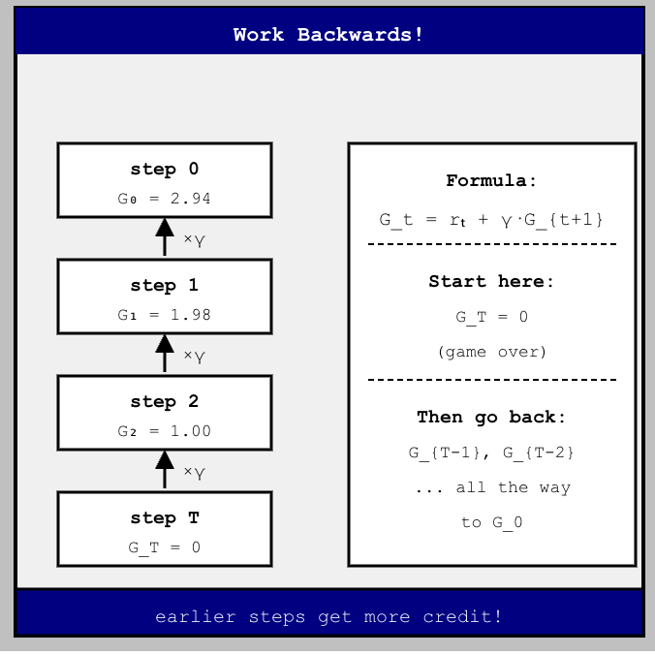
REINFORCE Algorithm
Computing Gₜ (Return)
What is Gₜ?
Gₜ = rₜ + γ·rₜ₊₁ + γ²·rₜ₊₂ + ...
= total reward from step t onwards
γ = discount factor = 0.98
rewards far in future = less certain multiply by γ each step
How to compute? Work BACKWARDS:
G_T = 0
G_t = rₜ + γ · G_{t+1}
Example
γ = 0.98, all rewards = +1
step 3: G_3 = 0
step 2: G_2 = 1 + 0.98 × 0.00 = 1.00
step 1: G_1 = 1 + 0.98 × 1.00 = 1.98
step 0: G_0 = 1 + 0.98 × 1.98 = 2.94
G_0 > G_1 > G_2 > G_3 → earlier steps get more credit!

Slide 14
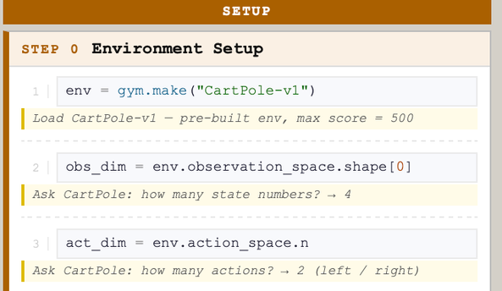
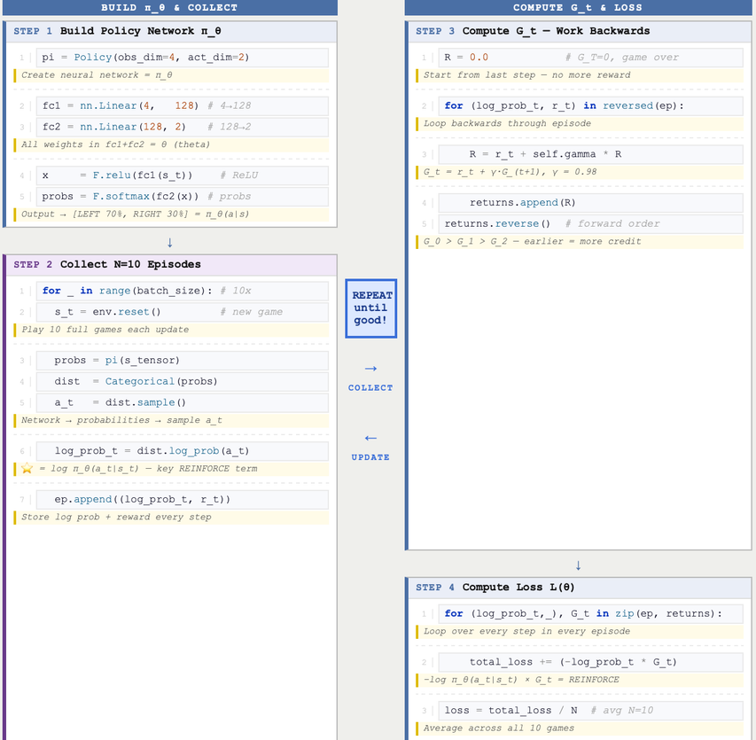
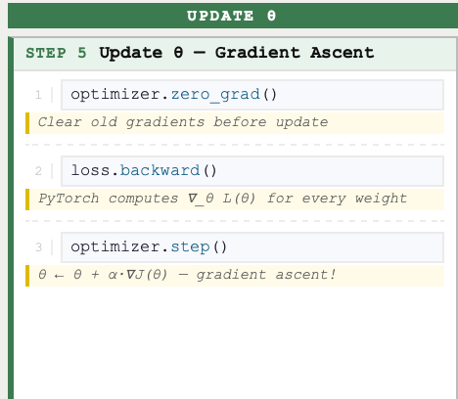
PyTorch Implementation
Code demo

Slide 15
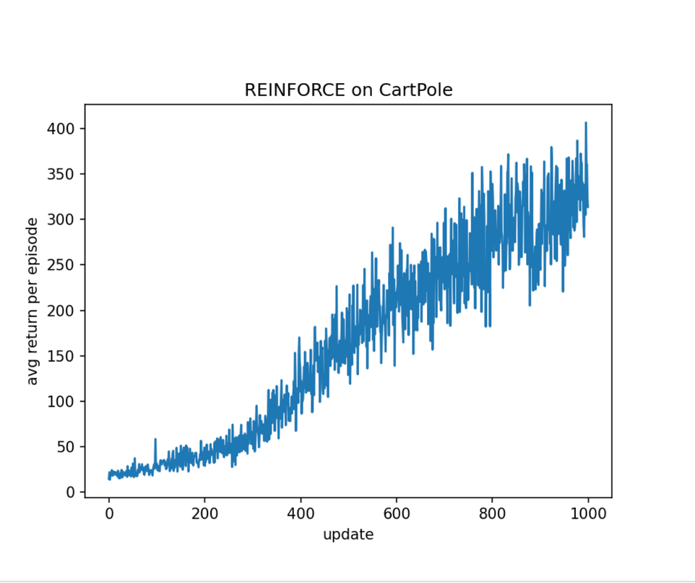
Implementation & Results
Training Results
REINFORCE on CartPole-v1
1000 updates, batch size = 10, γ = 0.98, lr = 2e-4Your paragraph text
Start (update 0):
avg score ≈ 15, policy is random, pole falls immediately
Mid (update 400):
avg score ≈ 150，policy starts learning to balance the pole
End (update 999):
avg score ≈ 350-400， policy balances well! approaching max 500
Note: score is noisy! Monte Carlo has high variance, normal for REINFORCE!

Slide 16

Conclusion
Summary & Takeaways
WHAT WE COVERED
KEY TAKEAWAYS
Reinforcement Learning
Your Agent learns by interacting with environment
Goal: maximize cumulative reward text
Policy gradient directly optimizes the
expected reward
Log Derivative Trick converts an intractable
gradient into a sampleable expectation
Monte Carlo estimation lets us learn from
real game experience
Negative loss = gradient ascent via PyTorch's
gradient descent
CartPole-v1
Classic control problem
State: 4 numbers, Action: left or right
J(θ) = E_τ[R(τ)]
Log Derivative Trick → ∇J(θ) = E_τ[Σₜ ∇log π_θ(aₜ|sₜ) · Gₜ]
Environment terms cancel out!
Mathematical Mathematical Derivation
Collect episodes → Compute Gₜ → Compute Loss → Update θ
Repeat until policy is good!
REINFORCE Algorithm
Results
Score improved from ~15 to ~400 over 1000 updates
REINFORCE works! But high variance is expected.

