Slide 1
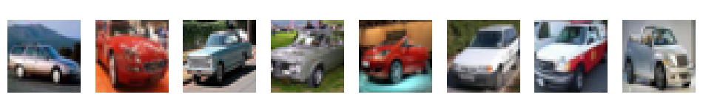
Teaching a GAN to draw cars
CSYE 7380 / APPLIED GENERATIVE AI
DCGAN on CIFAR-10 automobile: my build vs. Claude Code
Qi Chen · Prof. Subrata Das

Slide 2
Three requirements, built twice
01 / THE TASK
01
Swap Dense for convolutions
Class Dense GAN (MNIST)
Generator upsamples with Conv2DTranspose; discriminator downsamples with strided Conv2D.
My DCGAN (manual)
02
Train on one class
Only CIFAR-10 automobile images, 32×32 color.
Claude Code DCGAN
03
Control the noise vector
Show how changing the 100-number input changes the car.
Compare
Same data and settings; only the training code differs.

Slide 3
One dataset, one cleaning recipe
02 / SHARED DATA
6,000
LOAD
CIFAR-10, 32×32×3 color images
FILTER
keep class 1, automobile only
automobile images
(5,000 train + 1,000 test, merged)
DROP
labels; a GAN just imitates, no names needed
SCALE
pixels to [-1, 1] to match the tanh output
Real training images

Slide 4
Generator draws, discriminator judges
03 / ARCHITECTURE
GENERATOR / small noise in, picture out
z (100)
random noise
8×8×256
Dense + reshape
16×16×128
ConvT, stride 2
32×32×64
ConvT, stride 2
32×32×3
Conv + tanh
DISCRIMINATOR / picture in, verdict out
32×32×3
image
16×16×64
Conv, stride 2
8×8×128
Conv, stride 2
4×4×256
Conv, stride 2
real / fake
Dense(1)
Same size in both versions. Generator 2.31M vs 2.36M parameters, discriminator 663K vs 665K. One structural difference: only the Claude Code discriminator uses BatchNorm.

Slide 5
Same model, different engineering
04 / WHAT DIFFERS
ASPECT | MY BUILD | CLAUDE CODE
Data feeding | NumPy random slice each step | tf.data: next batch prepared in advance
Training step | predict + 3 train_on_batch calls | one compiled @tf.function step
Batch / steps | 64 / 4,000 | 128 / 2,760 (60 epochs)
D output | sigmoid probability | raw logits, from_logits=True
Real labels | 1.0 | 0.9 (keeps D from overconfidence)
Weight init | Keras default | Normal(0, 0.02), DCGAN paper
Shared: 100-d noise, Adam (lr 2e-4, β₁ 0.5), binary cross-entropy, tanh output.

Slide 6
The class recipe breaks in Keras 3
05 / A BUG I HIT
PROBLEM
MY FIX
WHY CLAUDE CODE AVOIDS IT
Discriminator froze for good
Toggle every step
No switch needed
discriminator.trainable = False was meant to pause D only while training G. In Keras 3 it paused D everywhere. D accuracy sat near 30% and the output was pure noise.
Separate optimizers for D and the combined model, and switch trainable on before D's turn and off before G's turn.
It never uses trainable. GradientTape updates only the generator's own weights in the G step, so D is never touched.

Slide 7
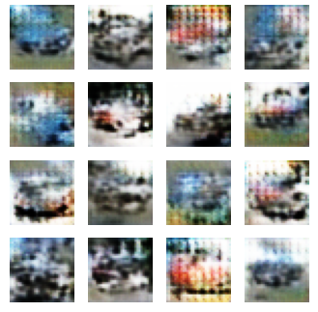
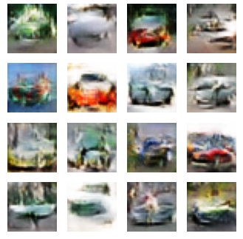
Claude Code trains about 2× faster
06 / RESULTS
MINE
CLAUDE
MINE, STEP 3,500
CLAUDE CODE, EPOCH 60
ms per step
118
84.5
total minutes
7.8
4.2
images / sec
~540
~1,500
Both runs stayed stable (no collapse). Batch size and step count differ, so the gap reflects code design plus training tricks together.
Both draw recognizable cars. Claude Code's are cleaner, with fewer checkerboard artifacts.

Slide 8

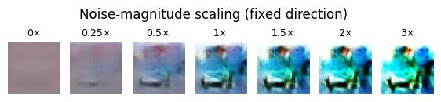
The noise vector steers the car
07 / NOISE CONTROL
INTERPOLATE z_a → z_b: one car morphs smoothly into another
TAKEAWAYS
1
Convolutions turn the MNIST toy GAN into a color-image DCGAN.
SCALE 0× = blank average; more noise = sharper, varied cars
2
Same model size, yet Claude Code finishes in about half the time with cleaner cars.
3
The gain is engineering, not a bigger model.

