Slide 1
Vehicle Price Analysis
EDA, Modeling, and Key Insights
Vinod Kasturi

Slide 2
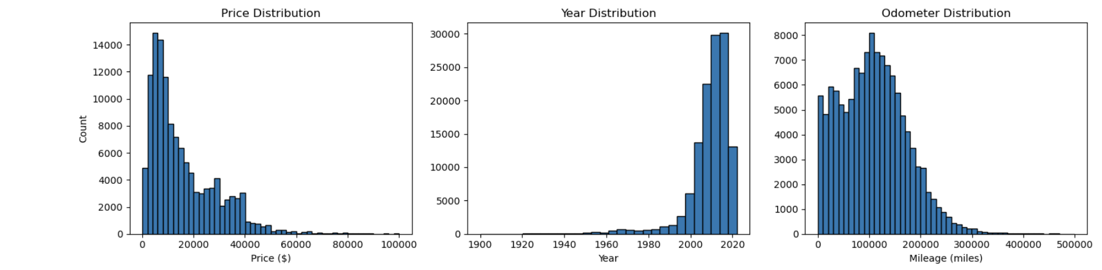
Distributions

Slide 3
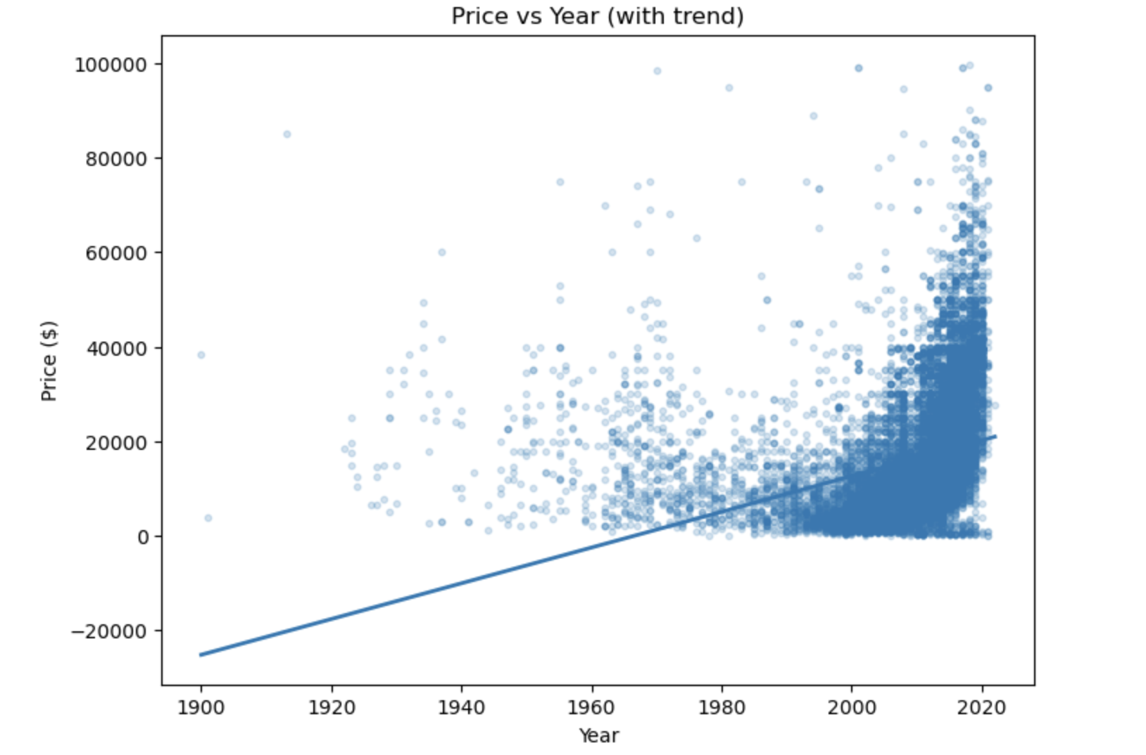
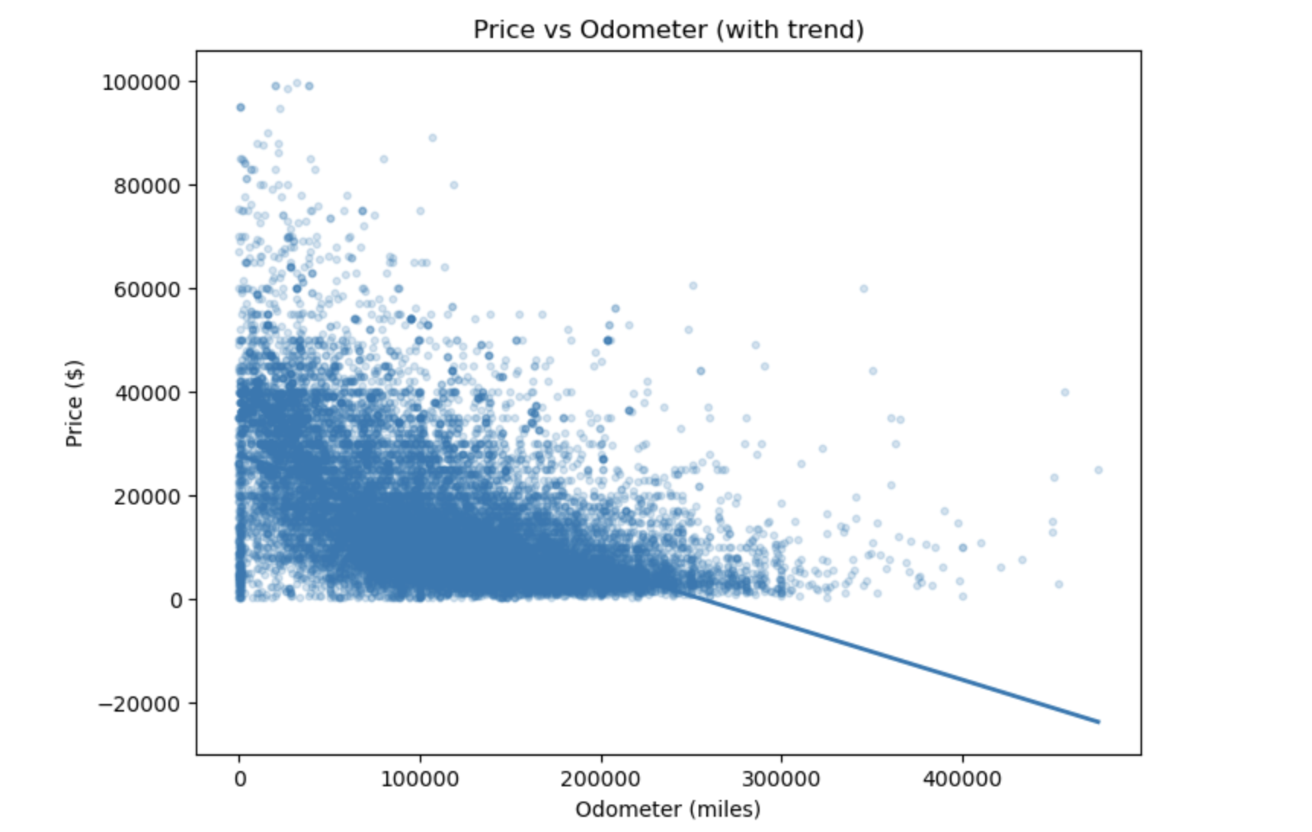
Relationships

Slide 4
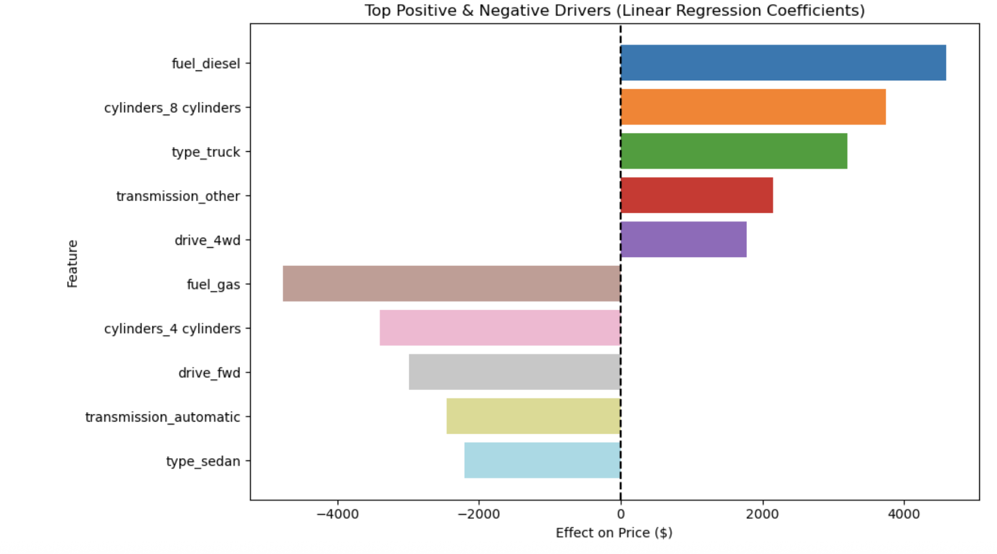
Top Positive & Negative Drivers of Price

