Slide 1
Deep DJ
Feel your audience, experience more.

Slide 2
We deliver a platform for measuring and reporting audience enthusiasm during music performances.

Slide 3
Why is this important?
Refines business decision-making
Real-time feedback for performers
Enables real-time control of lighting and music through live feedback loops

Slide 4
Featured Technology
Amazon DeepLens
AWS Rekognition
AWS SageMaker

Slide 5
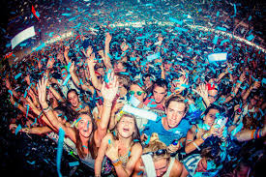
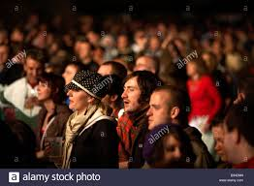
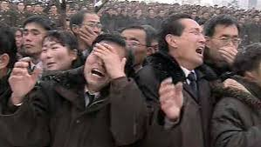
Approach
Measure individual facial expressions
Measure individual body movements

Slide 6
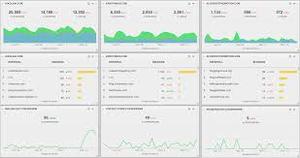


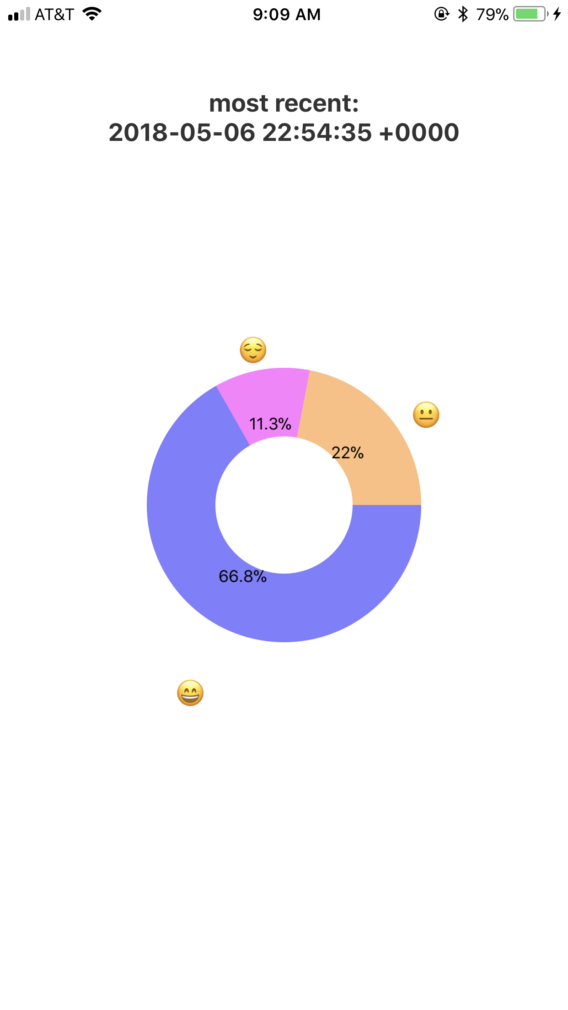
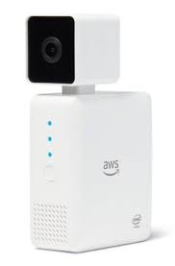
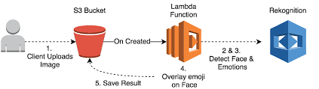
DeepDJ

Slide 7
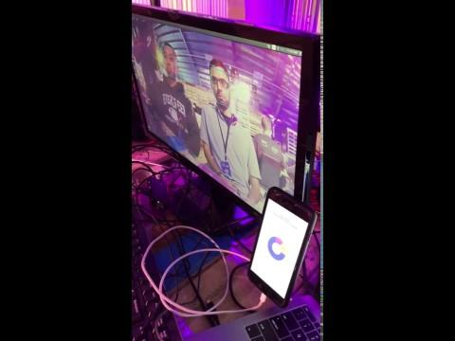
Tech Demo

Slide 8
Summary
We created a technology for measuring audience enthusiasm
Use key Amazon machine learning technology to accomplish this
We developed an end-to-end system for our prototype

