Slide 1

WEBSERVER BASICS
AWS

Slide 2
Helpful to know:
Linux (basics)
Virtual Machines
The Cloud

Slide 3





WHAT IS A WEBSERVER
Computer that Hands out
Files
Html
CSS
Javascript…
Static
Nothing special
Dynamic
Likes/comments
Checkout/Shopping Cart
Forms
Uses javascript
Client 1
Client 2
Web-Server
-DataBase
-Backend
-Storage
Client 3

Slide 4



WHAT MAKES A WEBSERVER… A WEBSERVER?
Microsoft Internet
Information Services (IIS)
Apache HTTP Server
Nginx
SO MANY OPTIONS:
LiteSpeed, Caddy, Cherokee, Apache Tomcat, Hiawatha, Monkey, Abyss Web Server, Tengine, Gunicorn, WebSphere Application Server, Lighttpd, Zeus Web Server, Resin, JBoss Web, Mongoose…

Slide 5
WHY SO MANY WEBSERVER OPTIONS
The many choices allows for tailored selection for specific project requirements:
Diverse needs/preferences
Different servers excel in performance, tech. stack compatibility
Security
Ease of configuration and scalability
Open source vs. Commercial ($)
Client 1
How easy and how fast
How many connections and how fast
Is it reliable or does it drop many connections
Client 2
Web-Server
-DataBase
-Backend -Storage
Client 3

Slide 6
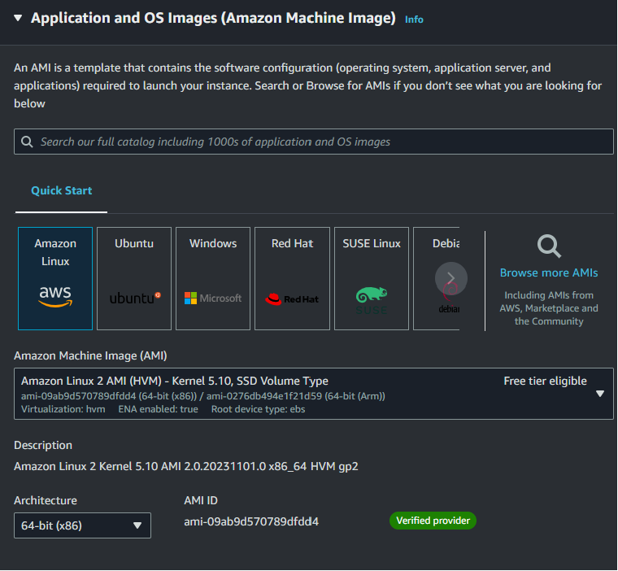
FOR THIS DEMO:
Client 1
Client 2
Backend
Web-Server
AMAZON AMI
O.S. = Amazon Linux 2 Public IP = xxx.xxx.xxx.xxx
Client 3

Slide 7
CREATE LINUX VIRTUAL MACHINE

Slide 8
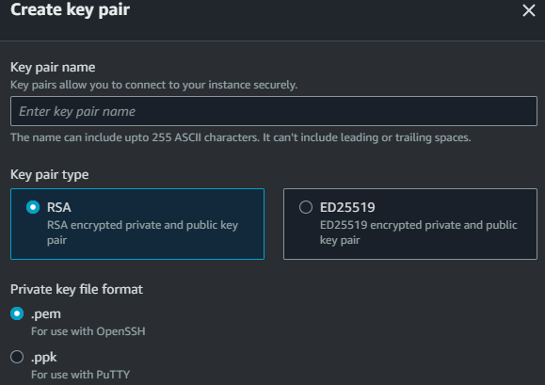
RSA VS. ECC (ED25519)
RSA (Rivest–Shamir–Adleman):
Key Size: Requires larger keys than ECC for security.
More computational demanding, especially for key generation and signature verification.
Long-established and widely used in cryptography.
Susceptible to potential quantum attacks.
Commonly used, but less favored in resource/performance-constrained environments.
ECC (Elliptic Curve Cryptography):
Key Size: Provides strong security with shorter keys.
More computational efficient
Generally more resistant to quantum attacks.
Results in smaller signatures, beneficial for bandwidth-constrained scenarios.
Increasing in popular for modern cryptographic applications.
Summary:
RSA has a longer history but requires larger keys and is more computationally intensive.
ECC offers efficient performance with shorter keys.
Private Key Format
Privacy Enhanced Mail OpenSSH (.pem) | used for RSA private/public keys, certificates, and more. It's a base64-encoded format with delimiters such as "-----BEGIN CERTIFICATE-----" <encryption> "-----END CERTIFICATE-----".
Putty Private Key Putty (.ppk) *WINDOWS* | file format associated with the Putty SSH client. Contains private keys for authentication in the SSH protocol. While more specific to SSH, can also be used with other crypto. algorithms supported by Putty.

Slide 9
SECURITY GROUPS
Firewall Rules: Security Groups act as virtual firewalls for your instances in a Virtual Private Cloud (VPC), controlling inbound and outbound traffic based on rules you define.
Stateful Filtering: Security Groups are stateful, meaning if you allow outbound traffic from your instance, related inbound traffic is automatically allowed. This simplifies rule configuration and enhances security. (INSTANCE SPECIFIC)
HTTP (Port 80) for 0.0.0.0/0:
This rule allows incoming traffic on port 80 (HTTP) from any IP address (0.0.0.0/0) to the specified resource.
Practical Use: Suitable for web servers that need to receive HTTP traffic from anywhere on the internet.
HTTPS (Port 443) for 0.0.0.0/0:
This rule allows incoming traffic on port 443 (HTTPS) from any IP address (0.0.0.0/0) to the specified resource.
Practical Use: Ideal for secure web servers that require encrypted HTTPS connections from any location.
SSH (Port 22) for 0.0.0.0/0:
This rule allows incoming traffic on port 22 (SSH) from any IP address (0.0.0.0/0) to the specified resource.
Practical Use: Be cautious when using 0.0.0.0/0 for SSH, as it exposes the SSH port to the entire internet, increasing the risk of unauthorized access. It's recommended to restrict SSH access to specific IP ranges or your known IP addresses for better security.
In practice, restricting access to specific IP ranges or known IP addresses is a best practice for security.
For sensitive services like SSH, consider narrowing down the allowed IP addresses to only those that need access.

Slide 10
SETTING UP APACHE SERVER

Slide 11
SETTING UP HTTPD (APACHE)
BASIC COMMANDS
Update the System:
sudo yum update -y
Updates the Linux virtual machine with the latest patches.
Install Apache:
sudo yum install httpd –y
sudo systemctl start httpd (start service)
sudo systemctl enable httpd (start service on reboot)
sudo systemctl status httpd (check if service is running)
Installs Apache along with all accompanying and dependency files.
Web Root: /var/www/html/
This is the default location for your web content. You can place your website files(or assests), such as index.html, style.css, about.html, dynamic.js, and cool.jpg, in this directory.
Log Files: /var/log/httpd/
Contains log files for Apache, including access and error logs.
BASIC APPACHE FILES
Configuration Files: /etc/httpd/
Configuration files for Apache, including the main configuration file httpd.conf.
Modules: /etc/httpd/modules/
Houses Apache modules, which are extensions that enhance and extend the functionality of the Apache web server. Modules can provide additional features such as security, authentication, URL rewriting, and more.
Virtual Hosts: /etc/httpd/conf.d/
Additional configuration files for setting up virtual hosts.

Slide 12
DEMO WEBSITE FILE TRANSFER
SIMPLE
Copy and Paste: (free)
sudo vi /var/www/html/index.html
NOTE: you can also use nano instead of vi as a text editor, just replace “vi” with “nano”
Copy text file content (ctr c + ctr v)
Use Secure Copy Protocol (scp): (free)
scp -i </dir/your-key.pem> /local/file/index.html ec2-user@123.456.789.012:/var/www/html/
Use S3 Bucket: ($)
Install S3 CLI onto local machine
Use the s3 command to upload files to s3 bucket
From Ec2 instance (vm webserver) use the s3 command to retrieve files
aws s3 cp s3://your-bucket/index.html ~/Downloads/index.html
scp -i <your-key.pem> /local/file/index.html ec2-user@123.456.789.012:/var/www/html/
Use a full-blown CI/CD pipeline ($$$)
Use either Jenkins or CodeStart
Host files in AWS CodeCommit
Every time there is a change:
Have a lambda function trigger a pipeline to move files to webserver
Then… why are you still watching this video
COMPLEX

Slide 13
WOOOOOOOWWWW!!!

Slide 14

Load Balancer:
TARGET GROUP
Public IP = <I.P_1>
Client 1
Health checks
Backend
Client 2
Client 3
Public IP = <I.P_2>

Slide 15
STAY WHOLESOME

